Slide 1
Angular Distance Group Activity
Part I

Slide 2
Questions 1-10

Slide 3
1.My Fist _______________ 2. My Thumb ______________

Slide 4
A penny has an angular diameter of 1 arc second (1”) if viewed from a distance of 4 km (about 2.5 miles)
3. If you saw the penny at the guard shack from Route 66
(about 0.8 miles) how big would its angular diameter be?
(Hint: How many times closer?) _______________

Slide 5
4. a) Which is really bigger? The sun or the moon? b) Why can’t angular measurement tell us the actual size of objects? 5. Why does the sun and moon appear the same size in the sky?

Slide 6
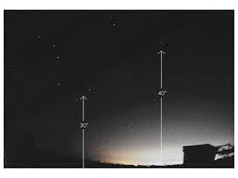
6. In a few hours, what will happen to the altitudes of the stars in the Big Dipper and Polaris? Draw a picture and explain it.
Big Dipper
Polaris

Slide 7
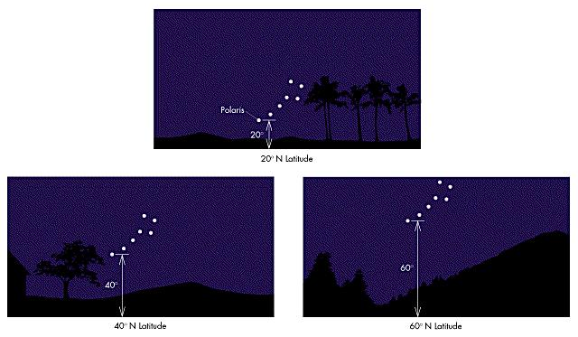
7. Look at these three pictures; what observation can you make between Polaris’ altitude above the horizon and the degrees of latitude of the observer?
Latitude of observer

Slide 8
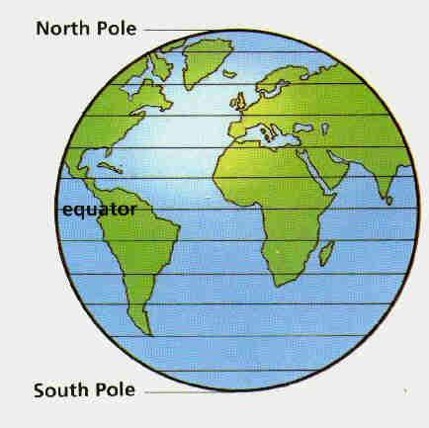
8. If Gallup’s latitude is 35.5° N, what would the altitude of Polaris be above the horizon if observed from Gallup? ________________
Gallup, NM 35°N

Slide 9
9. Could you use Polaris to find latitude in the
Southern Hemisphere? Why or why not?
Polaris
axis
35°S

Slide 10
10. You are lost at sea, you have no instruments and the GPS is out of
power.
A) How do you know which hemisphere you are in?
b) How can you figure out your latitude?

Slide 11
Questions and Answers

Slide 12
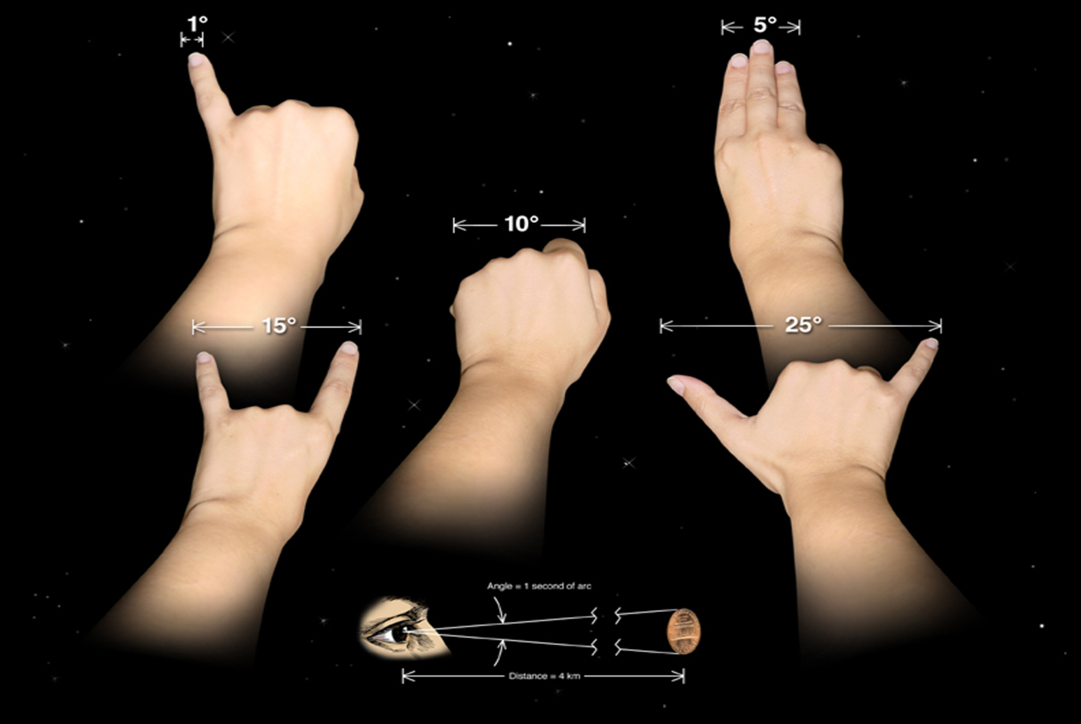
How many degrees does your fist and thumb measure?

Slide 13
1.My Fist _______________ 2. My Thumb ______________

Slide 14
A penny has an angular diameter of 1 arc second (1”) if viewed from a distance of 4 km (about 2.5 miles)
3. If you saw the penny at the guard shack from Route 66
(about 0.8 miles) how big would its angular diameter be?
(Hint: How many times closer?) _______________

Slide 15
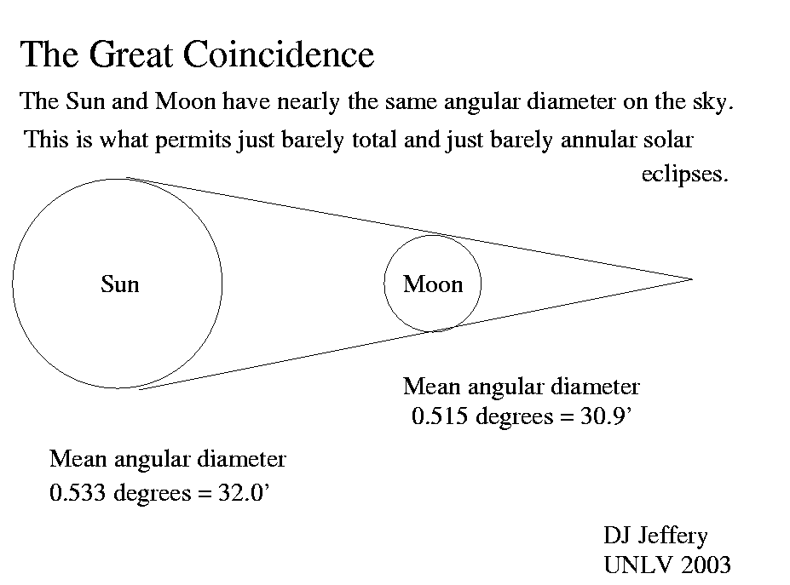
4. a) Which is really bigger? The sun or the moon? b) Why can’t angular measurement tell us the actual size of objects? 5. Why does the sun and moon appear the same size in the sky?
FACT:
The moon is 400
times smaller than
the sun but it is
400 times closer
than the sun
Different sizes
Different distances
Same angle

Slide 16
6. In a few hours, what will happen to the altitudes of the stars in the Big Dipper and Polaris? Draw a picture and explain it.
Big Dipper
Polaris

Slide 17
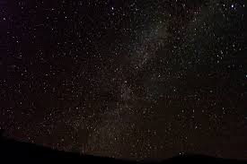
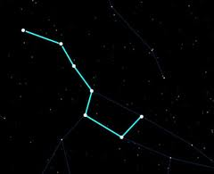
Polaris will remain in the same position, and the Big dipper will rotate around it in a counter clockwise position. Each position is about 6 hours after the previous one. The rotation is caused by the earth’s rotation.
Answer::
Rotation in
this direction

Slide 18
7. Look at these three pictures; what observation can you make between Polaris’ altitude above the horizon and the degrees of latitude of the observer?
Latitude of observer

Slide 19
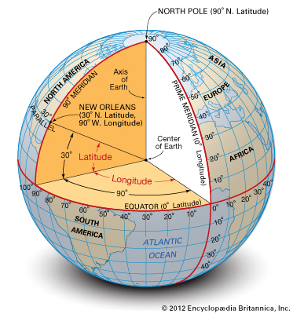
Answer
The latitude of the observer, is the same as the altitude (in degrees)of Polaris above the horizon.

Slide 20
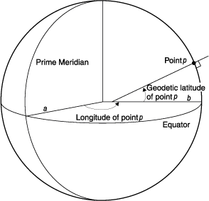
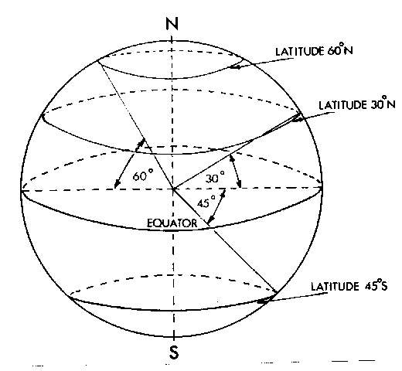

Slide 21
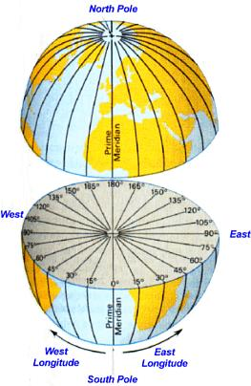
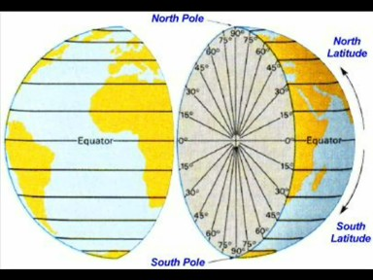

Slide 22
8. If Gallup’s latitude is 35.5° N, what would the altitude of Polaris be above the horizon if observed from Gallup? ________________
Gallup, NM 35°N

Slide 23
Polaris
35 °
horizon
zenith
35°N
35 °
axis

Slide 24
Polaris
35 °
horizon
zenith
35°N
Axis

Slide 25
9. Could you use Polaris to find latitude in the
Southern Hemisphere? Why or why not?
Polaris
axis
35°S

Slide 26
zenith
Answer
Polaris
axis
horizon
35°S

Slide 27
10. You are lost at sea, you have no instruments and the GPS is out of
power.
A) How do you know which hemisphere you are in?
b) How can you figure out your latitude?

Slide 28
End of Part I
Be sure to complete your Annotations!
Finish Color-coding
Write a Summary Paragraph
Write a Response Paragraph

