Slide 1
Questions and Answers

Slide 2
1. Is the north Star, Polaris, at the Zenith from our viewpoint in Gallup? Why or why not?

Slide 4
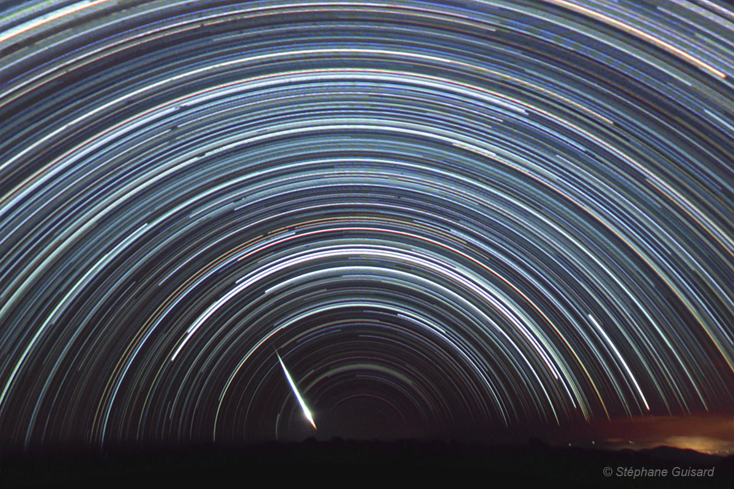
You are observing the sky at the equator, (this is a time-lapse
photo of what you see).
What part of the celestial sphere could you be looking
at on the horizon?

Slide 5
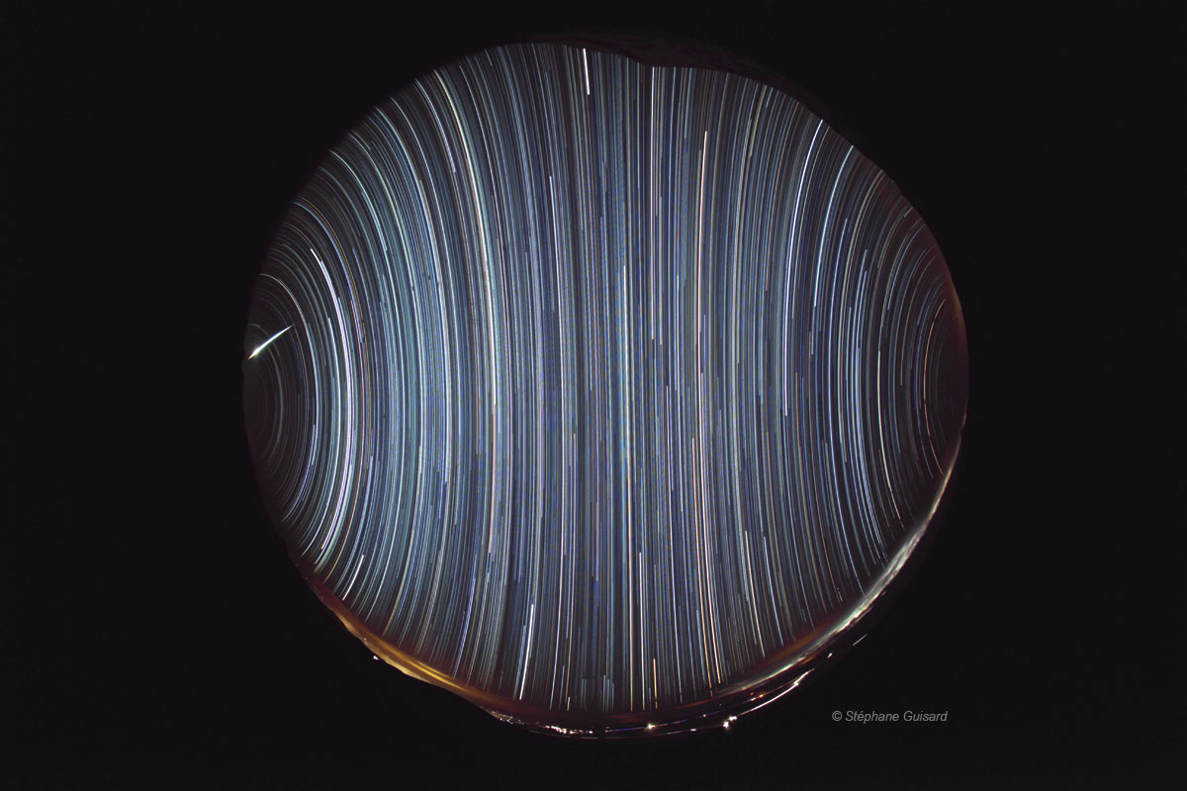
You are observing the sky at the equator, (this is a time-lapse
photo of what you see).
3. What part of the celestial sphere could you be looking at when you look at the zenith?

Slide 6
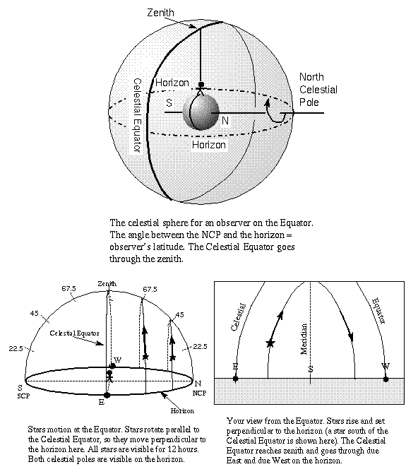

Slide 7
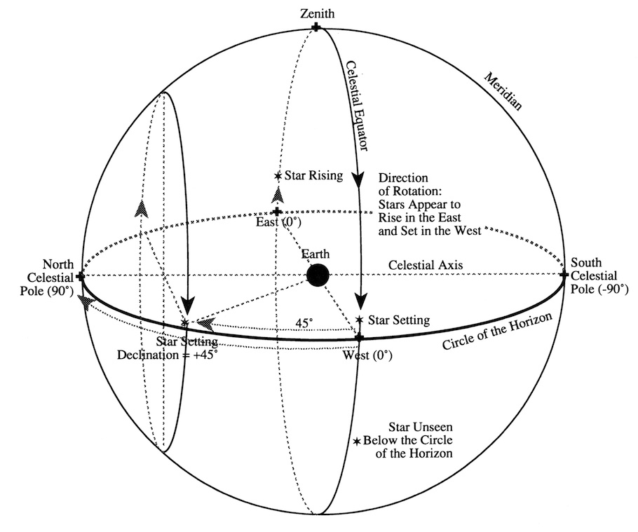
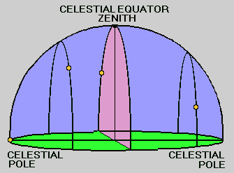

Slide 8
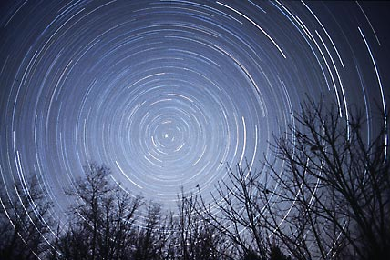
You are observing the sky at the north pole, (this is a
time-lapse photo of what you see).
What part of the celestial sphere could you be looking
at on the horizon?

Slide 9
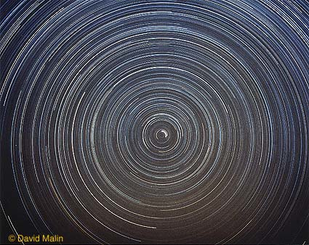
You are observing the sky at the north pole, (this is a
time-lapse photo of what you see).
5. What part of the celestial sphere could you be looking
at when you look at the zenith?

Slide 10
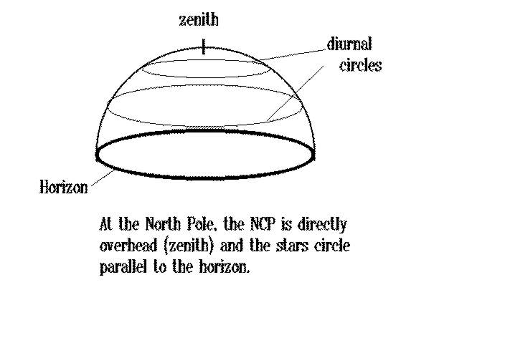
North celestial pole
Celestial equator

