Slide 1
Where are you
What is scale distance?
What is scale size?
Why do we rarely see planets, stars, and moons to scale?

Slide 2
26 Pictures Will Make You Re-Evaluate Your Entire Existence
The universe, man… THE UNIVERSE.
posted on Nov. 17, 2014, at 1:24 p.m.
Dave Stopera
http://www.buzzfeed.com/daves4/the-universe-is-scary#.fyr3jPk2b

Slide 3
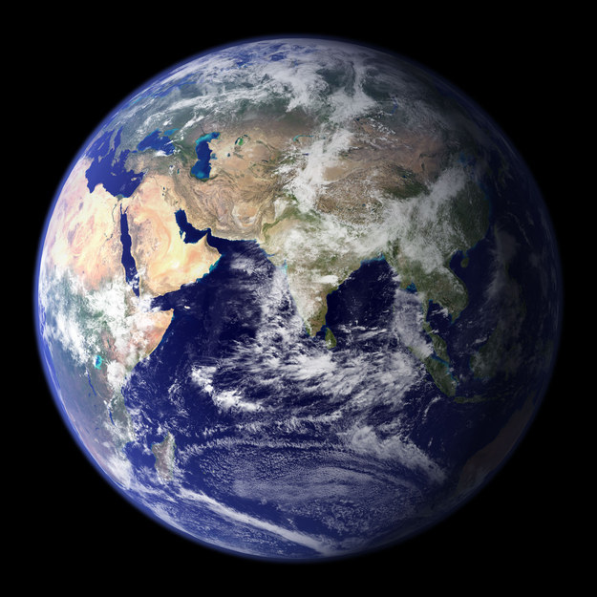
1. This is the Earth! This is where you live.

Slide 4
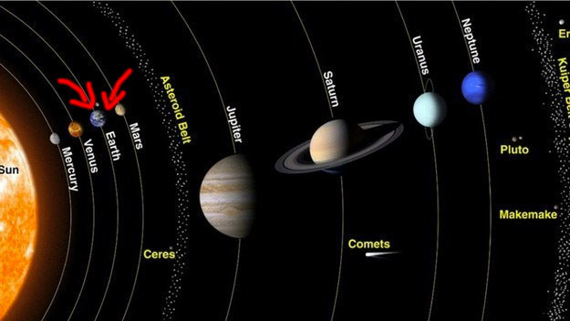
2. And this is where you live in your neighborhood, the solar system.

Slide 5
3. Here’s the distance, to scale, between the Earth and the moon. Doesn’t look too far, does it?

Slide 6
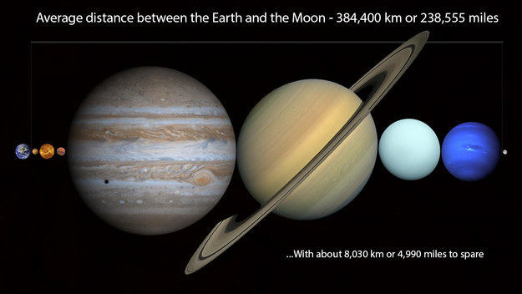
4. THINK AGAIN. Inside that distance you can fit every planet in our solar system, nice and neatly.

Slide 7
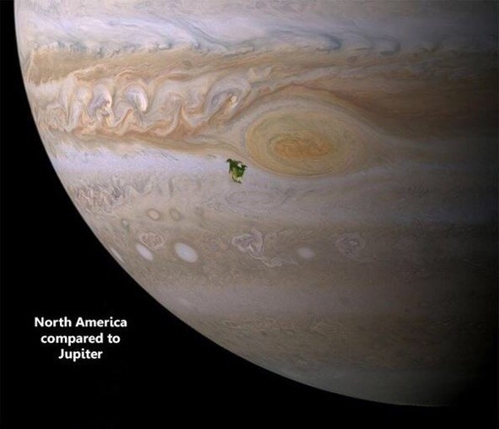
5. But let’s talk about planets. That little green smudge is North America on Jupiter.

Slide 8
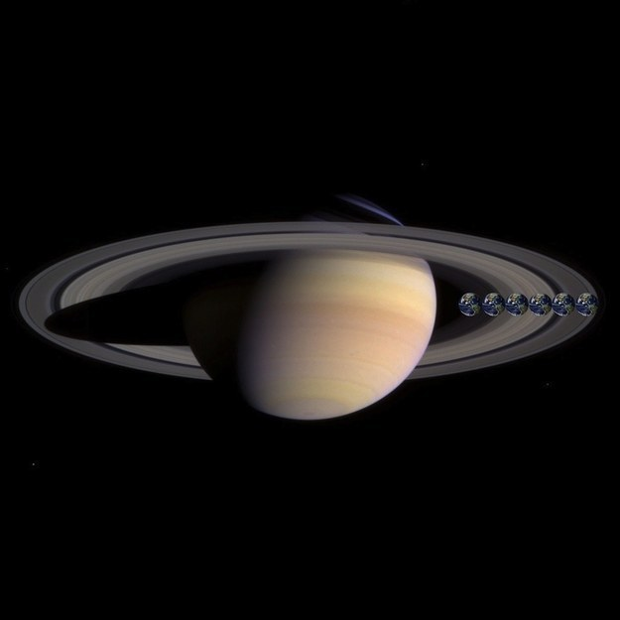
6. And here’s the size of Earth (well, six Earths) compared with Saturn:

Slide 9
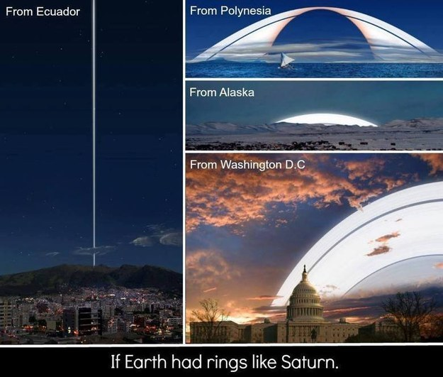
7. And just for good measure, here’s what Saturn’s rings would look like if they were around Earth:

Slide 10
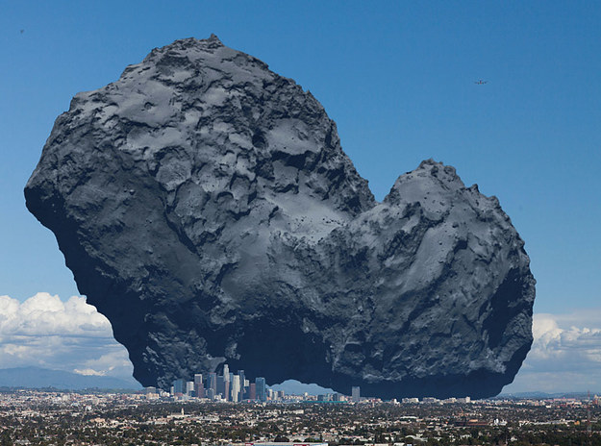
8. This right here is a comet. We just landed a probe on one of those bad boys. Here’s what one looks like compared with Los Angeles:

Slide 11
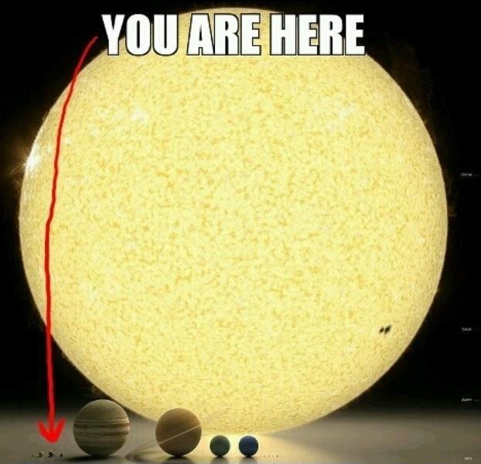
9. But that’s nothing compared to our sun. Just remember:

Slide 12
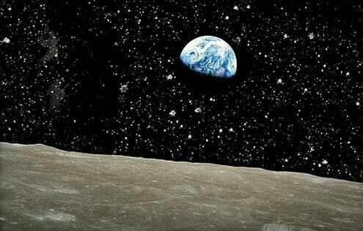
10. Here’s you from the moon:

Slide 13
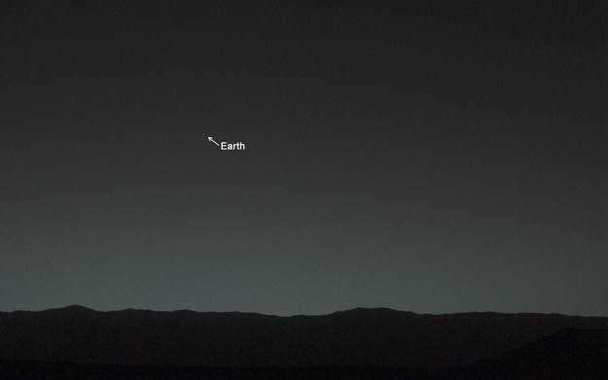
11. Here’s you from Mars:

Slide 14
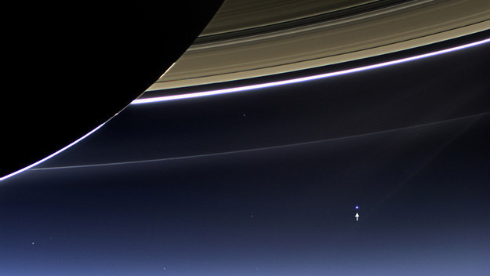
12. Here’s you from just behind Saturn’s rings:

Slide 15
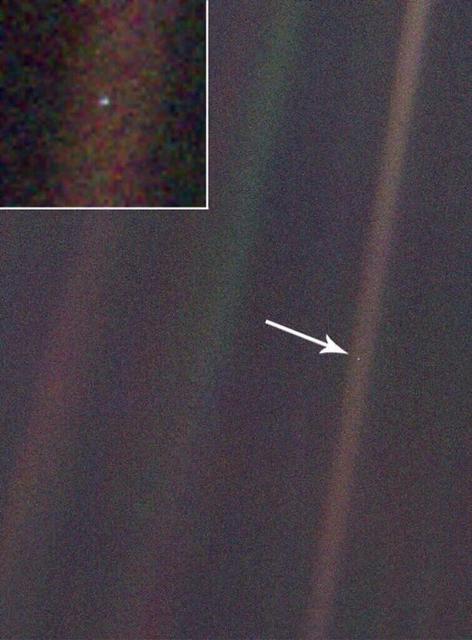
13. And here’s you from just beyond Neptune, 4 billion miles away.
To paraphrase Carl Sagan, everyone and everything you have ever known exists on that little speck.

Slide 16
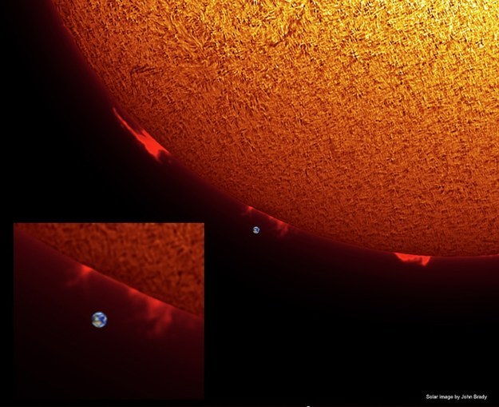
14. Let’s step back a bit. Here’s the size of Earth compared with the size of our sun. Terrifying, right?

Slide 17
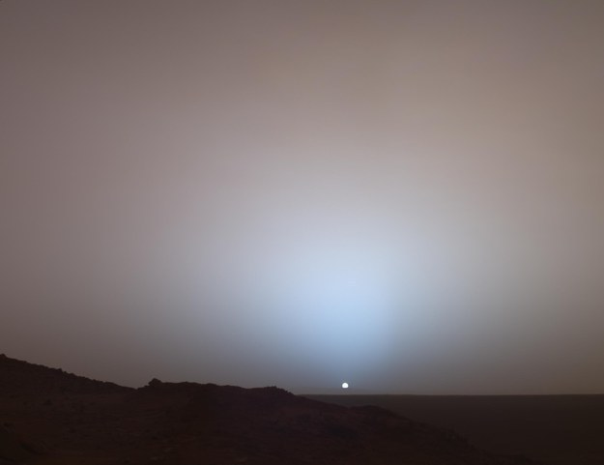
15. And here’s that same sun from the surface of Mars

Slide 18
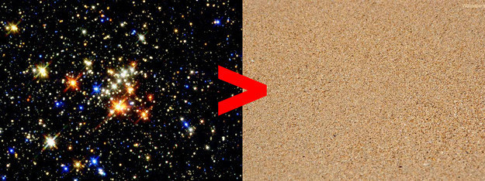
Stars
Sand
16. But that’s nothing. Again, as Carl once mused, there are more stars in space than there are grains of sand on every beach on Earth:

Slide 19
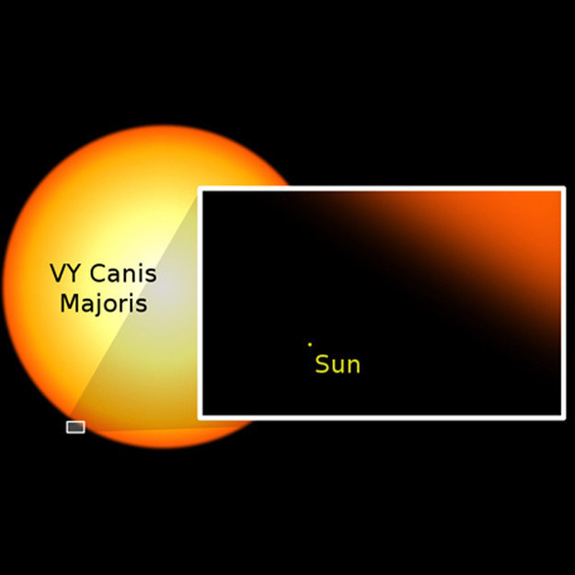
17. Which means that there are ones much, much bigger than little wimpy sun. Just look at how tiny and insignificant our sun is:

Slide 20
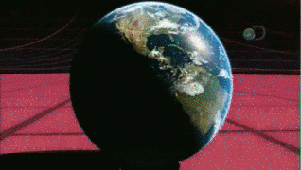
18. Here’s another look. The biggest star, VY Canis Majoris, is 1,000,000,000 times bigger than our sun:
http://ak-hdl.buzzfed.com/static/2014-11/14/11/enhanced/webdr03/anigif_enhanced-buzz-18492-1415983788-20.gif

Slide 21
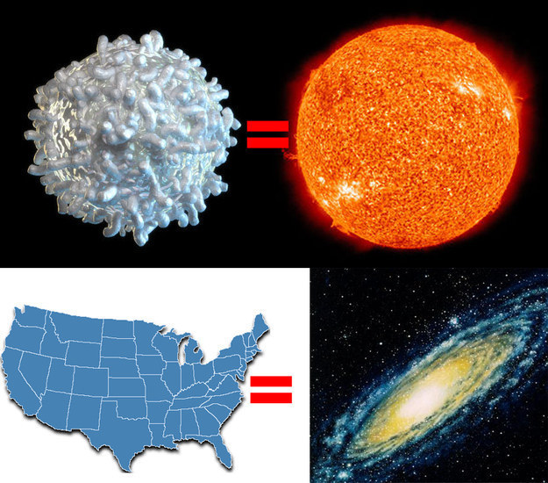
19. But none of those compares to the size of a galaxy. In fact, if you shrank the sun down to the size of a white blood cell and shrunk the Milky Way galaxy down using the same scale, the Milky Way would be the size of the United States:

Slide 22
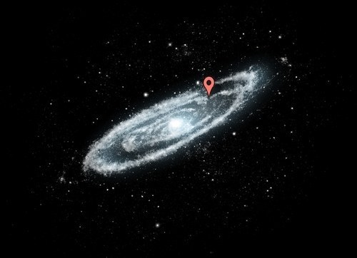
20. That’s because the Milky Way galaxy is huge. This is where you live inside there:

Slide 23
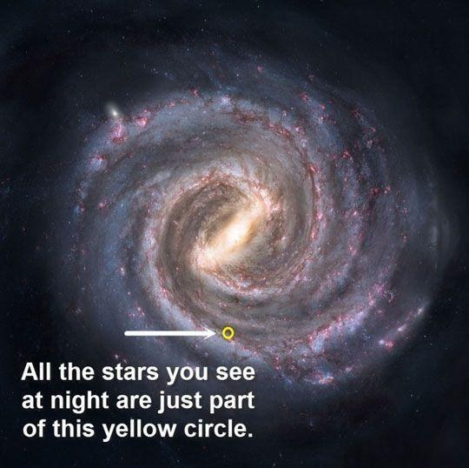
21. But this is all you ever see:
(That’s not a picture of the Milky Way, but you get the idea.)

Slide 24
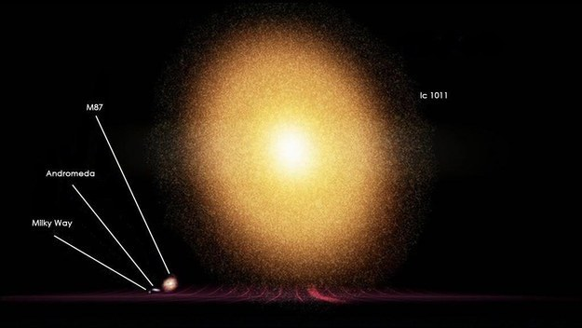
Just THINK about all that could be inside there.
22. But even our galaxy is a little runt compared with some others. Here’s the Milky Way compared to IC 1011, 350 million light years away from Earth:

Slide 25
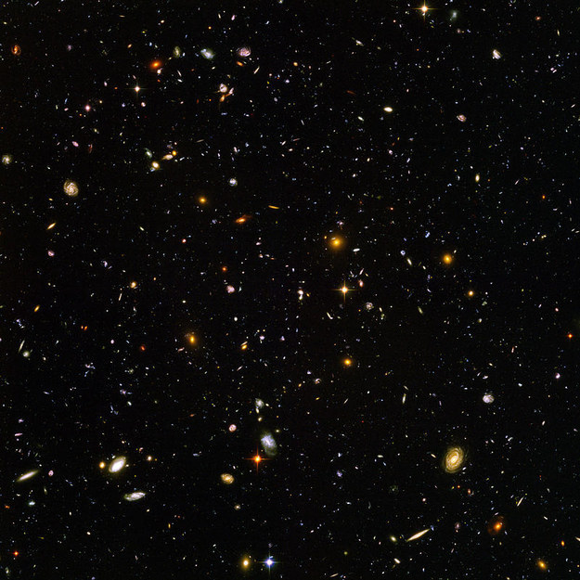
23. But let’s think bigger. In JUST this picture taken by the Hubble telescope, there are thousands and thousands of galaxies, each containing millions of stars, each with their own planets.

Slide 26
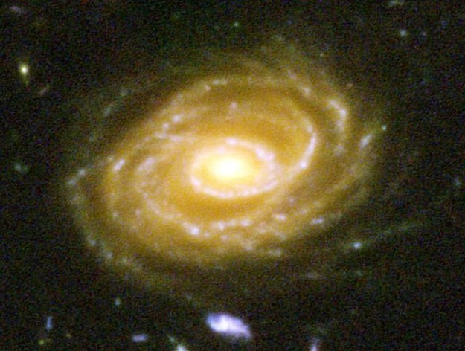
Some of the other galaxies are thought to have formed only a few hundred million years AFTER the Big Bang.
24. Here’s one of the galaxies pictured, UDF 423. This galaxy is 10 BILLION light years away. When you look at this picture, you are looking billions of years into the past.

Slide 27
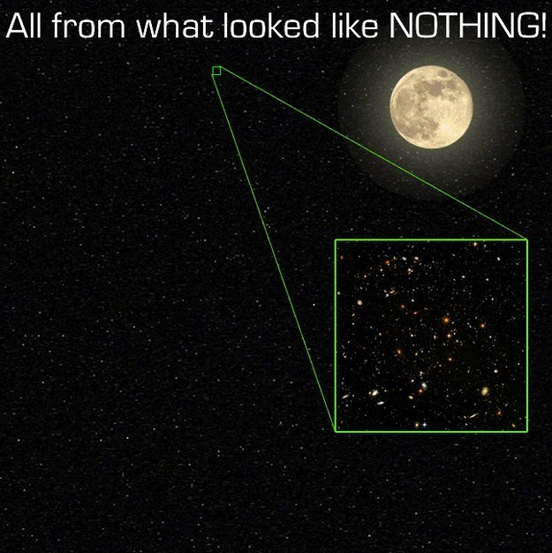
25. And just keep this in mind — that’s a picture of a very small, small part of the universe. It’s just an insignificant fraction of the night sky.

Slide 28
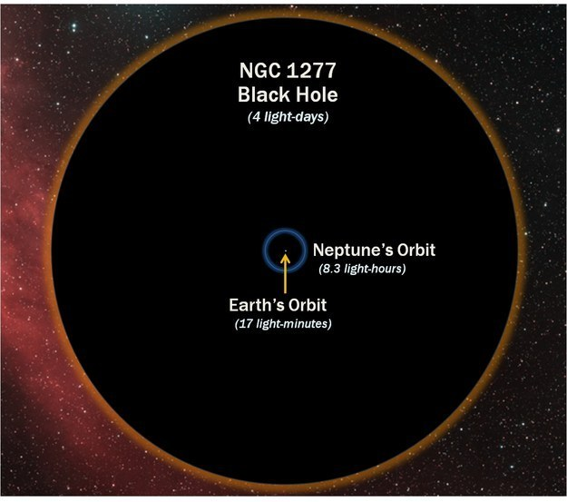
26. And, you know, it’s pretty safe to assume that there are some black holes out there. Here’s the size of a black hole compared with Earth’s orbit, just to terrify you:

Slide 29
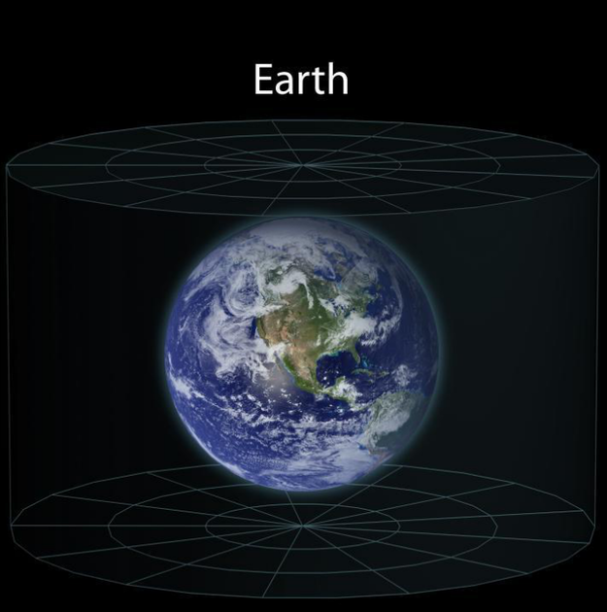
So if you’re ever feeling upset about your favorite show being canceled or the fact that they play Christmas music way too early — just remember…
This is your home.

Slide 30
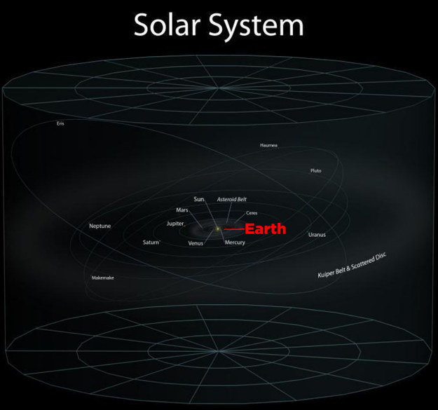
This is what happens when you zoom out from your home to your solar system.

Slide 31
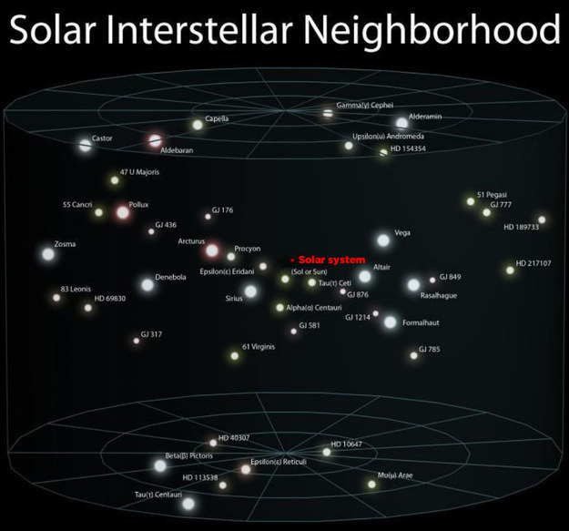
And this is what happens when you zoom out farther…

Slide 32
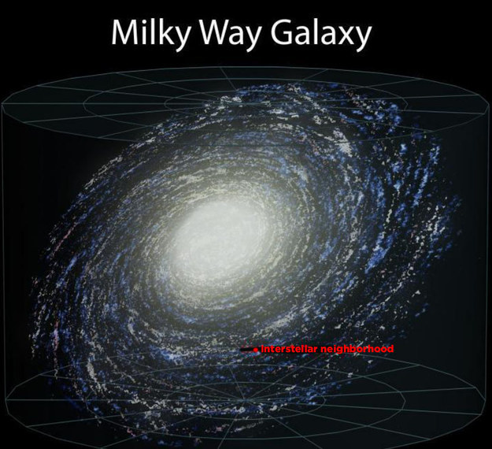
And farther…

Slide 33
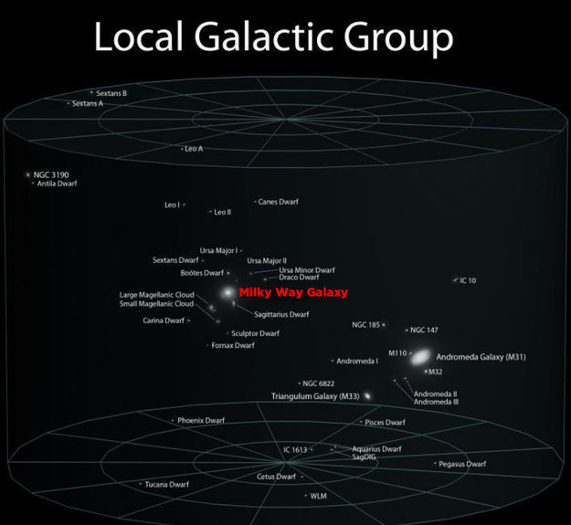
Keep going…

Slide 34
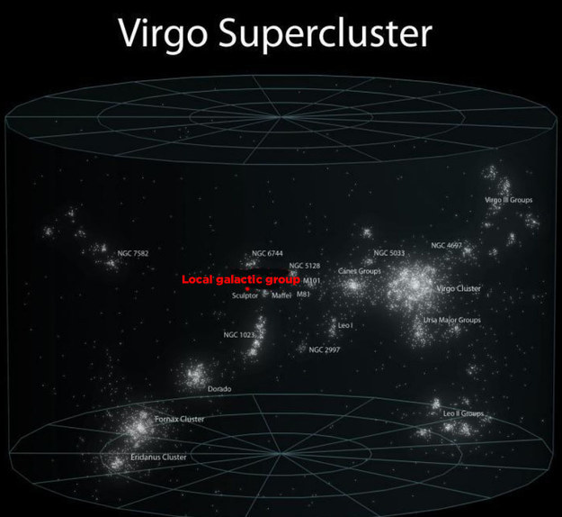
Just a little bit farther…

Slide 35
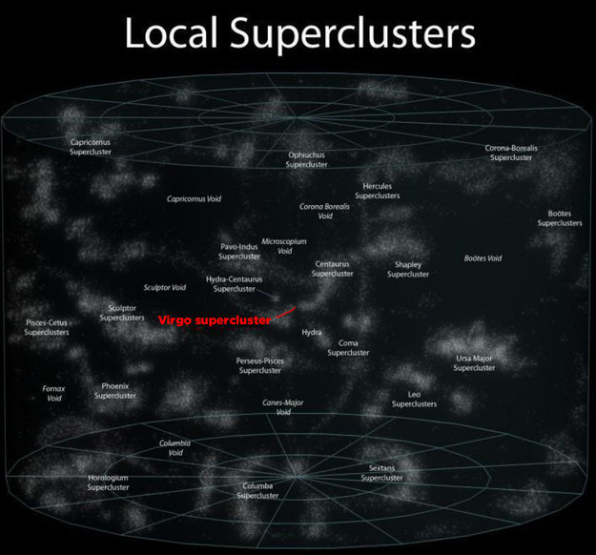
Almost there…

Slide 36
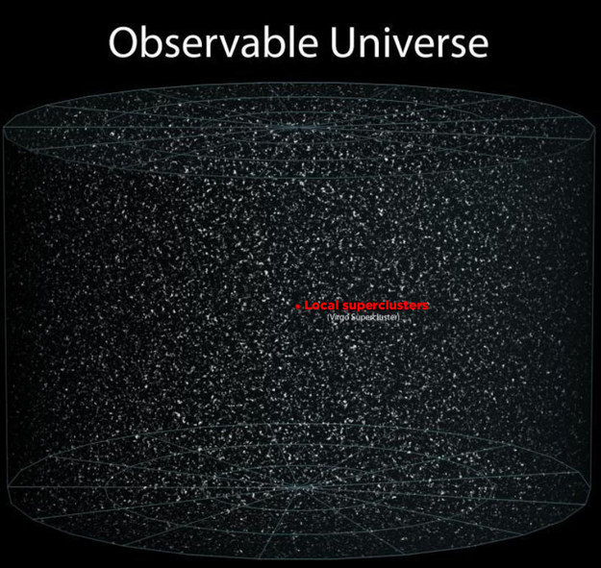
And here it is. Here’s everything in the observable universe, and here’s your place in it. Just a tiny little ant in a giant jar.

