Slide 1
What Are your Ideas About the Earth
Essential Questions:
What do you know about gravity and the way objects behave in a gravity field?
Why does the Earth appear flat?
What is the definition of ‘UP’ and ‘DOWN’?
What does a straight line in space mean?

Slide 2
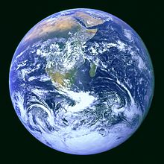
Question 1: Why is the Earth flat in picture #1 and round in picture # 2?
A. They are different Earths
B. The Earth is round like a ball but people live on the flat part in the middle
C. The Earth is round like a ball, but it has flat spots on it
D. The Earth is round like a ball but looks flat because we only see a small part of the ball
E. The Earth is round like a plate or CD, so it seems round when you’re over it, but flat when you’re on it
1
2

Slide 3
Question 2: Pretend that the Earth is glass and you could look straight through it. Which way would you look, in a straight line to see people in far-off countries like India or China?
A. Westward?
B. Eastward?
C. Upward?
D. Downward?

Slide 4
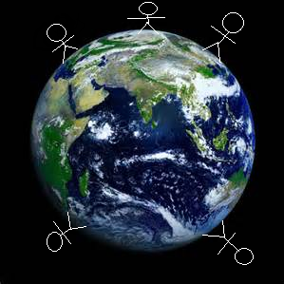
Question 3: This drawing shows some enlarged people dropping rocks at various places around the earth. Show what happens to each rock when it’s dropped by drawing a line from the person’s hand to where the rock finally stops.

Slide 5
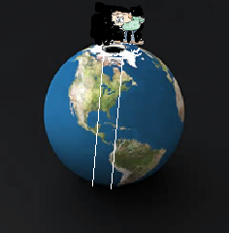
Question 4: Pretend that Superman dug a tunnel all the way through the earth from pole to pole. Imagine that a person holds a rock above the opening at the North Pole. Show what happens to the rock when it’s dropped by drawing a line from the person’s hand to where the rock finally stops.

Slide 6
Group participation grade sheet

