Slide 1
What I Learned About the Earth
(Or why Australians don’t fall off the ‘bottom’ of the Earth)

Slide 2
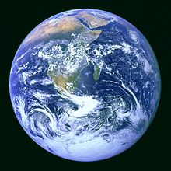
Question 1: Why is the Earth flat in picture #1 and round in picture # 2?
A. They are different Earths
B. The Earth is round like a ball but people live on the flat part in the middle
C. The Earth is round like a ball, but it has flat spots on it
D. The Earth is round like a ball but looks flat because we only see a small part of the ball
E. The Earth is round like a plate or CD, so it seems round when you’re over it, but flat when you’re on it
1
2

Slide 3
1.The Earth is huge and round. We only live on a small space, so it may seem flat. The earth is NOT flat! There are not even any flat places on it. We only see very small parts of the earth because we are small and the earth is huge. The earth is round like a ball.
Roundness is not affected by size but the bigger a circle is, the smaller arc we see.

Slide 4
If we were to enlarge a billiard ball to the same size as the earth, the earth would be smoother than the billiard ball.
If we draw the earth so it is 1 meter in diameter with a piece of chalk, the top of the atmosphere and the bottom of the deepest ocean trench would fit inside the thickness of the chalk-line.

Slide 5
Question 2: Pretend that the Earth is glass and you could look straight through it. Which way would you look, in a straight line to see people in far-off countries like India or China?
A. Westward?
B. Eastward?
C. Upward?
D. Downward?

Slide 6
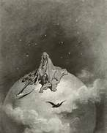
2. To see different countries, we would look down. If we look east or west (or even north or south) we see the earth curving into a round shape then we see the sky. Looking up we see the sky. If you look in any direction, up, north, south, east or west, you are looking at outer space (the sun, the moon, the stars etc.). No matter where we are on earth, the whole earth seems to be below us. If we look down, we see the whole earth.

Slide 7
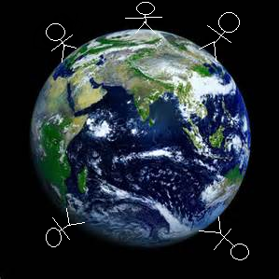
Question 3: This drawing shows some enlarged people dropping rocks at various places around the earth. Show what happens to each rock when it’s dropped by drawing a line from the person’s hand to where the rock finally stops.

Slide 8
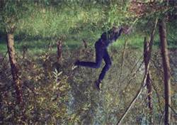
3. Gravity is pulling everything down. So the rocks that are dropped fall to the person’s feet. Gravity pulls things to the center of the earth. Things can’t fall off the southern hemisphere because there is no large body in space that would have enough gravity to pull us off the earth. Even if there was, it would also pull the earth down as well.

Slide 9
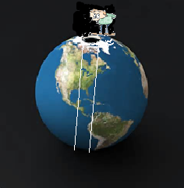
Question 4: Pretend that Superman dug a tunnel all the way through the earth from pole to pole. Imagine that a person holds a rock above the opening at the North Pole. Show what happens to the rock when it’s dropped by drawing a line from the person’s hand to where the rock finally stops.

Slide 10
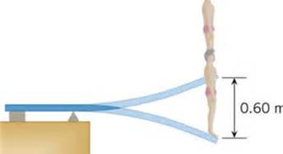
4. Gravity causes the rock dropped in the hole through the center of the earth to fall down. When it reaches the center the force created would push the rock past the center (now going up) until it almost reaches the other side where gravity pulls it down again. This back and forth motion will continue until the rock comes to a stop in the center.

Slide 11
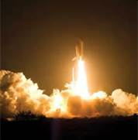
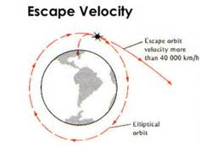
4.(cont) Gravity is a weak force. We can go against gravity for a short period of time but gravity will always overcome the small distance we can go. To escape gravity completely, a person, spaceship, or rocket must reach escape velocity which is:
To leave planet Earth, an escape velocity of 11.2 km/s (approx. 40,320 km/h, or 25,000 mph) is required; however, a speed of 42.1 km/s is required to escape the Sun's gravity (and exit the Solar System) from the same position.
$$v_{e}=\sqrt{\frac{2GM}{r}}$$

Slide 12
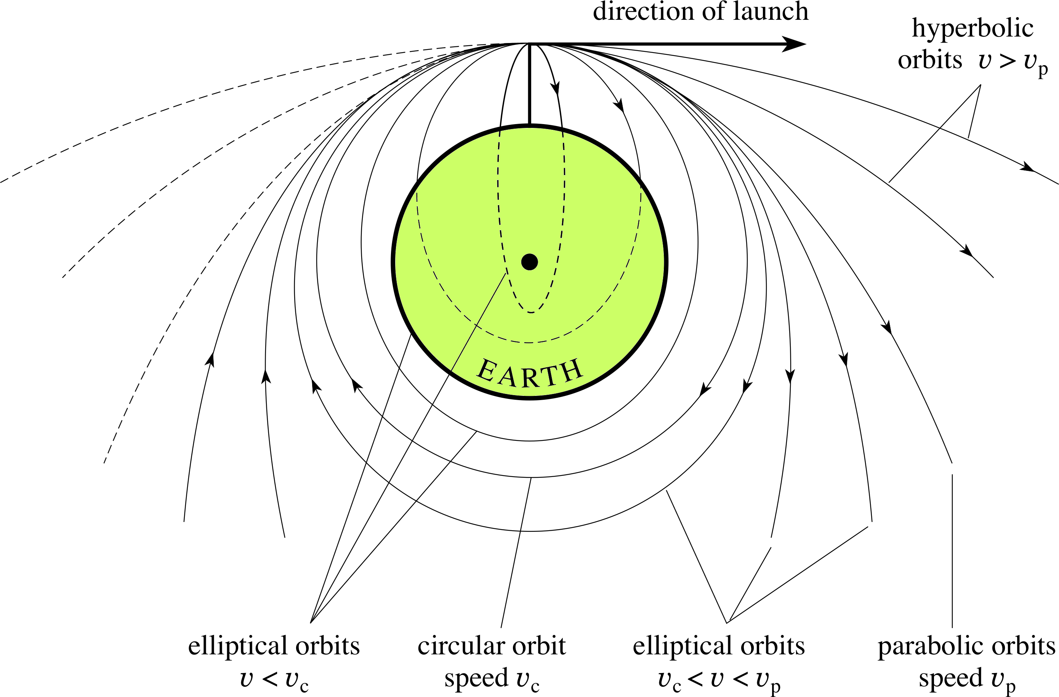

Slide 13
What you should have gotten out of the lesson
Be sure you have this information in your notes!

Slide 14
What I learned from Question #1
The Earth is huge and round. We only live on a small space, so it may seem flat.
The earth is NOT flat! There are not even any flat places on it. We only see very small parts of the earth because we are small and the earth is huge. The earth is round like a ball.
If we were to enlarge a billiard ball to the same size as the earth, the earth would be smoother that the billiard ball.
If we draw the earth so it is 1 meter in diameter with a piece of chalk, the top of the atmosphere and the bottom of the deepest ocean trench would fit inside the thickness of the chalk-line.

Slide 15
What I learned From Question #2
To see different countries, we would look down. If we look east or west (or even north or south) we see the earth curving into a round shape then we see the sky. Looking up we see the sky.
If you look in any direction, up, north, south, east or west, you are looking at outer space (the sun, the moon, the stars etc.). No matter where we are on earth, the whole earth seems to be below us. If we look down, we see the whole earth.

Slide 16
What I learned from question #3
Gravity is pulling everything down. So the rocks that are dropped fall to the person’s feet.
Gravity pulls things to the center of the earth. Things can’t fall off the southern hemisphere because there is no large body in space that would have enough gravity to pull us off the earth. Even if there was, it would also pull the earth down as well.
Even in outer space, gravity is still working on whatever is dropped.

Slide 17
What I learned from question #4
Gravity causes the rock dropped in the hole through the center of the earth to fall down. When it reaches the center the force created would push the rock past the center (now going up) until it almost reaches the other side where gravity pulls it down again. This back and forth motion will continue until the rock comes to a stop in the center.
Gravity is a weak force. We can go against gravity for a short period of time but gravity will always overcome the small distance we can go. To escape gravity completely, a person, spaceship, or rocket must reach escape velocity which is
$v_{e}=\sqrt{\frac{2GM}{r}}$
To leave planet Earth, an escape velocity of 11.2 km/s (approx. 40,320 km/h, or 25,000 mph) is required; however, a speed of 42.1 km/s is required to escape the Sun's gravity (and exit the Solar System) from the same position.

