Slide 1
Velocity and Momentum
What is the difference between velocity and speed?
How can an object’s momentum be calculated?
How is the motion of two objects relative to each other described?

Slide 2
Vocabulary
Speed- rate of change of position.
Velocity-an object’s speed and direction of motion
Momentum-the product of an object’s mass and velocity
$$momentum=mass ×velocity$$
$$p=mv$$

Slide 3
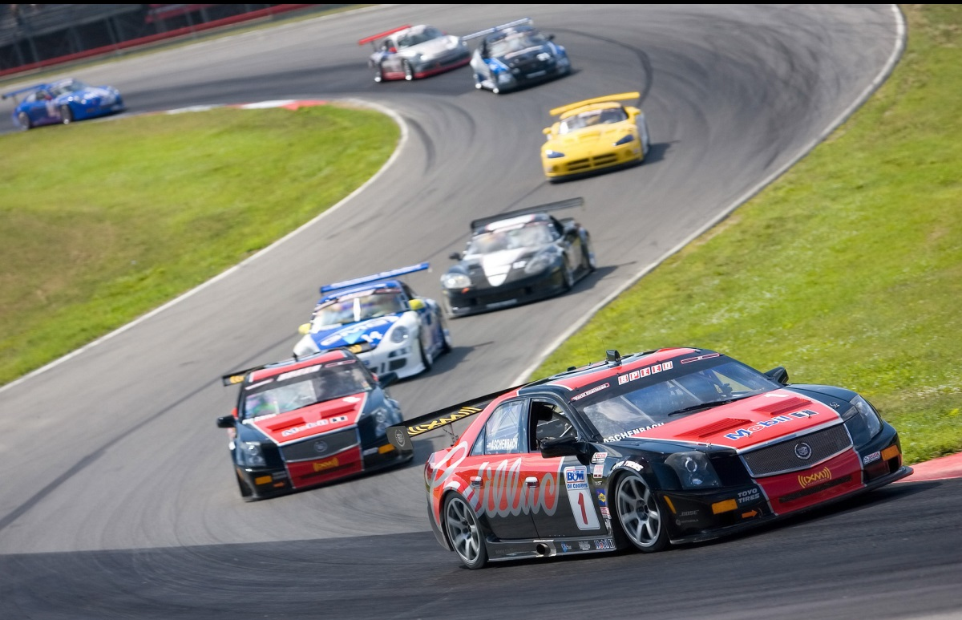
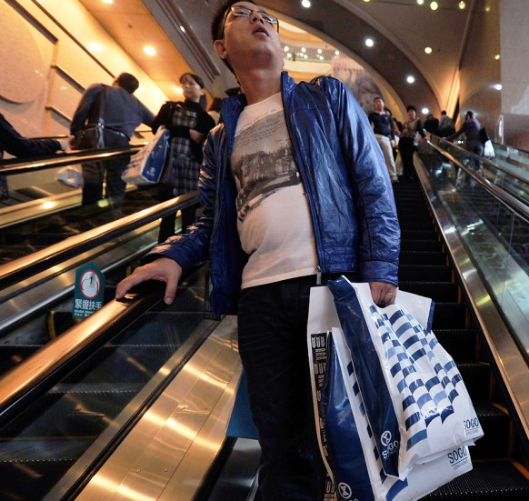
Change in Velocity
Because velocity is both speed and direction, Velocity can change even if speed is the same.
What could be an example of this?

Slide 4
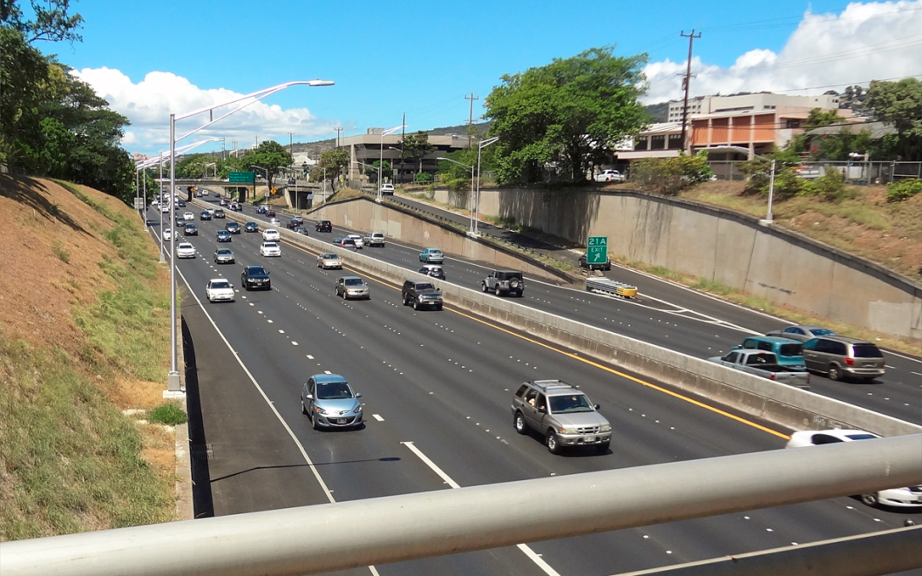
Relative Motion
Motion of other objects seems different if we are moving too.
Cars on the interstate going the same direction as us seem to go slowly while those going the opposite way seem to speed. In reality they are going the same speeds.

Slide 5
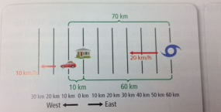
2:00 pm
If we choose a stationary reference point in this picture like the house, the picture shows how the 2 moving objects change. The car and hurricane are both moving west but one is going towards the house and one is going away from the house.

Slide 6
3:00 pm
An hour later we can see the change, the distance between the house and car is increasing at a rate of 10 km/h and the distance between the house and hurricane is decreasing at a rate of 20 km/h.

Slide 7
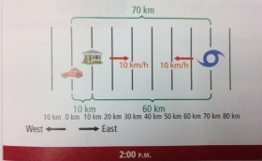
If you change the reference point to something moving like the car, which is traveling at 10 km/h west, the description changes. The person in the car would say the hurricane is approaching at 10 km/h and the house is receding at 10 km/h.

Slide 8
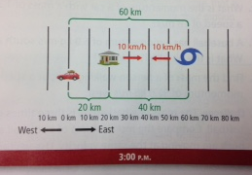
An hour later there is no change relative velocities, but the distance between each of them has changed.

Slide 9
http://boredomtherapy.com/wp-content/uploads/2017/01/escalator-fail-1.gif

Slide 11
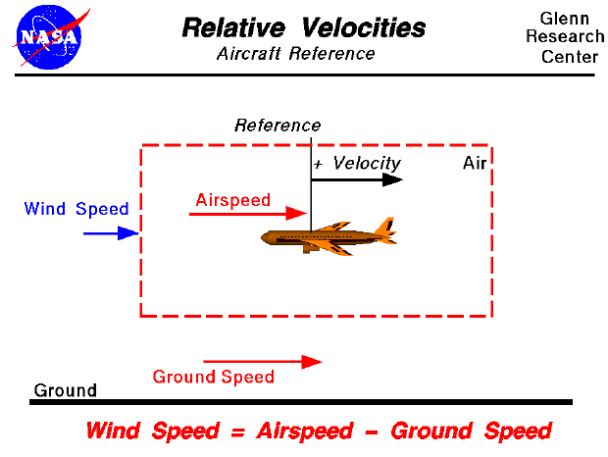

Slide 12
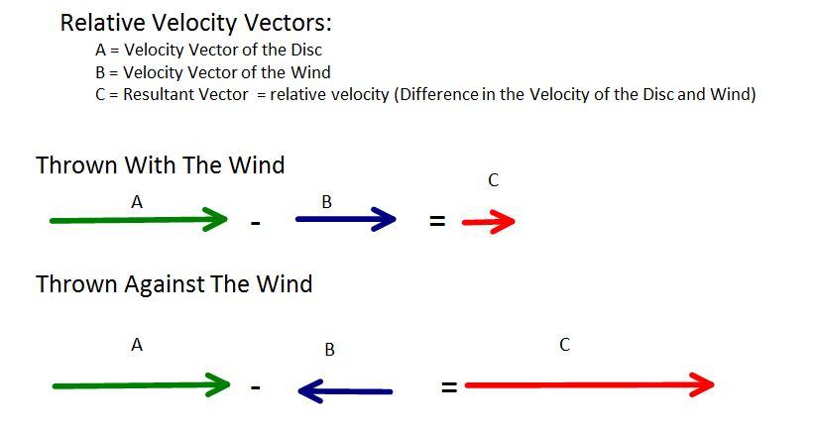
Both going the same direction, so the difference is small
Each going different directions, so the difference is large

Slide 13
Momentum Units
Momentum = kg·m/s
Mass = kg (convert if you must)
Velocity = m/s
kg= kilograms
m/s = meters per second
Momentum is a vector (it must have a direction) and the direction is always in the same direction as the velocity.

Slide 14
Momentum Equation
Momentum equation:
$$p=momentum$$
m = mass
v = velocity
$$momentum \left(in kg∙\frac{m}{s}\right)=mass \left(in kg\right)×velocity (in\frac{m}{s})$$
$$p=mv$$

Slide 15
Momentum
Momentum is the product of mass and velocity.
If we a have a scenario that has a velocity of 2 m/s and we apply that velocity to 2 different masses, for example a bug with a mass of 1g and a car with a mass of 1000 kg, which will have more momentum if they run into a vase? What would happen to the vase in each case?
p=0.001kg x 2m/s= 0.002 kg m/s
p= 1000kg x 2 m/s = 2000 kg m/s

Slide 16
Scenarios
What if we decreased the velocity of the car or increased the velocity of the bug?
Have you ever been in a rainstorm? Walking? Running? What if you are riding a bike? Riding a motorcycle or 4-wheeler?
What does a grain of sand feel like when it falls on you? What is a sandstorm like with high winds?
What does a cinder block feel like if you hold it up with your hands? What would it feel like if it was thrown at you?

Slide 17
What can you say about the momentum of these insects?

Slide 18
Problems
What is the momentum of a car with a mass of 1500 kg traveling south at a speed of 30 m/s?
A bird has a momentum of 4.5 kg m/s NW and a mass if 0.25 kg. What is the birds velocity?
Find the mass of a dog running east at a speed of 3 m/s with a momentum of 60 kg m/s east.

Slide 19
Problems
Turn to page 54 and 55 in the book
Do the problems 12-15 on page 54
Do questions 20-21 on page 55
Write the problems on your notes

Slide 20
Note summary
The velocity of an object includes the object’s speed and its direction of motion relative to a reference point.
An object’s motion is always described relative to a reference point.
The momentum of an object is the product of its mass and velocity: p=mv

Slide 21
Finish your notes
Color code
Annotations
Summary paragraph
Response paragraph

