Slide 1
Unit: The moon
Objectives and Vocabulary

Slide 2
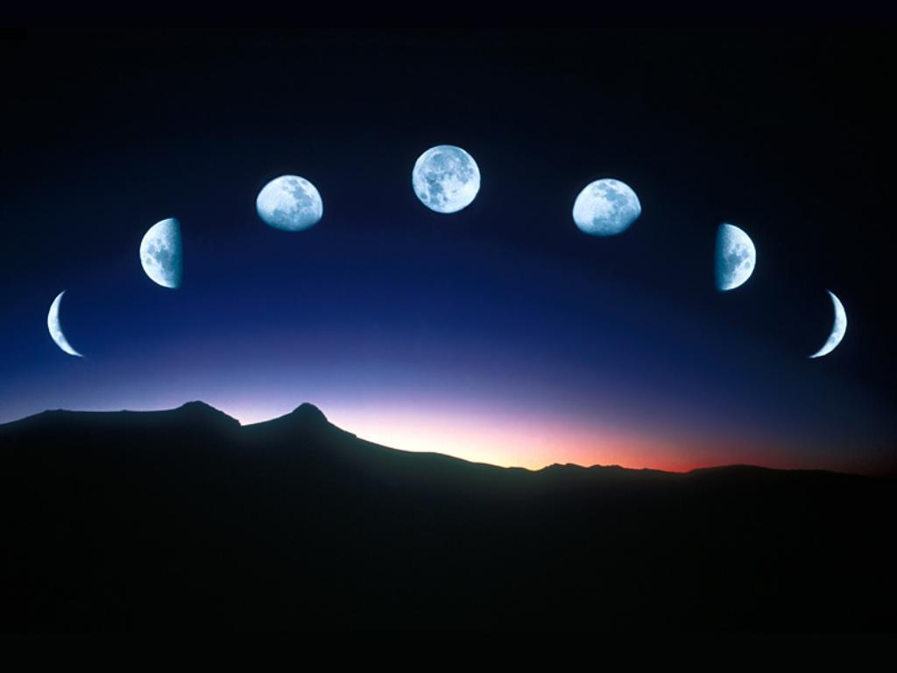
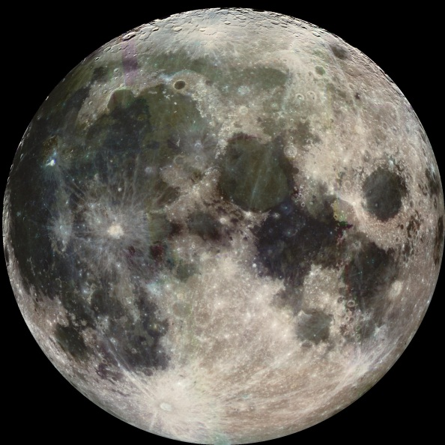
The Moon: Objectives
The Students will be able to:
Predict and explain the phases of the moon
Visualize the positions and motions of the sun, moon and earth
Build and use a model of the sun, moon, and earth
Explain the causes of eclipses and predict outcomes of hypothetical scenarios
Define and explain months (lunar orbits)
Compare and contrast Synodic and Sidereal Months

Slide 3
The Moon: Vocabulary
Moon
Orbit
Eclipse
Inertia
Time zone
Phase
Gibbous moon
Crescent moon
Quarter moon
New moon
Full moon
Horizon
Zenith
Ascending
Descending
Annular eclipse
Total eclipse
Lunar eclipse
Solar eclipse
Partial eclipse
gravity
Wax
Wane

