Slide 1
The manhattAN PROJECT

Slide 2
Essential questions
Who were the scientists that worked on the Manhattan project?
Where did the research take place?
Where were the bombs detonated?
Why did we build it?

Slide 3
Before the bomb
Early in 1939, the world's scientific community discovered that German physicists had learned the secrets of splitting a uranium atom.
Fears soon spread over the possibility of Nazi scientists utilizing that energy to produce a bomb capable of unspeakable destruction.

Slide 4
Scientists
Scientists ALBERT EINSTEIN, who fled Nazi persecution, and ENRICO FERMI, who escaped Fascist Italy, were now living in the United States.
They agreed that the President must be informed of the dangers of atomic technology in the hands of the Axis powers (the Nazis).
Fermi traveled to Washington in March to express his concerns to government officials. But few shared his uneasiness.

Slide 5
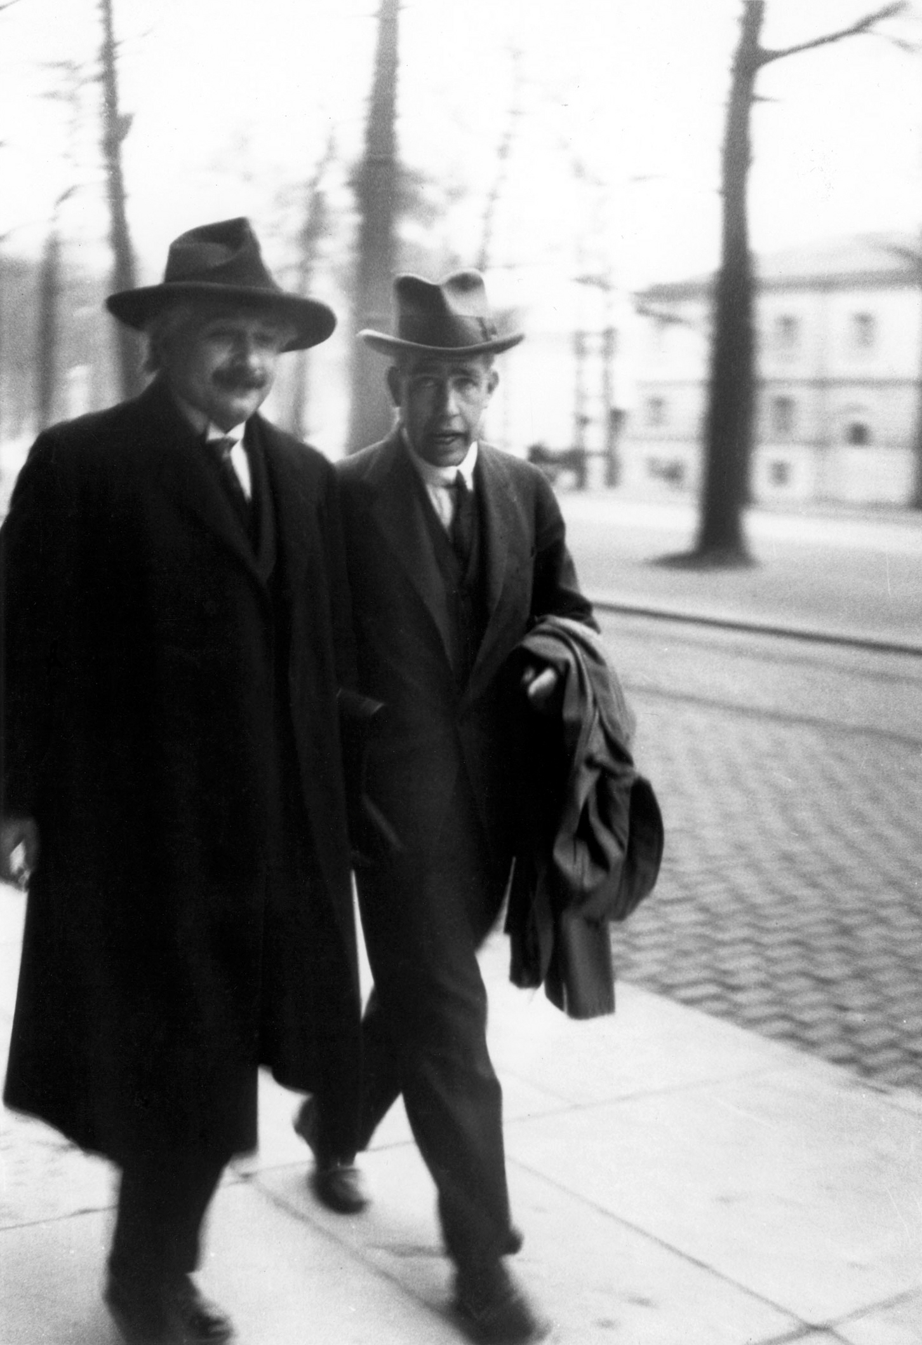
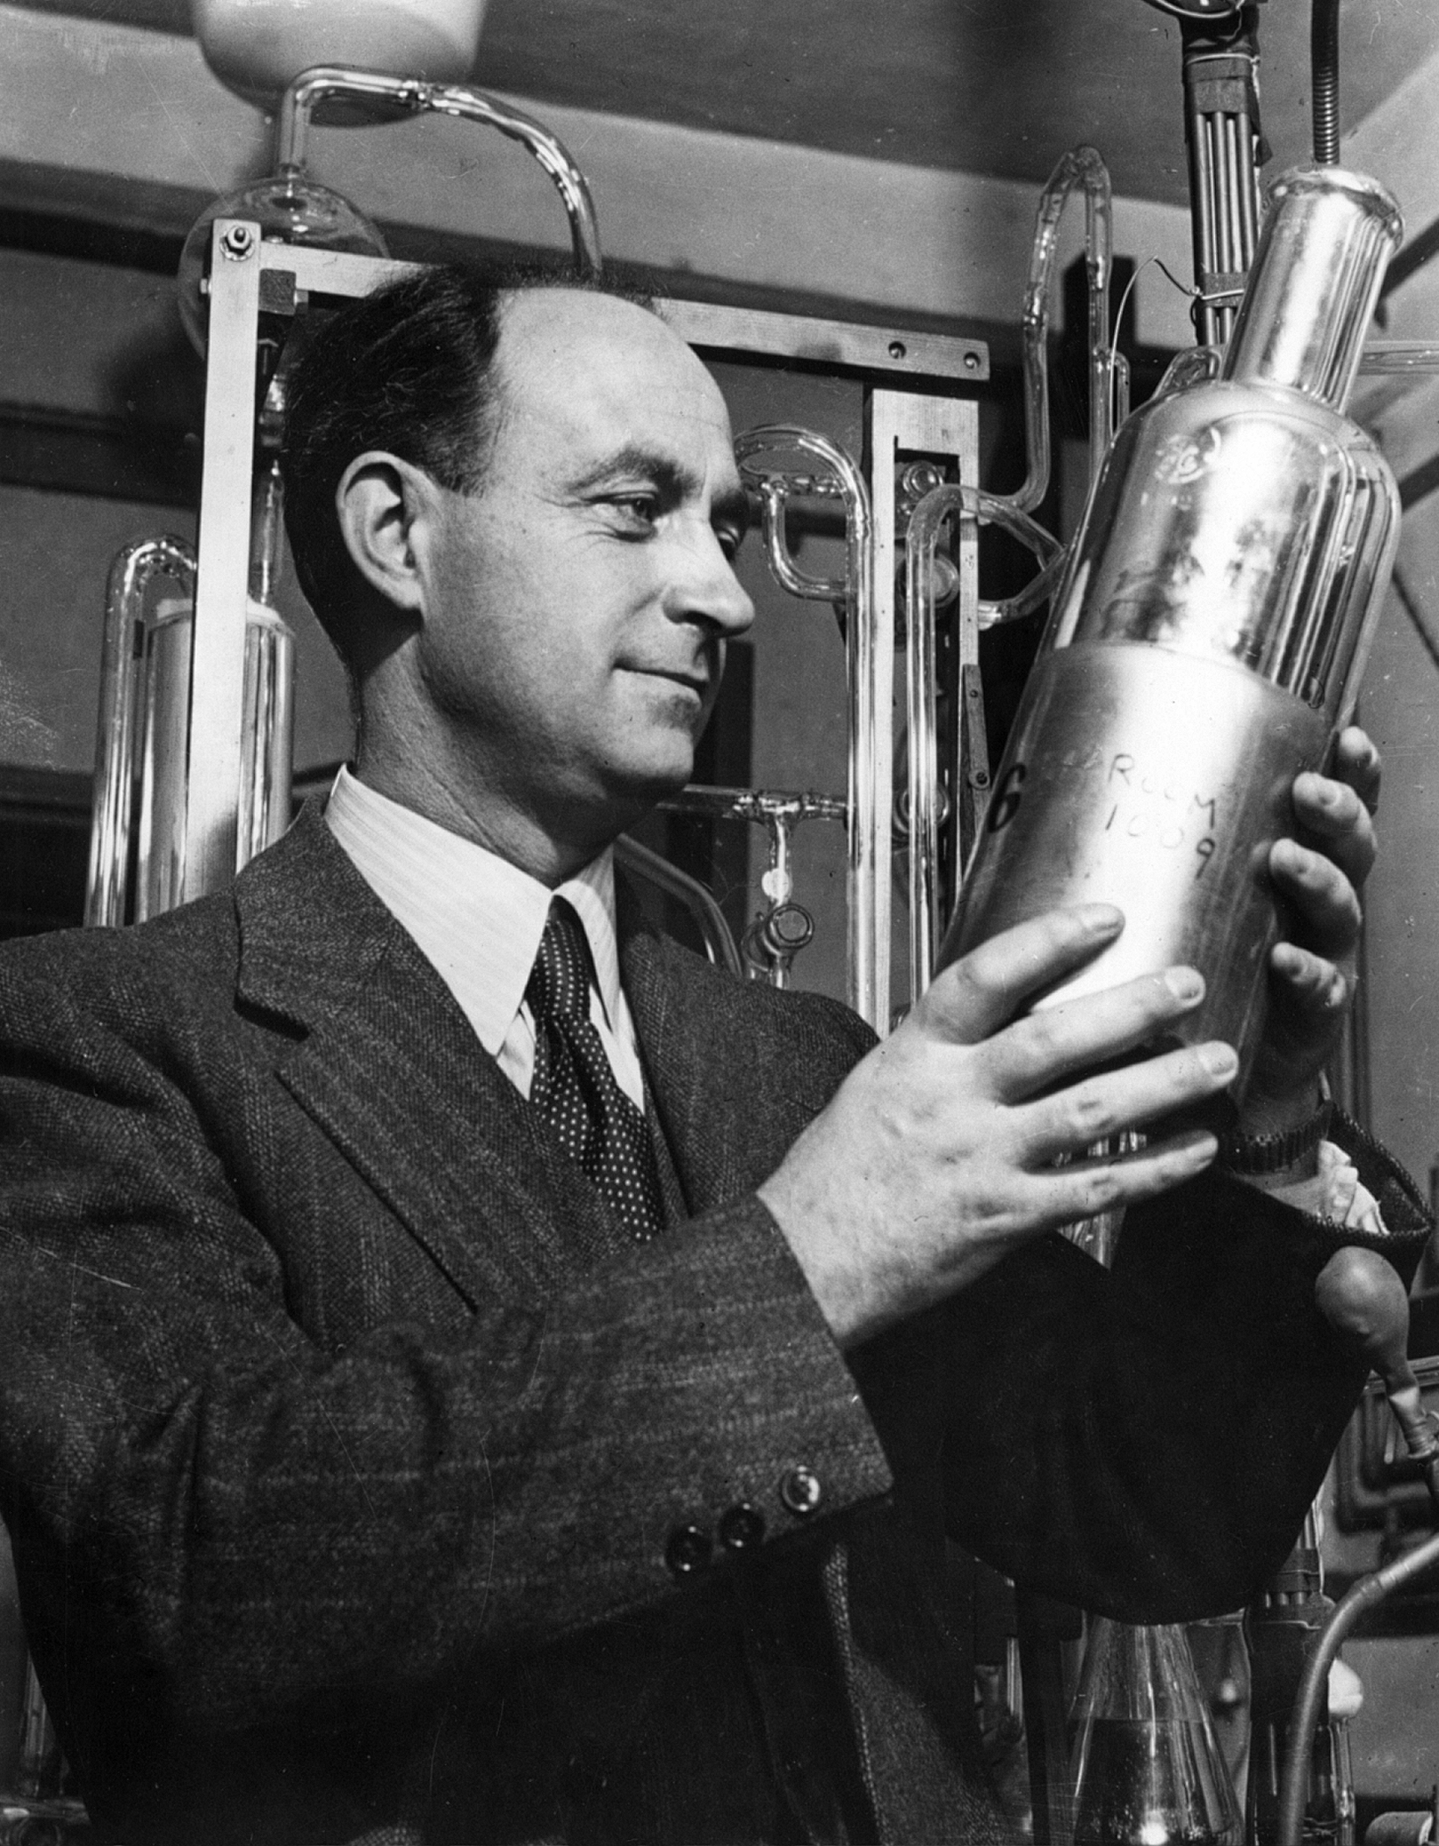
Enrico Fermi
Albert Einstein and Niels Bohr

Slide 6
The letter to the president
Einstein wrote a letter to President Roosevelt urging the development of an atomic research program later that year (1939).

Slide 7
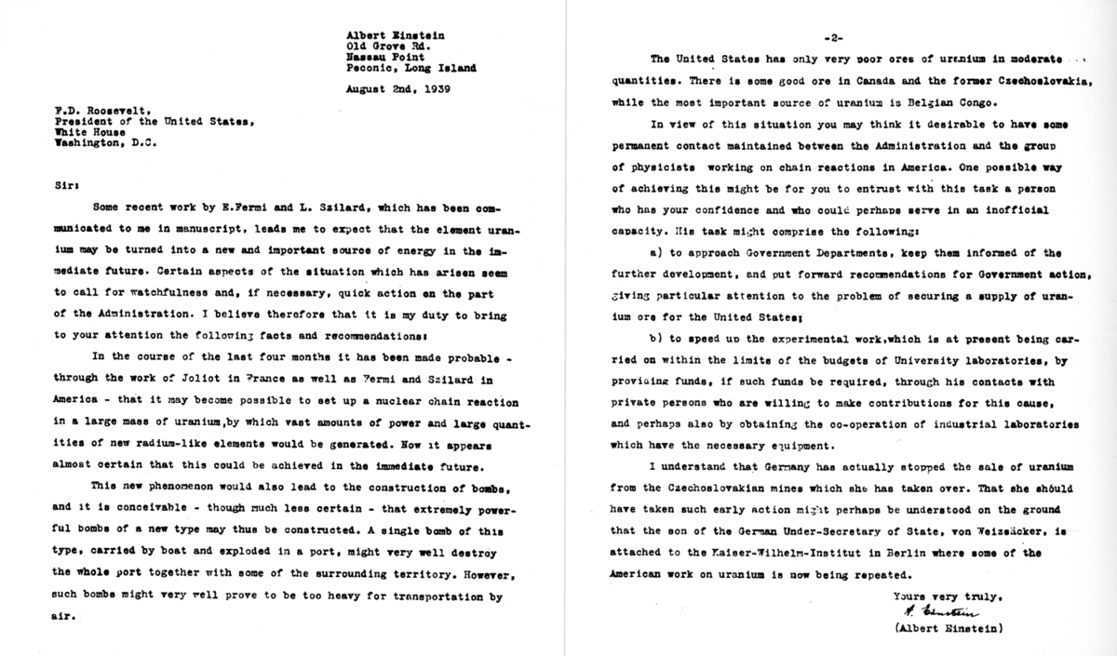
Einstein’s letter to the president

Slide 8
The manhattan project gets its name
Roosevelt was unconvinced of the necessity or the utility for such a project, but agreed to proceed slowly.
In late 1941, the American effort to design and build an ATOMIC BOMB received its code name —
the MANHATTAN PROJECT.

Slide 9
The research starts
At first the research was based at only a few universities —
Columbia University
University of Chicago
University of California at Berkeley.
A breakthrough occurred in December 1942 when Fermi led a group of physicists to produce the first controlled NUCLEAR CHAIN REACTION under the grandstands of STAGG FIELD at the University of Chicago.

Slide 10
The projects moves ahead
After this milestone, more funds were made available, and the project advanced at breakneck speed.
The main assembly plant was built at LOS ALAMOS, NEW MEXICO.
ROBERT OPPENHEIMER was put in charge of putting the pieces together at Los Alamos.
Nearly $2 billion had been spent on research and development of the atomic bomb.
The Manhattan Project employed over 120,000 Americans.

Slide 11
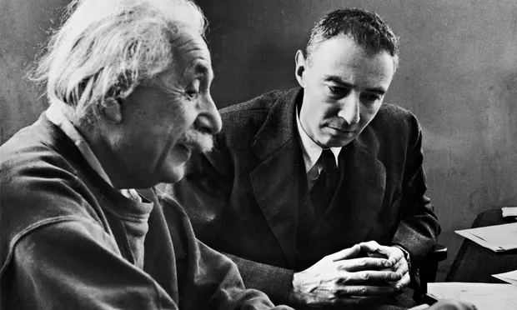
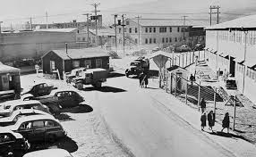
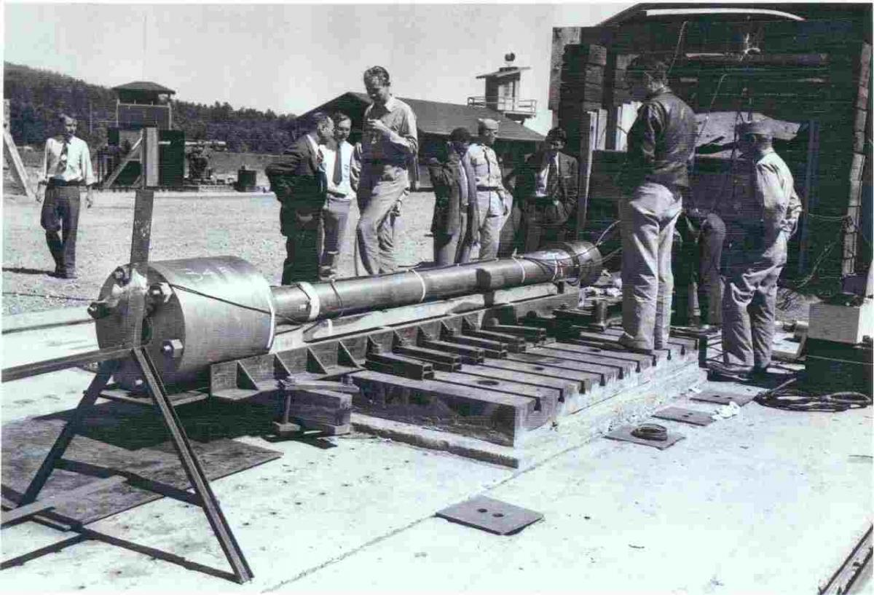
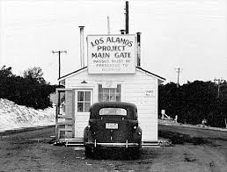
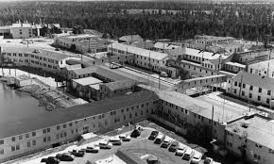
Los Alamos, New Mexico
Albert Einstein and Robert Oppenheimer

Slide 12
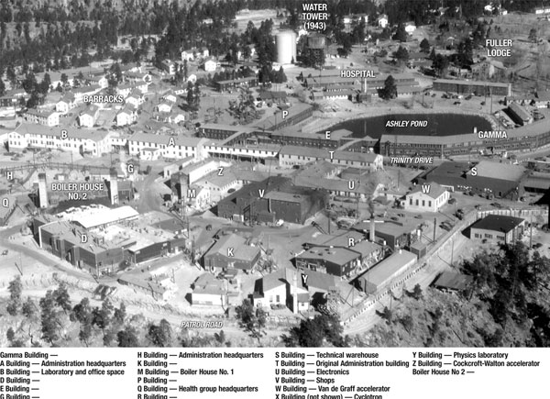

Slide 13
secrets
Secrecy was paramount. Neither the Germans nor the Japanese could learn of the project. Roosevelt and Churchill also agreed that the Stalin would be kept in the dark. Consequently, there was no public awareness or debate. Keeping 120,000 people quiet would be impossible; therefore only a small privileged cadre of inner scientists and officials knew about the atomic bomb's development. In fact, Vice-President Truman had never heard of the Manhattan Project until he became President Truman
Secrecy was paramount.
Neither the Germans nor the Japanese could learn of the project.
Roosevelt and Churchill also agreed that the Stalin would be kept in the dark. Consequently, there was no public awareness or debate.
Keeping 120,000 people quiet would be impossible; therefore only a small group of inner scientists and officials knew about the atomic bomb's development.
In fact, Vice-President Truman had never heard of the Manhattan Project until he became President Truman

Slide 14
Testing the bomb
By the summer of 1945, Oppenheimer was ready to test the first bomb.
On July 16, 1945, at TRINITY SITE near ALAMOGORDO, NEW MEXICO, scientists of the Manhattan Project readied themselves to watch the detonation of the world's first atomic bomb.
The device was affixed to a 100-foot tower and discharged just before dawn. No one was properly prepared for the result.

Slide 15
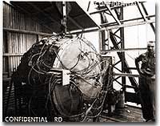
This once classified photograph features the first atomic bomb — a weapon that atomic scientists had nicknamed "Gadget." The nuclear age began on July 16, 1945, when it was detonated in the New Mexico desert.

Slide 16
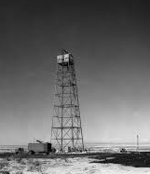
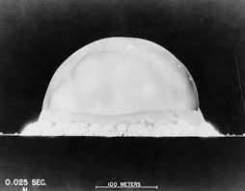
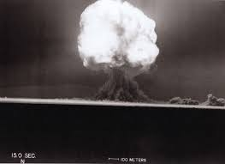
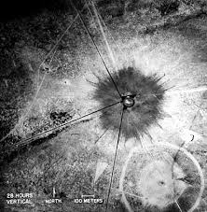
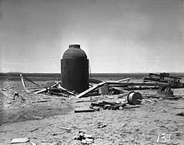
2.
3.
1.
4.
The tower
1/16th of a second
15 seconds
Arial view of ½ mile wide crater
Debris left over from detonation
5.

Slide 17
Trinitiy
A blinding flash visible for 200 miles lit up the morning sky.
A mushroom cloud reached 40,000 feet, blowing out windows of civilian homes up to 100 miles away.
When the cloud returned to earth it created a half-mile wide crater metamorphosing sand into glass.
A bogus cover-up story was quickly released, explaining that a huge ammunition dump had just exploded in the desert.
Soon word reached President Truman in Potsdam, Germany that the project was successful.

Slide 18
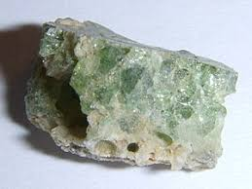
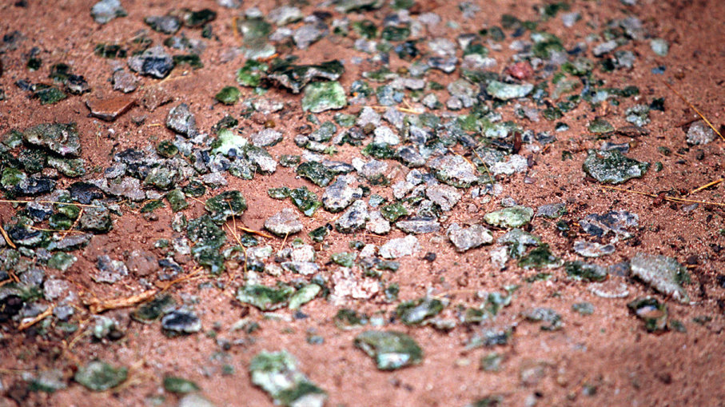
Trinitite-also known as atomsite or Alamogordo glass, is the glassy residue left on the desert floor after the plutonium-based Trinity nuclear bomb test.

Slide 19
Trinity Quote: Robert Oppenheimer
The first atomic bomb was detonated on July 16, 1945, in the Trinity test in New Mexico; Oppenheimer later remarked that it brought to mind words from the Bhagavad Gita:
"Now I am become Death, the destroyer of worlds."

Slide 20
The world had entered the nuclear age.

