Slide 1
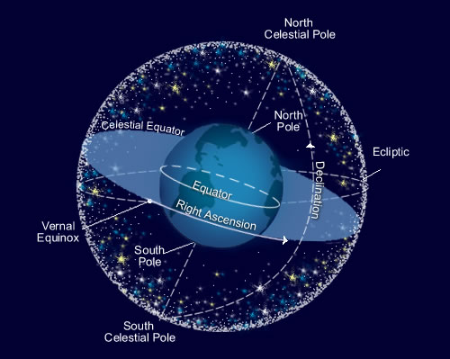
The Celestial sphere

Slide 2
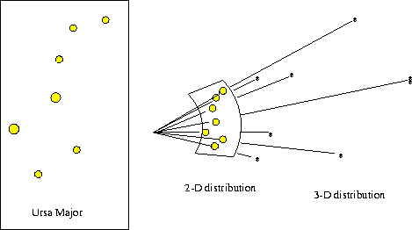
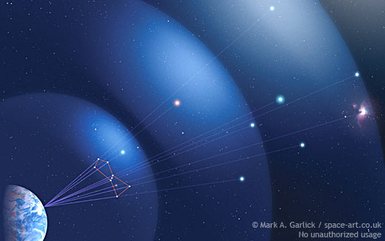
The Celestial Sphere is the imaginary sphere surrounding earth to which all the stars, planets, moons and sun appear to be attached.
Constellations are the areas that the sky is divided up into. There are 88 constellations in the whole celestial sphere.
Asterisms are found in the constellations; they are the pictures observed by man in the stars. These also appear to be on the celestial sphere.
1. The stars in a constellation are in the same general direction
2. The stars in a constellation are NOT the same distance from earth
Ursa Minor

Slide 4
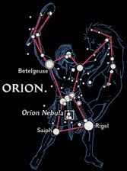
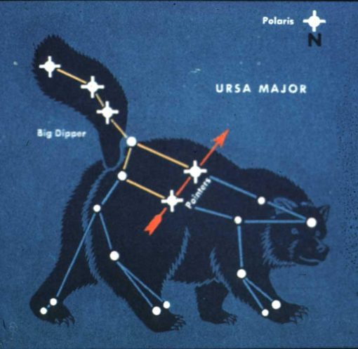
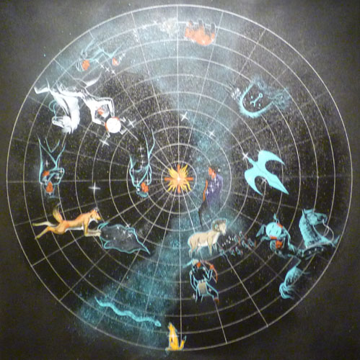
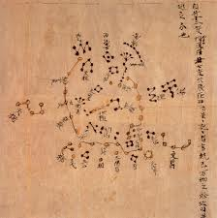
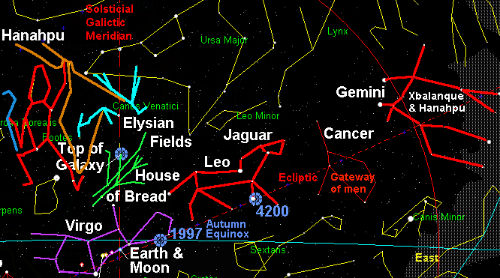
Different cultures used the asterisms in the constellations:
Greek and Roman
To explain history or stories
To worship gods
To honor ancestors
As calendars
As direction finders. We still use the stars for this today!
Navajo Constellations
Chinese
Mayan

Slide 5
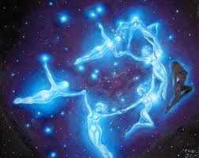
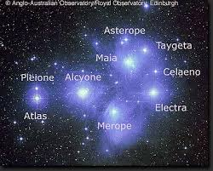
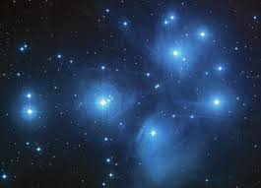
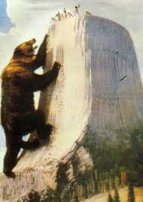
Pleiades

Slide 6
Polaris, The North Star
North Celestial Pole
C
My zenith
Apparent spin of the sky.
(We all know it is NOT spinning!)
East to West
The earth spins west to east
My sky
North Pole
equator
Celestial equator
earth
Axis
South Pole
My Horizon
Celestial sphere
South Celestial Pole

Slide 7
Polaris, The North Star
North Celestial Pole
Apparent spin of the sky.
(We all know it is NOT spinning!)
East to West
My zenith
Axis
My sky
North Pole
Celestial equator
equator
earth
Axis
South Pole
My Horizon

Slide 8
Polaris, The North Star
North Celestial Pole
Apparent spin of the sky.
(We all know it is NOT spinning!)
East to West
My zenith
Axis
My sky
North Pole
Celestial equator
equator
earth
My Horizon

Slide 9
Zenith
Observer’s sky
Polaris,
Celestial North Pole
Celestial Equator
axis
Observer’s horizon
Observer
The axis and the equator make a right angle!
The zenith and the horizon make a right angle too!

Slide 10
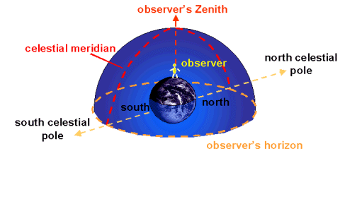

Slide 11
Everyone’s horizon and zenith are different, depending on the time of day,
position on earth, and time of year.
C
zenith
horizon
zenith
horizon

Slide 12
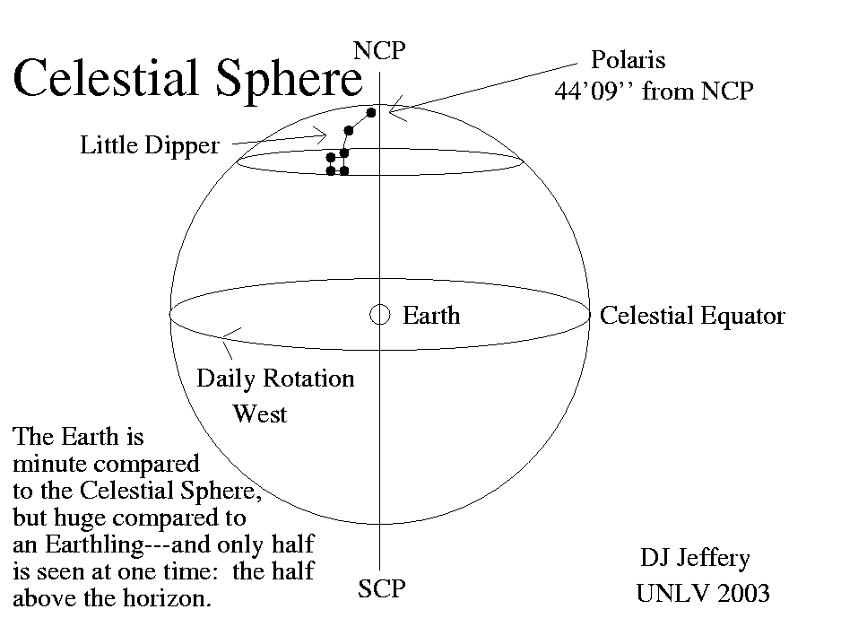

Slide 13
Define these terms:
Zenith
Celestial
Celestial Sphere
Horizon
Axis
Equator

Slide 14
Finish Your Notes
Be sure you have all the information from the PowerPoint and Lecture in your notes (5 POINTS)
Use your Cue Column for annotations. DO NOT LEAVE IT BLANK!!!!!! (5 POINTS)
Color code your notes and drawings with at least 3 colors(5 POINTS)
Write a Summary Paragraph of at least 5 sentences
(5 POINTS)
Write a Response Paragraph of at least 5 sentences (5 POINTS)
TOTAL POINTS POSSIBLE-25 POINTS

