Slide 1
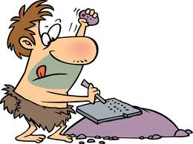
TAKING CORNELL STYLE NOTES
A guide to note-taking

Slide 2
You are required to take notes following the guidelines in this presentation.

Slide 3
The notes will be turned in and graded.

Slide 4
Your notes will be returned to you. You will put them in your notebook, in order!

Slide 5
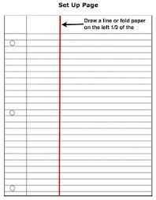
Set up your paper for note-taking
Title, Name and Date and hour
(on every page you write!)
Main body of notes
Annotations

Slide 6
Set up your paper
Name
Date
Hr/Class
Title
Using a ruler divide your paper as shown. In the picture. Between $1/4$ and $1/3$ of a page.
2. Write your heading in the upper right-hand corner.
3. Put the title on the top of the page
4. The Title, your name and date should go an every page. This helps keep everything in order.

Slide 7
TAKING CORNELL STYLE NOTES
A guide to note-taking

Slide 8
Name
Date
Hr/Class
Title
1. Write notes by copying the board,
PowerPoint, or the important parts
of a text
box
2. Draw relevant pictures/diagrams
3. Label the drawings or diagrams

Slide 9
Essential Questions
What are Cornell Notes?
What is the cue column used for?
How do these notes help me?
How will my notes be graded in Chemistry?

Slide 10
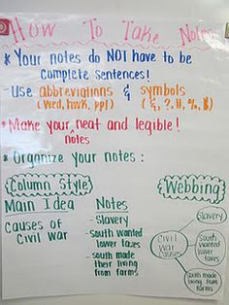
You do not have to copy the board, the power point or the book word for word!
Write the information so it means something to you and you can remember what you wrote!

Slide 11
ANNOTATIONS
Annotating keeps the reader engaged with the text. While you are reading or taking notes, use one or more of these strategies to mark the article you are reading or add to the notes from class. Annotations include your thoughts and questions.

Slide 12
Write annotations in the margins of the article or in an area of your paper set aside for annotations or on sticky notes if it is not possible to write on the article or book. Annotations can be:
Questions
Opinions
Comments

Slide 13
Where do you write the annotations for your notes?

Slide 14
The cue column or ‘extra column’.

Slide 15
THE CUE COLUMN
Questions
Main Ideas
Reactions
Inferences
Vocabulary
Drawings
Connections
Significant Items
The cue column is filled in after the notes are taken.
Sometimes, if you have a brilliant idea, you might want to jot it down quickly in the cue column before you forget it.
What goes into the cue column? See the list.

Slide 16
Write a few annotations in your cue column right now. Remember that you can also write them at the same time as you write the other notes, too.

Slide 17
Highlighting and color-coding
Use highlighters, colored pens or pencils, or crayons to color your notes.
Highlighting/ color-coding means:
Using color to emphasize certain, important words or paragraphs
Colored ■bullets or *stars or ●dots on lists
Differentiating passages or words from each other. Example: All vocabulary is blue
Boxes, circles, squiggles etc. drawn around passages to make them stand out for remembering

Slide 18
Highlighting/color-coding does NOT mean:
Using your highlighter to draw lines through all the text so it is pink (or green or yellow)
Randomly coloring words so it looks like you did something
Writing everything in red colored pen or blue pencil
Color-coding should MEAN something to YOU!

Slide 19
Color-coding notes
The following slides will show you some techniques of color-coding your notes.
There are also slides on ‘visual note-taking’ which is a pictorial method of note-taking that also uses color.
You must use at least 3 colors on your notes in my class.
The coloring is up to you but it must be MEANINGFUL! Not just a random blob of color.

Slide 20
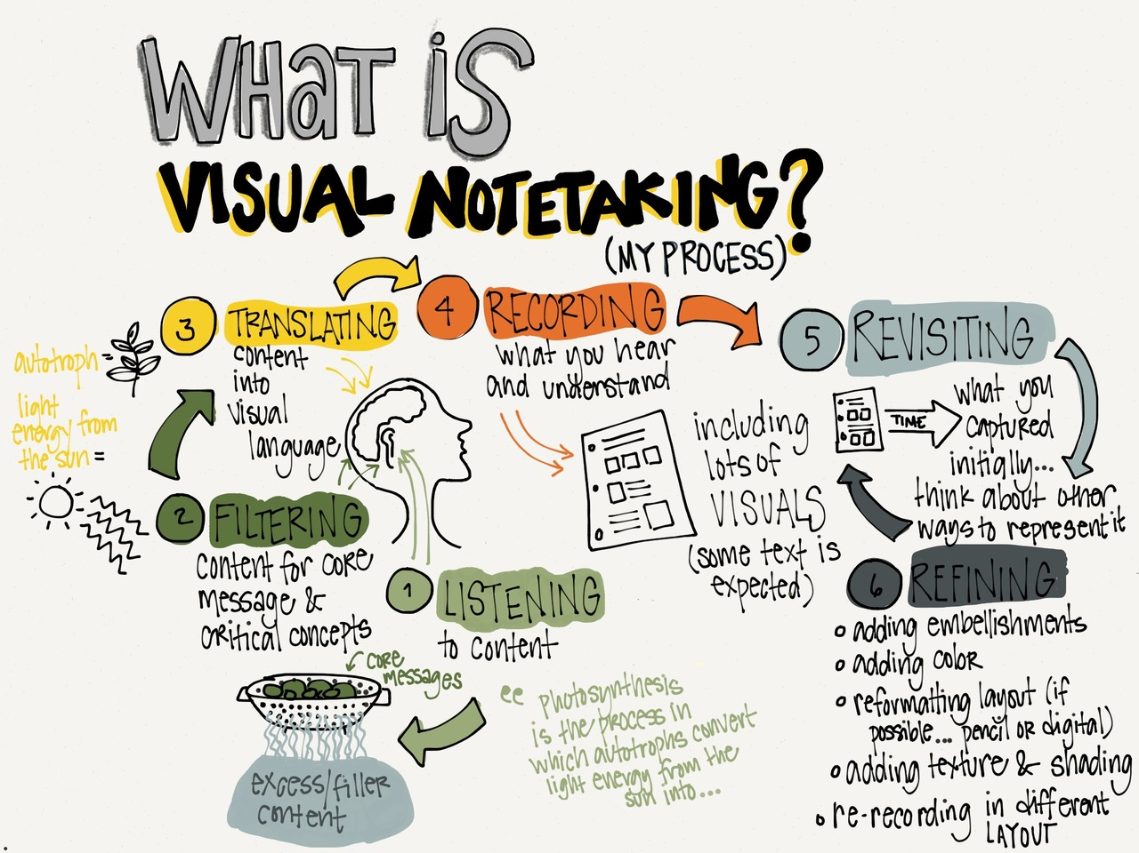

Slide 21
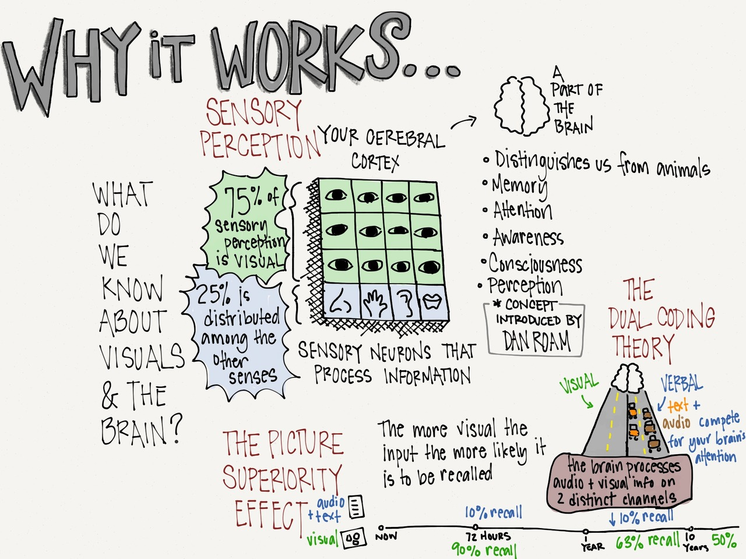

Slide 22
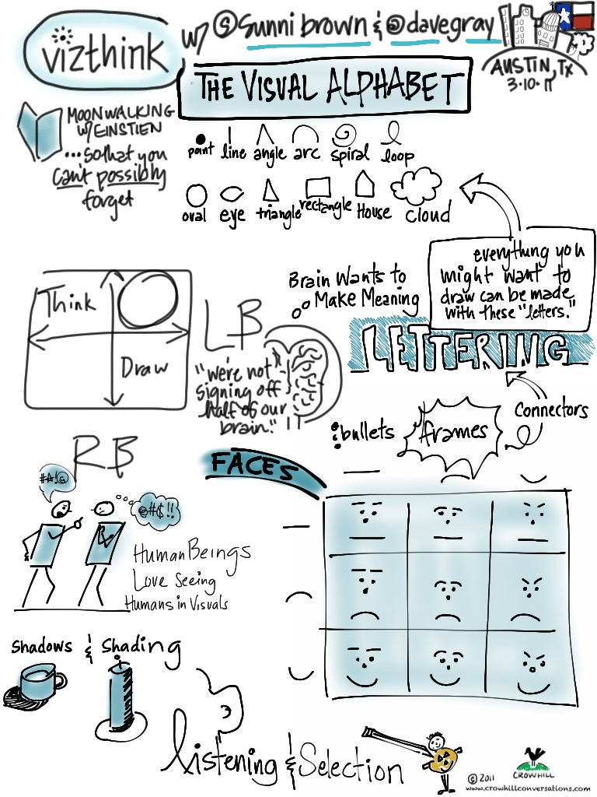

Slide 24
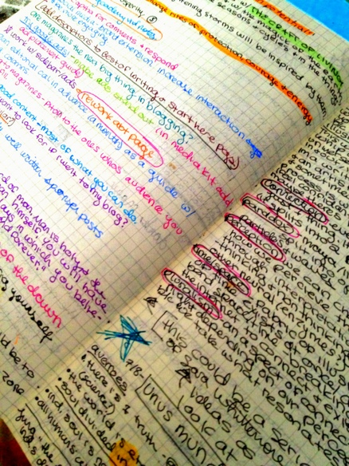
The student highlighted these passages when they re-read the notes for emphasis
Colored circles to help an item stand out
Different colors for items in a list to differentiate them
Vocabulary words circled in color
New day marker to help find beginning and end of notes

Slide 26
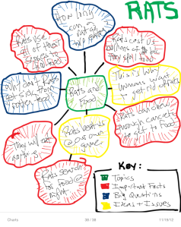
Sometimes, a key helps us to make sense of our notes and the colors we choose.

Slide 27
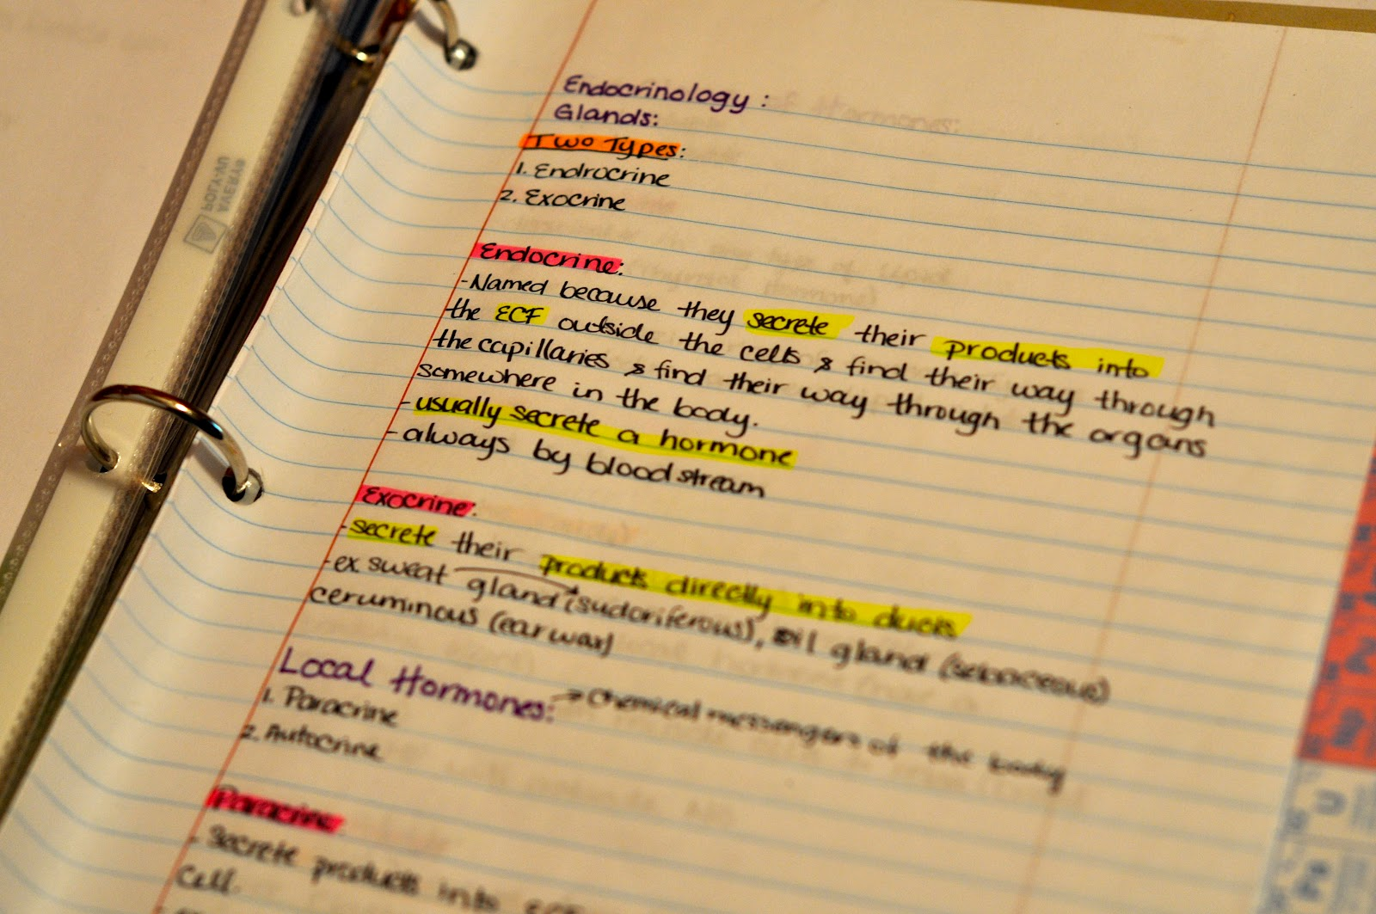

Slide 28
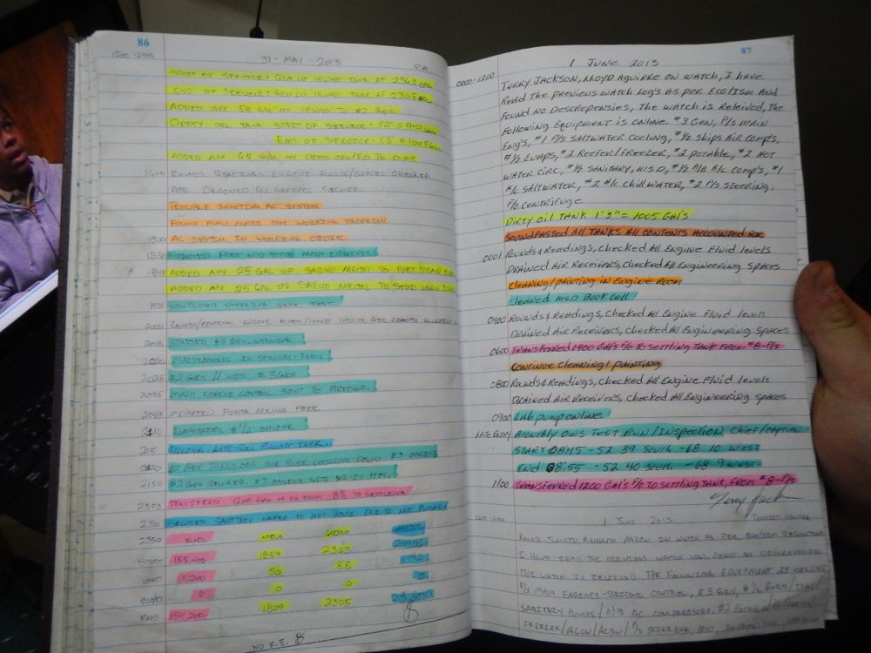

Slide 29
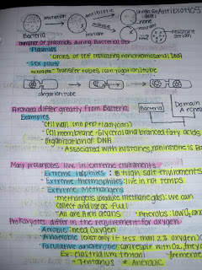
Even with only 3 colors, you can really make a difference in your notes.

Slide 30
Choosing your style
Whether you decide to take your notes in a visual style, or more traditional, is purely a personal choice. What makes more sense to you?
Remember, notes are for YOU, not the teacher!
As you practice with the different methods, find the way that helps you most.
You can change your method from one set of notes to the next. You will be graded on taking notes, not which form you use.

Slide 31
Finishing up!
When your notes are completed, you will summarize what you learned in the lesson in a SHOW ME paragraph in your own words.
Be careful! Don’t say, “We learned about . . . .” ‘We learned about the sun today.’ will not help you study for a test!
Be specific, think of the summary or SHOW ME as a cheat sheet. Tell details.
You will also write a “Response or Reflection Paragraph”.
You will summarize your annotations inferences, connections and reactions to the notes in this paragraph.
This is also where you can evaluate the lesson or your understanding of the material.
The following slides will discuss these 2 paragraphs in more detail.

Slide 32
SUMMARY or
SHOW-ME PARAGRAPHS
When you re-read your notes to add annotations and color, mark the main ideas.
These main ideas can be used to write your summary paragraph.
Be specific, but not too detailed. You want to review what you learned and not just mention the topic. Writing that you ‘learned about’ something will not help you study!
Imagine you are going to have a quiz over the topic and you can bring a 3 x 5 card or a post-it note to the quiz as a cheat sheet, what would you write?

Slide 33
RESPONSE/
REFLECTION PARAGRAPHS
Response or Reflection paragraphs are your thoughts about the subject. This is where you make connections to your life or experiences. You can use your annotations to help.

Slide 34
Connecting in this way helps you remember the material and you can see what impact the knowledge has on your life. In this class we will write response paragraphs for:
Notes
Articles
Dialectical Journals *
*A dialectical journal shows your conversation with a movie or text. It is used to question, make connections, and explore ideas you had as you watch the movie or read the article or book.
Other assignments

Slide 35
These are sentence starters for your responses or annotations. You can use more than one in a response. You don’t have to use them but they can help you.
I guess/predict/imagine that. . .
This part about ____ makes me wonder . . .
These are similar because. . .
These are different because. . .
What would happen if . . .
Why . . .
I think/believe that . . .
I think this section about ________ means . . .
This reminds me of. . .
This part is like . . .
This is similar to . . .
The differences are. . .
I also . . .
.
I never . . .
This topic reminds me of . . .
This is good because . . .
This is hard because . . .
This is confusing because . . .
I like the part where . . .
I don’t like this part because . . .
My favorite part so far is . . .
I think that . . .
Oh, I get . . .
Now I understand . . .
I will remember ____ because it reminds me of . .

Slide 36
Grading the notes
You will be graded in this manner. Do your notes have:
1. A copy of the notes the teacher provided
including heading and title 5pts
2. Color coding of the notes with at least 3 colors 5pts
3. Filling in the cue column 5pts
4. A summary or SHOW ME paragraph (or equivalent) 5pts
5. A Response or Reflection paragraph (or equivalent) 5pts
Total points possible 25pts

Slide 37
Putting note-taking into practice

Slide 38
Annotations
Now that you have written the notes from the presentation, lets practice finishing them.
Re-read your notes. Add some more annotations in the annotation column.

Slide 39
Color code the notes
With at least 3 different colors, re-read your notes and add color to the parts that you:
Want to remember
Think are important
Need help in identifying
Think should be different form the rest for one reason or another
Remember, you should know why you colored or marked something

Slide 40
Write a Summary and Response
Summary/Show Me
First, think of the most important things you learned in these notes. Re-write them in YOUR OWN WORDS in some way that you can remember and understand.
Be thorough, and don’t leave anything out
But also, don’t just copy.
Remember DO NOT WRITE, “We learned about . . .”
Response/Reflection
Using one or more of the sentence starters in these notes, or use the annotation hints from the previous lesson, write a response, telling what you think about these notes.
This is where you put down connections your brain makes with the material.

Slide 41
Turn in your work!
You should have a great set of notes on note-taking now.
Be sure your name, date and title are on ALL pages to avoid losing them
Turn in these notes.
They will be graded according to the guidelines I gave you.

