Slide 1
Star Spectra (part 1)
How do we use spectra to tell us about the stars?
What can spectra tell us?

Slide 2
The Sun’s Spectrum
Notice the elements identified by the absorption lines.

Slide 3
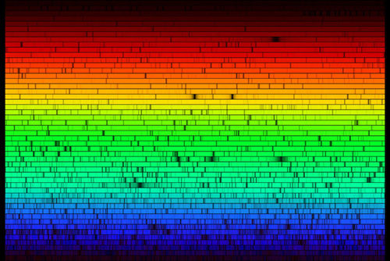
This is a more detailed view of the sun’s spectrum.

Slide 4
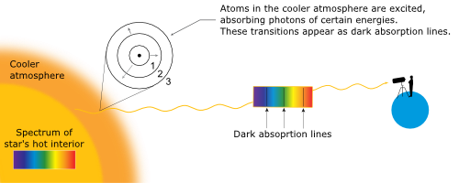
Why does the sun have an absorption spectrum?
5800 K
Continuous spectrum in interior
93,000,000 K

Slide 5
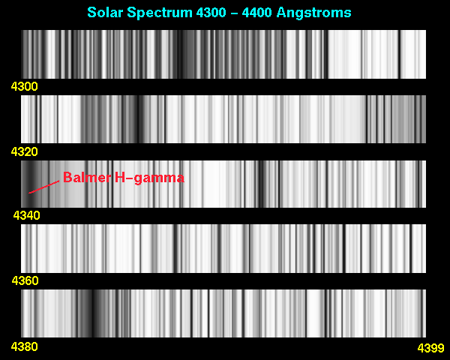
Solar Spectrum
Because Scientists are only looking for the lines, they usually use just a black and white printout showing the wavelengths.

Slide 6
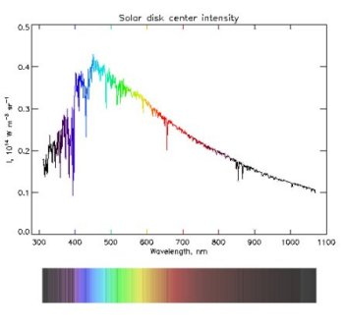
Other ways to view spectra
Sometimes, scientists use a more detailed graph representation of the spectrum. It gives them more information.
Every dip, or lowering in the intensity is an absorption line

Slide 7
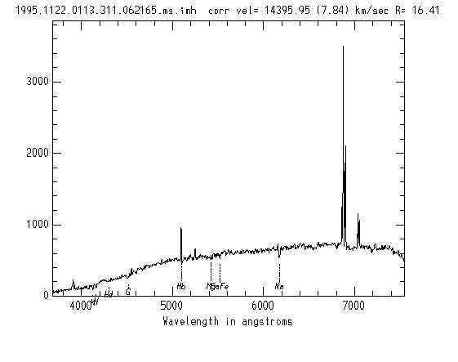
Emission lines show as spikes in intensity

Slide 8
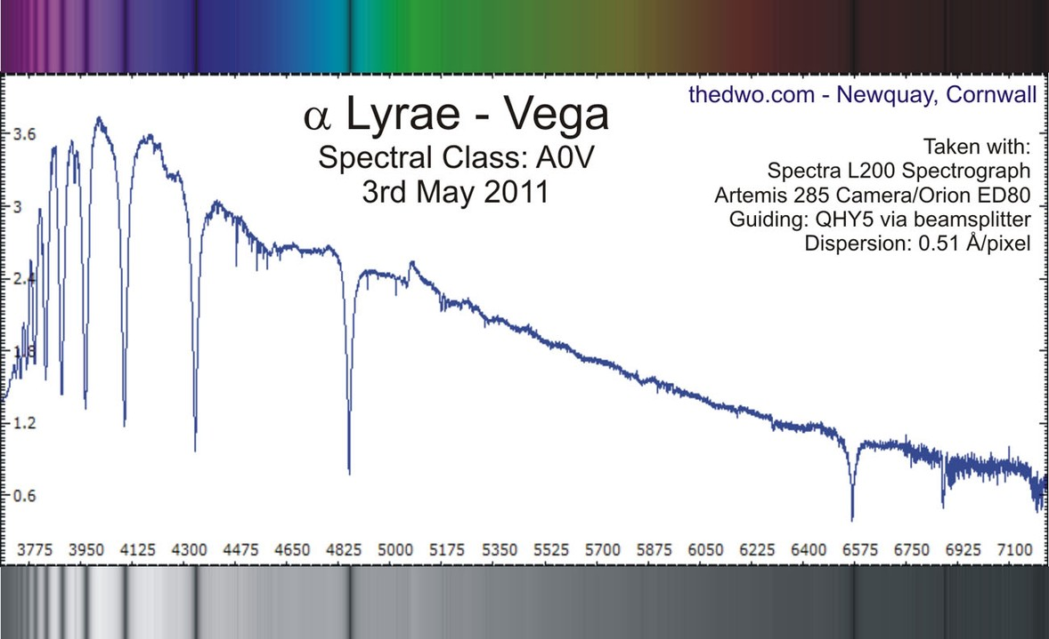
Absorption lines show as dips in intensity
Intensity
Wavelength

Slide 9
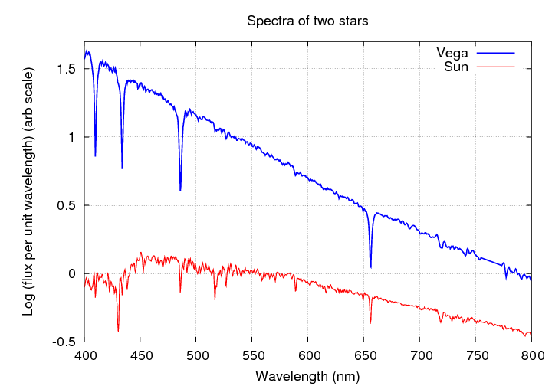
Spectra of 2 stars: Vega and the Sun

Slide 10
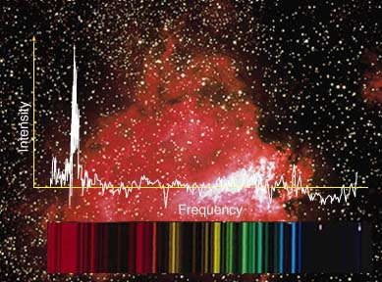
Actual Spectrum from a cosmic object

Slide 11
Spectral Line Analysis
What can spectra from Cosmic objects tell us?

Slide 12
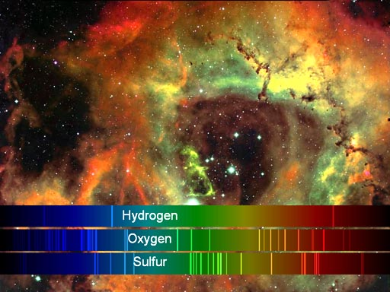
Spectral Lines Present
By observing the lines that are present in a spectrum we can tell what elements are present in the object we are observing.

Slide 13
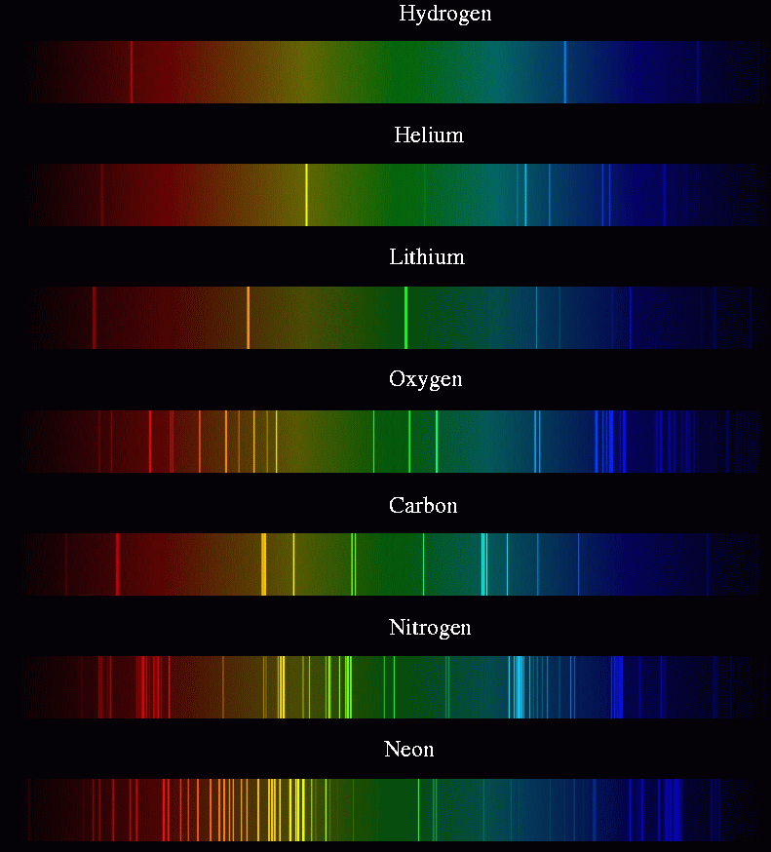

Slide 14
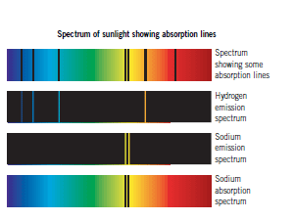
By comparing the emission spectra of known elements to the absorption spectra of a star, we can describe the composition of that star.

Slide 15
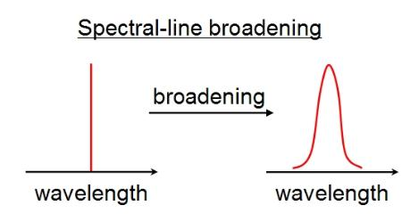
Line Broadening
Normal Spectrum
Spectrum with broadened lines
In graph form

Slide 16
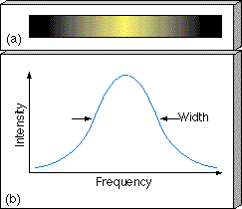
Sometimes the spectral lines are broader than normal. This broadening can be caused by different things.

Slide 17
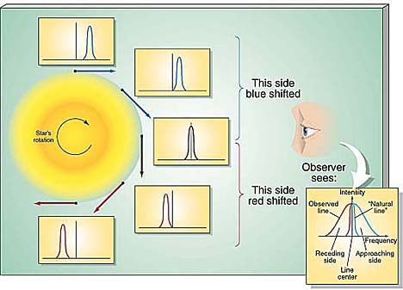
Rotation
Line broadening can be caused by a star’s rotation.
Moving toward
Moving away

