Slide 1
Star Spectra
How do we use spectra to tell us about the stars?
What can spectra tell us?

Slide 2
The Sun’s Spectrum
Notice the elements identified by the absorption lines.

Slide 3
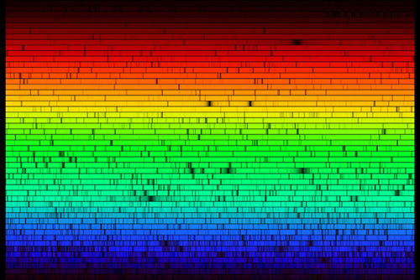
This is a more detailed view of the sun’s spectrum.

Slide 4
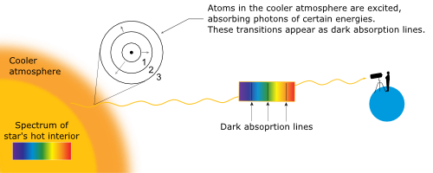
Why does the sun have an absorption spectrum?
5800 K
Continuous spectrum in interior
93,000,000 K

Slide 5
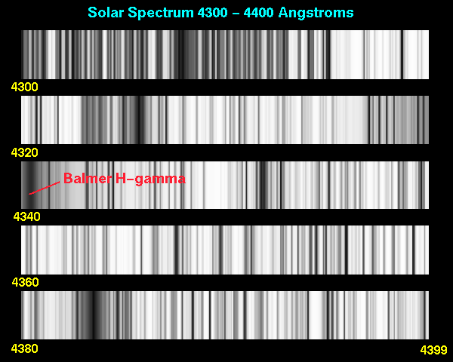
Solar Spectrum
Because Scientists are only looking for the lines, they usually use just a black and white printout showing the wavelengths.

Slide 6
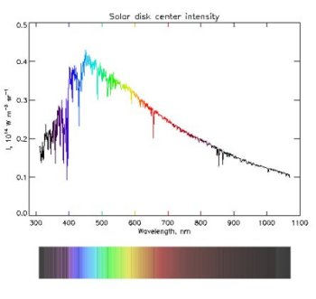
Other ways to view spectra
Sometimes, scientists use a more detailed graph representation of the spectrum. It gives them more information.
Every dip, or lowering in the intensity is an absorption line

Slide 7
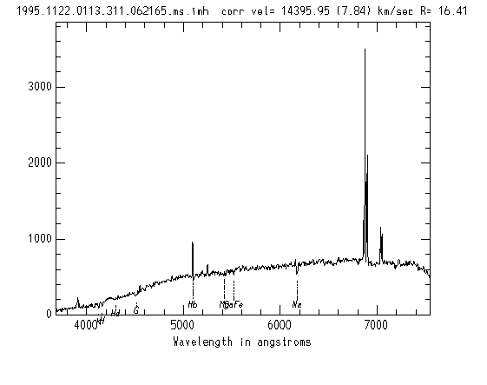
Emission lines show as spikes in intensity

Slide 8
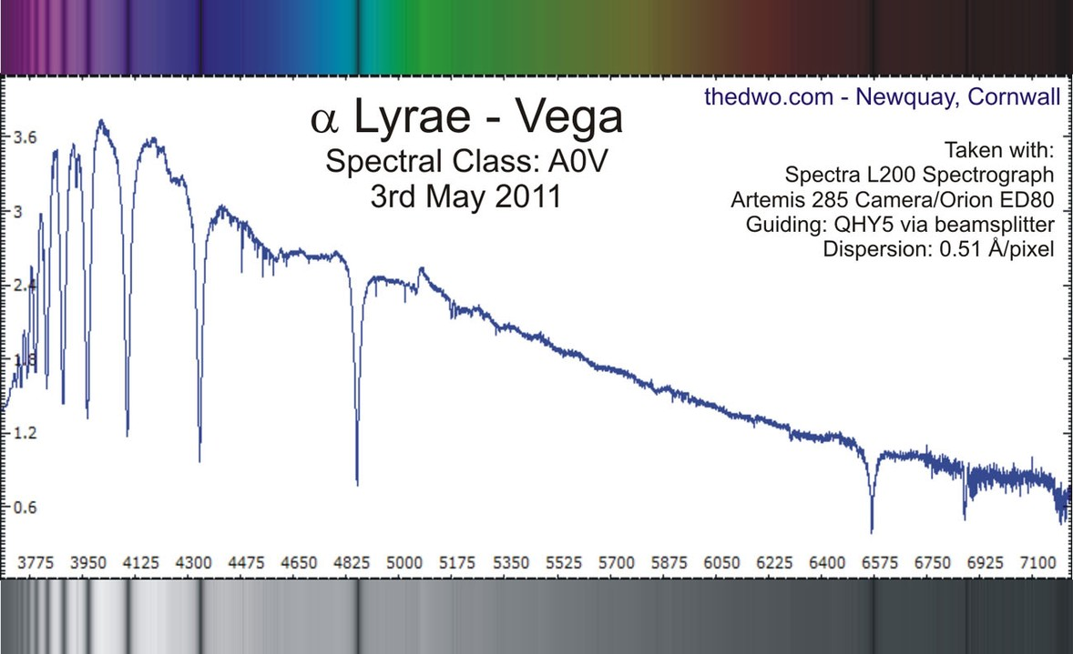
Absorption lines show as dips in intensity
Intensity
Wavelength

Slide 9
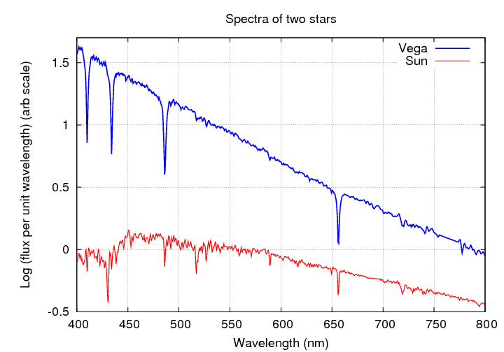
Spectra of 2 stars: Vega and the Sun

Slide 10
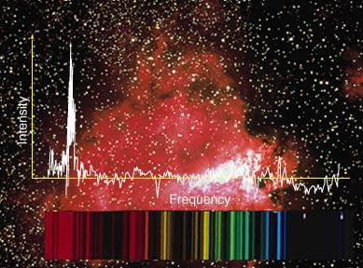
Actual Spectrum from a cosmic object

Slide 11
Spectral Line Analysis
What can spectra from Cosmic objects tell us?

Slide 12
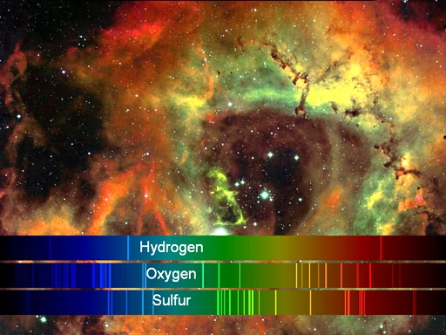
Spectral Lines Present
By observing the lines that are present in a spectrum we can tell what elements are present in the object we are observing.

Slide 13
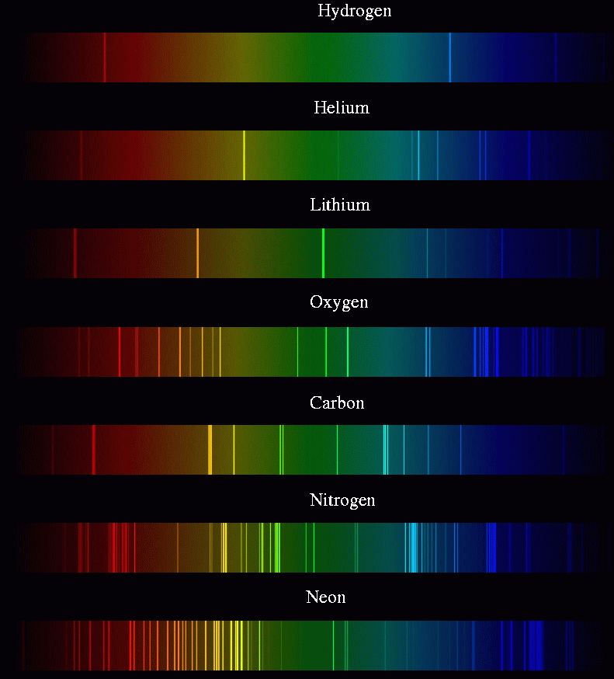

Slide 14
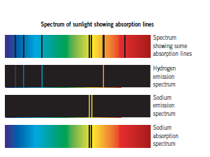
By comparing the emission spectra of known elements to the absorption spectra of a star, we can describe the composition of that star.

Slide 15
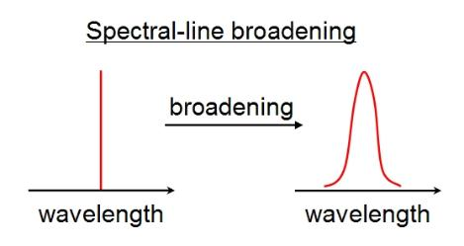
Line Broadening
Normal Spectrum
Spectrum with broadened lines
In graph form

Slide 16
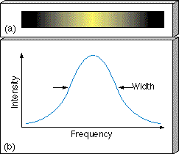
Sometimes the spectral lines are broader than normal. This broadening can be caused by different things.

Slide 17
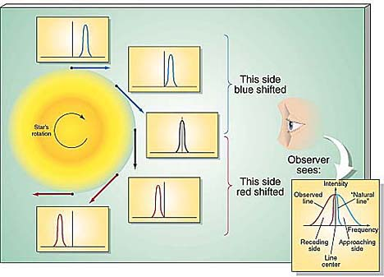
Rotation
Line broadening can be caused by a star’s rotation.
Moving toward
Moving away

Slide 18
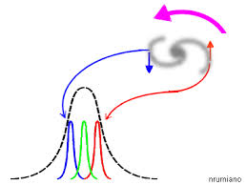

Slide 19
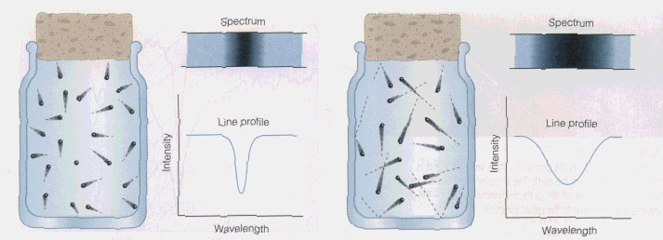
Temperature
Hotter gas, the particles move faster
Cooler gas, the particles move slower
This random motion of individual particles will give off individual red or blue Doppler shifts.
Thus, hotter gases will produce broader lines.
cooler
hotter

Slide 20
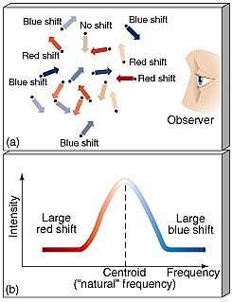
TEMPERATURE
BROADENING

Slide 21
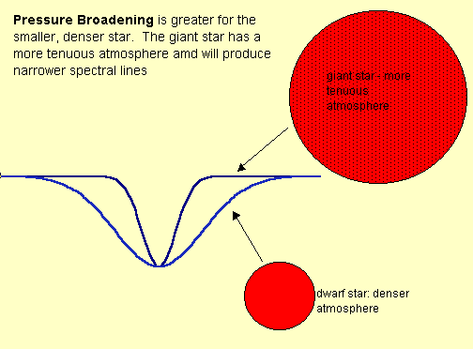
High Pressure (Caused by small star size with high density)
High Pressure of a star can increase the density of the atmosphere, which in turn can cause line broadening in spectra.

Slide 22
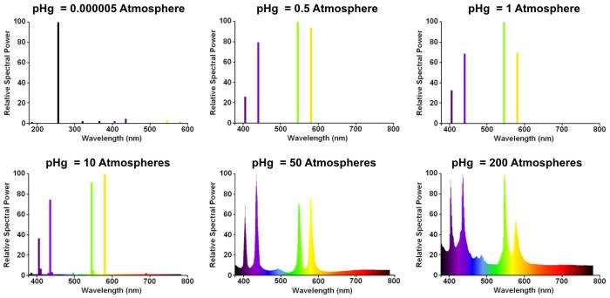
Pressure effects
Comparing Thin to Thick atmosphere

Slide 23
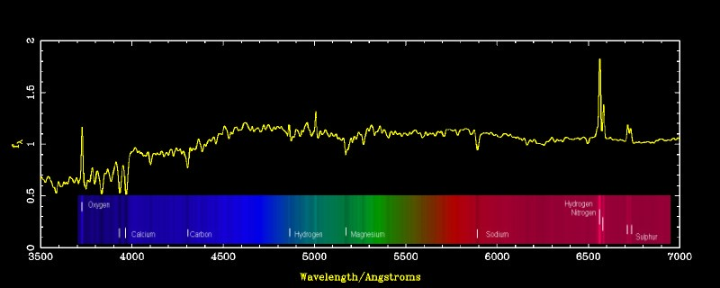
Spectral Line Intensity
Some lines have more intensity than others. We can see this on the graph as height and on the spectrum as brightness or dimness.

Slide 24
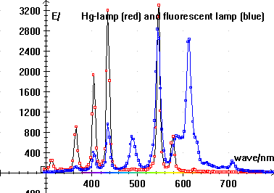
High intensity lines
Low intensity lines

Slide 25
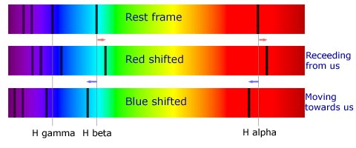
Doppler Shift
If an object is moving toward us or away from us the whole spectrum is shifted.
The amount of shift tells the speed. Large shift means greater speed, small shift means smaller speed.

Slide 26
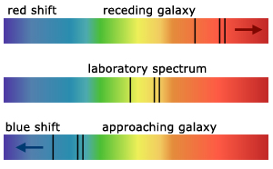
Spectral view

Slide 27
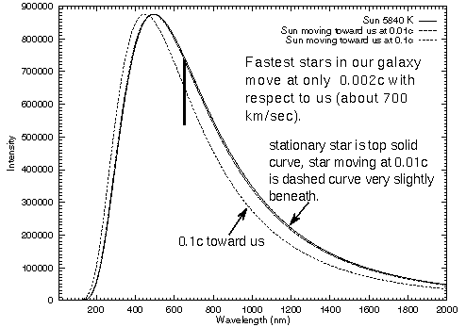
Graph view

Slide 28
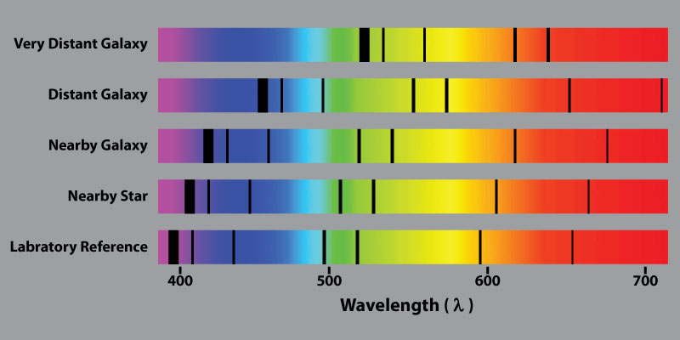
As we get farther from the sources, the speed increases according to the Doppler Shifts of their Spectra.

Slide 29
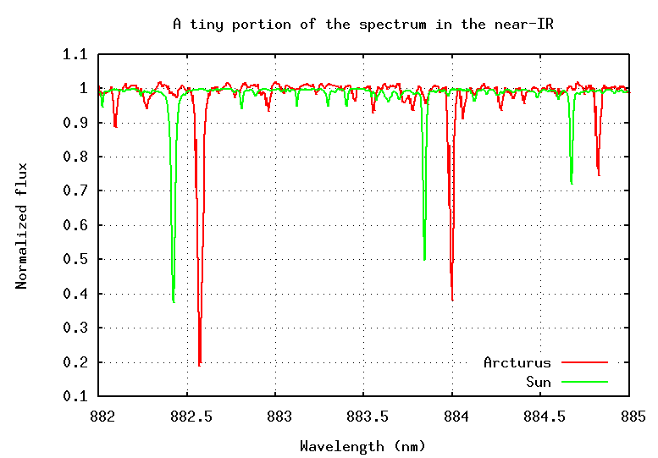
Arcturus is a star with similar composition to the sun, but its Doppler shift shows that it is moving away from us. (Or we are moving away from it!)

Slide 30
Observed Spectral Characteristic | Information Provided
Peak Frequency or wavelength (Continuous Spectra Only) | Temperature (Wien’s Law)
Lines Present in the Spectrum | Composition, Temperature
Line intensities | Temperature, Composition
Line width | Temperature, turbulence, rotation speed, density, magnetic field
Doppler Shift | Line-of-sight Velocity

Slide 31
Using this information we can tell a lot of information about the stars, galaxies, nebulae and other astronomical objects.

Slide 32
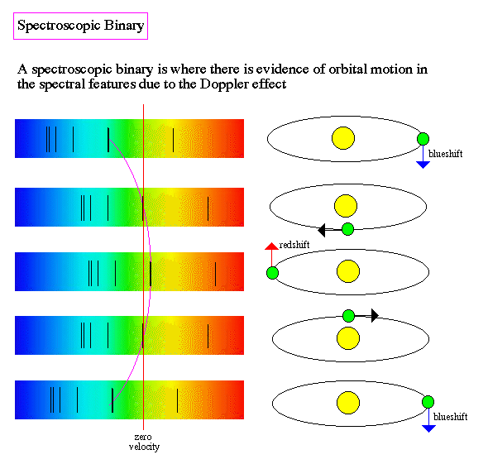
Binary Stars
Binary Stars- Stars that rotate around each other.
We can use spectroscopy techniques to find and identify binary stars

Slide 33
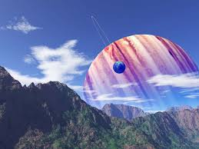
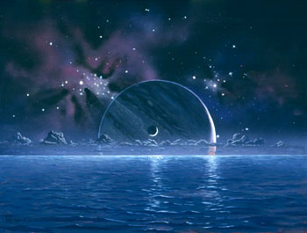
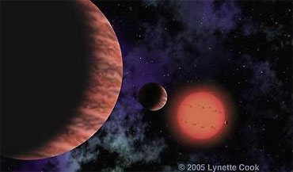
Extra-solar Planets
An ‘extra-solar planet’ is a planet that orbits a star other than the sun

Slide 34
Why do scientists look for ‘extra-solar planets?
Scientists are looking for other life in the universe.
Scientists are also looking for other inhabitable planets that we may one day want to colonize.
Scientists want to study planetary formation in other systems to see if our planets are unique in the way they formed and if there are other ways out there.
New planets would give us so much more information about our planet and the universe we live in.

Slide 35
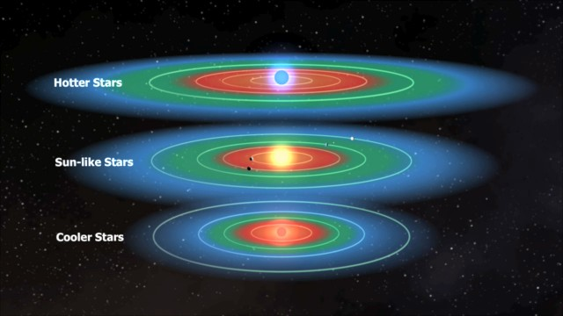
The Goldilocks Zone This is where we think habitable planets may lie in orbit around their suns. We theorize that these planets have the best chances of supporting life.

Slide 36
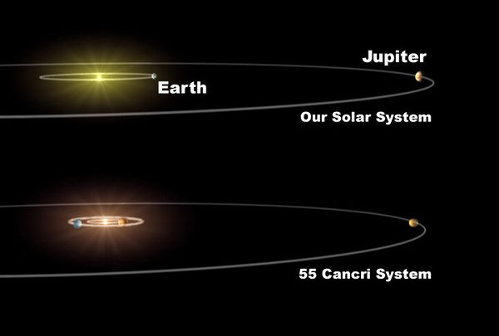
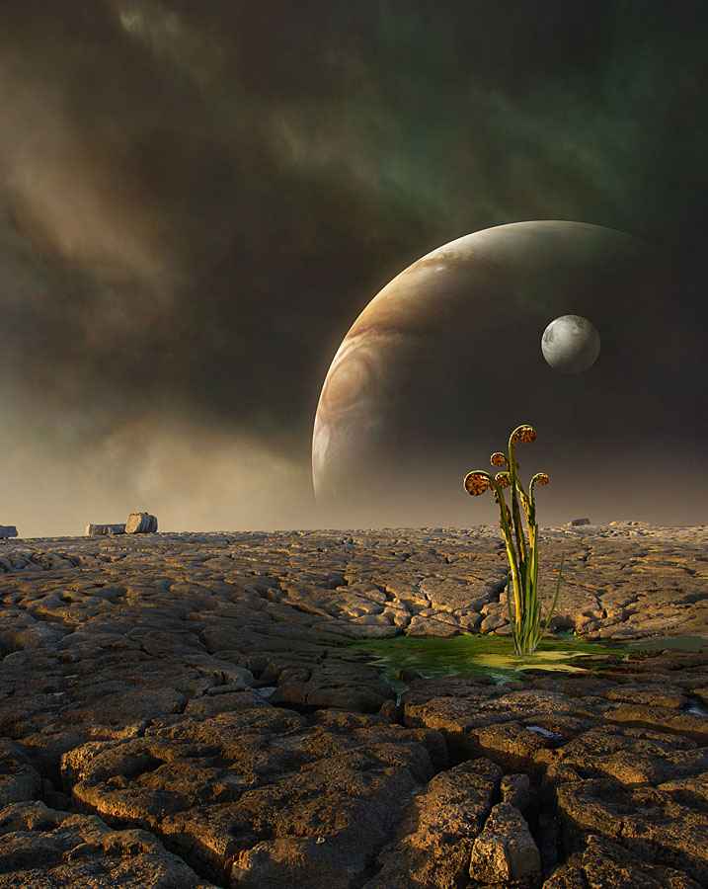
This drawing compares our system with the system “55 Cancri” where a planet was discovered

Slide 37
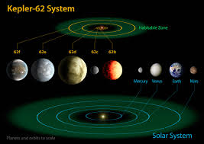
This is a comparison of the Kepler-62 system and the Solar sytem.

Slide 38
We use different techniques to find and identify ‘extra-solar planets’
Absorption lines caused by a planet in front of a distant star
Spectral line intensity decreases
Slight red and blue shifts that indicate ‘wobble’ between the planet and star

Slide 39
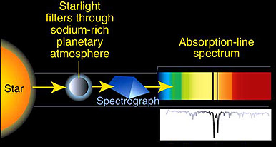
Absorption lines of the star’s spectrum.
Absorption lines change when the planet is in front of the star. The planetary atmosphere absorbs some of the star’s wavelengths

Slide 40
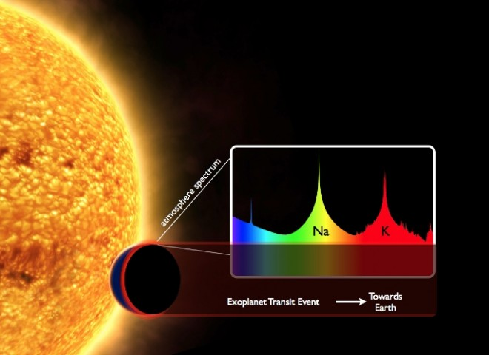

Slide 41
Once the spectra of both the planet and the star have been identified and isolated we can tell what elements are in the planet.
The spectrum gives us information about the composition, density and size of the planet
Scientists can speculate about what the planet could look like.

Slide 43
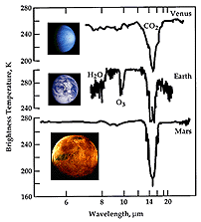
Planetary Atmospheres
We can detect the elements in a planet’s atmosphere with spectral analysis.

Slide 44
Spectral line intensity
With a planet either blocking the star or not, the intensity of the wavelengths that reach the earth fluctuate with the planet’s orbit around the star.

Slide 45
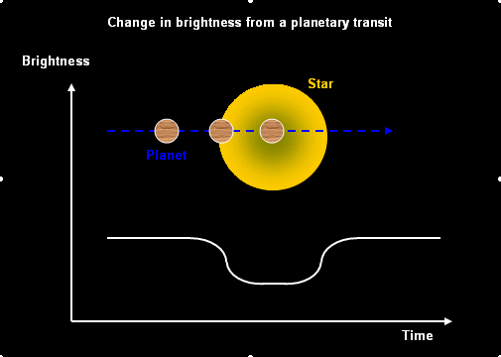
Spectral line intensity decreases slightly when a planet goes in front of the star.

Slide 46
We can use the 2 previous techniques together as shown in the next slide.

Slide 47
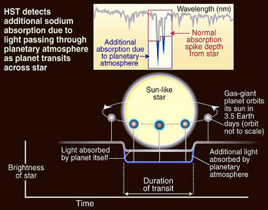

Slide 48
Using the information
By analyzing the time it takes the planet to cross in front of the star, we can calculate
The planetary orbital period
The distance the planet is from the star
The speed the planet is traveling in its orbit.

Slide 49
Gravity will cause a planet-star system to wobble.
Even if there is no other evidence of a planet, the effects of a planet’s gravity can be seen a slight red- and blue-shift of the planet-star system.
If there is no other explanation for a star’s wobble, it could be a planet.

Slide 50
Red and blue shifts caused by the wobble
The star is pulled by the planet just enough to change its distance from the earth
This is evident in the slight red and blue shifts seen in a star’s spectrum.
Gravity isn’t just a large object acting on a small object. Gravity is the pull of anything with mass on other things with mass.
The planet and star pull on each other. The star pulls more because it has more mass.

Slide 51
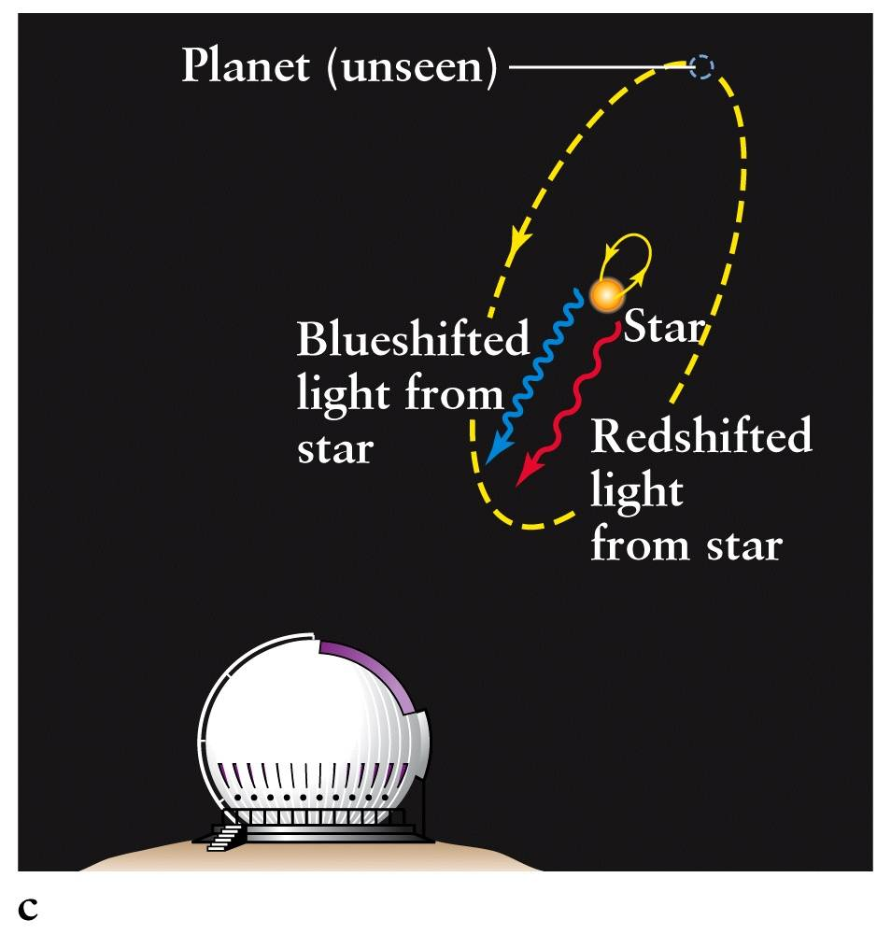
The gravitational effects of a planet orbiting a star cause the star to ”wobble”, which is seen as slight blue-and red-shifts.

Slide 52
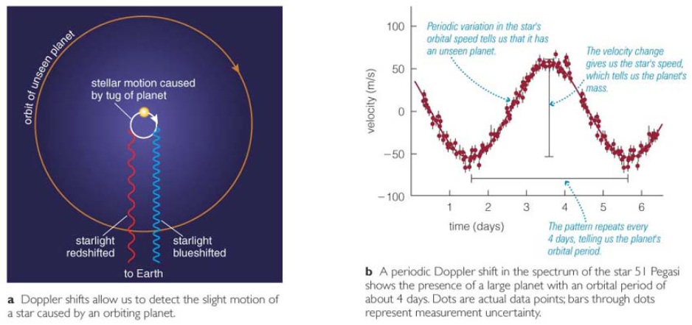

Slide 53
In conclusion
Because the only thing that reaches earth from the stars is the light of the stars, scientists have learned to interpret that light to get as much information from it as possible.
With only the light from distant stars, galaxies and nebulae, we have learned an enormous amount about our vast universe.

Slide 54
Review Questions
What information can we tell from star spectra?
What can spectral line broadening tell us?
What does the Doppler shift tell us?
What is an ‘extra solar planet’?
What different methods do astronomers use to search for ‘extra solar planets’?
Why do we want to know about other planets?

Slide 55
Complete your notes
Write annotations; use pages 97-101and pages 393-399 in the Astronomy book to add information to your notes. Be sure to write the page numbers by the information you add.
Color code your notes, color your drawings.
Write a summary paragraph.
Write a response paragraph.

