Slide 1
Spectra
How are spectra formed?
What are the 3 different types of spectra?
What can spectra tell us?

Slide 2
spec·trum ˈspektrəm/ noun
1. a band of colors, as seen in a rainbow, produced by separation of the components of light by their different degrees of refraction according to wavelength.
the entire range of wavelengths of electromagnetic radiation.
an image or distribution of components of any electromagnetic
radiation arranged in a progressive series according to
wavelength.
an image or distribution of components of sound, particles, etc.,
arranged according to such characteristics as frequency, charge,
and energy.
2. used to classify something, or suggest that it can be classified, in terms of its position on a scale between two extreme or opposite points.

Slide 3
Producing spectra
Using a spectroscope will separate light into its corresponding spectra.
A spectroscope works by:
Allowing a source of light to enter a narrow, slit-like opening
Having it pass through a prism or diffraction grating
And the result projected onto a screen for viewing.

Slide 4
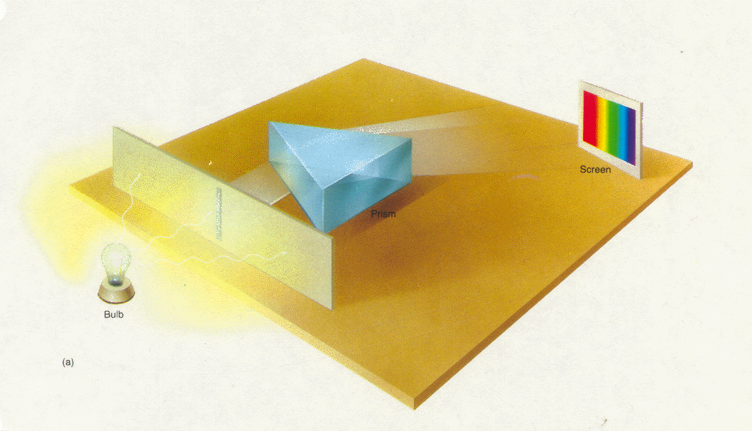
Spectroscope Diagram
Prism
Narrow opening
Screen
Light source

Slide 5
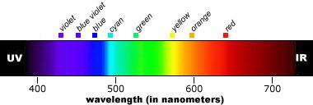
Kirchhoff's Laws
Continuous Spectrum
First Law: A hot solid, liquid, or dense gas emits radiation at all wavelengths ("a continuous spectrum of radiation").

Slide 6
Kirchhoff's Laws
Emission Spectrum
Second Law: A low density hot gas in front of a cooler background emits radiation at a discrete set of isolated wavelengths.
These discrete, isolated wavelengths are called the "emission lines" of the spectrum. The whole spectrum is called an "emission-line" spectrum.
The wavelengths of the emission lines are unique to the type of atom that is producing the emission lines.

Slide 7
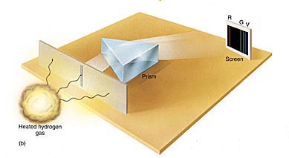
Producing an Emission Spectrum

Slide 8
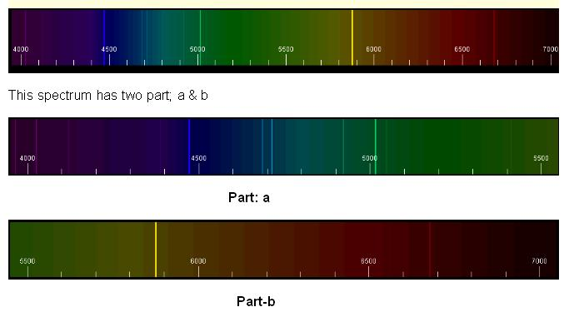
Emission lines
Sometimes the emission lines are just brighter areas against a pale or dimmer, background, not black.

Slide 9
Kirchhoff's Laws
Absorption Spectrum
Third Law: A thin cool gas in front of a hotter solid, liquid, or dense-gas background removes the radiation from the background source at special wave lengths.
The spectrum is dark lines superimposed on the continuous band of colors due to the background. These dark lines are called "absorption lines.“
The wavelengths of the absorption lines are unique to the type of atom that is producing the emission lines.

Slide 10
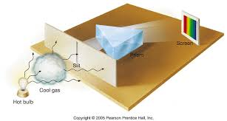
Producing an Absorption Spectrum

Slide 11
Absorption Lines
Sometimes the absorption lines are not black, just paler or grayer than the surrounding wavelengths.

Slide 12
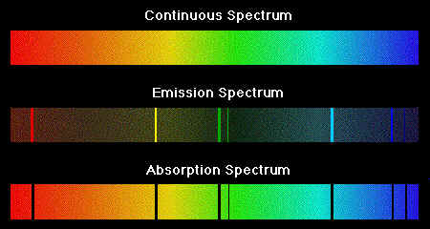

Slide 13
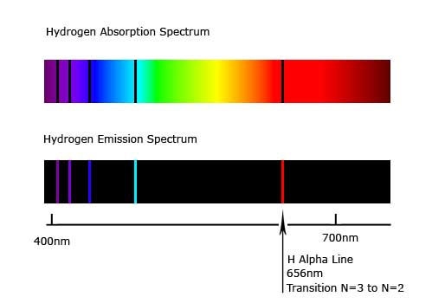
Absorption and Emission Lines
If a certain type of gas produces absorption lines at certain wavelengths when it is in front of a hot background, then when that same type of gas is seen in front of a cooler background, it produces emission lines at the exact same wavelengths.

Slide 14
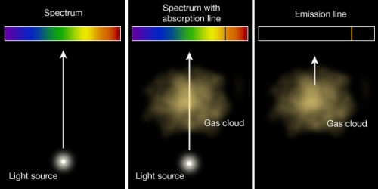
Cool
Hot
Star
Star
1st Law
3rd Law
2nd Law

Slide 15
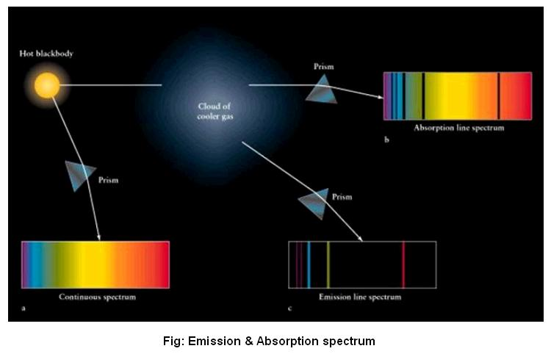

Slide 16
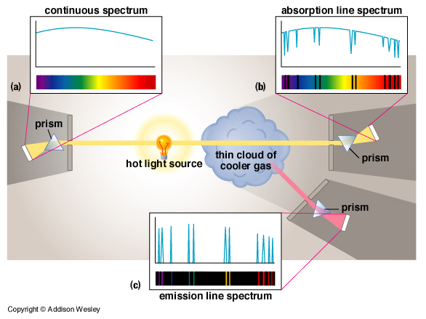

Slide 17
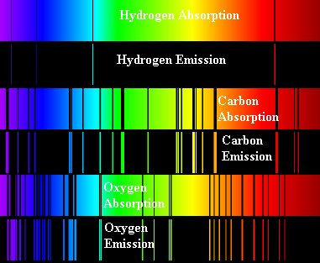
Identifying elements

Slide 18
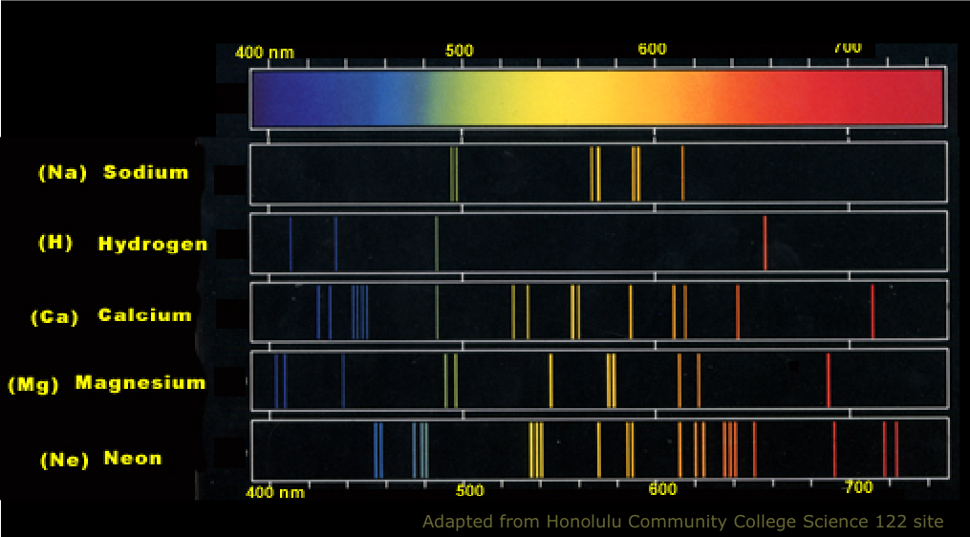
More elements

Slide 19
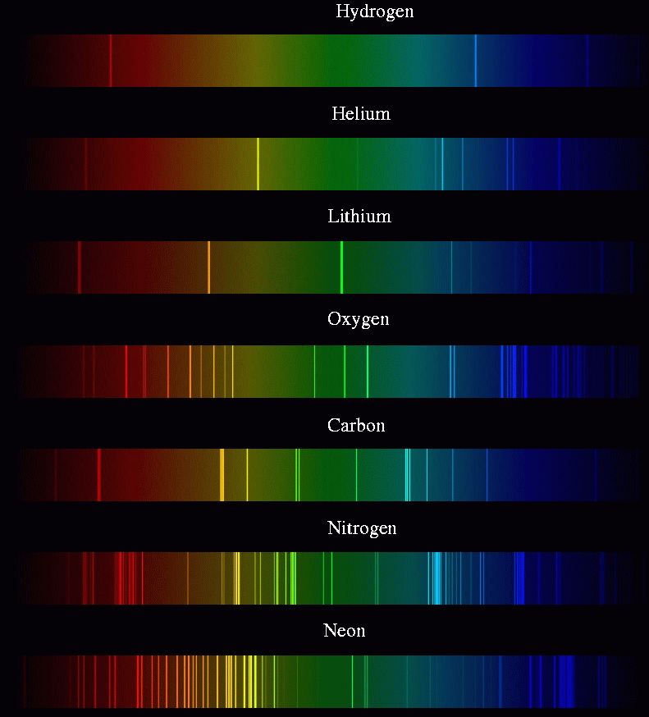

Slide 20
The Sun’s Spectrum
Notice the elements identified by the absorption lines.

Slide 21
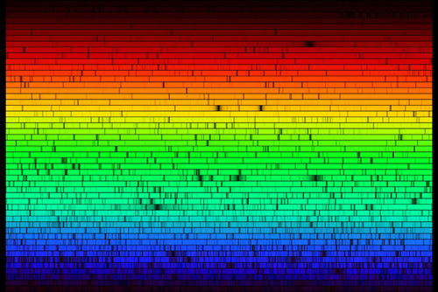
This is a more detailed view of the sun’s spectrum.

Slide 22
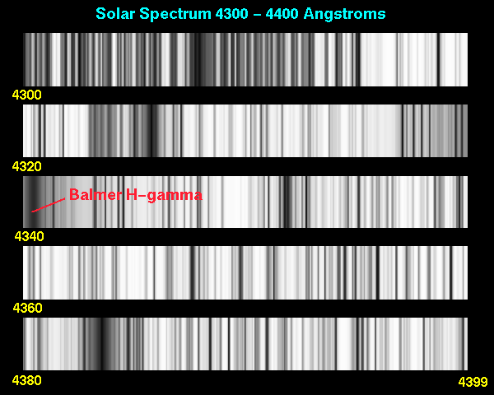
Solar Spectrum
Because Scientists are only looking for the lines, they usually use just a black and white printout showing the wavelengths.

Slide 23
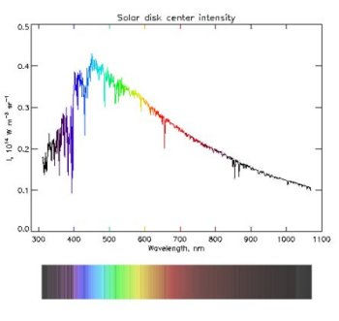
Other ways to view spectra
Sometimes, scientists use a more detailed graph representation of the spectrum. It gives them more information.
Every dip, or lowering in the intensity is an absorption line

Slide 24
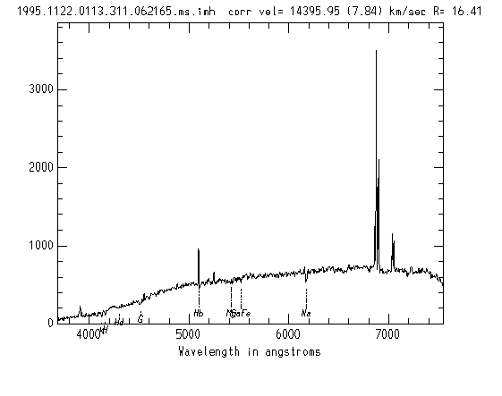
Emission lines show as spikes in intensity

Slide 25
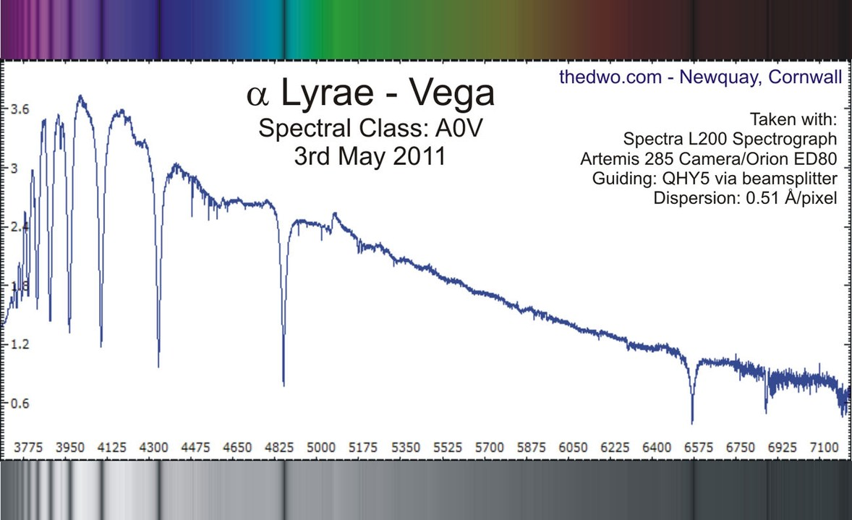
Absorption lines show as dips in intensity

Slide 26
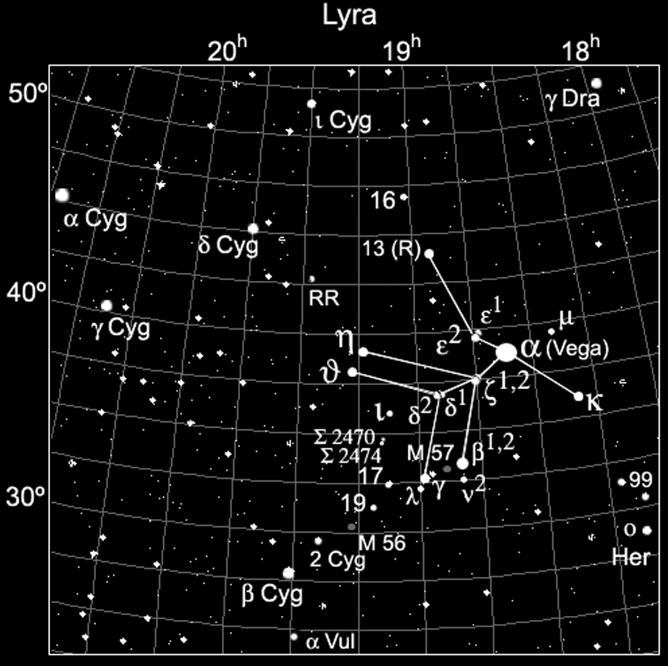

Slide 27
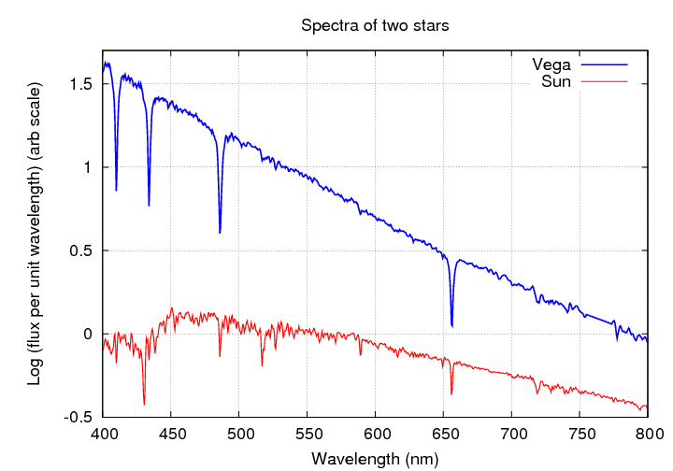
Spectra of 2 stars: Vega and the Sun

Slide 28
Conclusion
What are Kirchhoff’s 3 laws?
What are the 3 different types of spectra?
What is the difference in how they are formed?
What is a spectroscope?
What information can spectral lines tell us?

