Slide 1
Recruitment 2019
Part 4

Slide 2
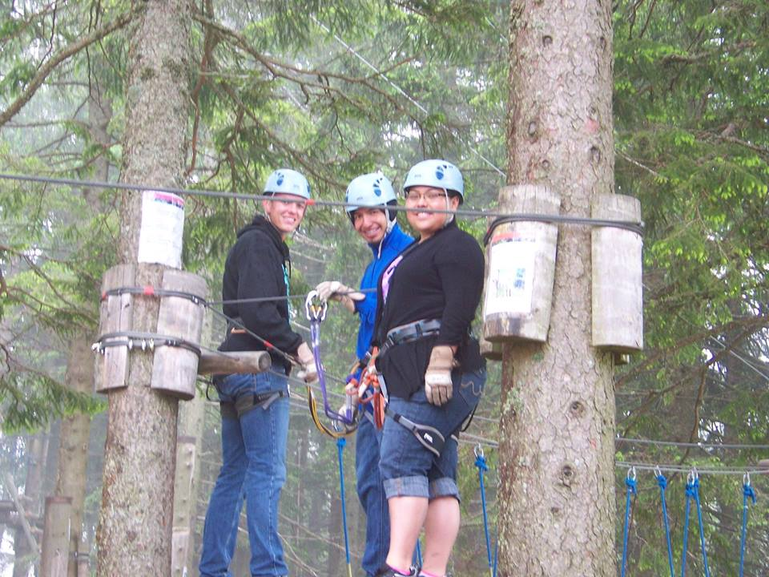
“To travel is to live.”
― Hans Christian Andersen
Switzerland 2013

Slide 3
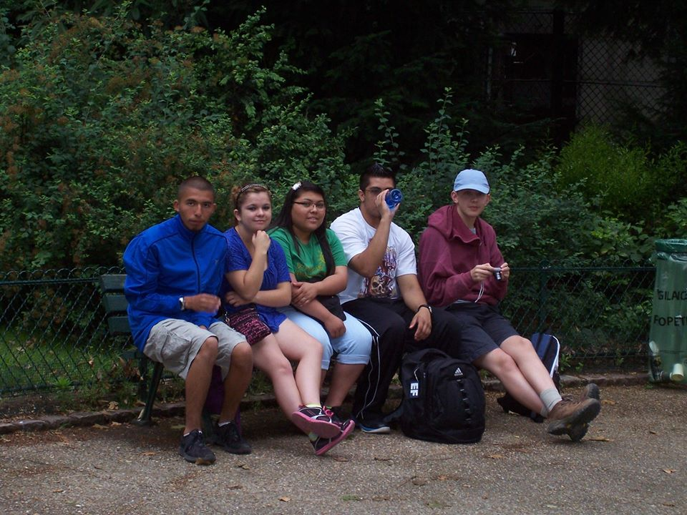
“Travel makes one modest. You see what a tiny place you occupy in the world.”
― Gustave Flaubert
Paris 2013

Slide 4
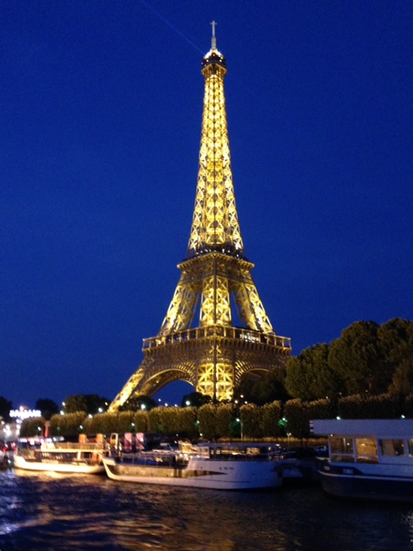
“I am not the same having seen the moon shine on the other side of the world.”
― Mary Anne Radmacher
Paris 2015

Slide 5
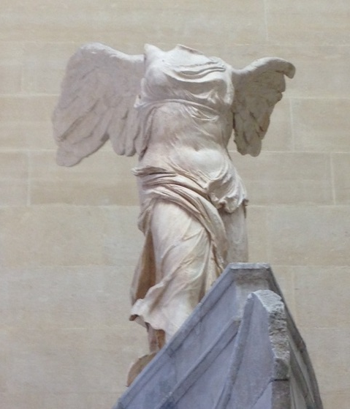

“Every dreamer knows that it is entirely possible to be homesick for a place you've never been to, perhaps more homesick than for familiar ground.”
― Judith Thurman
Paris 2015

Slide 6
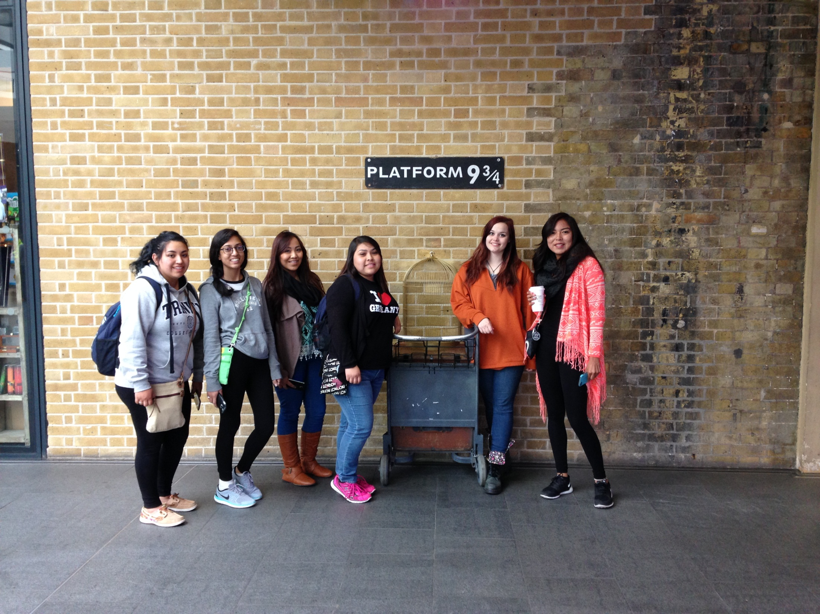
“Personal happiness lies in knowing that life is not a checklist of acquisition.”
- J.K. Rowling
London 2015

Slide 7
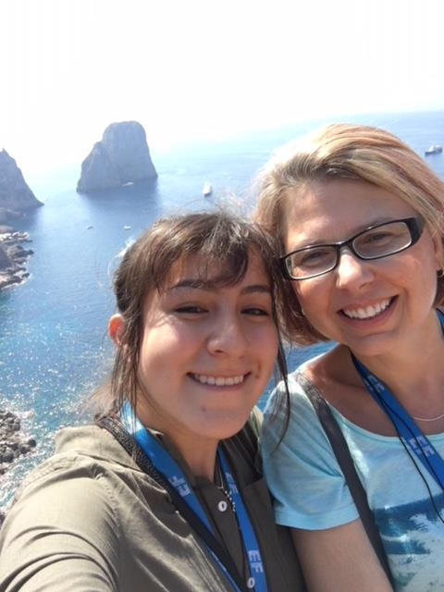

“Travel is fatal to prejudice, bigotry, and narrow-mindedness, and many of our people need it sorely on these accounts. Broad, wholesome, charitable views of men and things cannot be acquired by vegetating in one little corner of the earth all one's lifetime.”
― Mark Twain
Capri 2017

Slide 8
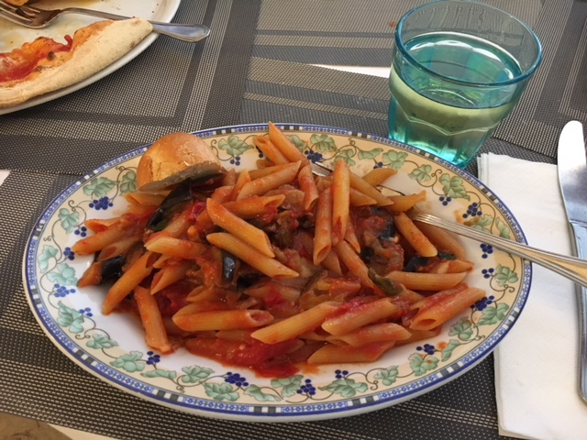
“If you reject the food, ignore the customs, fear the religion, and avoid the people, you might better stay home.”
― James A. Michener
Capri 2017

Slide 9
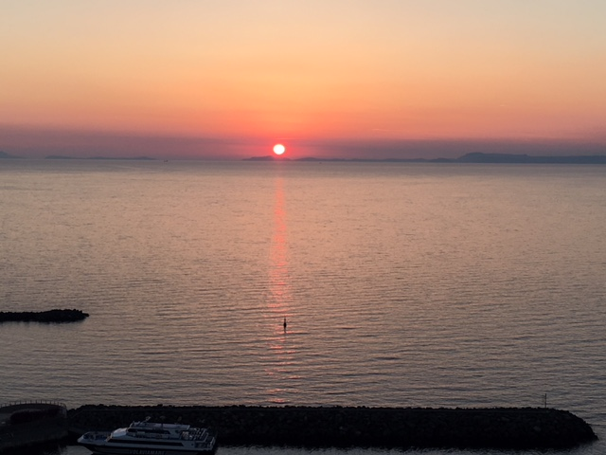
“Every one of a hundred thousand cities around the world had its own special sunset and it was worth going there, just once, if only to see the sun go down.”
― Ryū Murakami
Sorrento 2017

Slide 10

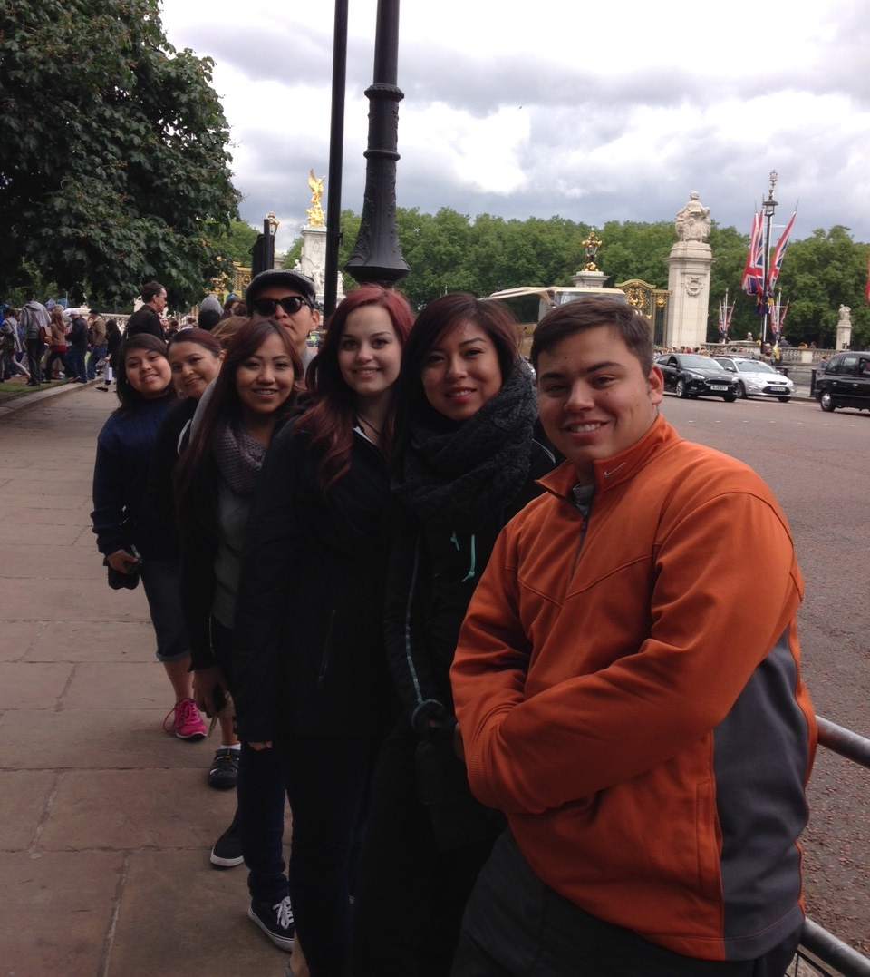
The purpose of life is to live it, to taste it, to experience to the utmost, to reach out eagerly and without fear for newer and richer experience.
ELEANOR ROOSEVELT
London 2015

Slide 11
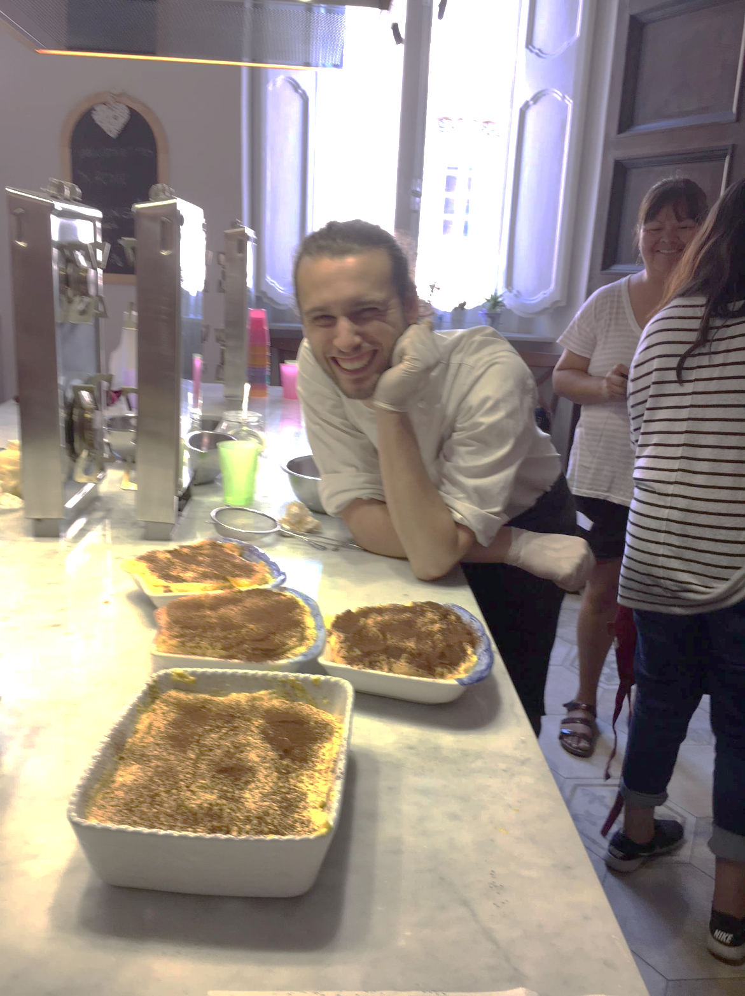
‘Cooking and eating in a foreign country may be the truest way to its soul.’
-Unknown
Rome 2017

Slide 12
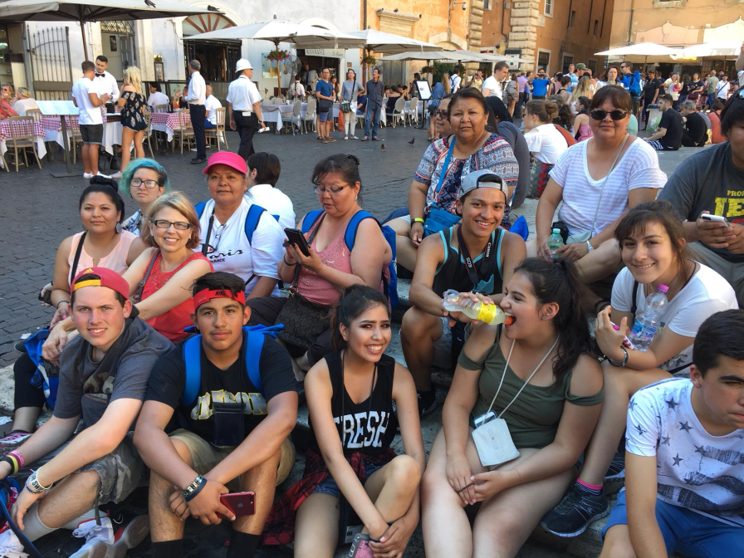
“Traveling outgrows its motives. It soon proves sufficient in itself.
You think you are making a trip, but soon it is making you - or unmaking you.”
― Nicolas Bouvier
Rome 2017

Slide 13
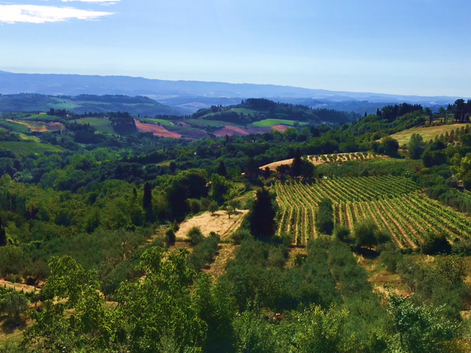
“I didn't know that the world could be so mind-blowingly beautiful.”
― Justina Chen
San Gimignano, Tuscany, Italy 2017

