Slide 1
Recruitment 2019
Part 2

Slide 3
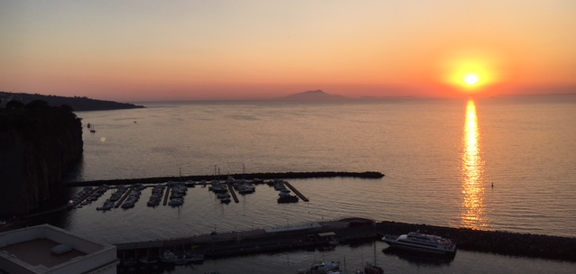
Why travel?
Sorrento 2017
The next slides are the best reasons to sign up for a trip like this. All pictures are from the Gallup High School Eurotrip EF Tours.

Slide 4
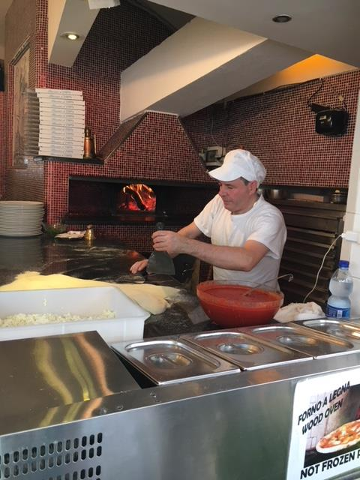

“Only it seems to me that once in your life before you die you ought to see a country where they don't talk in English and don't even want to.”
― Thornton Wilder
Italy 2017

Slide 5
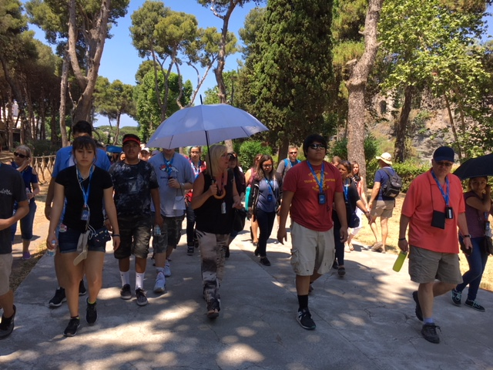

“Nobody can discover the world for somebody else. Only when we discover it for ourselves does it become common ground and a common bond and we cease to be alone.”
― Wendell Berry
Italy 2017

Slide 6
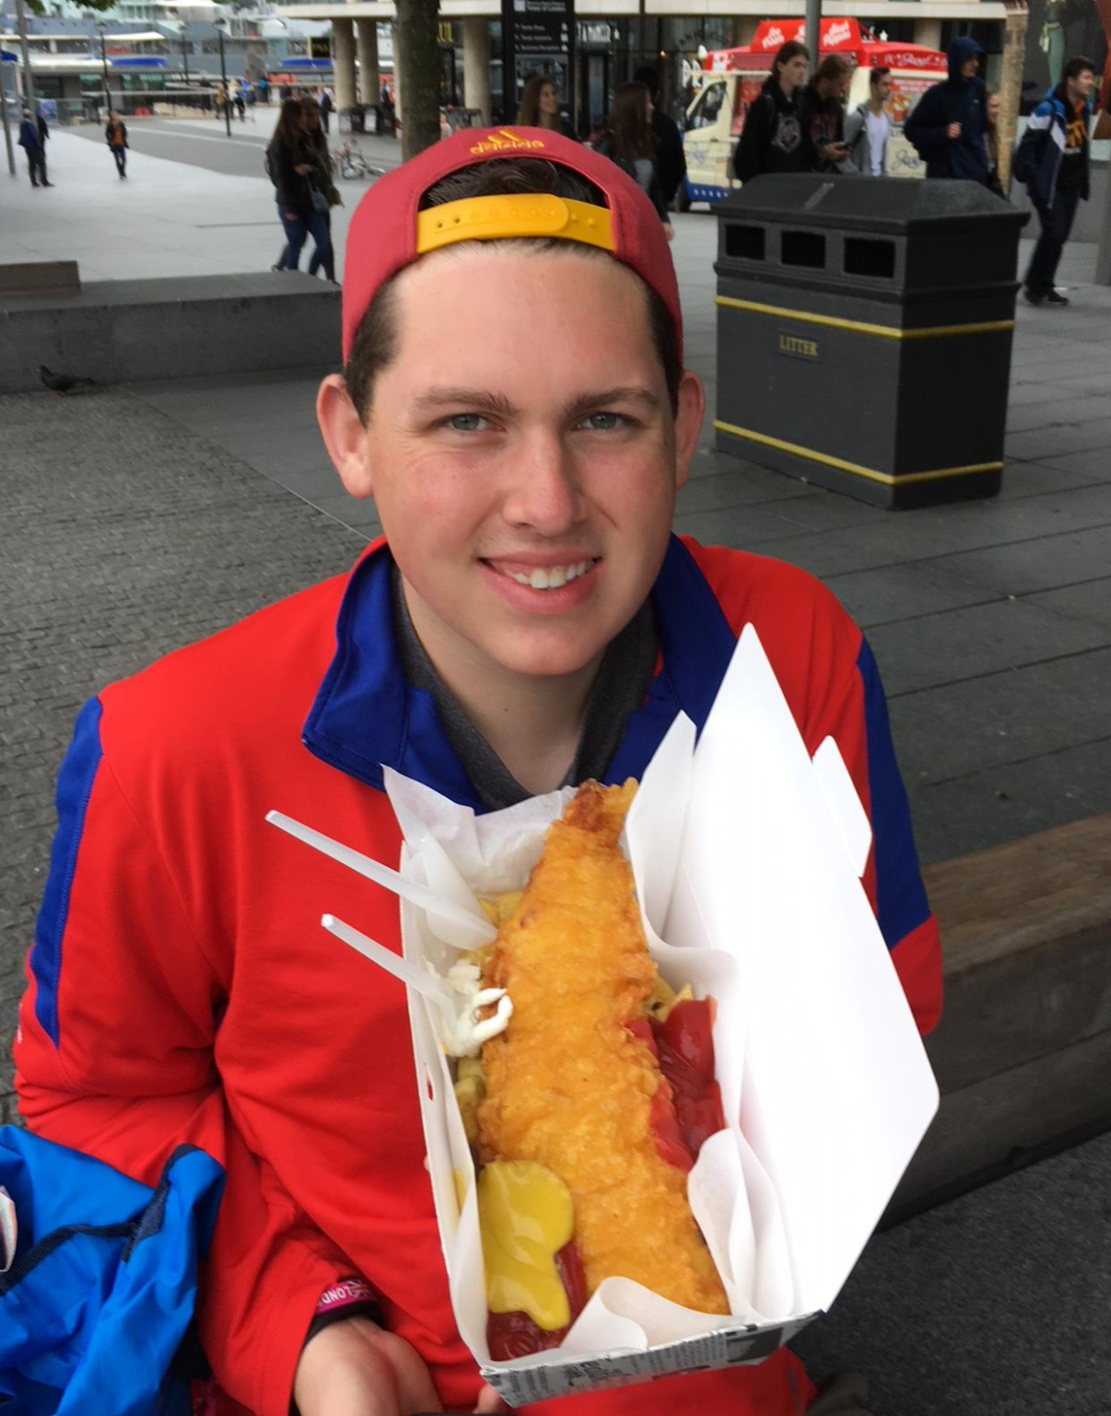
“I like the spirit of this great London which I feel around me.”
― Charlotte Brontë
London 2017

Slide 7
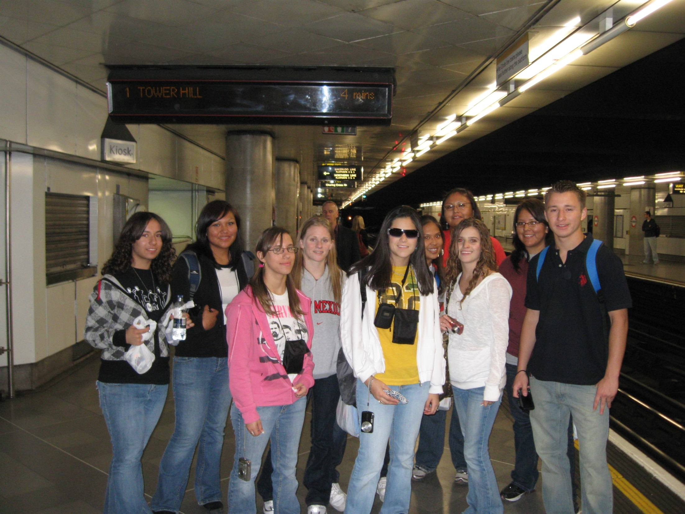
“You can't understand a city without using its public transportation system.”
― Erol Ozan
London 2011

Slide 8
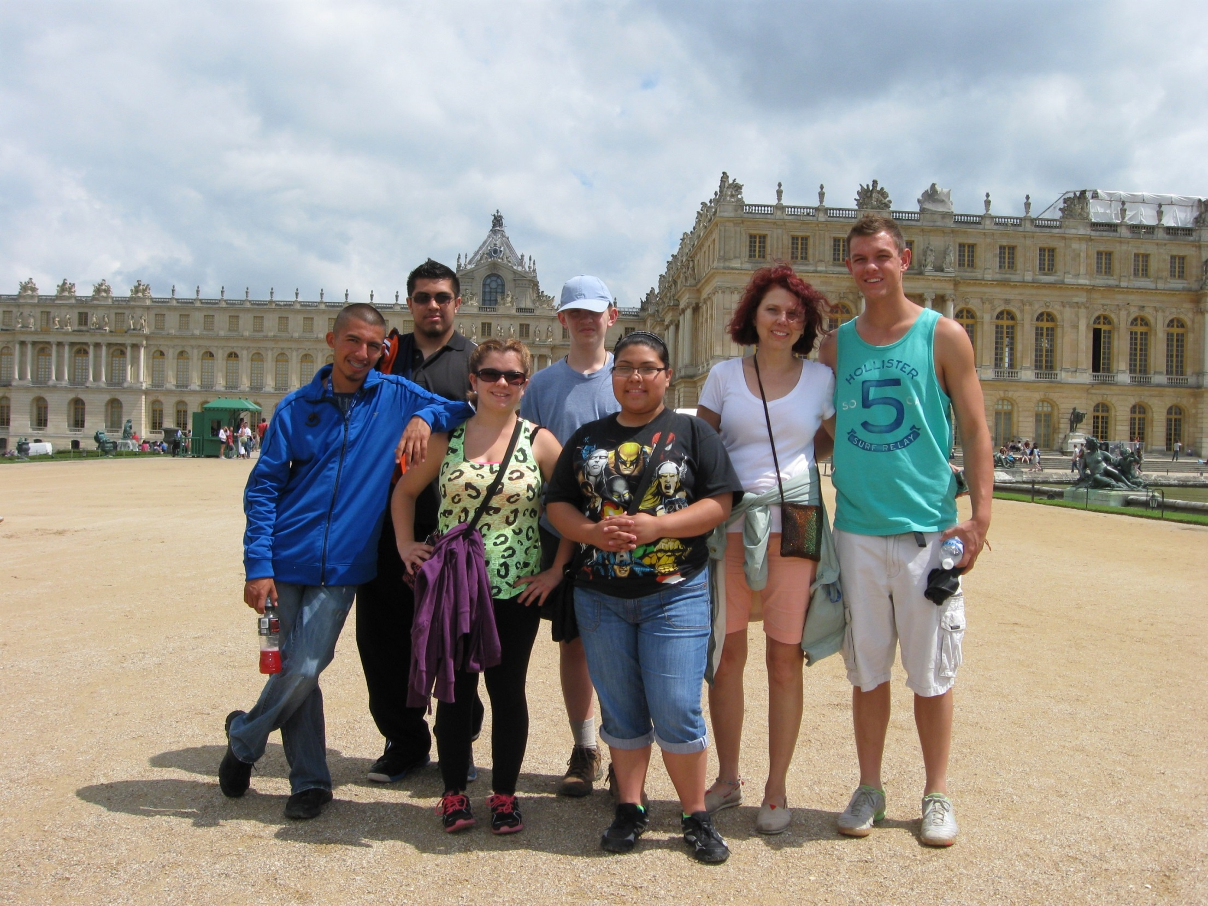
“All that is gold does not glitter; Not all those who wander are lost.”
― J.R.R. Tolkien, The Fellowship of the Ring
Versailles 2013

Slide 9
