Slide 1
Recruitment 2019
Part 2

Slide 2
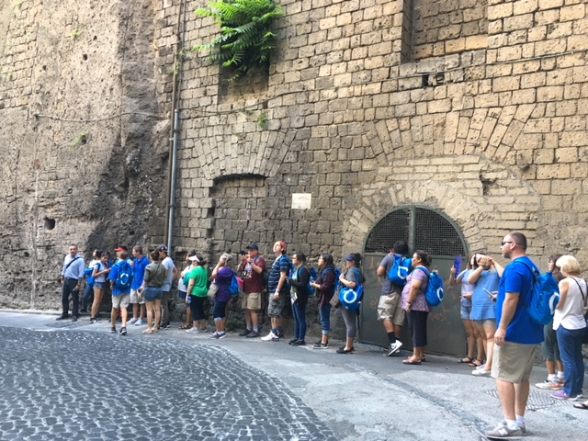
Why group travel?
Group travel keeps tours affordable, allowing more students to see the world
Combined groups get the best value
Tour choice and departure date flexibility to match with other groups
Meet other students from around the country
Our departure date window is June 2019!
Traveling with EF
Sorrento 2017

Slide 4
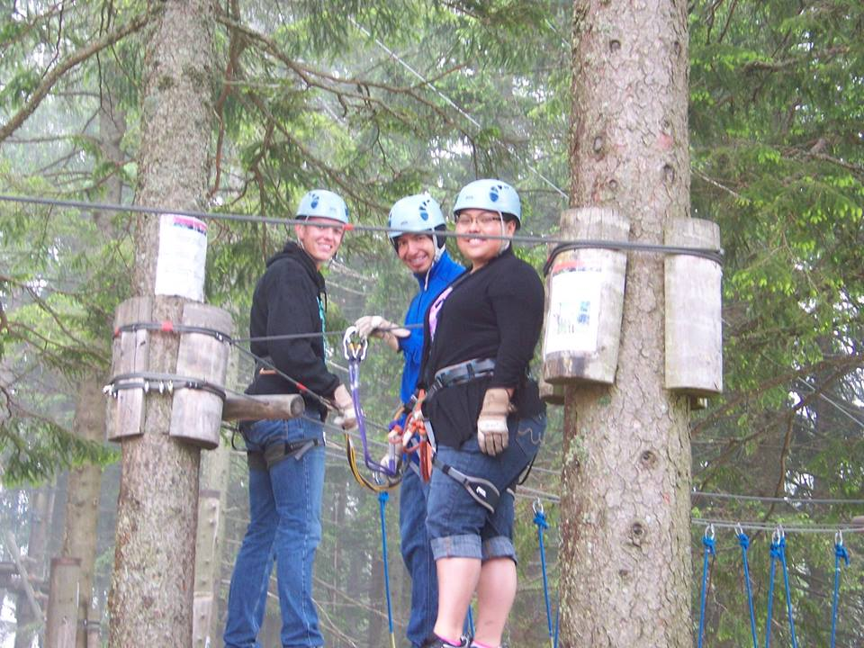
All-Inclusive Coverage Plan
The plan covers your child for:
Tour cancellation and interruption
Illness and accident
Baggage and property
Flight delay
24-hour access to an English-speaking representative
Switzerland 2013
For more information visit eftours.com/coverage or call EF’s Customer Service Department at 800-665-5364.

Slide 5
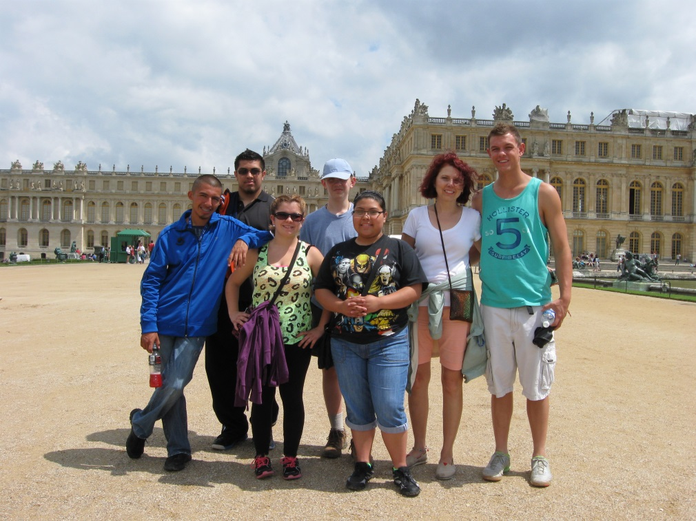
My approach to safety
My 6-to-1 chaperone ratio (for every six students there is one adult chaperone)
My rules:
No alcohol or drug use.
No one in rooms of the opposite sex.
Be on time.
If a traveler (student) violates my rules, I have the right to send them home from tour at the parents’ expense.
Versailles 2013

Slide 6
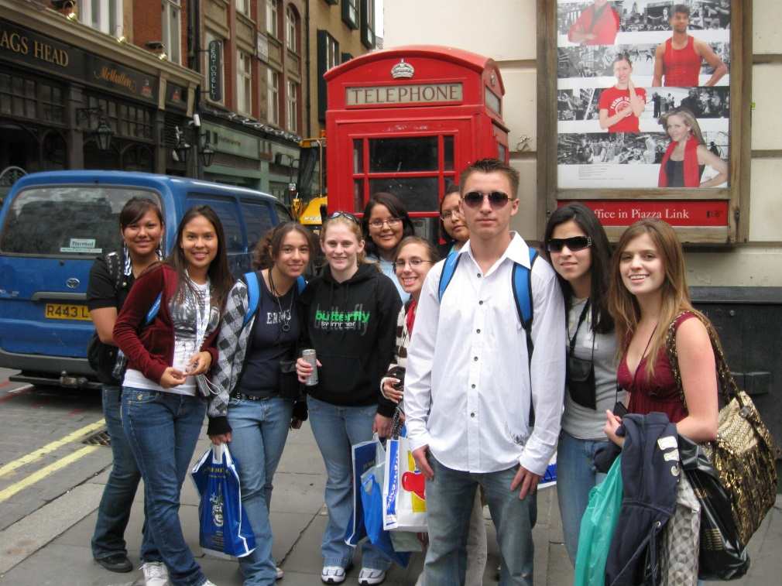
What are you responsible for?
Spending money for optional excursions, free time activities, souvenirs, beverages, lunches and snacks ($30-$65 per day)
Tips for your Tour Director, bus driver and local guides (around $10 per day)
Passport and/or visa fees
These are all necessities each traveler will be responsible for on this tour.
London 2011

Slide 7
Passports and visas
All travelers are responsible for securing necessary documentation
Valid passports are required for all travelers
Passports may take up to 14 weeks to process
Some destinations may require travel visas
Non-U.S. citizens may require special visas or other travel documents
Important note: Passports must be valid for at least six months after our scheduled return date

Slide 8
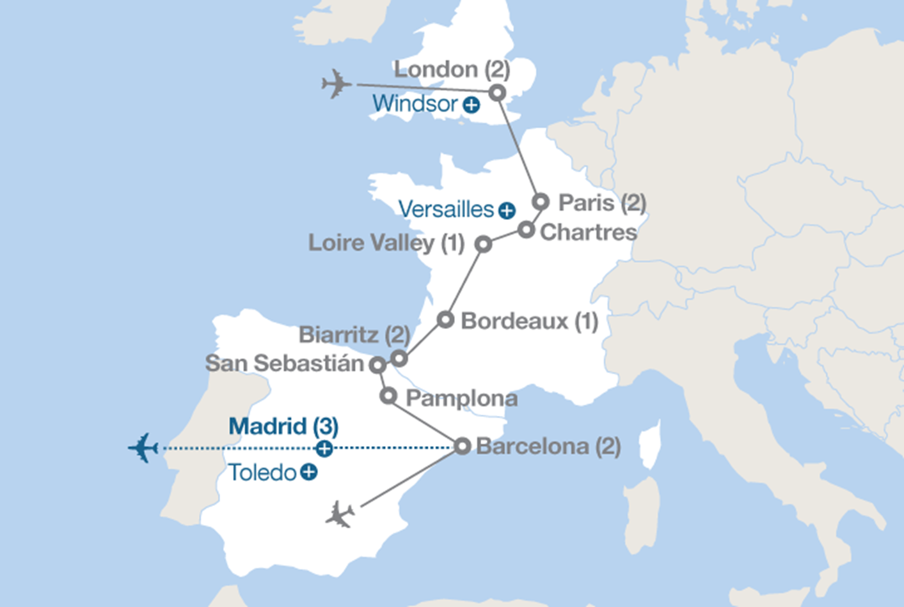
Our tour map:
London 2011

Slide 9
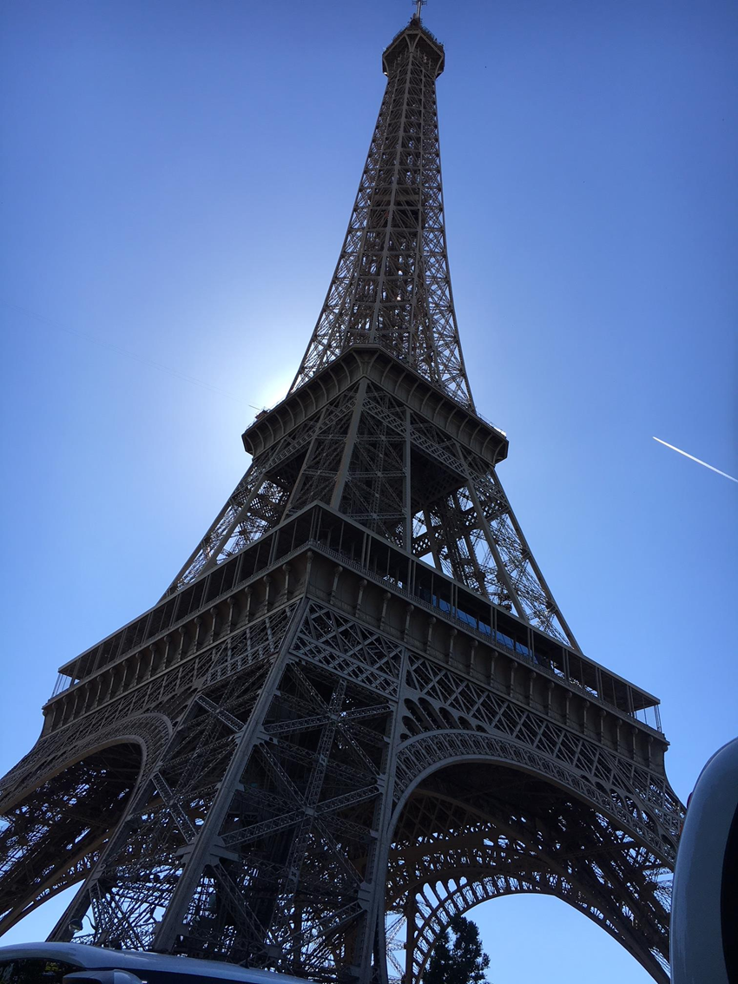
Tour Name | England, France and Spain
Provider | EF Educational Tours
Estimated Departure Date | 6/10/19
Estimated Return Date | 6/21/19
Number of Days | 12
Departure City | Albuquerque
Total Price Students | $4272 (until November 17 2017)
Total Price Adults | $4872 (until November 17 2017)
Tour dates finalized by Spring Break, 2019 Sign up by November 17, 2017 for cheapest rate!
Paris 2017

Slide 10
Sample Itinerary- Daily breakdown
Day 1: Fly overnight to England
Day 2: London – Meet your Tour Director at the airport in London, a city of 8 million people that has become one of the world’s great melting pots while maintaining a distinct character that’s all its own.
Day 3: London – Take an expertly guided tour of London. Time to see more of London or Visit Windsor Castle
Day 4: London | Paris – Travel by Eurostar train to Paris, the City of Light
Day 5: Paris – Take an expertly guided tour of Paris: Place de la Concorde; Champs-Élysées; Arc de Triomphe; Les Invalides; Eiffel Tower –Visit Versailles
Day 6: Loire Valley – Visit Chartres Cathedral – Travel to the Loire Valley – Visit Chenonceau

Slide 11
Sample Itinerary- Daily breakdown (cont.)
Day 7: Saintes | Bordeaux – Travel to Bordeaux – Take an expertly guided tour of Bordeaux
Day 8: Arcachon | Biarritz – Travel to Arcachon – See the Dune de Pilat – Continue on to Biarritz
Day 9: Biarritz – Take a tour of San Sebastián and St. Jean de Luz – Take a tour of Biarritz
Day 10: Pamplona | Barcelona – Take a tour of Pamplona – Continue on to Barcelona, an art lover’s dream city and the place where masters like Miró, Picasso and Dalí flourished.
Day 11: Barcelona – Take an expertly guided tour of Barcelona: La Sagrada Familia; Montjuïc Hill – Visit Park Güell – Take a walking tour of Barcelona: Las Ramblas. Attend a Barcelona Flamenco Evening
Day 12: Depart for home

Slide 12
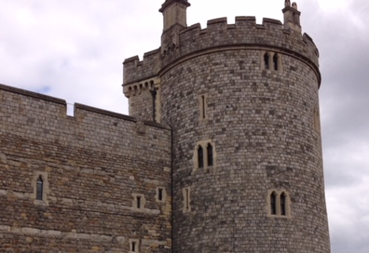
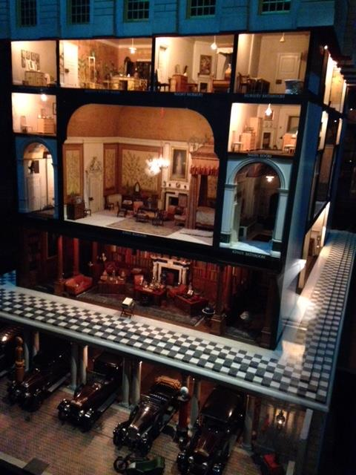
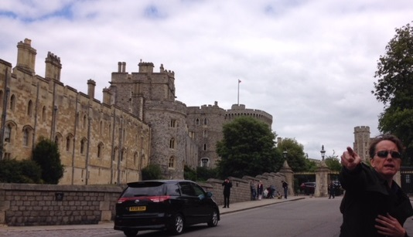
Windsor Castle
This is your invitation to the Royal Family’s retreat, Windsor Castle! Join a local guide on your half-day excursion to Windsor, built by William the Conqueror in 1070. Priceless objects are found in the State Apartments, from paintings by Rubens to Henry VIII’s sword and suit of armor. You will also see Queen Mary’s Dolls’ House and St. George’s Chapel, the final resting place of many monarchs
Windsor 2015

Slide 13
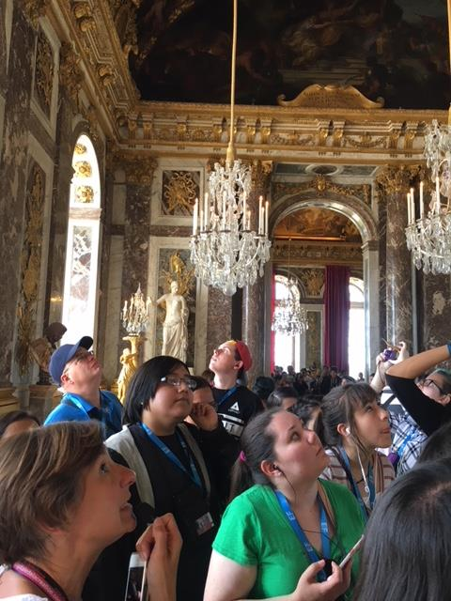
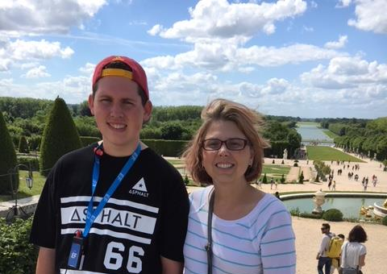
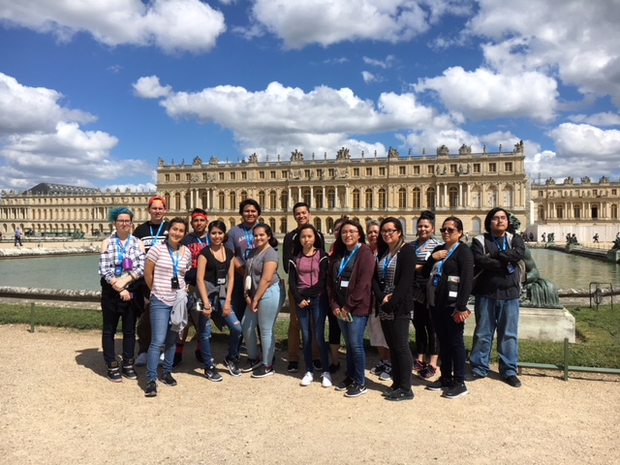
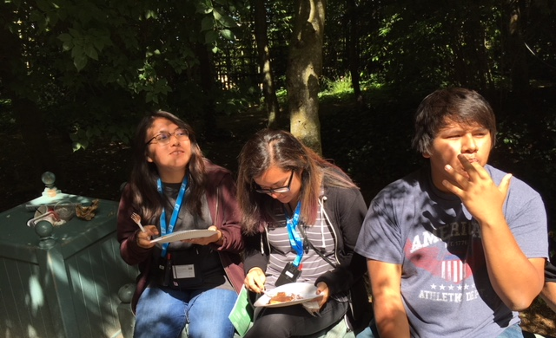
Versailles
Enjoy an excursion to the grand palace of Versailles, where Louis XIV held court in the most lavish style imaginable. On a tour, stroll through the elegantly landscaped gardens, the historic Hall of Mirrors, and the ornately decorated State Apartments.
Versailles 2017

Slide 14
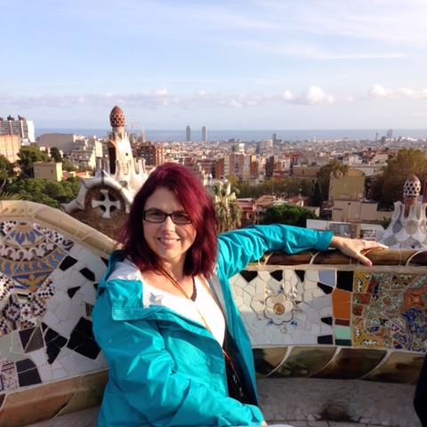
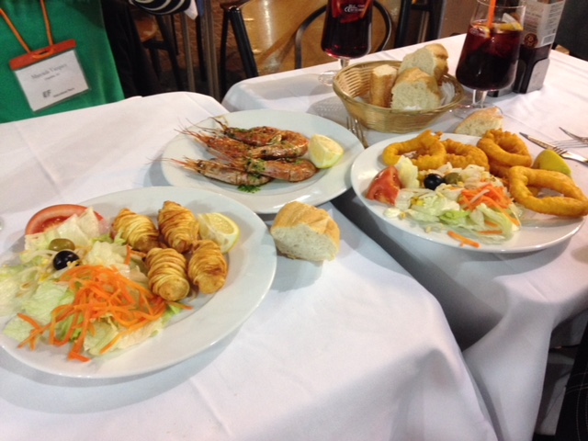
Barcelona Flamenco Evening
Feel the pulse of Spain when you attend an unforgettable flamenco performance! Born of Indian, Moorish, Arabian, and gypsy influences, flamenco dance is a passionate display of dramatic poses and colorful costumes, accompanied by song and guitar. Marvel at the intricate rhythms created by a dancer’s steps, castanets, and clapping. A beverage is included during the one-hour performance.
Barcelona 2016

Slide 15
Program Price
Barcelona flamenco evening | $70
Versailles | $99
Windsor Castle | $88
Weekend Supplement | $35
Global Travel Protection | $165
Early Enrollment Discount | -$200
EF's Peace of Mind Program * | Free
Total for Students (under 20) | $4,272
19 monthly payments | $220/mo
Adult Supplement | $600
Total for Adults | $4,872
19 monthly payments | $252/mo
Program Price | $4,015
Includes: Round-trip airfare and on tour transportation Hotels with private bathrooms Breakfast and dinner (see your itinerary for meal details) Full-time Tour Director Daily activities, tours and entrances to attractions

Slide 16
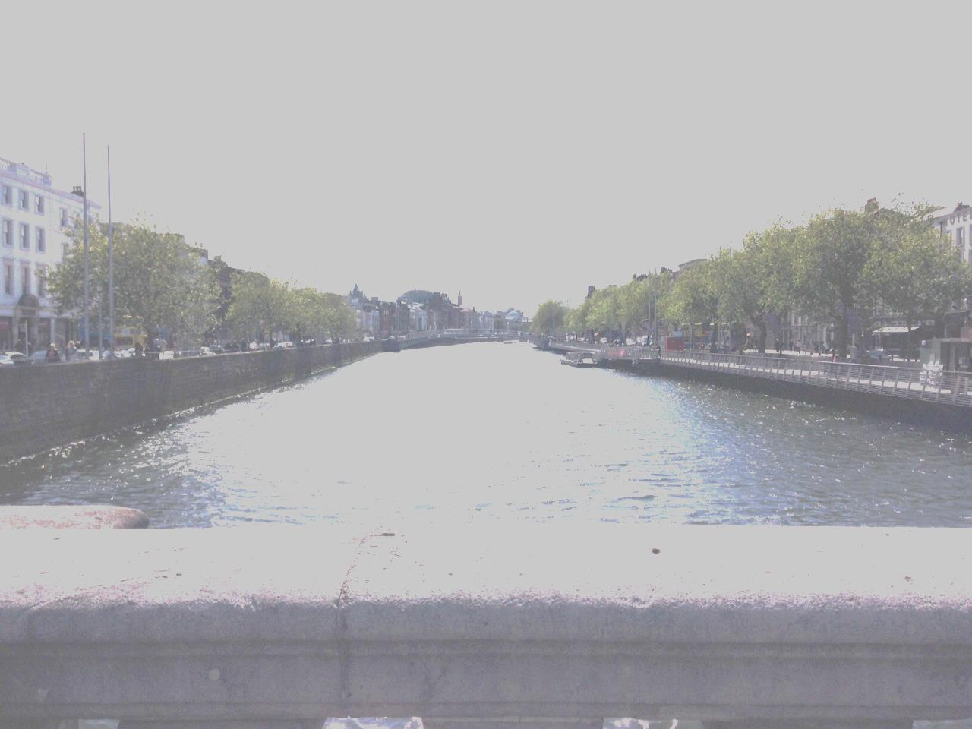
PAYMENT OPTIONS
Pay in Full at Enrollment
Pay your entire balance at the time you enroll
Payment methods accepted: Visa or MasterCard, ATM/debit card or personal checks.
1
Automatic Payment Plan – Free
Payments automatically deducted from your bank account – choose monthly or bi-weekly
Payment methods accepted: ATM/debit card or checking account only.
2
Manual Payment Plan - $50 plan fee
Receive invoices and make your payments in up to three installments
Payment methods accepted: Visa or MasterCard, ATM/debit cards or personal checks.
3
River Liffey, Dublin Ireland 2015

Slide 17
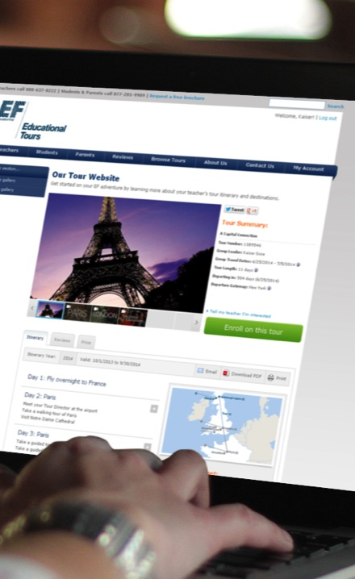
How do I enroll?
Online:
www.eftours.com/1969502PM
Phone: 800-665-5364
Tour Number: 1969502PM
Enrollment deadline:
December 2018!
(However the price will continue to increase! Enroll early to lock in the best value!)

Slide 18
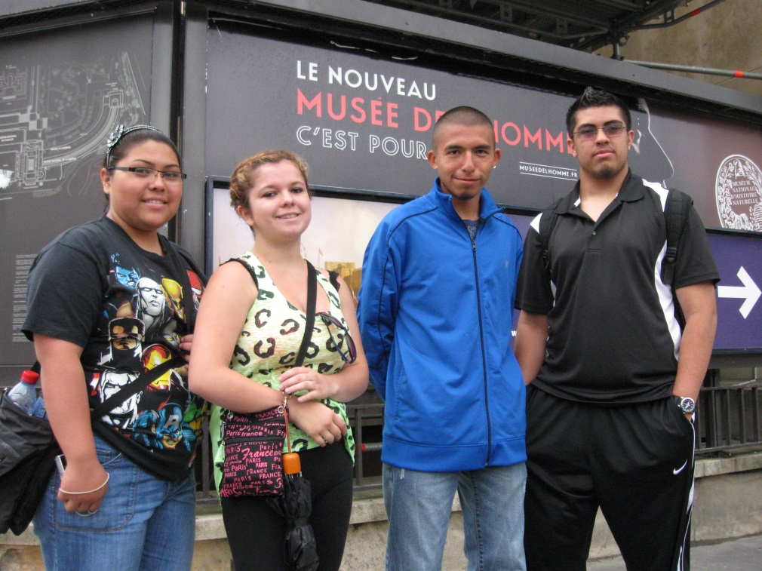
The EF Price Guarantee
Once you enroll your price will never change.
Enroll today to get the most manageable, lowest monthly payment.
Paris 2013
Information, videos and other useful stuff:
https://www.eftours.com/educational-tour/england-france-spain

