Slide 1
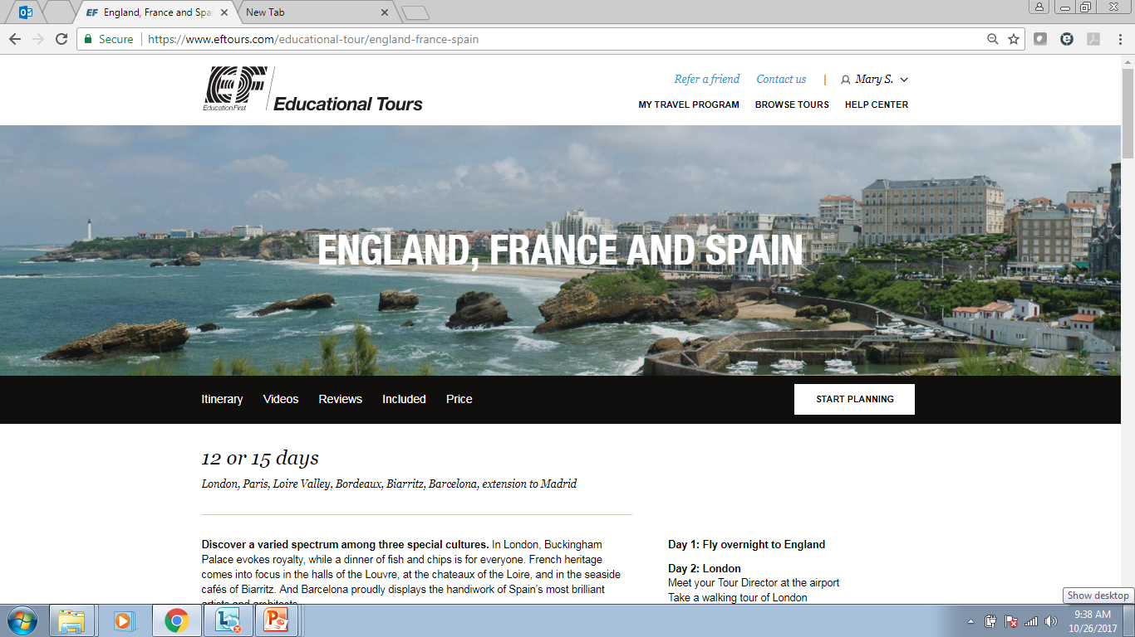

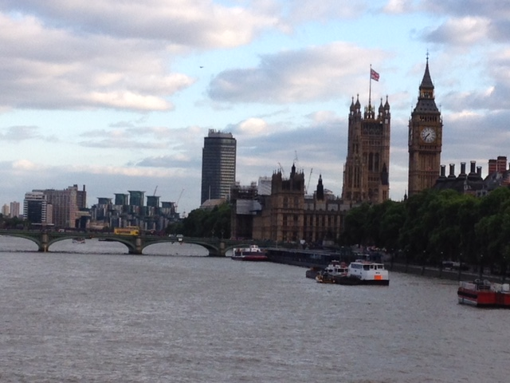
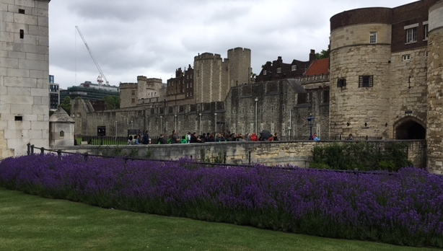
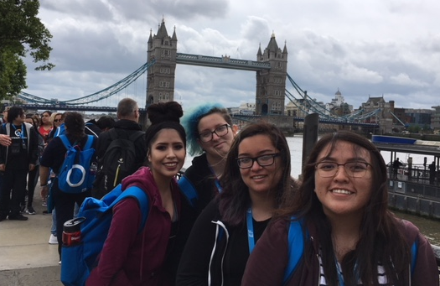
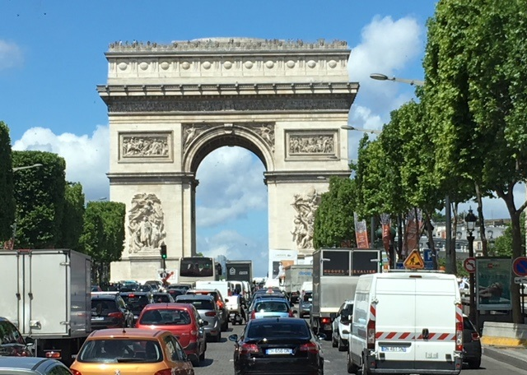
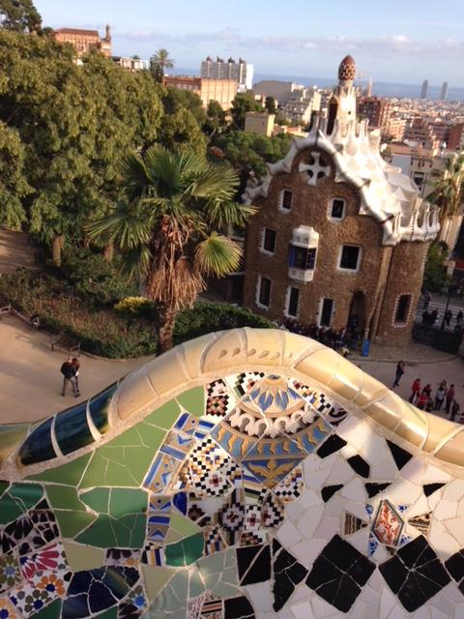
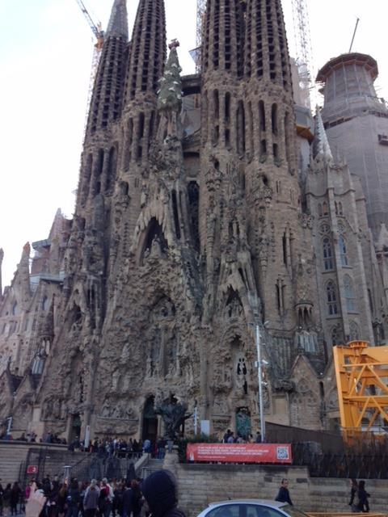
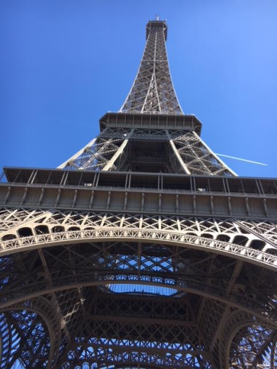
London 2017
London 2017
London 2017
Paris 2017
Paris 2017
Barcelona 2016
Barcelona 2016

Slide 2

Tour Number
Enrollment Website for Travelers
www.eftours.com/1969502PM
All pictures in the slide show are from Mrs. Seslar’s and Mr. Gearhart’s trips with EF.
Paris 2017

Slide 3

Our meeting agenda
Why Travel?
EF Education First
  Who are they?
  Why did we choose them?
Safety on tour
Our tour package
  What’s included?
  What isn’t?
Passports and visas
Our tour itinerary
Pricing, Monthly Payment Plan
How to enroll/signing-up to be “Kept in the Loop”
Questions and answers
Paris 2017

Slide 4
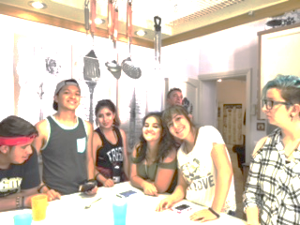
To promote international understanding
and a respect for a variety of cultures
To clarify and deepen our understanding
of the American identity and its values and
beliefs through intercultural experience
To expand our knowledge about culture and history and the basis for different values and beliefs
To develop the interpersonal skills necessary to navigate a new environment with confidence, maturity and flexibility.
Align with school curricula to bring subjects, people, places and events to life.
Sharpen key 21st century skills, including communication and global competence.
Educational objectives
Rome 2017

Slide 5
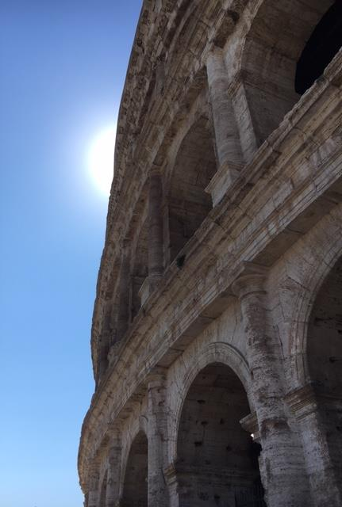
Why EF: Education First?
EF is the World Leader in International Education.
For nearly half a century, EF has broken down barriers of geography, language and culture. EF has over 400 schools and offices in more than 50 countries.
EF is different.
In addition to educational tours, EF provides worldwide language learning, student exchange, cultural immersion and service tours, au pair services and college study programs, as well as a top-ranked international business school.
Rome 2017

Slide 6
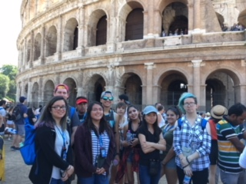


Why EF?
Most educational
Fully accredited,
just like our school
Full-time personal, bilingual
Tour Director
Educational itineraries
based on almost 50 years
of experience
Best value
Highest quality tours at the guaranteed lowest prices
Planning and organizing
all tour logistics by
travel experts
Rome 2017

Slide 7

Why EF?
EF’s Peace of Mind Program
Should social unrest or natural events make traveling to our destination unsafe, EF will
work with our group to make alternative arrangements.
Safety first
All-Inclusive Coverage Plan
6-to-1 student-to-chaperone ratio
Trained & licensed local guides
24-hour emergency on-call service
Capri 2017

Slide 8
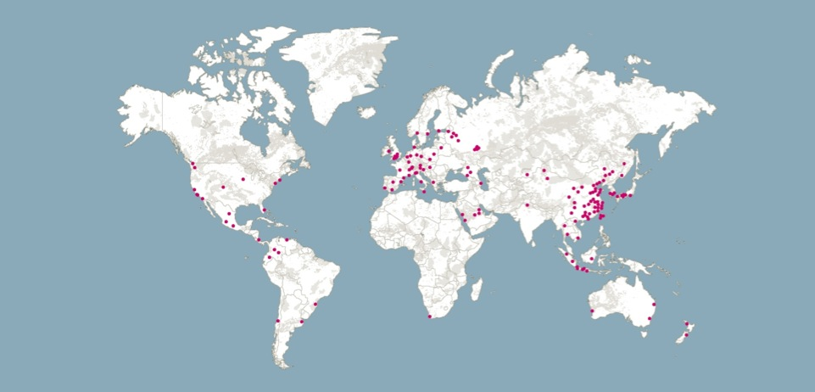
Wherever we learn, EF is there
EF has 34,000 staff and teachers
in more than 400 offices in over 50 countries

