Slide 1
Radiation
What is radiation?
How is the Electromagnetic Spectrum organized?
What are the parts of waves?
What are the types of Electromagnetic radiation?

Slide 2
waves

Slide 3
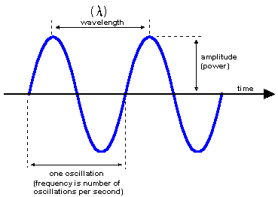
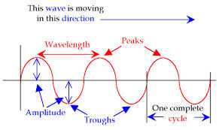
Waves
Electromagnetic radiation (e.m.r.) travels in the form of waves.
Draw and label these wave diagrams.
One oscillation or cycle.
Frequency is the number of cycles or oscillations per second

Slide 4
IMPORTANT!!!!
Speed of the wave is NOT the same as wavelength or frequency!!!

Slide 5
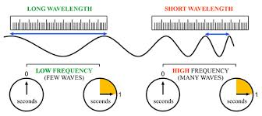
If waves are all traveling at the same speed, fewer of the long wavelength (low frequency) waves reach the destination than waves with a short wavelength (high frequency) ,which will have more waves reach the destination.

Slide 6
TERMS
Frequency- how often the wave crests pass a certain point. Measured in Hertz (Hz) or megahertz (MHz)
Wavelength- the distance between a point on one wave and the same point on the next wave. (The symbol for wavelength is λ)
Amplitude- the height of the wave, or the amount of energy in a wave. Amplitude is not affected by wavelength or frequency. (And wavelength or frequency is not affected by amplitude.)

Slide 7
Waves are not physical objects. They are the result of energy moving through something.
Light energy does not travel instantaneously.
Because a wave travels one wavelength in one period (of time), it follows that wave velocity is equal to the wavelength divided by the period.
$$v=\frac{λ}{t}$$

Slide 8
Waves move through the medium , the stuff the waves are in. For example waves move through water, air, and glass. But the waves do not carry the molecules of water, air or glass from one place to the next.
Notice the picture below of a dragonfly on the surface of the water. The wave hits the dragonfly, and he goes up and down with the wave but he is not moved from right to left.
DIRECTION WAVES ARE MOVING

Slide 9
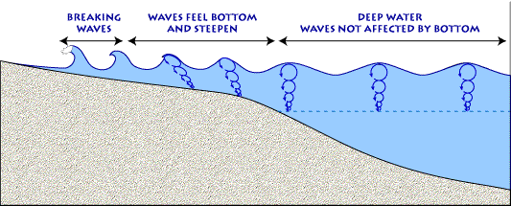
Notice the circles in the diagram, these show the small, circular paths the water molecules follow. The water doesn’t change position much.

