Slide 1
Vocabulary
Property – an attribute, quality, or characteristic
Reactivity-able to combine with another substance
Toxicity – poisonness
Luster – how shiny
Malleability – shapeable
Conductivity – able to conduct electricity
Oxidize – able to combine with oxygen
Mass – the amount of matter in a substance
Volume – how much space a substance takes up
Weight – the amount gravity pulls on a substance
Ductility – able to be drawn out into a thin wire
Combustion – burning

Slide 2
Physical and Chemical Properties
What is a property?

Slide 3
Essential Questions
What is a physical property?
What is a chemical property?
How are these properties related to physical or chemical changes?
What type of property is density?
How is density calculated?

Slide 4
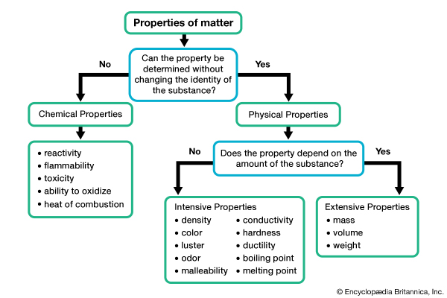
Describes how the substance reacts with other substances
Describes the physical characteristics of the substance
(Internal)
Dissolves
Rusts
Reacts
Corrosive
(External)
(Internal)
Texture
Sounds
Phase at room temp.
Solubility
Magnetic

Slide 5
Difference between intensive and extensive properties
Intensive Properties
Extensive Properties
Intensive properties are bulk properties, which means they do not depend on the amount of matter that is present.
Intensive properties can be used to help identify a sample because these characteristics do not depend on the amount of sample, nor do they change according to conditions.
Extensive properties do depend on the amount of matter that is present. An extensive property is considered additive for subsystems.
While extensive properties are great for describing a sample, they aren't very helpful in identifying it because they can change according to sample size or conditions.
One easy way to tell whether a physical property is intensive or extensive is to take two identical samples of a substance and put them together. If this doubles the property (e.g., twice the mass, twice as long), it's an extensive property. If the property is unchanged by altering the sample size, it's an intensive property.

Slide 6
Density, an Intensive, Physical Property
What is density? How do we calculate it?

Slide 7
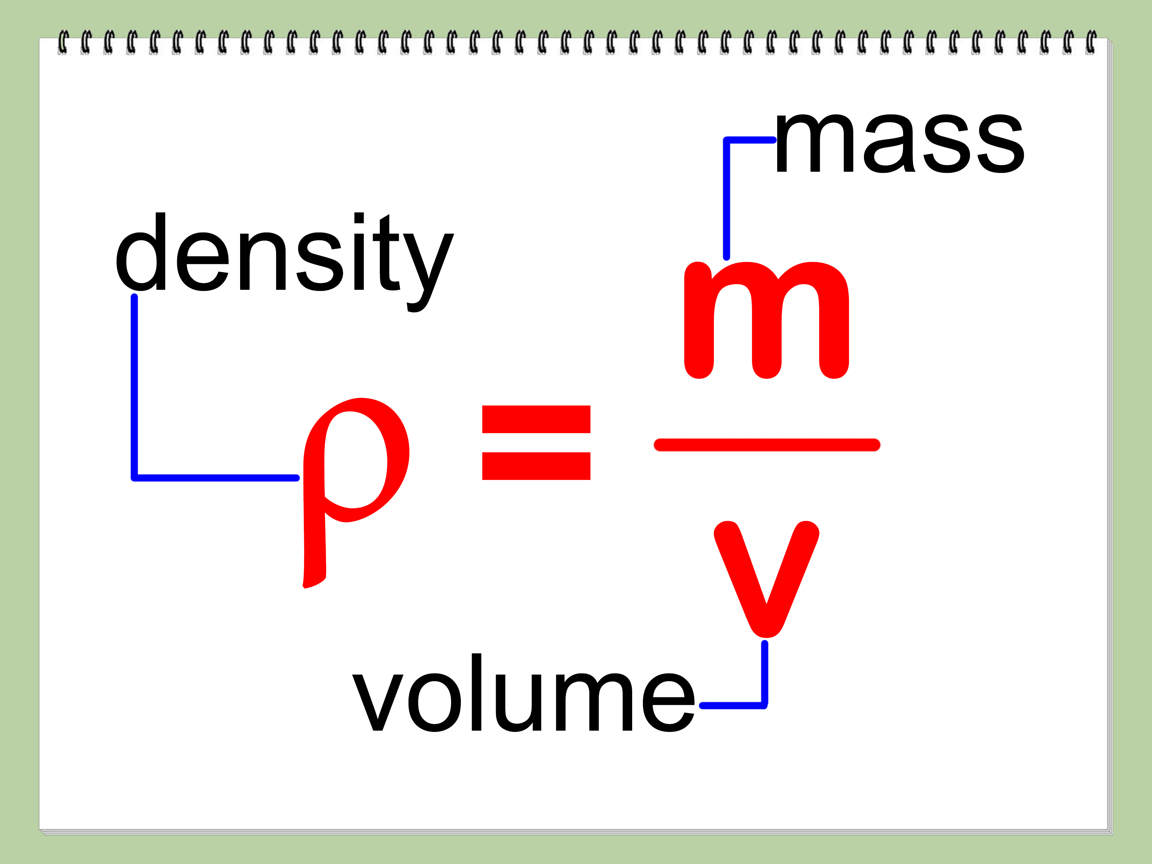
Density
the degree of compactness of a substance.
(PHYSICS) - degree of consistency measured by the quantity of mass per unit volume.

Slide 9
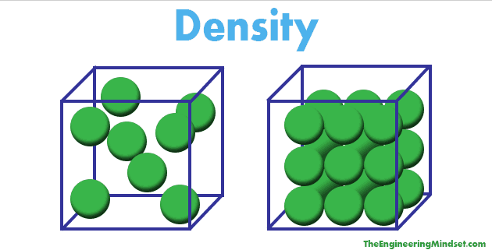
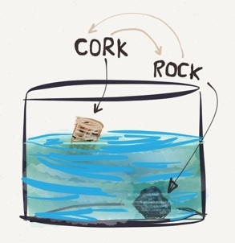
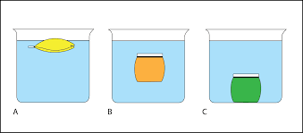

Slide 10
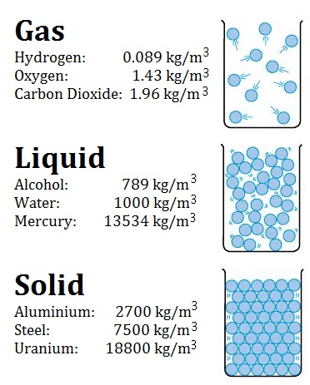
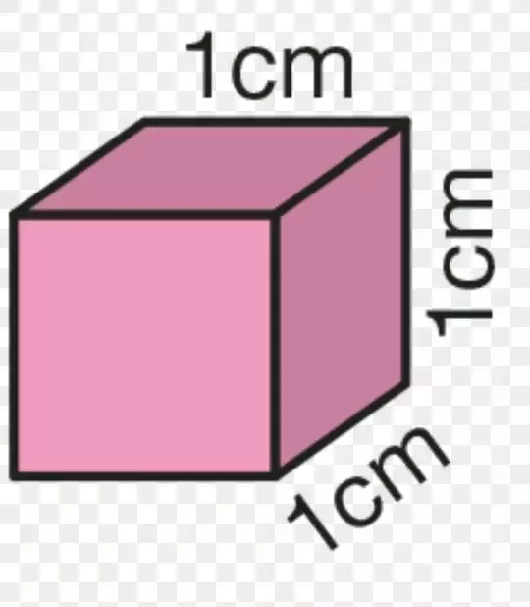
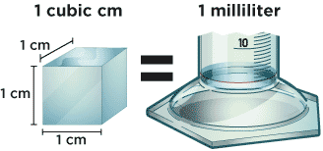
Units:
kg/m³
g/cm³
g/mL
mL=cm³

Slide 11
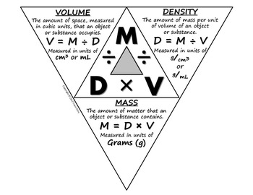

Slide 12
LAB:Calculate density of a block of wood
1. Figure out the volume, by measuring the dimensions of a solid. Convert any units as needed to get a number in centimeters cubed.
2. Put the object or material on a scale and figure out its mass in grams.
3. Divide the mass by the volume to figure out the density
(ρ = m / v).

Slide 13
Calculate density of water
1. Calculate the mass of the water
(mass of water and cylinder – mass of cylinder = mass of water)
2. Figure out the volume, by using a graduated cylinder. Convert any units as needed to get a number in centimeters cubed or mL.
3. Divide the mass by the volume to figure out the density
(p = m / v).

Slide 15
Calculate density of a rock
1. Calculate the mass of the rock
2. Figure out the volume, by using a graduated cylinder and thread tied around the rock.
(ending volume – beginning volume = volume of rock)
Convert any units as needed to get a number in cm cubed or mL.
3. Divide the mass by the volume to figure out the density
(p = m / v).

Slide 16
