Slide 1
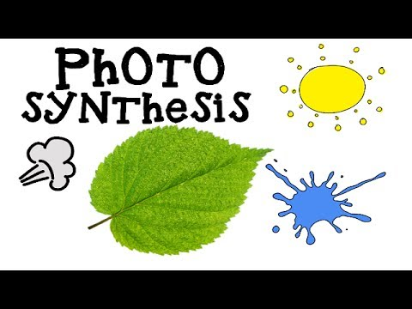
Title Page

Slide 2
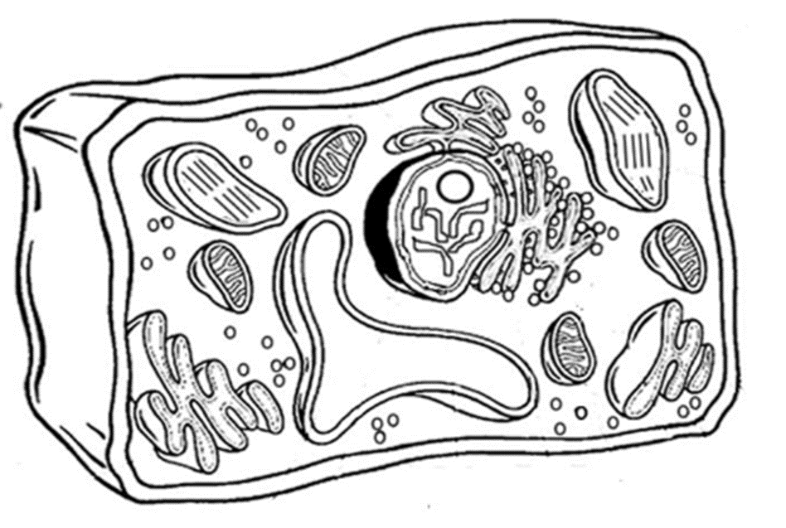
Nuclear membrane (black)
Nucleolus (brown)
Cell Membrane(orange)
Cell Wall (dark green)
Nucleus (yellow)
Smooth endoplasmic reticulum (pink)
Chloroplasts (light green)
Mitochondria (red)
Rough endoplasmic
reticulum (Pink)
Cytoplasm (white)
Ribosomes (purple)
Golgi apparatus (dark blue)
Vacuole (light blue)
Chromosomes (gray)

Slide 3
Nuclear membrane (black)
Nucleolus (brown)
Cell Membrane(orange)
Cell Wall (dark green)
Nucleus (yellow)
Smooth endoplasmic reticulum (pink)
Chloroplasts (light green)
Mitochondria (red)
Rough endoplasmic
reticulum (Pink)
Cytoplasm (white)
Ribosomes (purple)
Golgi apparatus (dark blue)
Vacuole (light blue)
Chromosomes (gray)

Slide 4
Nuclear membrane (black)
Nucleolus (brown)
Cell Membrane(orange)
Cell Wall (dark green)
Nucleus (yellow)
Smooth endoplasmic reticulum (pink)
Chloroplasts (light green)
Mitochondria (red)
Rough endoplasmic
reticulum (Pink)
Cytoplasm (white)
Ribosomes (purple)
Golgi apparatus (dark blue)
Vacuole (light blue)
Chromosomes (gray)

Slide 5
Nuclear membrane (black)
Nucleolus (brown)
Cell Membrane(orange)
Cell Wall (dark green)
Nucleus (yellow)
Smooth endoplasmic reticulum (pink)
Chloroplasts (light green)
Mitochondria (red)
Rough endoplasmic
reticulum (Pink)
Cytoplasm (white)
Ribosomes (purple)
Golgi apparatus (dark blue)
Vacuole (light blue)
Chromosomes (gray)

Slide 6
Nuclear membrane (black)
Nucleolus (brown)
Cell Membrane(orange)
Cell Wall (dark green)
Nucleus (yellow)
Smooth endoplasmic reticulum (pink)
Chloroplasts (light green)
Mitochondria (red)
Rough endoplasmic
reticulum (Pink)
Cytoplasm (white)
Ribosomes (purple)
Golgi apparatus (dark blue)
Vacuole (light blue)
Chromosomes (gray)

Slide 7
Organelle | Function
Nucleus | The “brains” of the cell, the nucleus directs cell activities and contains genetic material called chromosomes made of DNA.
Mitochondria | Make energy out of food
Ribosomes | Make protein
Golgi Apparatus | Make, process and package proteins
Lysosome | Contains digestive enzymes to help break food down
Endoplasmic Reticulum | Called the "intracellular highway" because it is for transporting all sorts of items around the cell.
Vacuole | Used for storage, vacuoles usually contain water or food. (Are you are thirsty? Perhaps your vacuoles need some water!)
Plant cells also have:
Chloroplasts | Use sunlight to create food by photosynthesis
Cell Wall | For support

