Slide 1
Phases of the Moon
What are the phases of the moon?
What causes the phases of the moon?

Slide 2
You can turn to page 19 in the book to have a picture of what we will draw in the next slide.

Slide 3
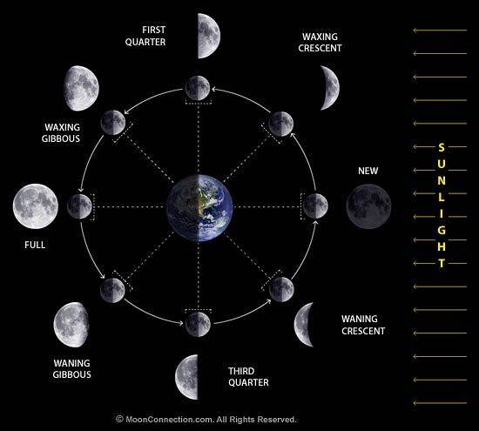
The phases of the moon
View from Earth
View from Space

Slide 4
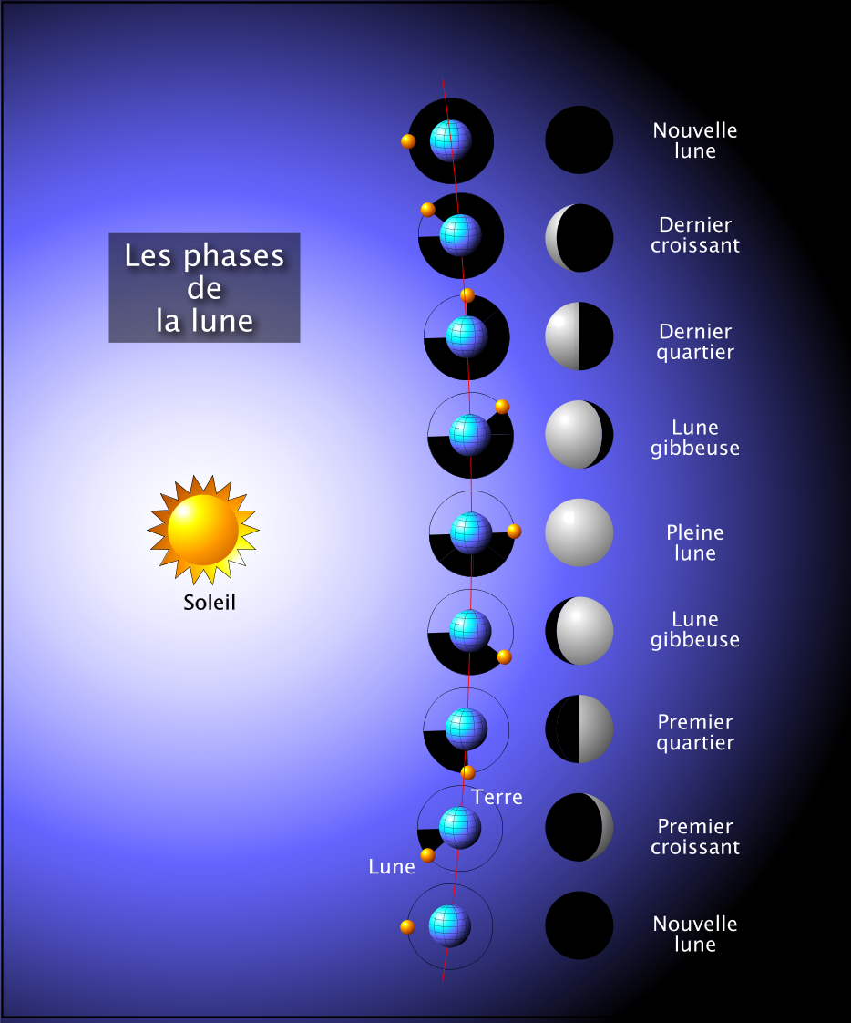
1. New Moon
8. Waning Crescent Moon
Phases of
the moon
7. Third Quarter Moon
6. Waning Gibbous Moon
5. Full Moon
4. Waxing Gibbous Moon
3. First Quarter Moon
2. Waxing Crescent Moon
1. New Moon

Slide 5
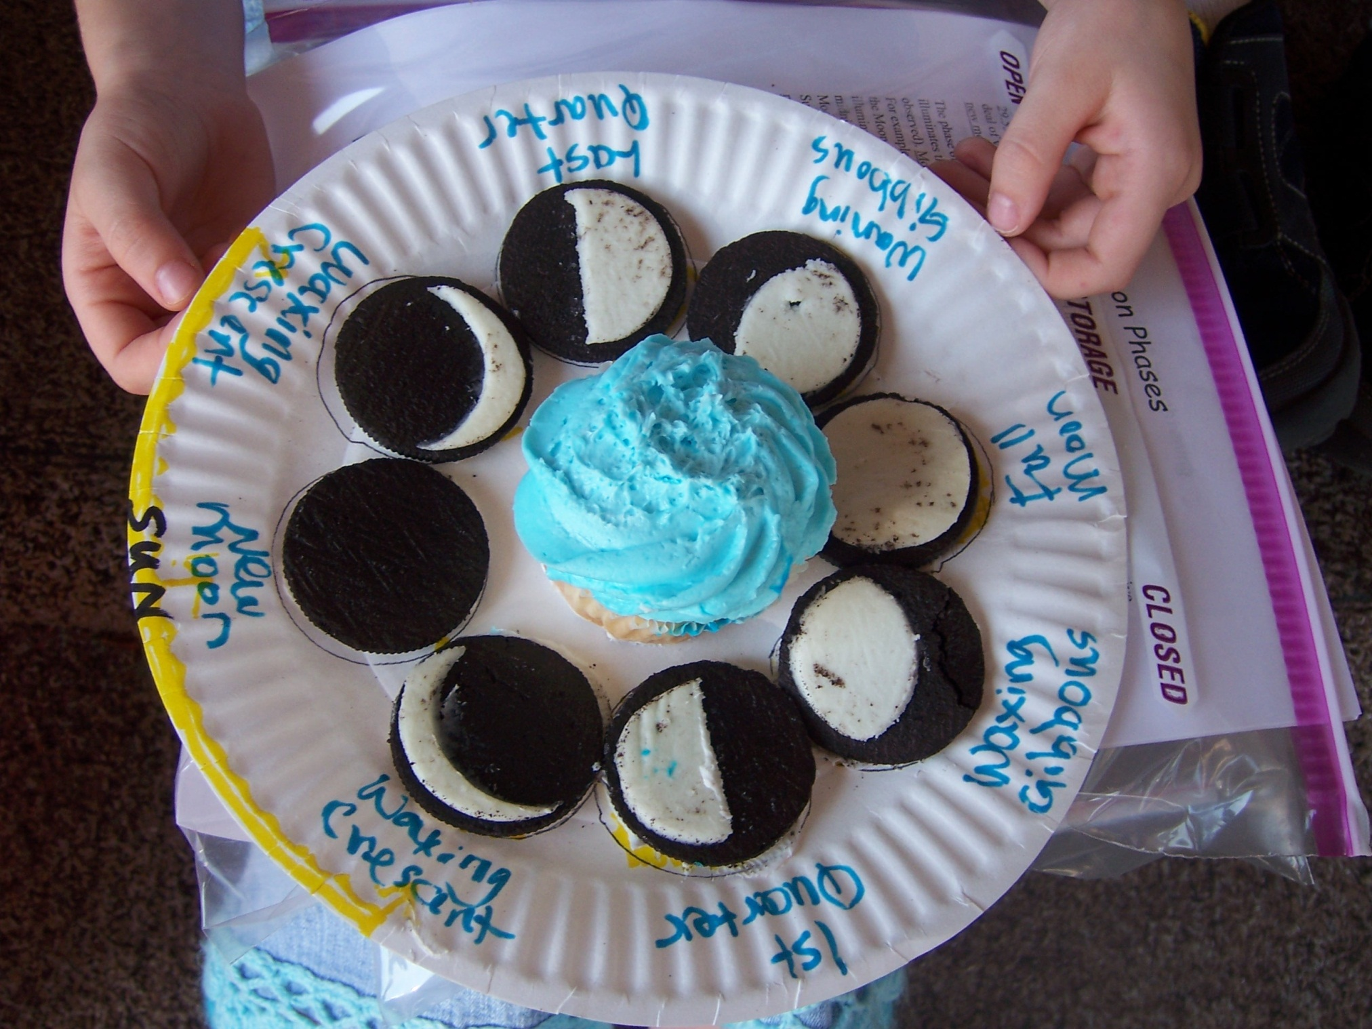

Slide 6
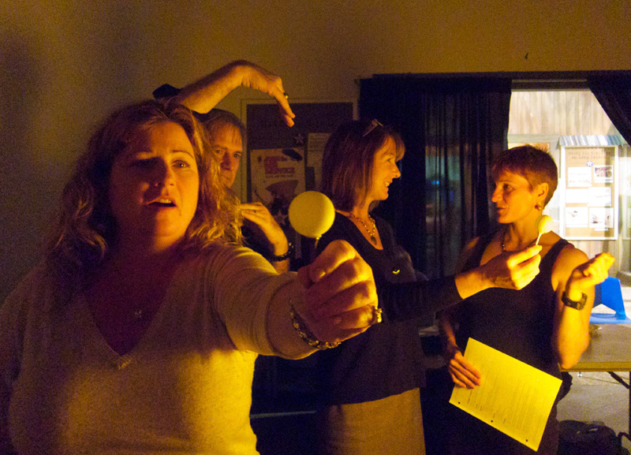
We will now do an experiment to model the phases of the moon.

Slide 7
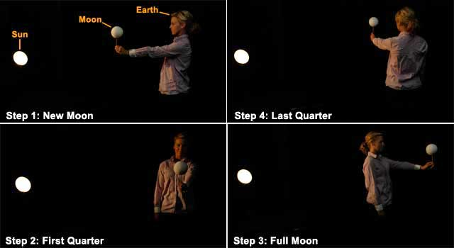
After your experience with the Styrofoam moons and the light bulb sun, write in your own words, what causes the phases of the moon.

Slide 8
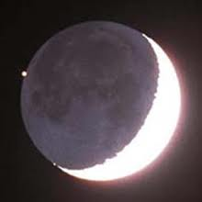
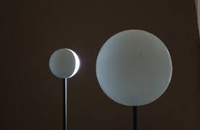
What causes the phases of the moon?
Half of the moon is always lit
Half of the moon is facing earth at all times
BUT the lit half and the facing half aren’t always the same half.
So we can say that the phases of the moon are caused by half of the moon being lit at all times and as the moon orbits the earth, we see different amounts of the lit side.

Slide 9
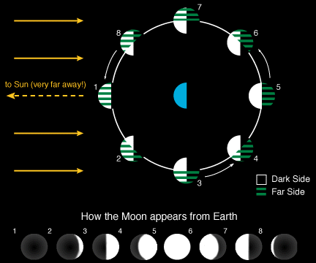

Slide 10
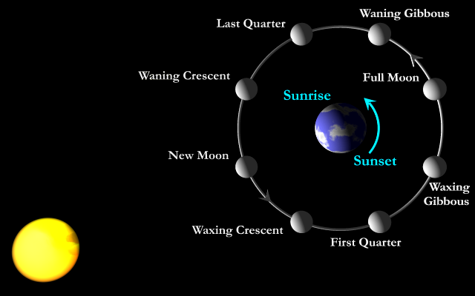
How long does each phase last?
Each phase lasts about 3 ½ days (all the phases total about 29 days)
That means that what ever phase it is for us in New Mexico, that is the phase the whole earth will see.
A New Moon means a New Moon in Paris, Albuquerque, New York, China and Chinle!

Slide 11
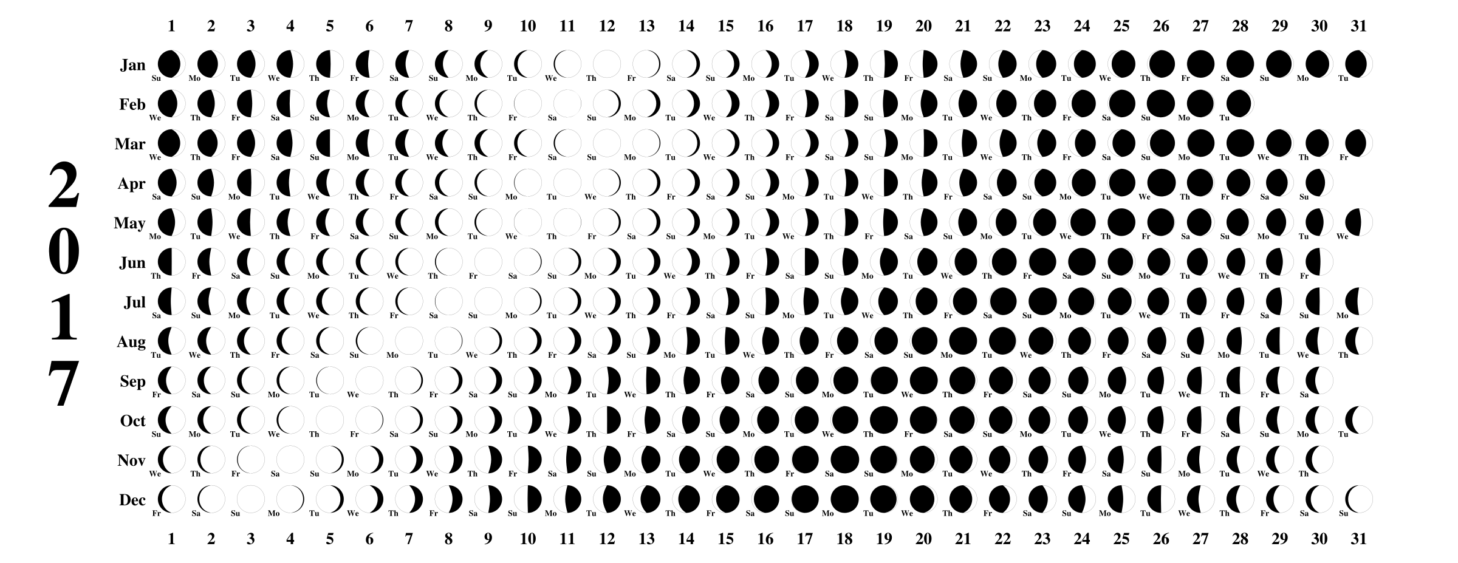
Moon Phase Calendar for 2017

Slide 12
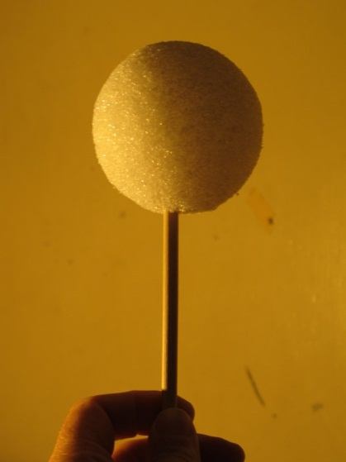
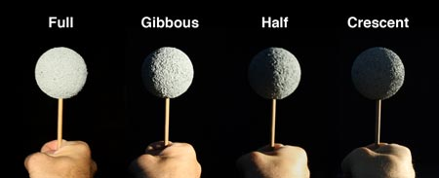
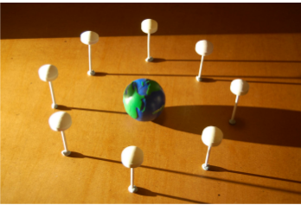
Finishing the notes
Color your notes
Add annotations
Write a Summary
What are the phases of the moon?
What causes the phases of the moon?
What did you learn with the activity?
Write a Response

