Slide 1
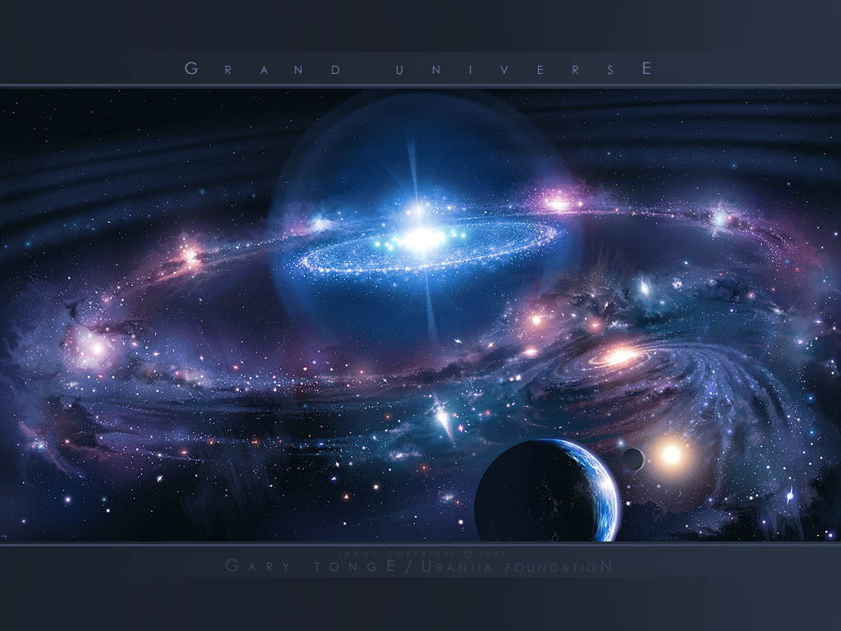
Our Place in Space
Essential Questions
What does the word Universe mean?
What does it entail?
What is a Galaxy? What is our galaxy?
What are Major and Minor planets?
What are some features of the planets?
What is a moon?
What other objects are out there and what do they look like?

Slide 2
Objects in the universe
Define these terms:
Universe Moon
Galaxy Rings
Star Comet
Solar system/Star system Meteor
Sun Meteoroid
Planet Meteorite
Asteroid Nebula

Slide 3
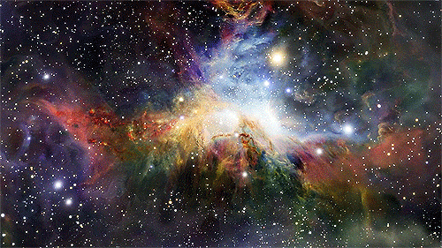
Universe- the totality of all space, time, matter, and energy

Slide 4
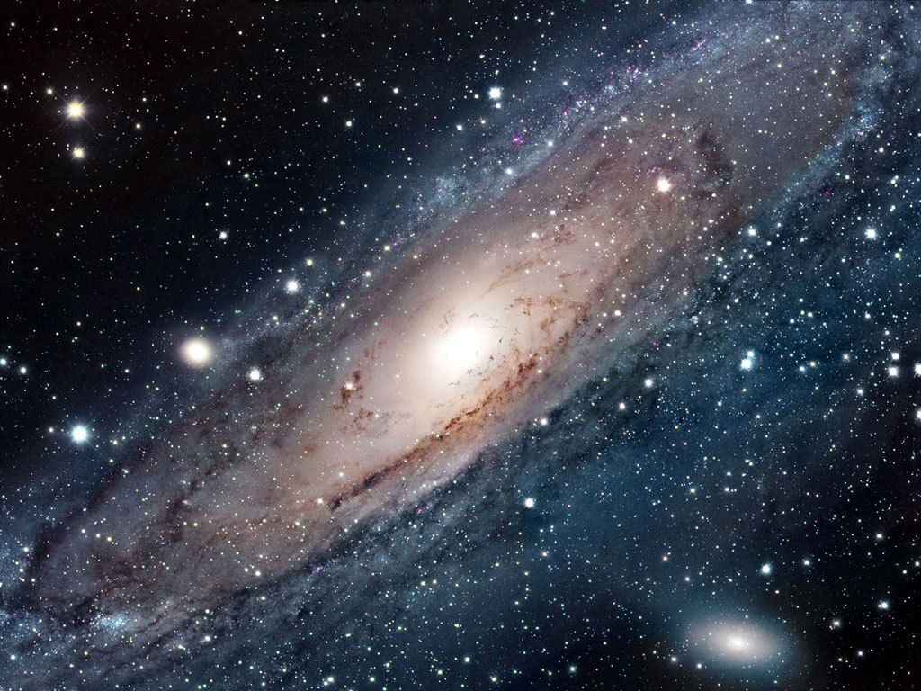
Galaxy-A gravitationally bound collection of stars; the Milky Way is our galaxy

Slide 5
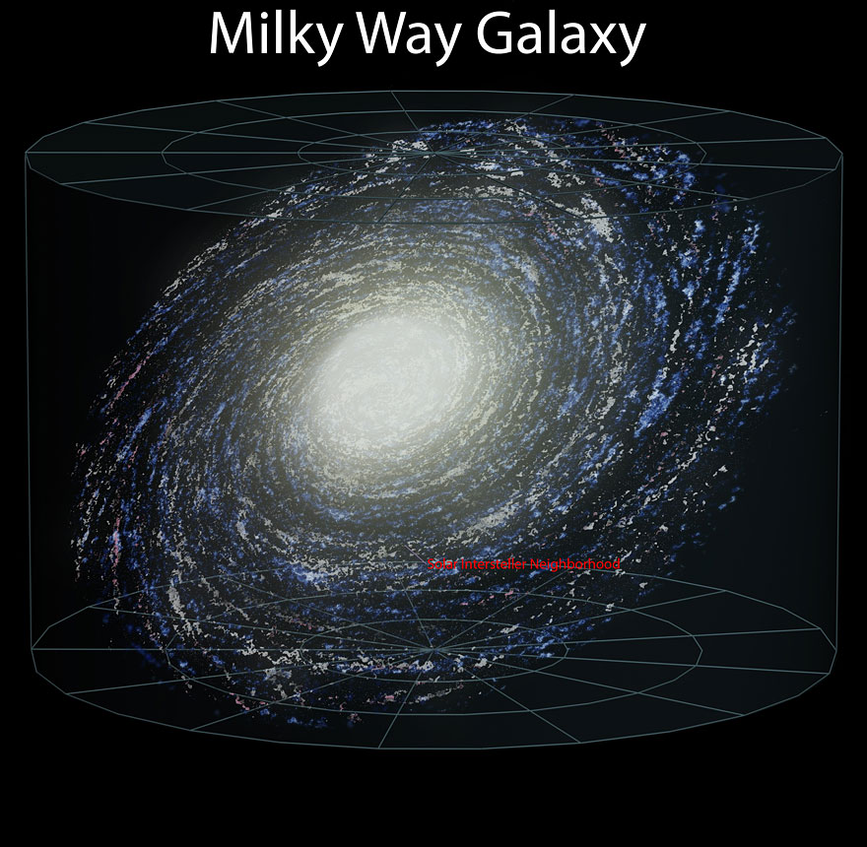

Slide 6
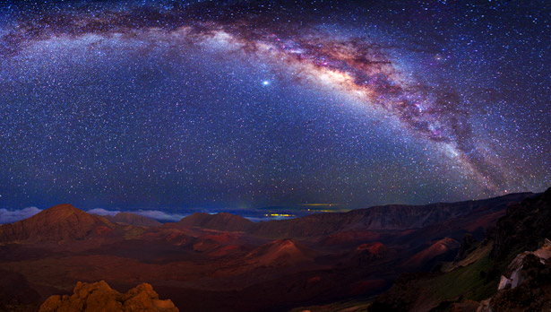
Milky Way From Earth

Slide 7
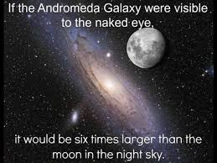

Slide 8
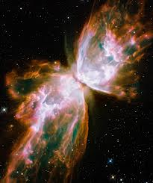
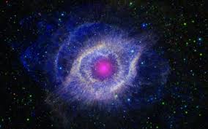
Nebula-a cloud of gas and dust in space. Either the remnants of a star or the birthplace of a star.
Butterfly Nebula
These are star remnants.
Helix Nebula

Slide 9
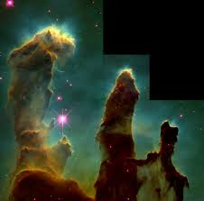
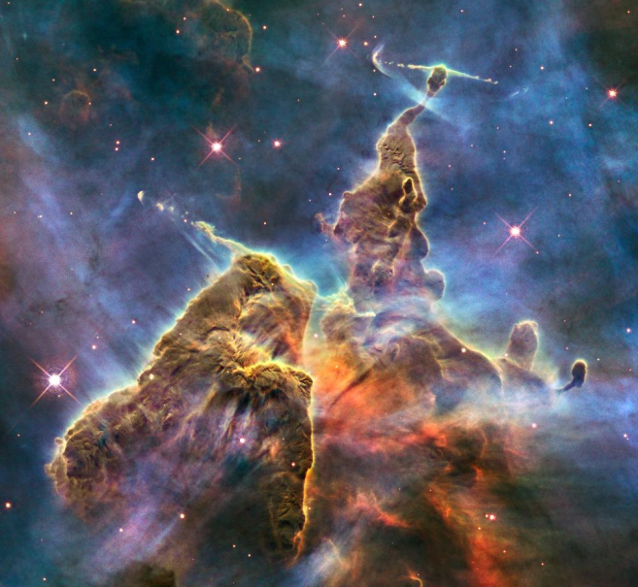
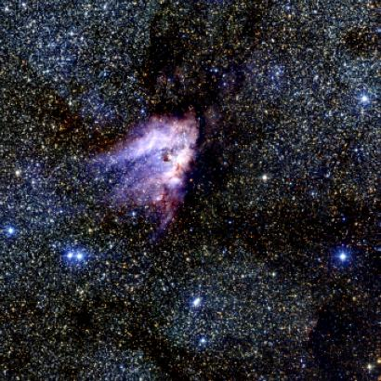
Nebula- interstellar gas and dust, birthplaces of stars; star factories
Eagle Nebula
Carina Nebula
Horseshoe Nebula

Slide 10
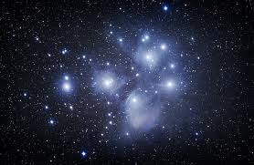
The pleides: young stars that formed in a nebula and the remains of the nebula are still visible.

Slide 11
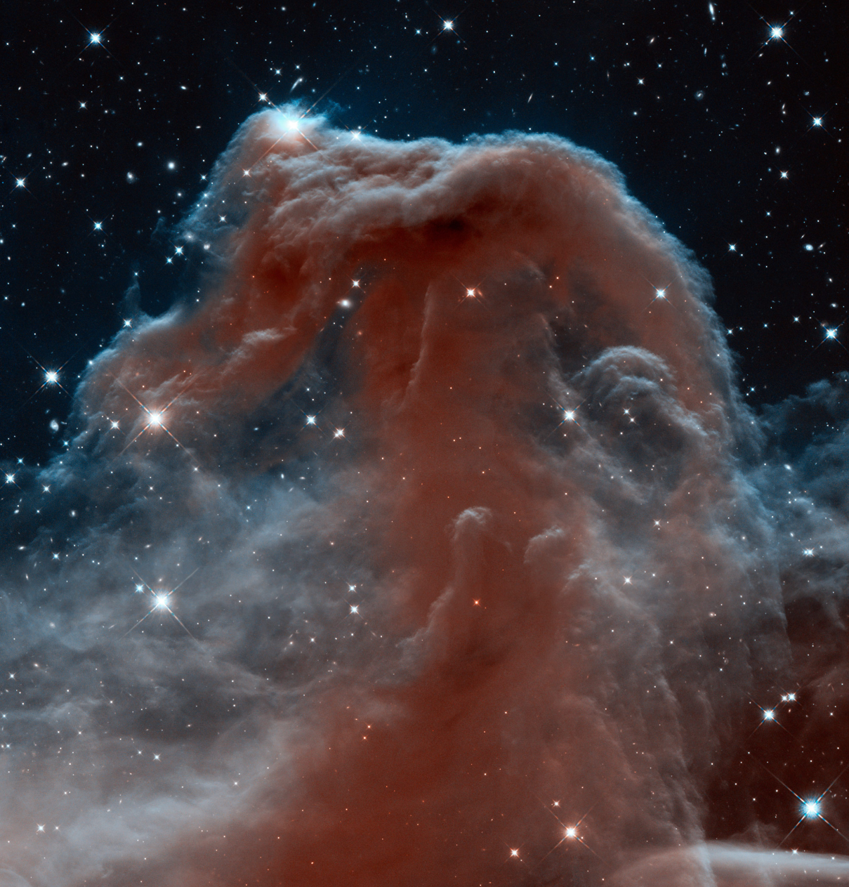
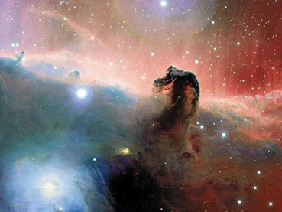
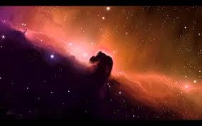
Horsehead nebula
Hubble Telescope view
Ground-based Telescope view

Slide 12
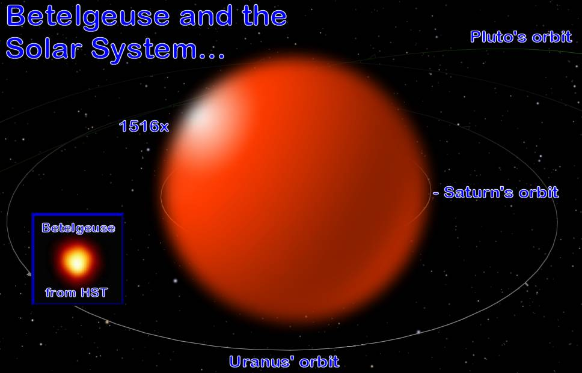
Star-a glowing ball of gas

Slide 13
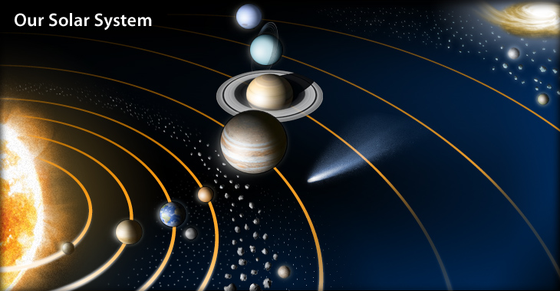
Solar System – (Star System) the sun (or star) and all planets, moons, comets, asteroids, rocks etc. that orbit it.

Slide 14
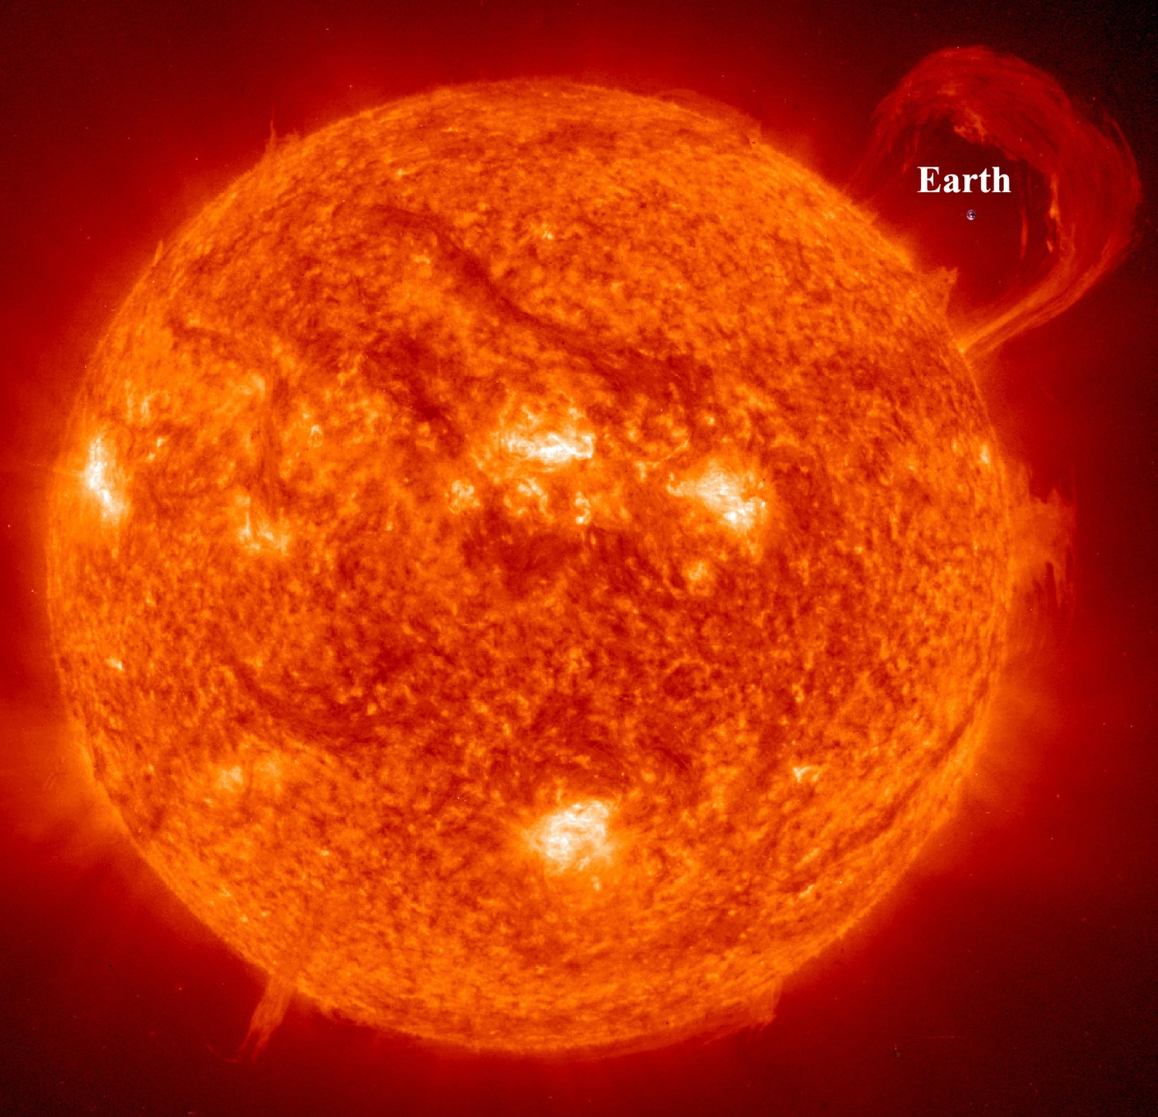
Sun-Our star, gives us light and life.

