Slide 1
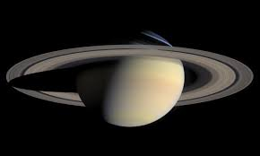
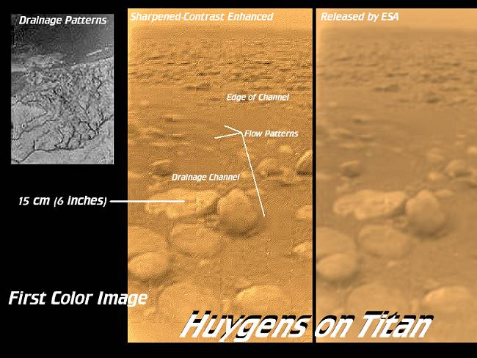
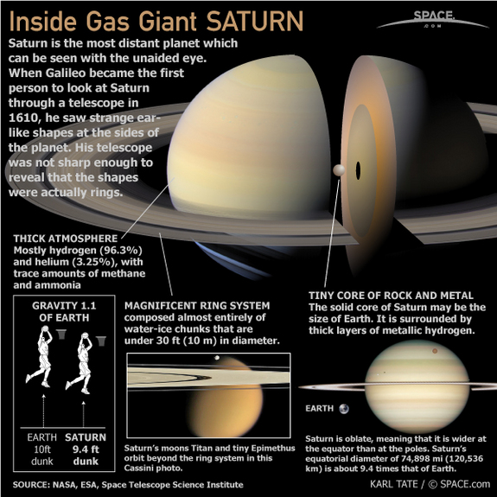
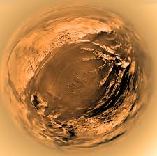
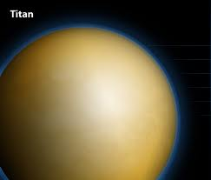
saturn
Saturn’s moon Titan is larger than Mercury
Titan is large enough to have an atmosphere

Slide 2
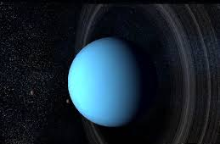
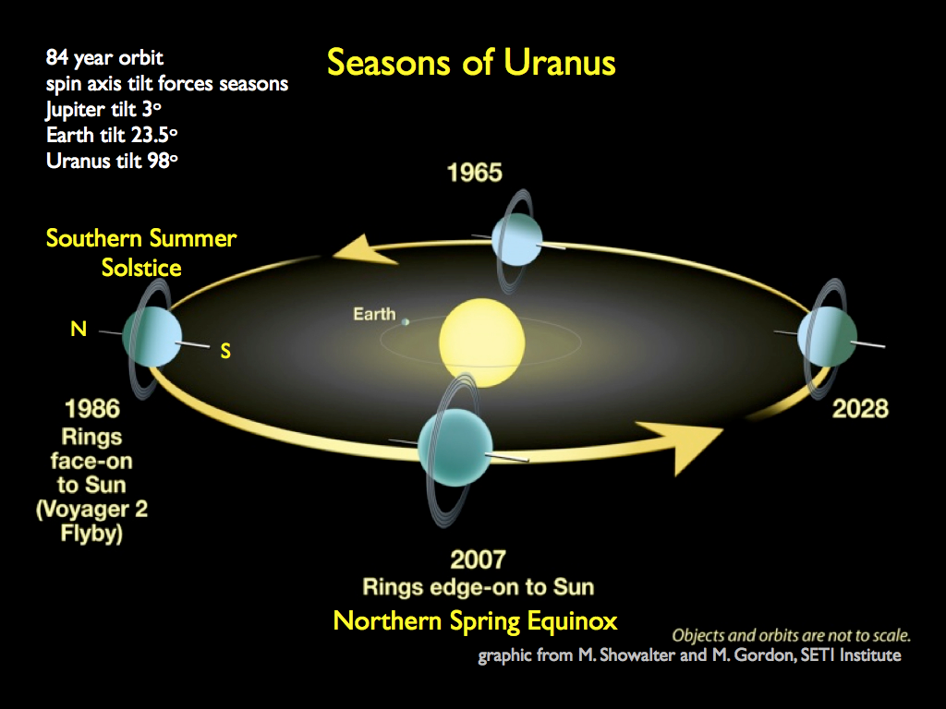
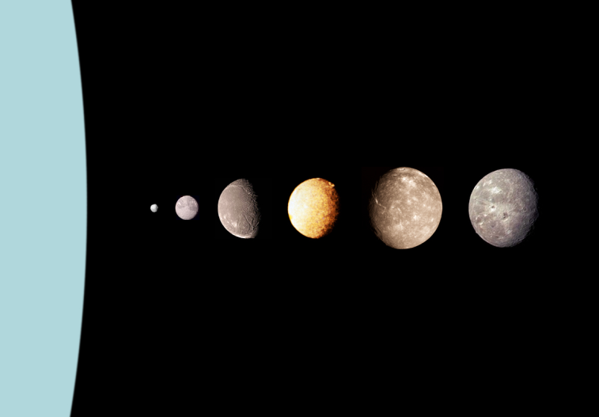
Uranus
Rotates on its side
The rings go around the equator
Is blue because of the Methane in its atmosphere
Uranus takes 84 years to go around the sun
Uranus’ moons are named after
Shakespeare characters

Slide 3
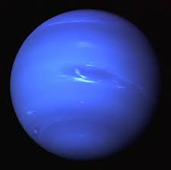
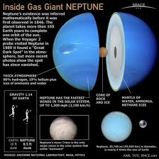
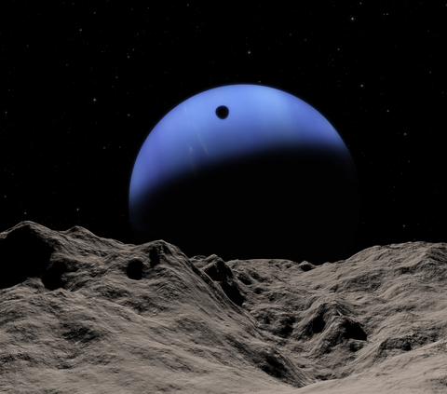
neptune
Also blue because of methane gas in the atmosphere, it has even
more methane than Uranus.
Neptune has the fastest winds in the solar system

Slide 4
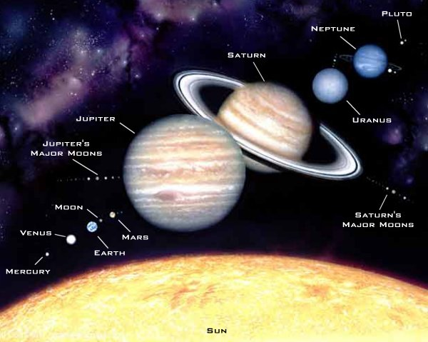
Planets to scale in size

Slide 5
Minor planets
Ceres – the largest asteroid
Pluto – used to be the farthest planet
Charon – Pluto’s moon
Eris – planet ’X’ 2x farther away from sun than Pluto
Minor Planets do not conform to one or more of the criteria for the major Planets
Examples:
Orbits are more eccentric (oval) and not on the same plane as the rest of the planets
(Pluto, Charon, Eris)
The orbit is not clear of other objects (Ceres, Pluto, Charon, Eris )
Does not orbit the sun directly (Charon)

Slide 6
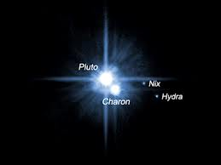
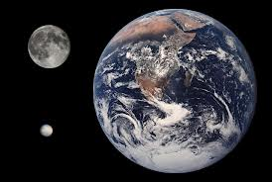
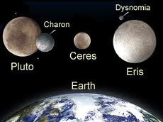
Minor planets
Earth
Charon
moon
Pluto
Ceres

Slide 7
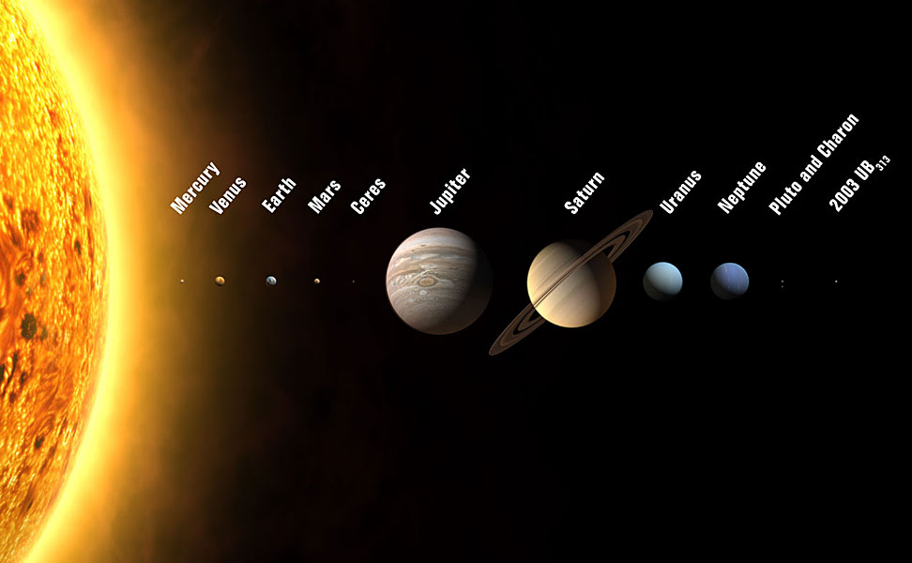
Location of minor planets in our solar system

Slide 8
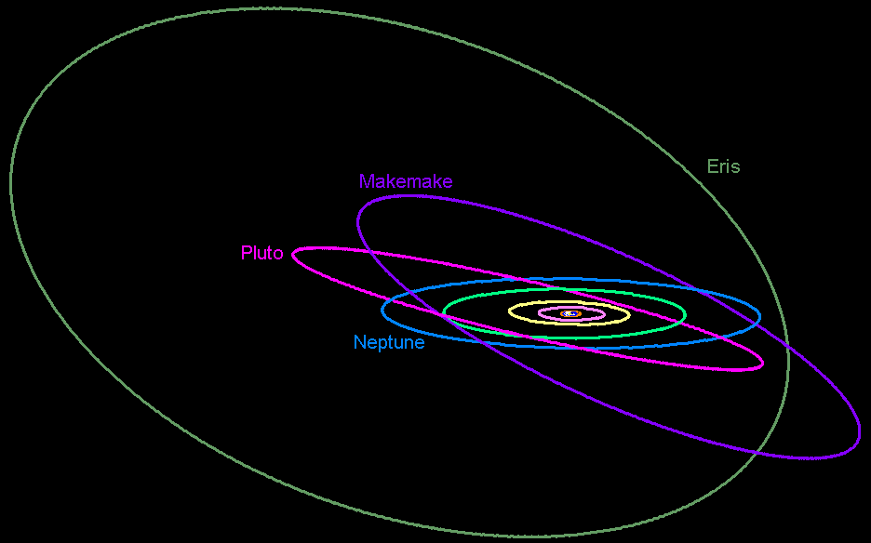
Planet orbits
Notice that some orbits are not in the same plane as the other planets

Slide 9
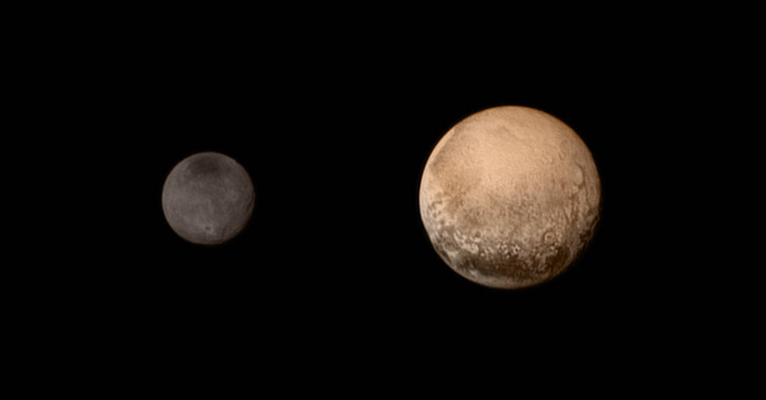
Pluto
Pluto (minor-planet designation: 134340 Pluto) is a dwarf planet in the Kuiper belt, a ring of bodies beyond Neptune. It was the first Kuiper belt object to be discovered.
A portrait from the final approach. Pluto and Charon display striking color and brightness contrast in this composite image from July 11, showing high-resolution black-and-white LORRI images colorized with Ralph data collected from the last rotation of Pluto. Color data being returned by the spacecraft now will update these images, bringing color contrast into sharper focus.

Slide 10
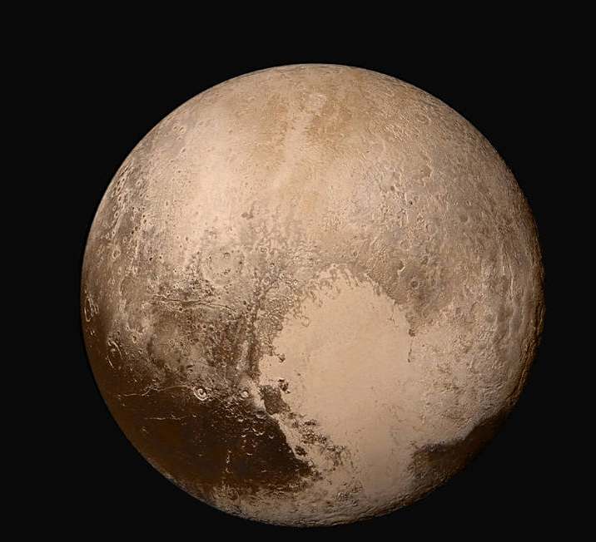

Slide 11
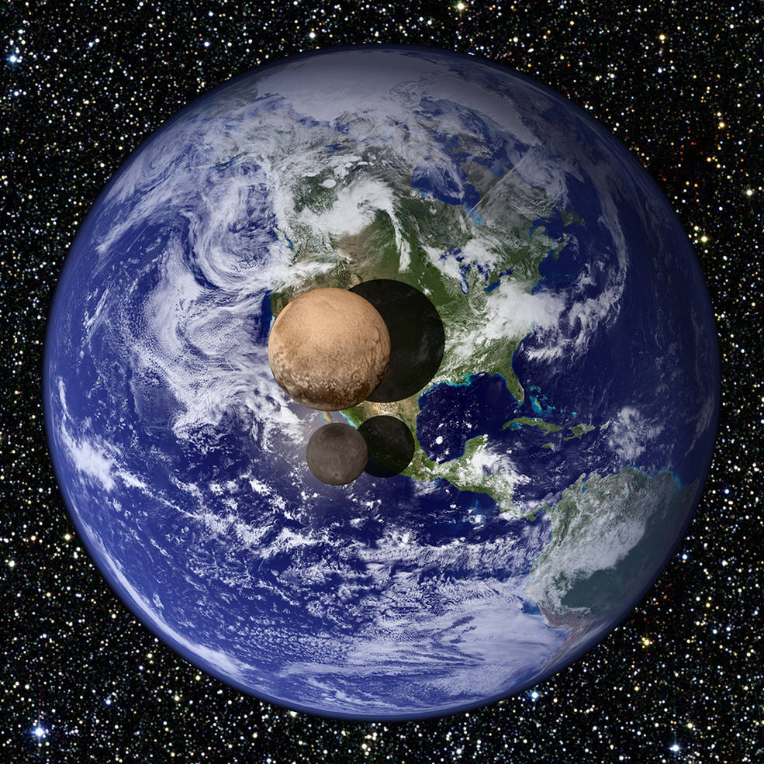

Slide 12
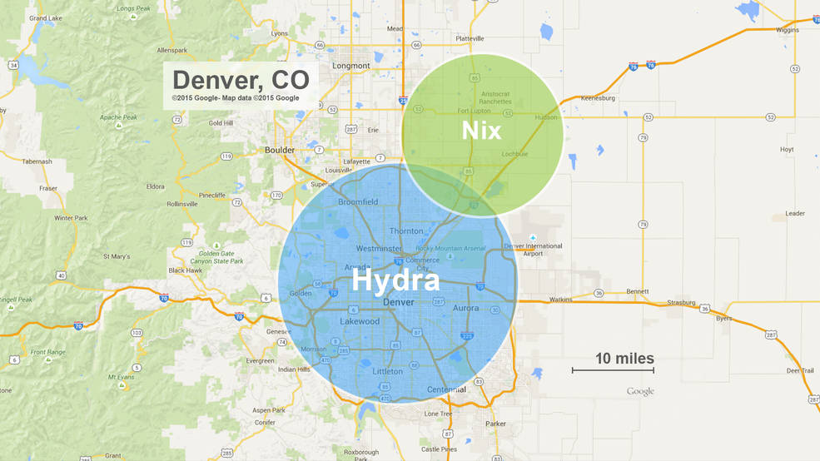
date

Slide 13
Finish your notes
Discuss 3 thoughts/questions/comments/opinions with a partner
Write at least 3 of them (yours or your partner’s) as annotations,
use the sentence starters if you have problems
Color- code!
Write a Summary paragraph (5+ sentences)
Write a Response paragraph (5+ sentences) You can use the
annotations to help you get started on a Response paragraph

