Slide 1
Characteristics of major planets
Must orbit the sun directly, usually in the same general plane
Must be spherical in shape (caused by gravity)
Have enough mass to create enough gravity to clear their orbit
Orbit cannot be too eccentric (squishy) or elliptical (oval)

Slide 2
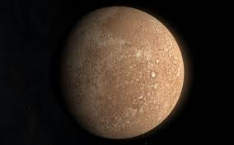
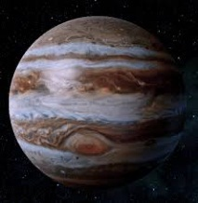
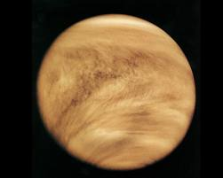
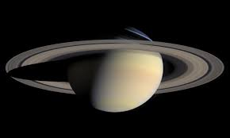
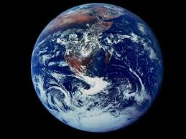
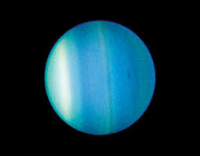
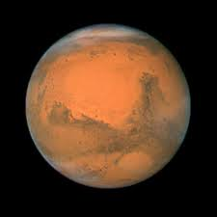
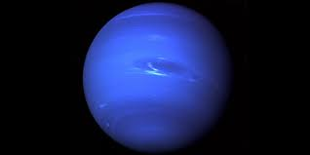
Major planets
Inner or Terrestrial planets
Outer or Jovian planets
Mercury
Venus
Earth
Mars
Jupiter
Saturn
Uranus
Neptune

Slide 3
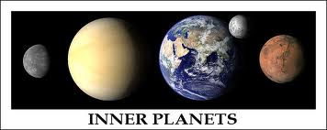
Inner or terrestrial planets
Rocky, metallic or earthy planets. You can stand on them

Slide 4
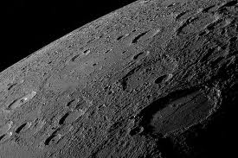
Mercury
Very cratered, similar to the moon. Closest to the sun. No atmosphere

Slide 5
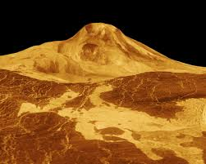
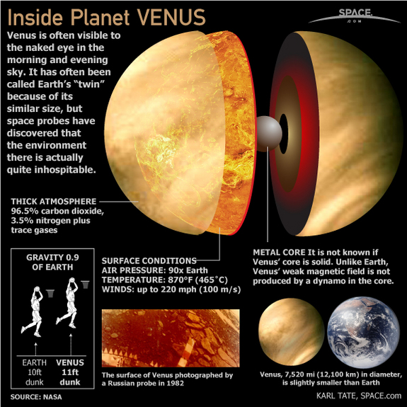
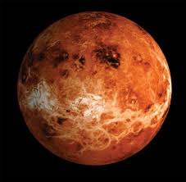
Venus
Venus has acid rain and is about 400°C
Close up of radio mapping
Hottest planet, greenhouse effect, closest to Earth
Radio mapping of Venus
What Venus looks like without clouds

Slide 6
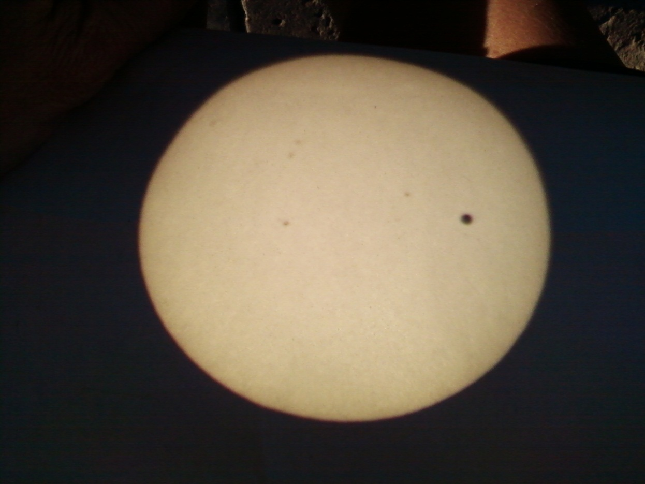
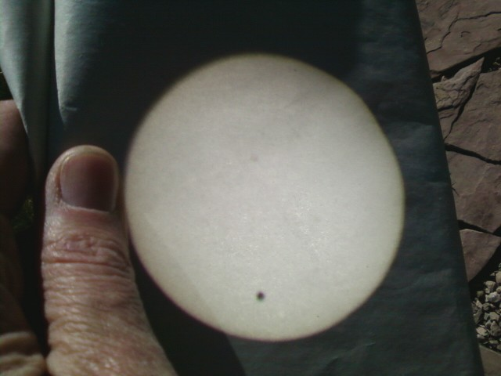
Transition of Venus across the sun
Sunspots!
June 5, 2012
Shadow of Venus
On the sun’s surface
Pictures by Mary Ann Seslar

Slide 7
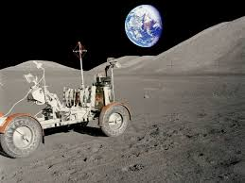
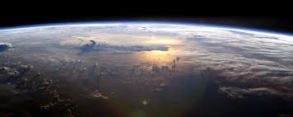
Earth
Only known planet with life

Slide 8
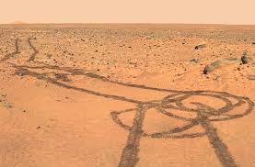
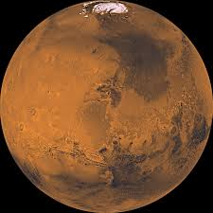
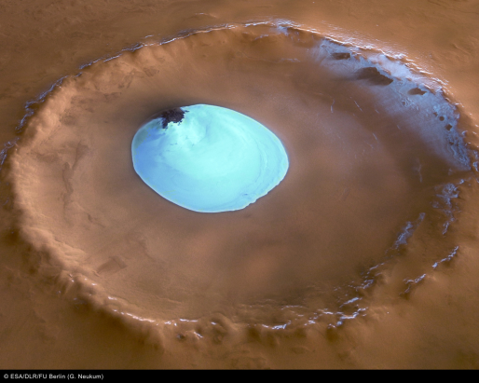
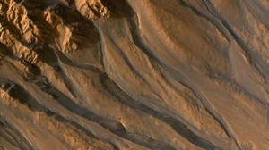
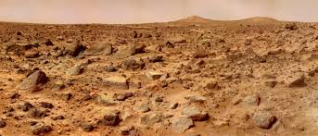
mars
The most visited planet in the solar system
Ice caps on mars- frozen carbon
Dioxide and water
Craters with ice inside
Rover tracks
There used to be water
on Mars
Red dirt, pink sky

Slide 9
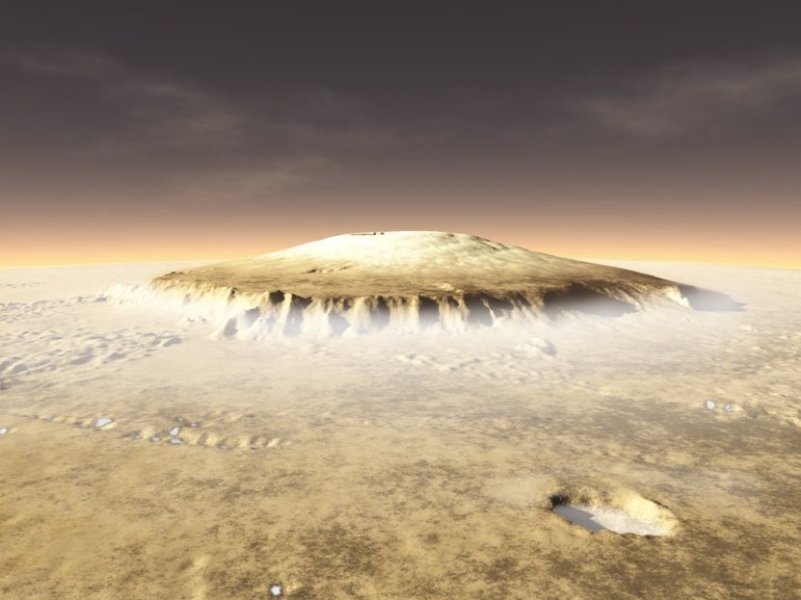
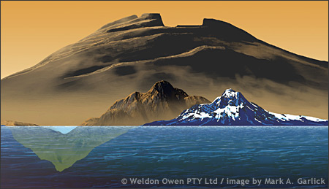
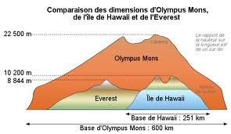
Mars
Olympus Mons (Mount Olympus)- the highest volcano/mountain in the solar system.
Olympus Mons on Mars
Maxwell Montes on Venus
Mauna Kea, Hawaii on Earth

Slide 10
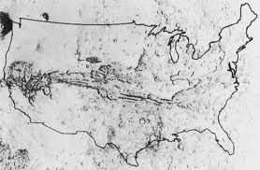
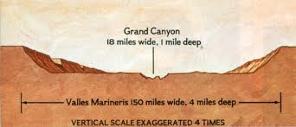
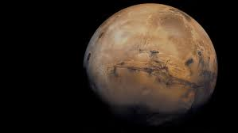
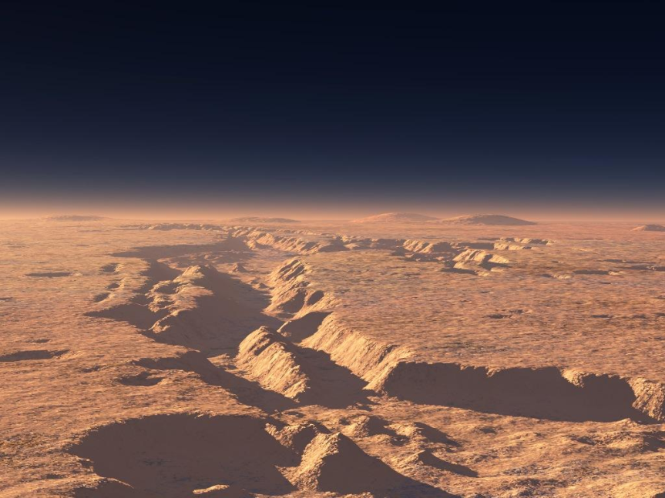
Mars
Valles Marineris (Mariner Valley)

Slide 11
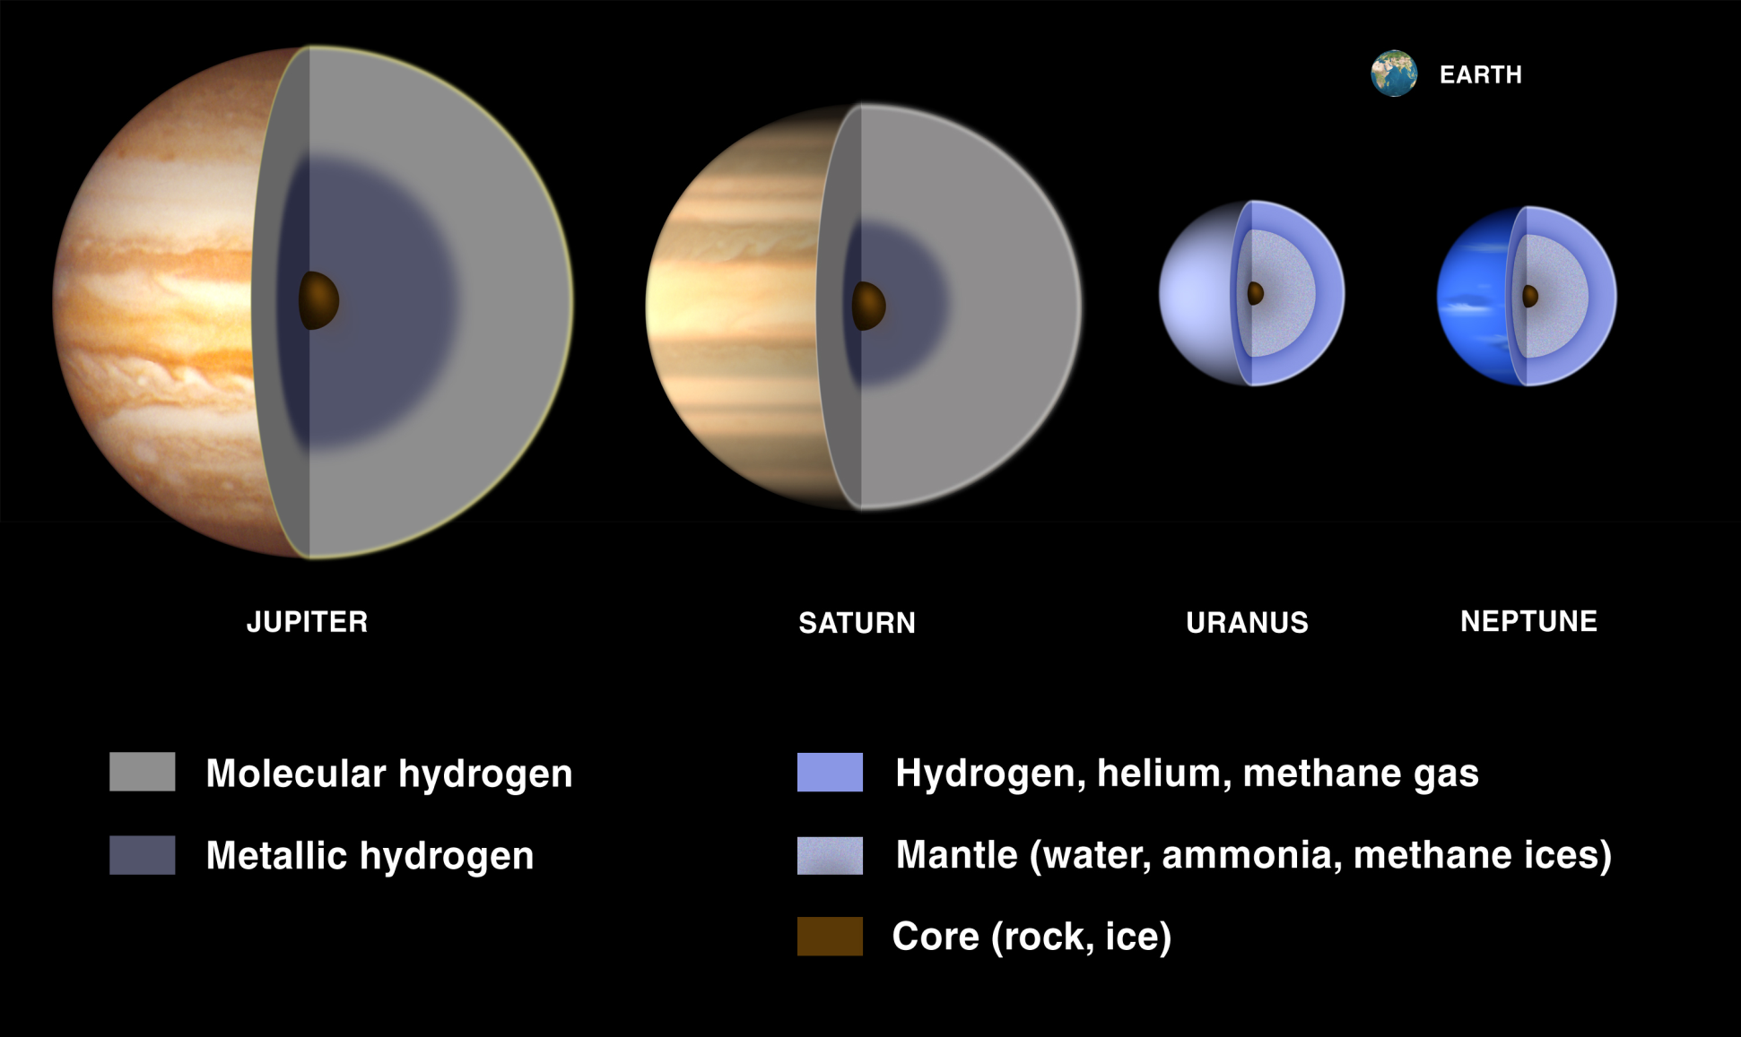
Outer or jovian planets
Much larger, gaseous planets.
You can’t stand on them.

Slide 12
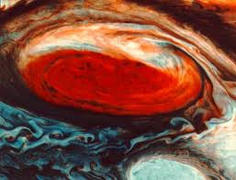
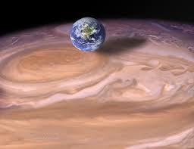
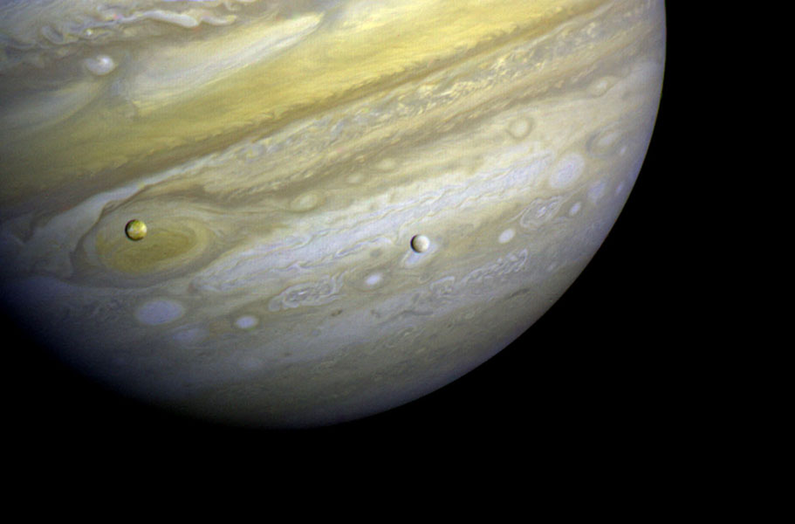
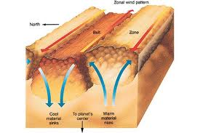
Jupiter
A person would weigh 2.5x more on Jupiter
Largest planet in Solar System.
Has 4 moons discovered by
Galileo. Has 20+ total moons.
Ring discovered in 1979 by
The Voyager missions.
Great Red Spot 3x larger than earth, the planet is
12x larger than earth’s diameter.
Surface of Jupiter is not smooth, the darker areas
are actually deeper and in shadow.
Moons in front of Jupiter

