Slide 1
Vocabulary: Objects in the Universe

Slide 2
Objects in the universe
Define these terms:
Universe
Galaxy
Nebula
Star
Solar system/Star system
Sun
Planet
Moon
Rings
Comet
Asteroid
Meteoroid
Meteor
Meteorite

Slide 3
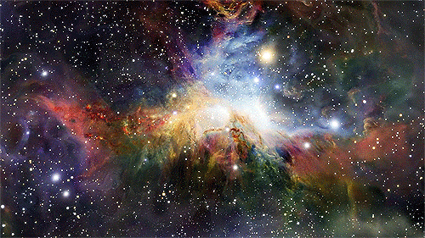
1. Universe- the totality of all space, time, matter, and energy

Slide 4
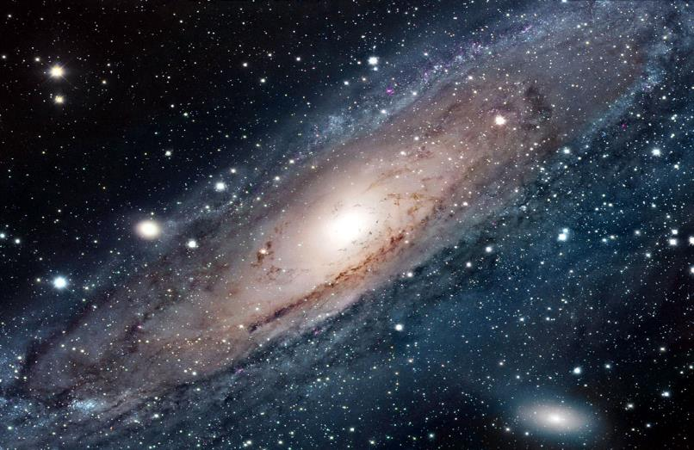
2. Galaxy-A gravitationally bound collection of stars; the Milky Way is our galaxy

Slide 5
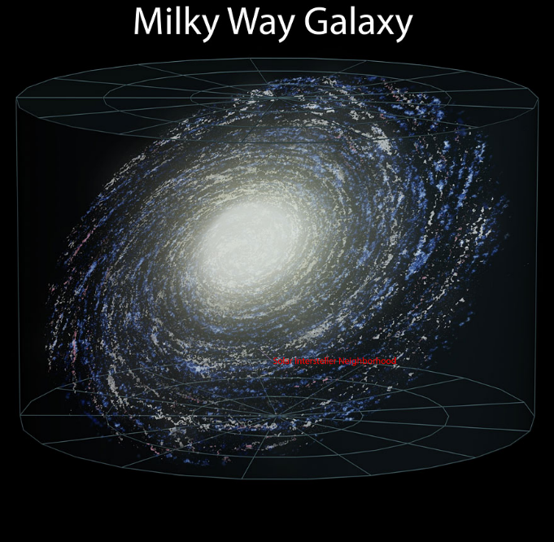

Slide 6
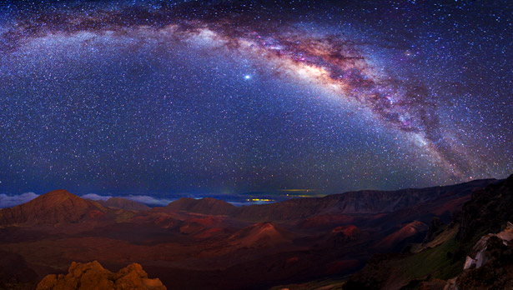
Milky Way From Earth

Slide 7
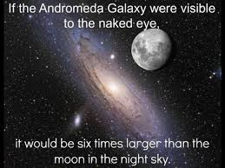

Slide 8
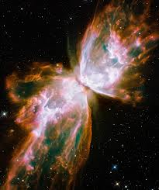
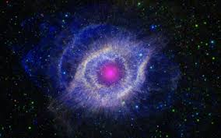
3. Nebula-a cloud of gas and dust in space. Either the remnants of a star or the birthplace of a star.
Butterfly Nebula
These are star remnants.
Helix Nebula

Slide 9
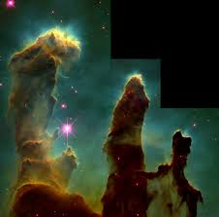
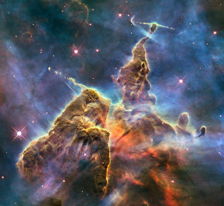
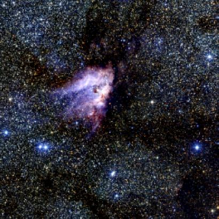
Nebula- interstellar gas and dust, birthplaces of stars; star factories
Eagle Nebula
Carina Nebula
Horseshoe Nebula

Slide 10
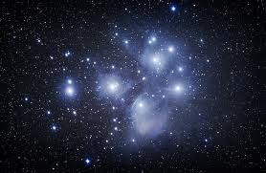
The pleides: young stars that formed in a nebula and the remains of the nebula are still visible.

Slide 11
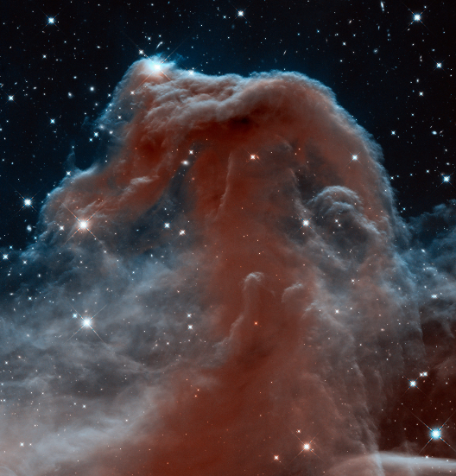
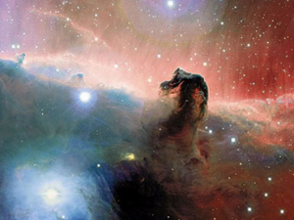
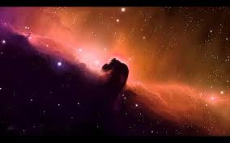
Horsehead nebula
Hubble Telescope view
Ground-based Telescope view

Slide 12
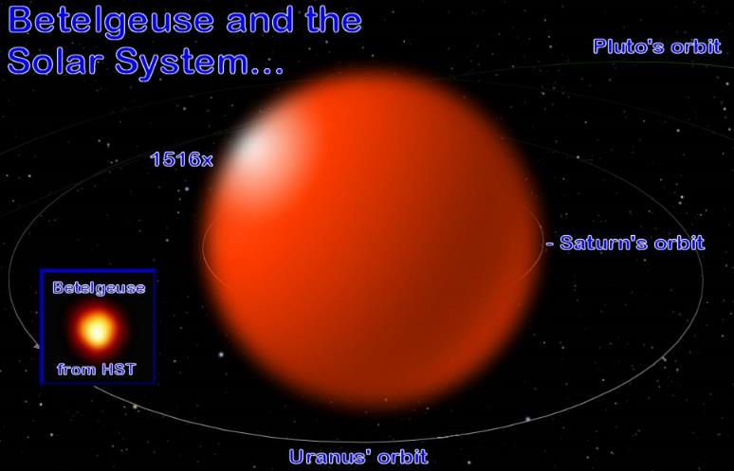
4. Star-a glowing ball of gas

Slide 13
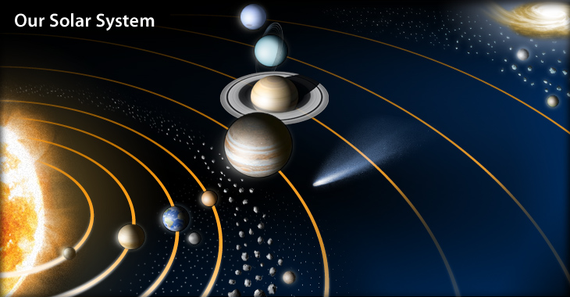
5. Solar System – (Star System) the sun (or star) and all planets, moons, comets, asteroids, rocks etc. that orbit it.

Slide 14
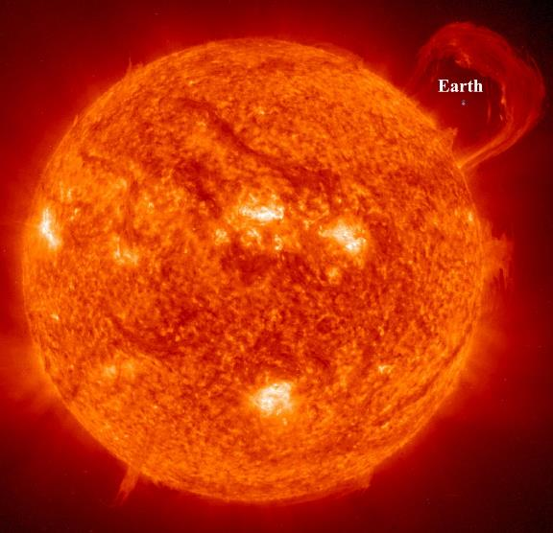
6. Sun-Our star, gives us light and life.

Slide 15
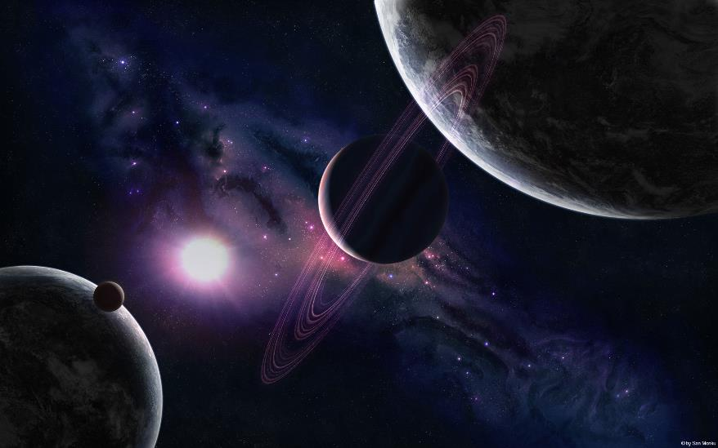
7. Planet- a body that orbits a star directly

Slide 16
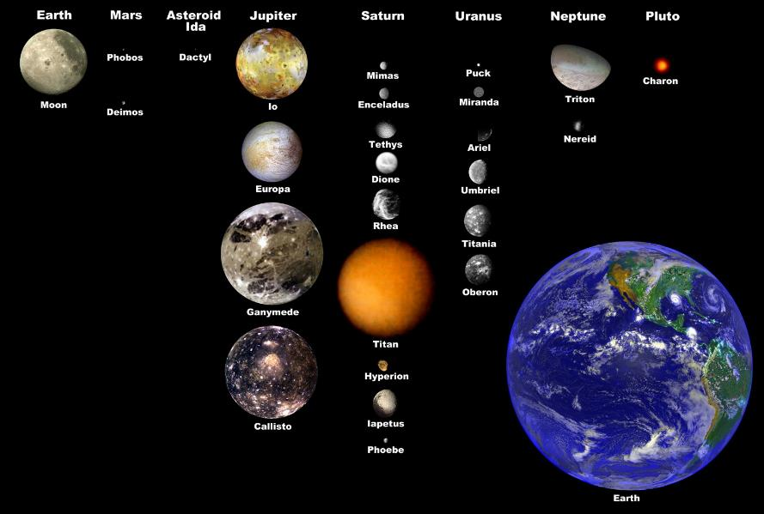
8. Moon- a body that orbits a planet

Slide 17
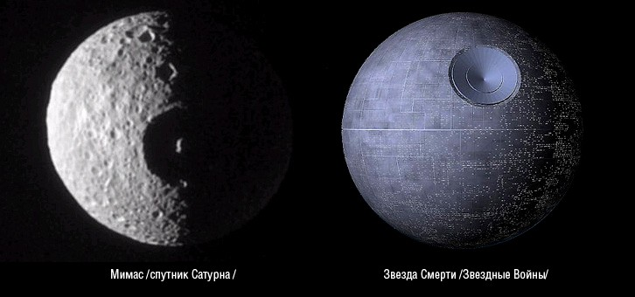
MOONS?
Mimas, moon of Saturn
Death Star

Slide 18
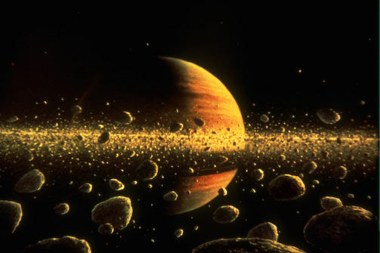
9. Rings-Material (ice, dust, rock) organized in thin, flat areas that circle a planet’s equator. All the gas giant planets have rings.

Slide 19
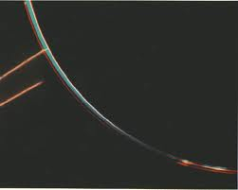
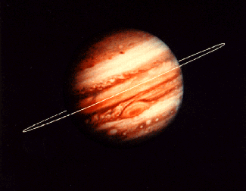
JUPITER

Slide 20
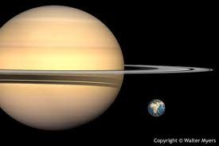
sATURN

Slide 21
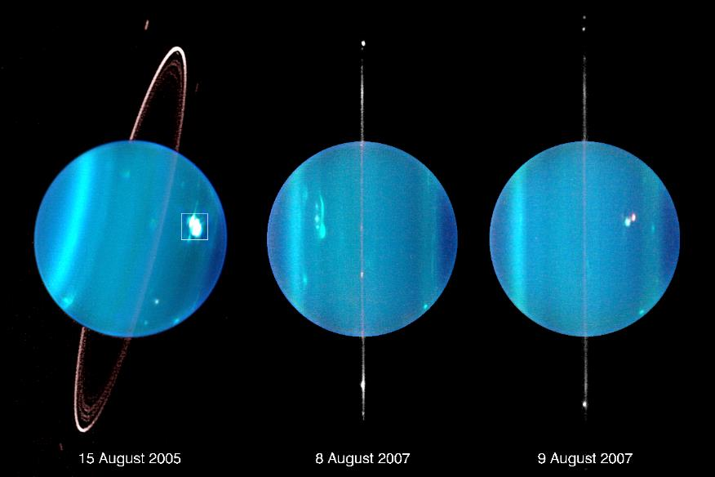
URANUS

Slide 22
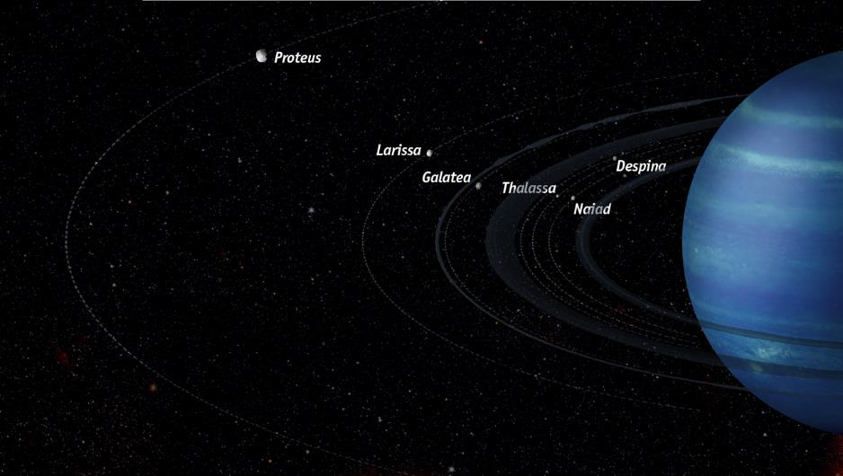
neptune

Slide 23
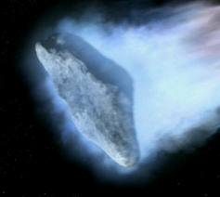
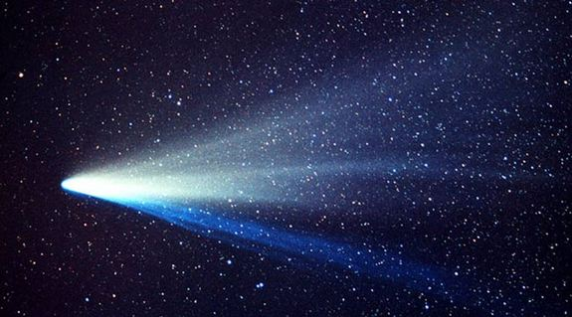
10. Comet-chunk of ice, rock, dust (dirty, icy, snowball) with an elliptical orbit. Originates in the Kuiper Belt beyond Pluto.

Slide 24
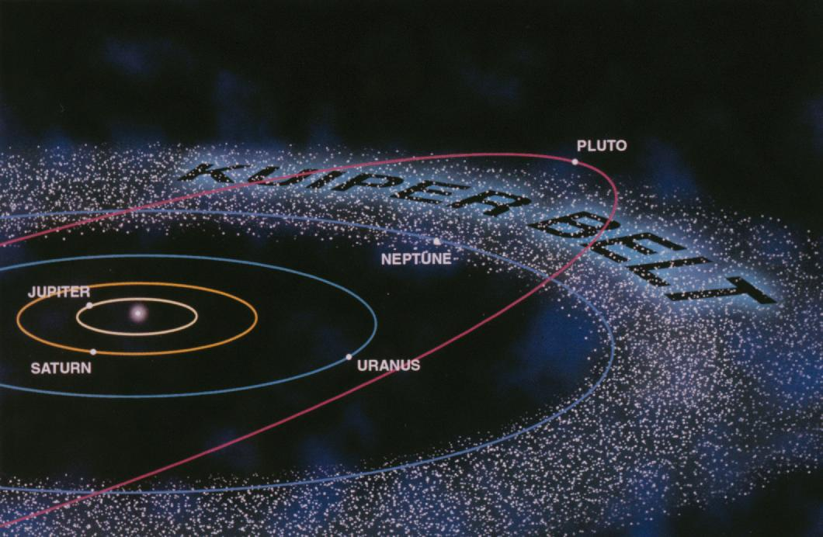
Kuiper belt
Comet orbit

Slide 25
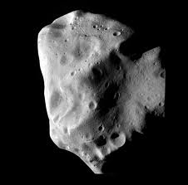
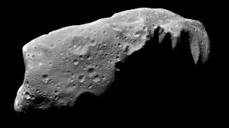
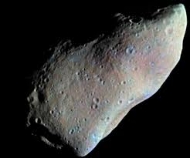
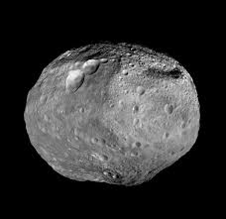
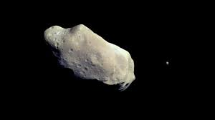
11. Asteroid-space rocks. A belt of them is found between Mars and Jupiter

Slide 26
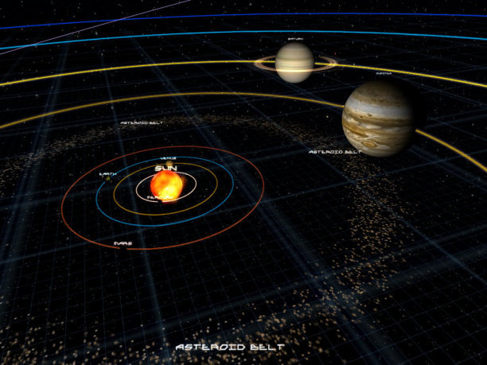
Asteroid belt

Slide 27
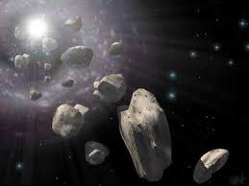
12. Meteoroid- small space rock

Slide 28
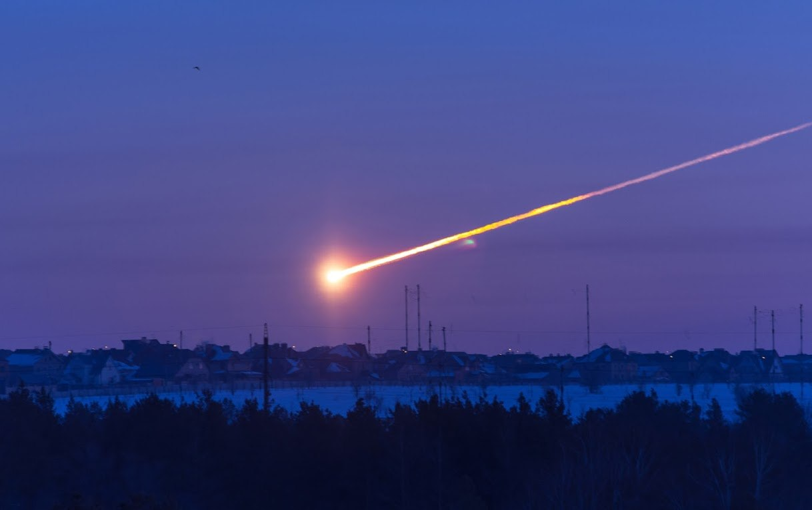
13. Meteor- a space rock that has entered Earth’s atmosphere

Slide 29
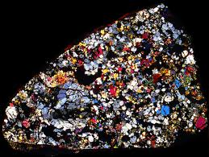
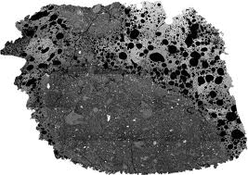
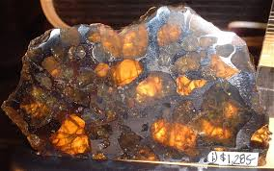
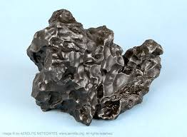
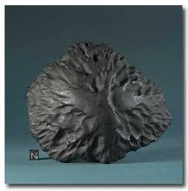
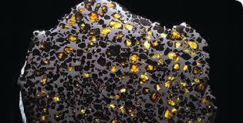
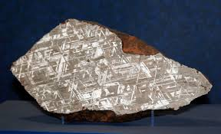
14. Meteorite- the part of the meteor that survives to the earth’s surface.

Slide 30
Fill out 2 pages in your notebook with 3 columns word Definition Picture
word
definition
picture

