Slide 1
Which way does the moon go?
Can we figure out which way is ‘up’ on the moon?
What are the dark areas on the moon?
How does this help us?

Slide 2
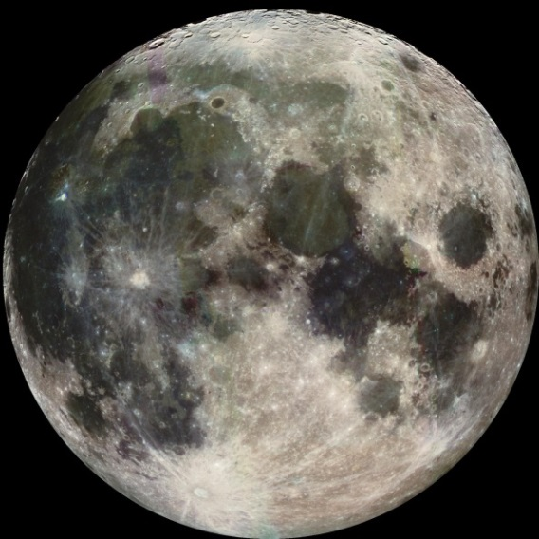
Oceans on the Moon
Oceans of Lava called ‘mare’
‘Maria’ is plural for mare- Latin for sea
The Dark parts are hardened, cooled lava.
The rock is called basalt.

Slide 3
Which show the North to the top of the picture and South to the bottom of the picture?

Slide 4
North
South

Slide 5
These pictures are not arranged so the north is up and south is down. When you cut your pictures out arrange them correctly
This is correct!

Slide 6
We cannot see the New Moon, it is all in shadow. Arrange your pictures of the moon like the shapes above but also with the north facing up and south facing down.

Slide 7
Assignment
1. Cut out the moons
2. Arrange them so the features match the north and south of the moon.
Arrange them in order of the different phases. (slide 6)
Label the moon phases with the names of the phases.

Slide 8
North
Waxing crescent
Waning crescent

