Slide 1
Months
Part 2

Slide 2
Comparing Sidereal and Synodic months

Slide 3
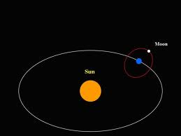
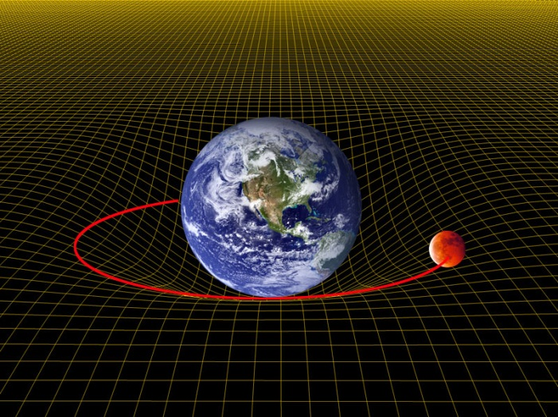
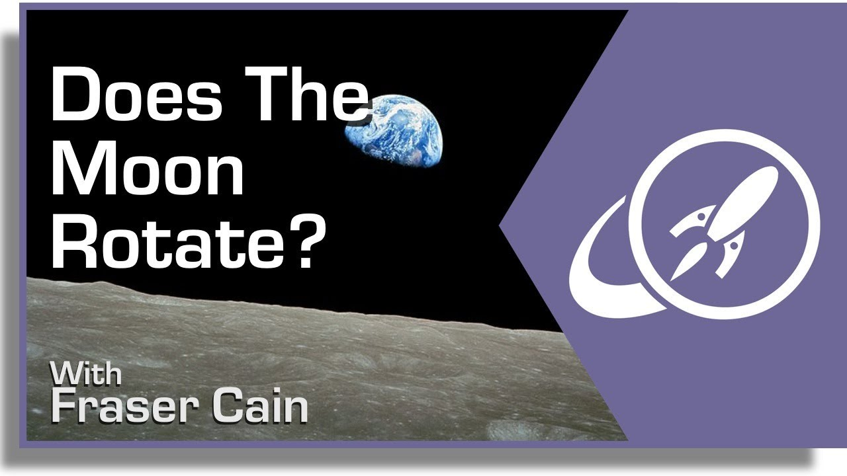
Months are caused by the motions of the moon
Revolution- the moon orbits the earth
Rotation- the moon spins on its axis
Revolution- the moon goes around the sun with the earth
YES!

Slide 4
Which shows the correct path?

Slide 5
What do the motions of the moon look like?

Slide 6
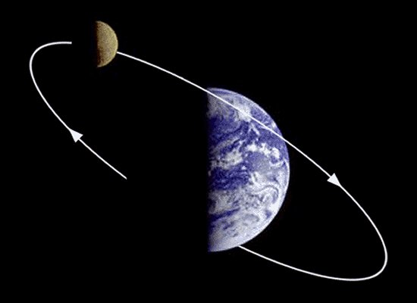
#1. The Moon’s revolution around the Earth and sun
The moon doesn’t precisely revolve around the Earth. The Earth and moon revolve around each other as they orbit the sun.
The picture at right
doesn’t show an
accurate depiction
of the truth.

Slide 7
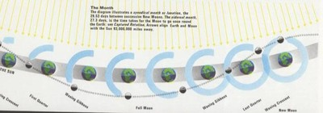
orbit
The yellow lines represent the noon sun each day of the month. As the earth moves, it drags the moon with it.

Slide 8
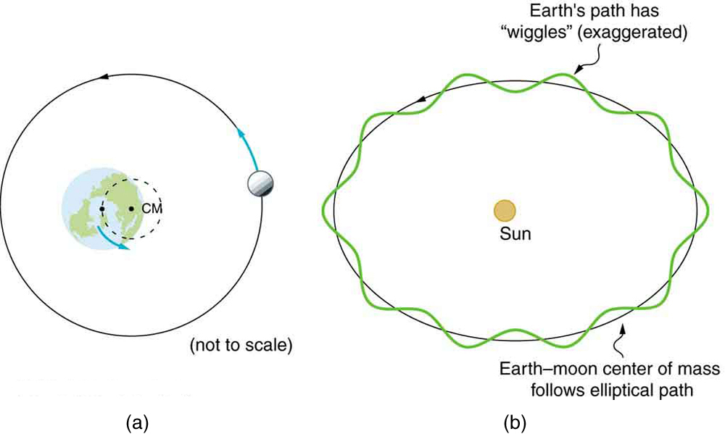

Slide 9
m
Moon
Earth

Slide 10
mz
Moon
Earth

Slide 11
m
Moon
Earth

Slide 12
m
Moon
Earth

Slide 13
This is an extremely
exaggerated drawing

Slide 14
#2. The Moon always shows the same face to the earth
This is because the period of revolution(orbiting) is exactly the same as the period of rotation (spinning)
Therefore, the moon does spin on its axis, it is just that the earth is inside the spin so we only see one side of the moon
The side we don’t see is called the “Far Side of the moon”
The first time we ever saw the far side was when astronauts sent back photos taken when they orbited the moon during the Apollo missions

Slide 15
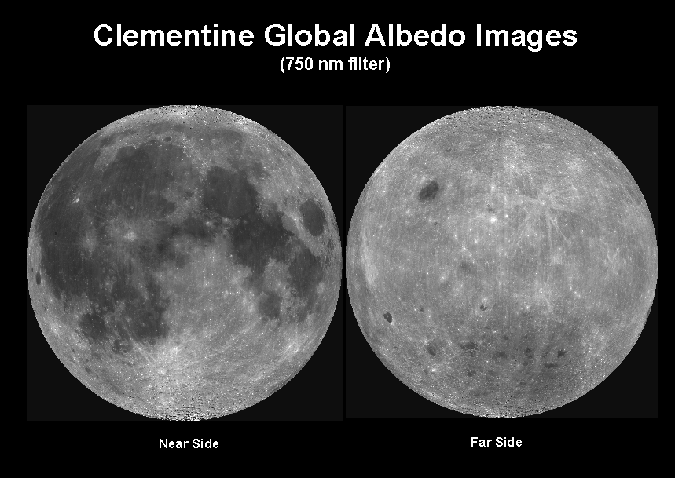
The Far side of the Moon

Slide 16
Seas on the moon?
The ancient people thought that the moon was just like Earth; if the earth had land and water, then so did the moon.
Ancients thought that the dark areas on the moon were the seas. They called them mare (sea in Latin; maria plural).
They were partly right, the dark areas are seas of lava, made from basalt, a rock made from hardened lava
These ‘seas’ haven’t been liquid for millions and millions of years.

Slide 17
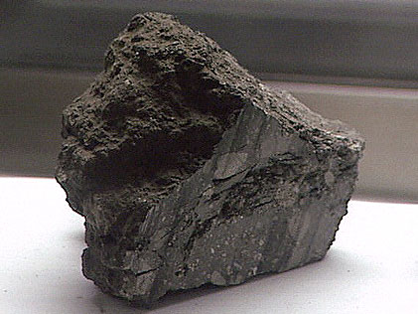
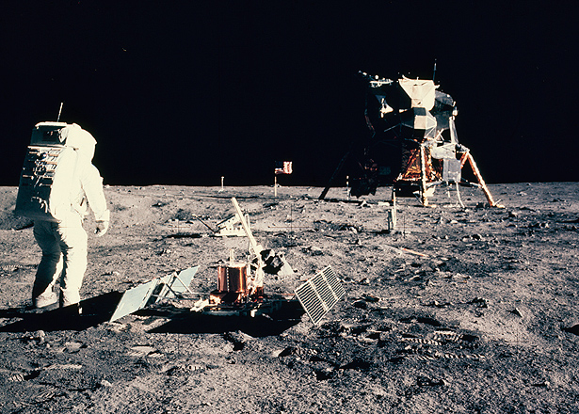
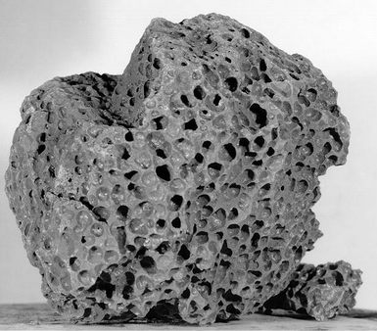
Moon Basalt
Moon Basalt Scoria (basalt with holes)

Slide 18
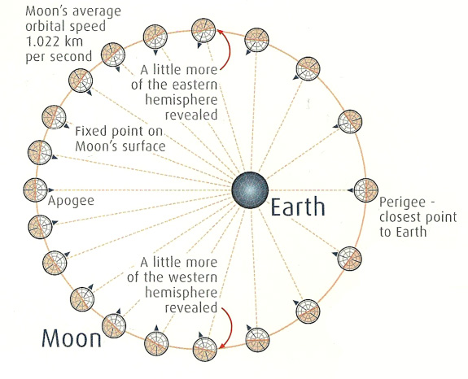
Why we only see one side of the moon but it still rotates on its axis

Slide 19
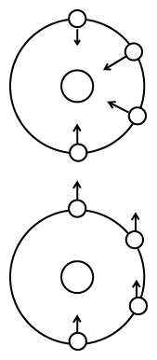
Rotation
Non-rotation

Slide 20
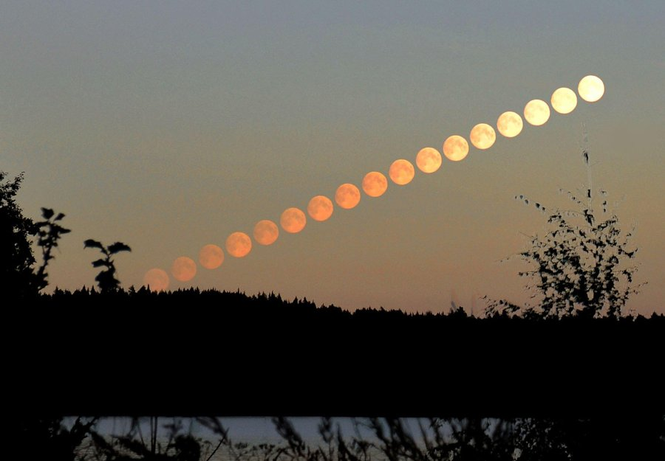
#3. The Moon appears to move across the sky every night.
The moon looks like it is moving from east to west because the earth is spinning.
This is not a real motion, this is apparent motion
These photos were taken a few minutes apart and put together in one image.
The moon appears to have moved up and to the right (E-W)
Apparent moon motion
E
W
Actual earth motion

Slide 21
#4. The moon actually moves from west to east.
The moon is moving in its orbit around the earth a little each day.
the moon travels a small part of its orbit every day
The amount the moon moves is about 12º every day.

Slide 22
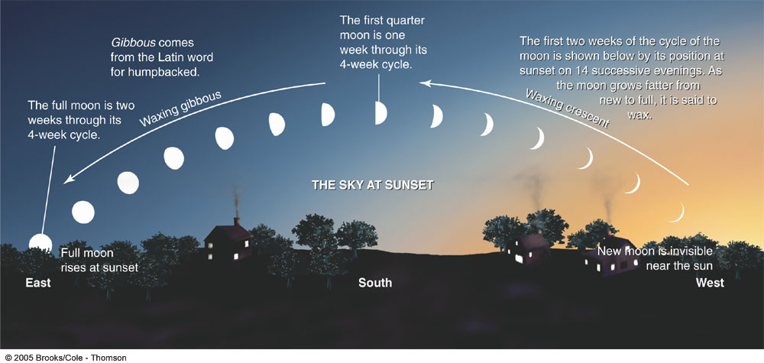
Composite photo of moon positions during a half month
12º
12º
12º
12º
This photo shows the moon the same time every night for half a month

Slide 23
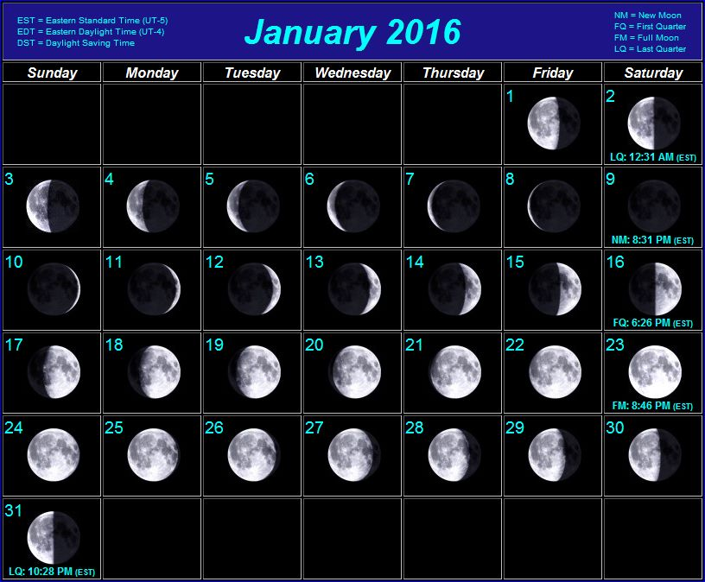
Finish your notes!
Annotations
Color coding
Write a summary
Write a response
You will a have an open-note quiz over the notes! Be sure you have good notes!

