Slide 1
Lab Equipment
What equipment are we going to use in the lab?
What is it used for?
What are the names of the equipment?

Slide 2
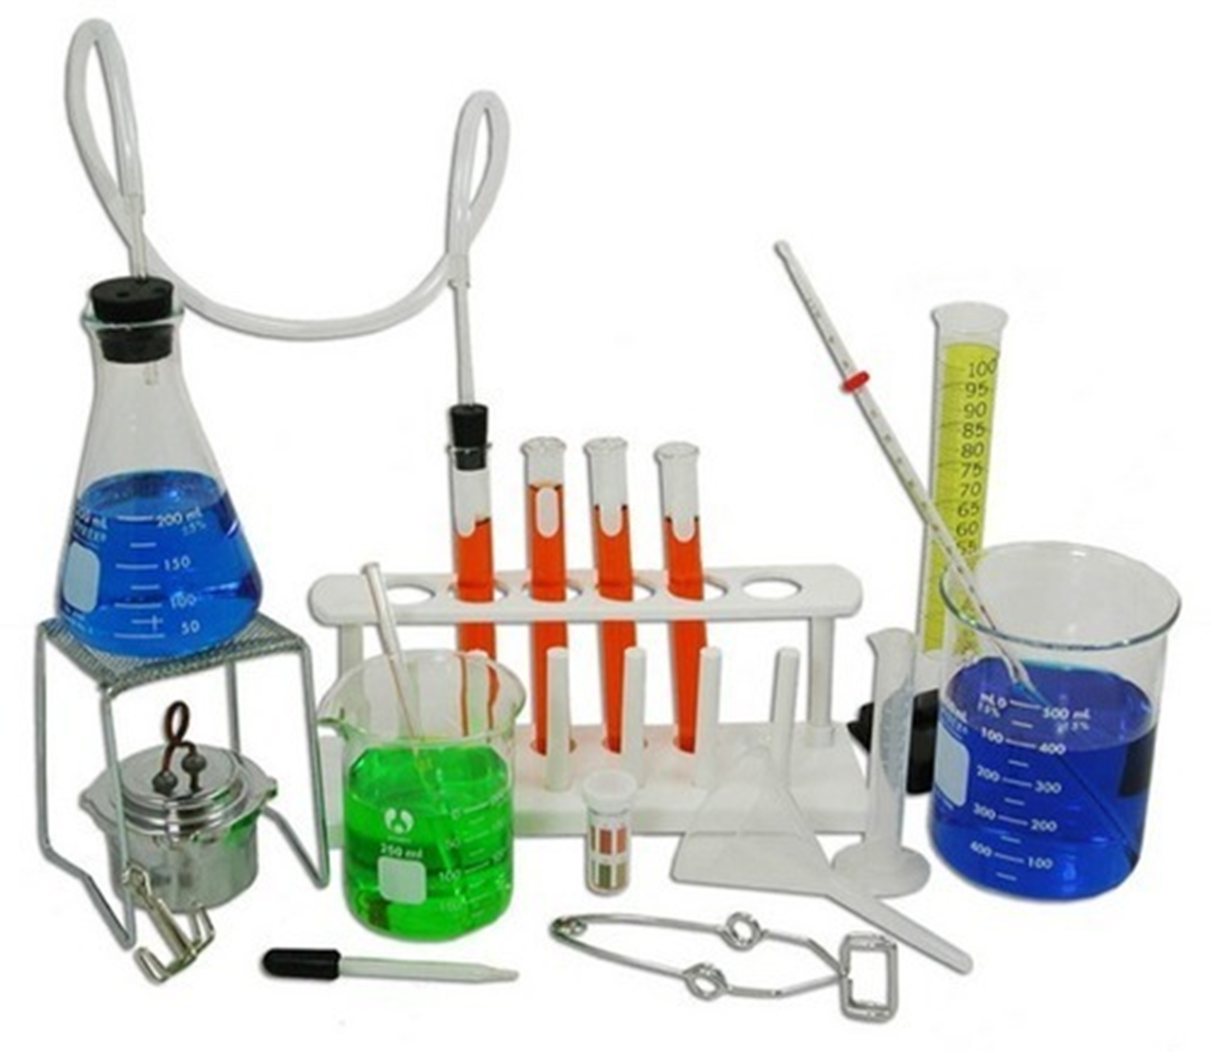

Slide 3
Picture Name Notes
Picture Name Notes

Slide 4
Lab equipment
Lab equipment
Graduated Cylinder
Glass stirring rod
Erlenmeyer Flask
Thermometer
Forceps or tweezers
Beaker
Triple Beam Balance
Funnel
Florence Flask
Ring stand
Ring Clamp
Meter Stick
Eye dropper (medicine dropper)
Spring Scale
Test Tube
Test tube rack
Test Tube holder
Test Tube clamp
Test Tube Brush
Beaker Tongs
Goggles
Wire Screen (Wire gauze)
Bunsen Burner
Watch glass

Slide 5
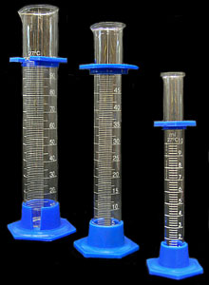
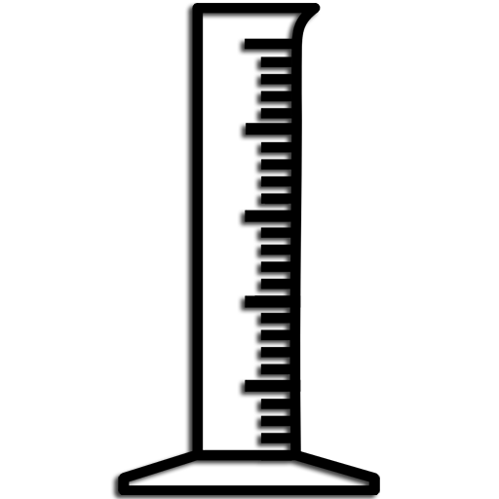
Graduated Cylinder
Glass or plastic
Marked with a milliliter (mL) scale
Used to measure volume
Used to pour liquids
NOT for heating or mixing substances

Slide 6
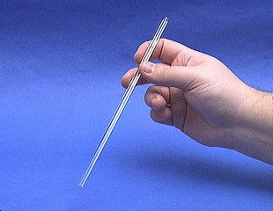
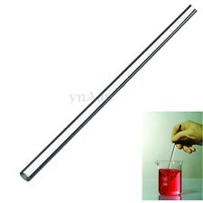
Glass stirring rod
Made of glass
Resists heat and corrosion
Different lengths
Used to stir liquids
Used to mix substances

Slide 7
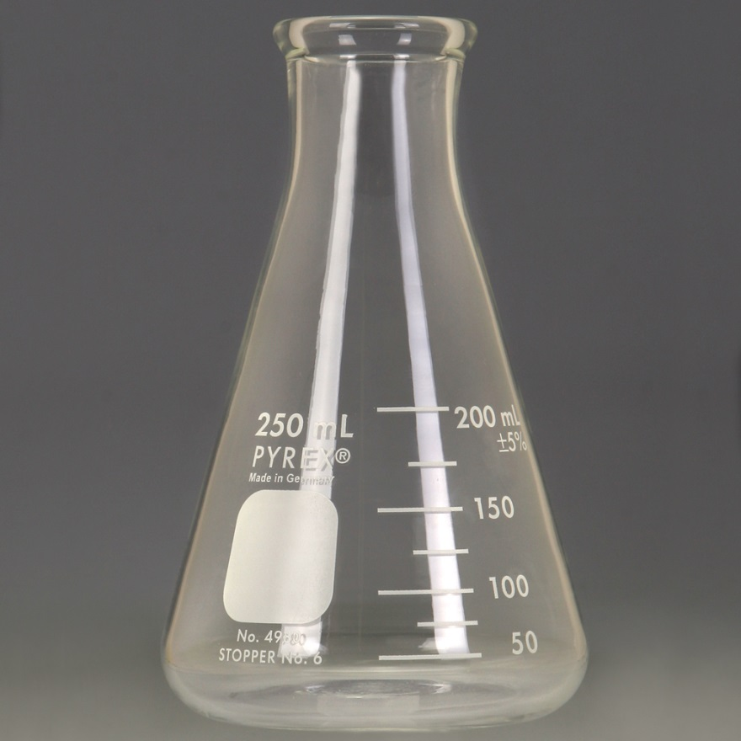
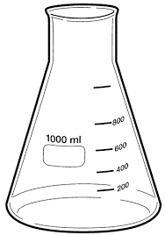
Erlenmeyer Flask
Glass
Flat bottomed
Different sizes
Measured in mL (milliliters)
125 mL; 250, mL;
500mL
May be heated
For measuring and
pouring, heating or
mixing substances

Slide 8
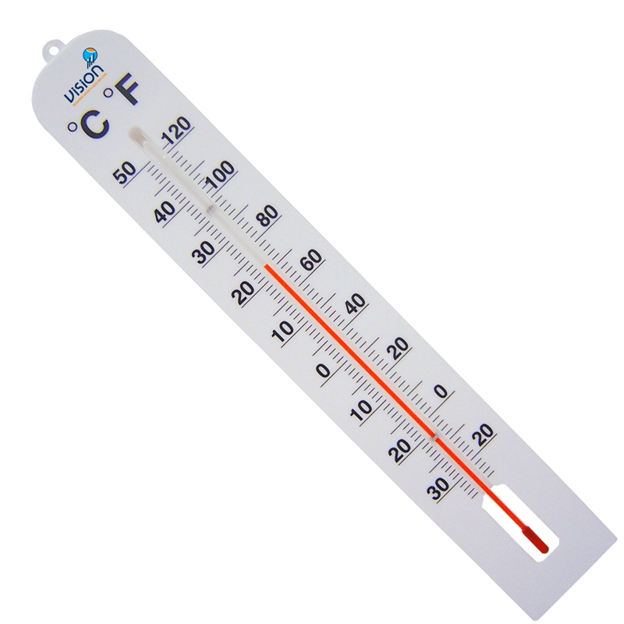
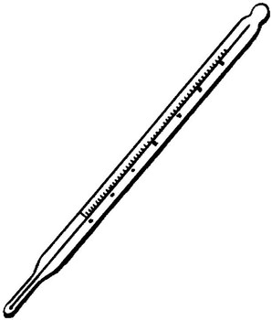
Thermometer
Glass, resists heat and corrosion
Alcohol or mercury inside
Measures temperature
Can be
Celsius (°C)
Fahrenheit (°F)

Slide 9
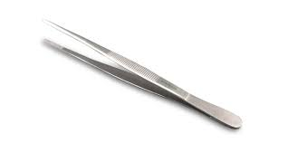
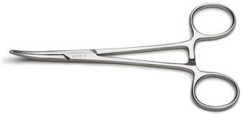
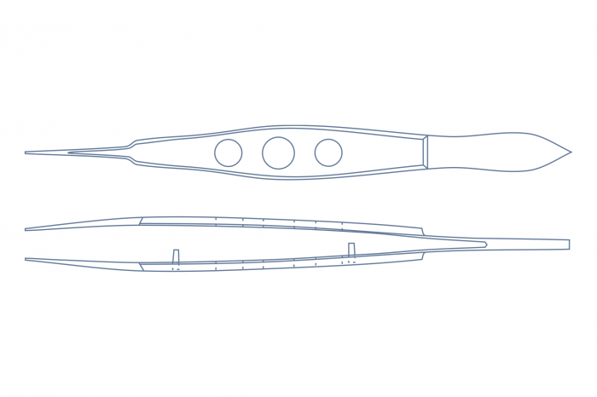
Forceps or Tweezers
Metal
For picking up and handling small objects

Slide 10
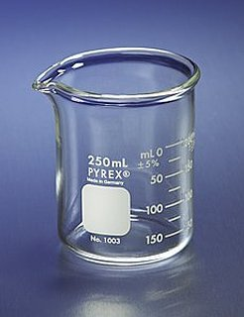
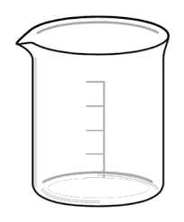
Beaker
Made of glass or plastic
Different sizes (100 mL; 250 mL; 400 mL; 1000 mL
Measures in mL (milliliters)
For measuring, stirring, pouring, heating, mixing

Slide 11
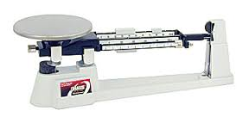
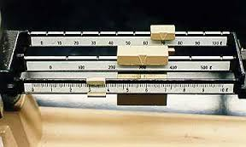
Triple Beam Balance
3 metal bars, with riders in 1, 10, and 100 grams measurement
Finds mass of objects in grams (g)

Slide 12
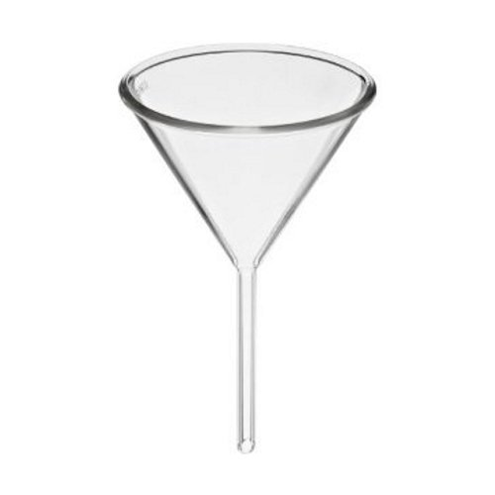
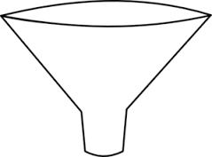
Funnel
Glass to resist heat and corrosion
Plastic for other uses
To aid in pouring a liquid from wide mouth to small mouth container
If used with filter paper, can be used to filter substances

Slide 13
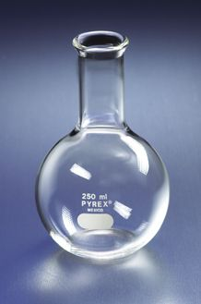
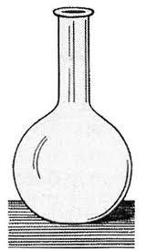
Florence Flask
Round bottomed
Glass
Different sizes
Measured in mL (milliliters)
125 mL; 250, mL;
500mL
Designed for uniform heating and boiling
For measuring and
pouring, heating or
mixing substances

Slide 14
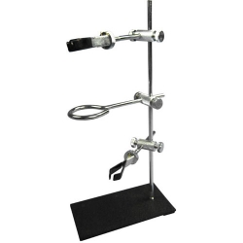
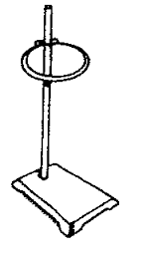
Ring Stand
Metal stand with detachable rings, and other equipment
Pole holds clamps
Platform holds heating unit

Slide 15
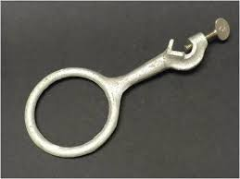
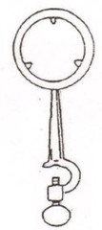
Ring Clamp
Metal
Attaches to the Ring Stand
For supporting a flask or beaker on a ring stand

Slide 16
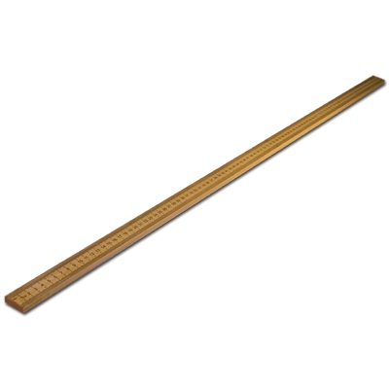
Meter Stick
Wooden or metal.
Sometimes has both metric and English system
We will use only the metric side
For measuring length or distance in millimeters, centimeters, and meters.

Slide 17
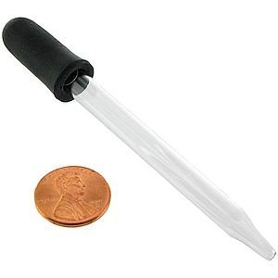
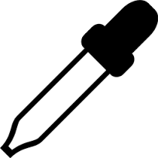
Eye dropper (medicine dropper)
Glass or plastic
Rubber squeezable end to create a vacuum to draw up liquids
For transferring small amounts (drops) of liquid

Slide 18
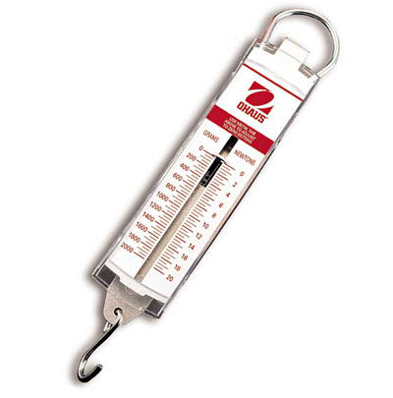
Spring Scale
Metal or plastic container
Has a hook for attaching to an object
A spring inside
For measuring weight
For measuring force in Newtons (N)

Slide 19
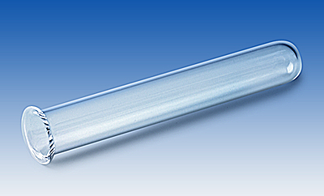
Test Tube
Glass
Many different sizes
For heating a small amount of substance
For mixing small amounts of a liquid or substance.

Slide 20
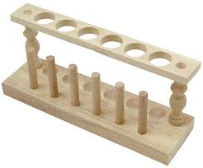
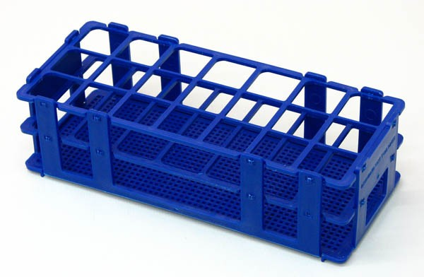
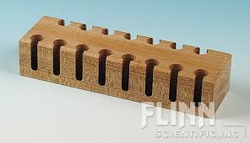
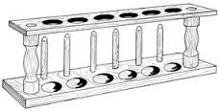
Test Tube Rack
Wooden stand with holes for full test tubes, and pegs for empty test tubes
Can be wire or plastic
For holding one or more test tubes
For drying cleaned test tubes

Slide 21
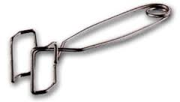
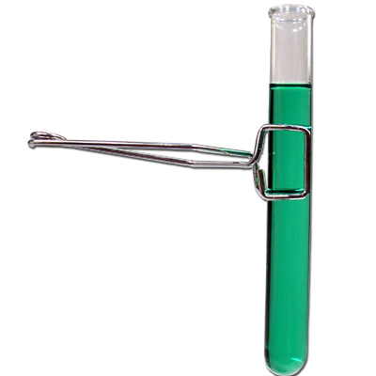
Test Tube Holder
Small metal tongs
Keeps hands from touching a test tube
For holding an individual test tube.
Above flame or heat
To see a reaction

Slide 22
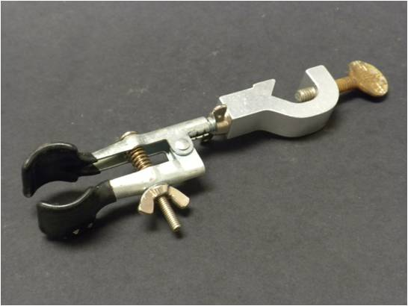
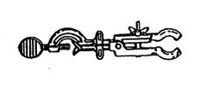
Test Tube Clamp
Metal
Has a bolt that tightens onto the ring stand pole and a wing-nut that tightens on the test tube, flask
For holding a test tube or flask on a ring stand

Slide 23
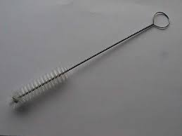
Test Tube Brush
Wire or wooden handle
Plastic or wire bristles
Cleaning insides of test tubes

Slide 24
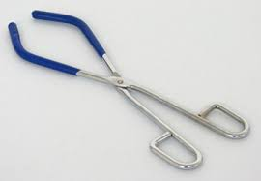
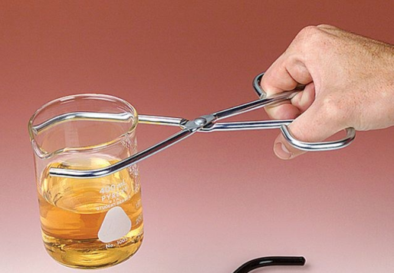
Beaker Tongs
Metal
Coated with rubber sometimes
Pivots open and closed like scissors
For removing and holding a hot
beaker

Slide 25
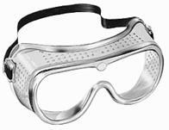
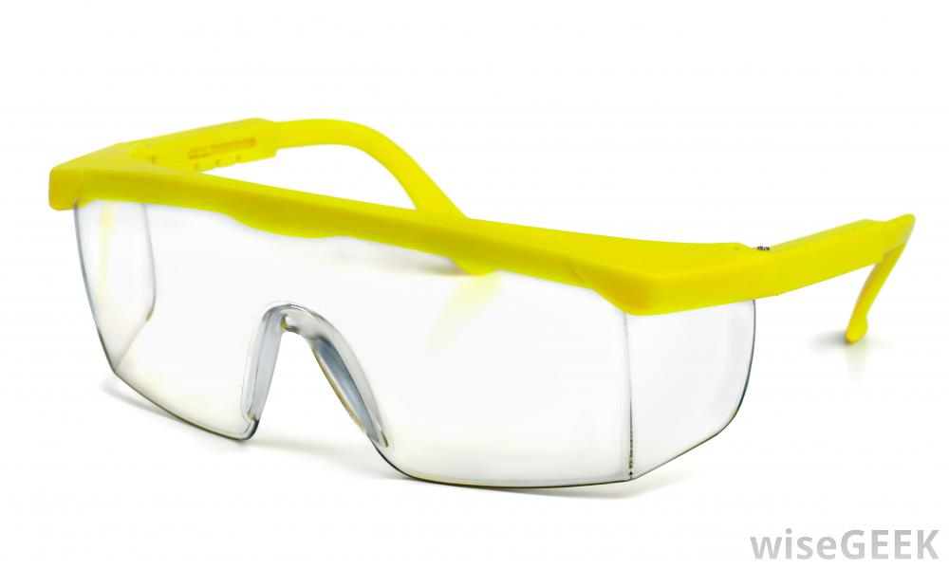
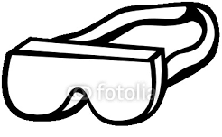
Goggles
Made of soft or brittle plastic
Fit like glasses
Or fit over your head with elastic band
To protect the eyes.

Slide 26
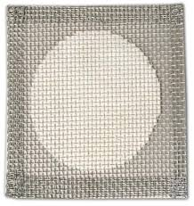
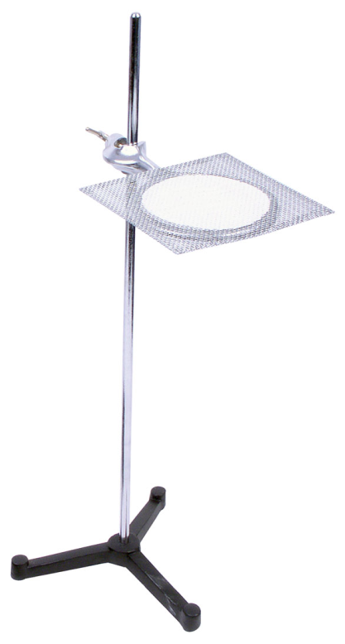
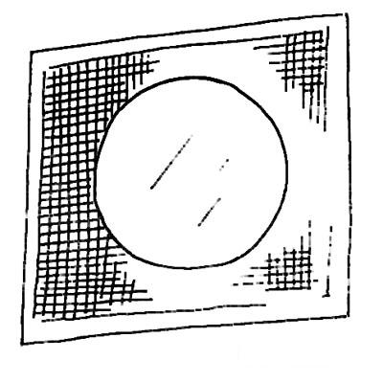
Wire Screen (Wire gauze)
Screen of wire mesh
Sometimes with a ceramic center
Fits over the ring on a ring stand
To protect the bottom of a beaker or flask from flame
To support a beaker or flask on a ring clamp

Slide 27
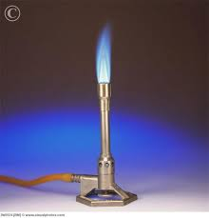
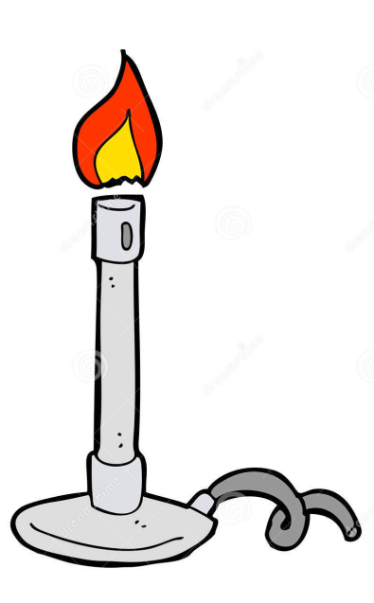
Bunsen Burner
Metal apparatus connected to the gas jets with a rubber hose
Valves to adjust the amount of oxygen and gas
For heating, sterilization, and combustion

Slide 28
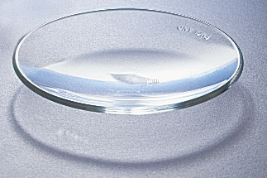
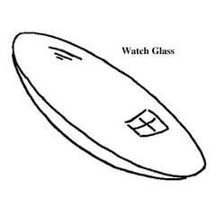
Watch glass
Shallow glass dish
Looks like a big contact lens
For evaporating liquids
To hold solids while being weighed
To heat very small amounts of a substance

