Slide 1
Engineering Notebooks
What is an Engineering notebook?
What does it look like?
What goes in it?
How is it grades?

Slide 2
S.S.’s Notebook
Junior Student

Slide 3
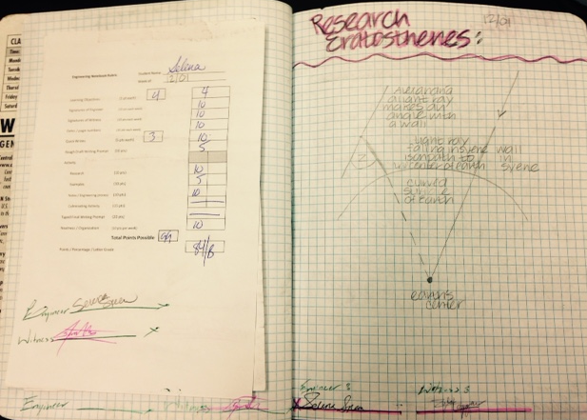

Slide 4
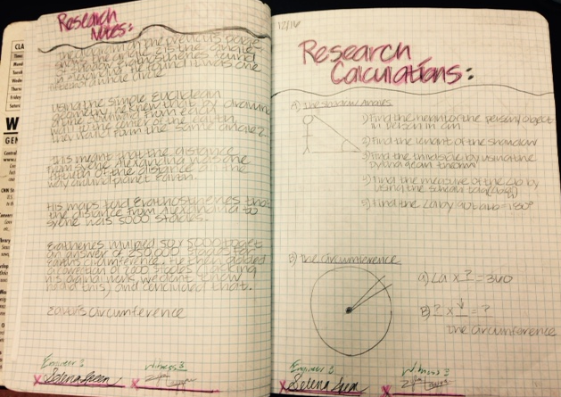

Slide 5
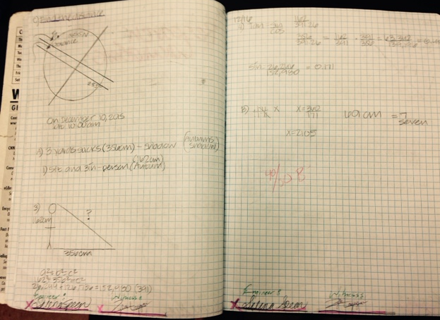

Slide 6
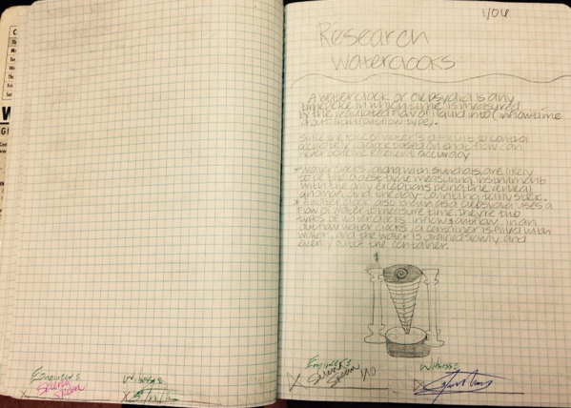

Slide 7
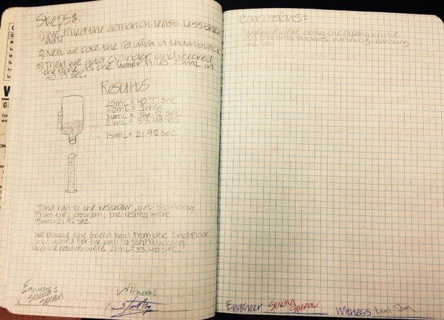

Slide 8
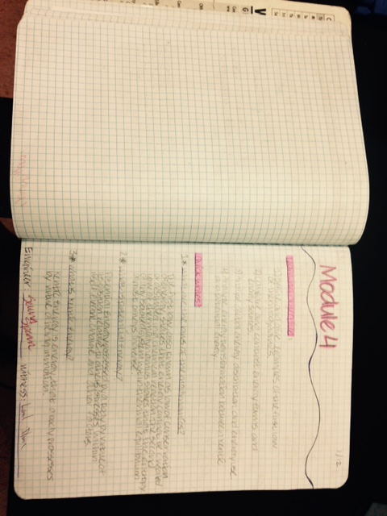

Slide 9
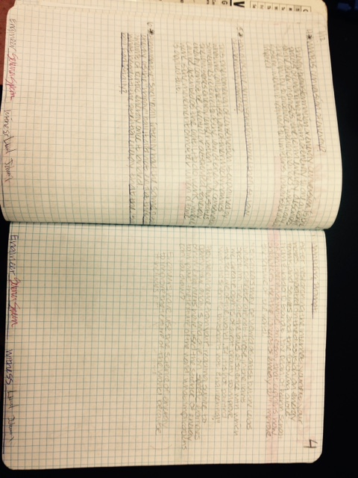

Slide 10
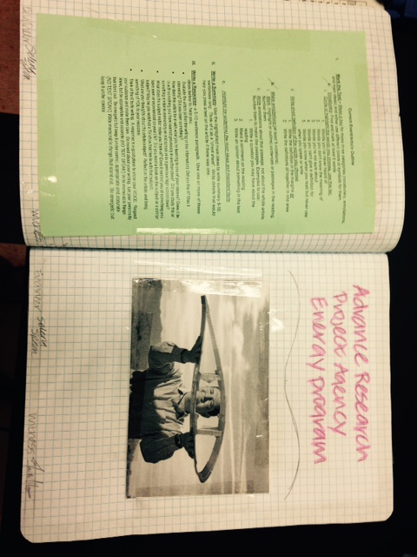

Slide 11
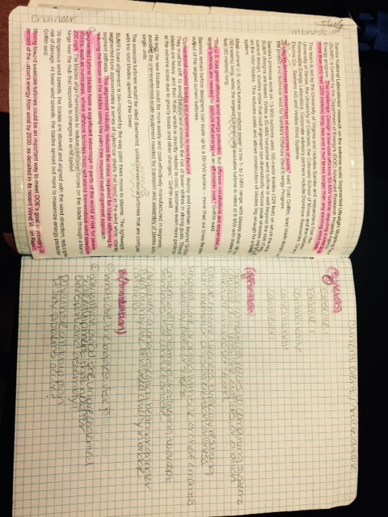

Slide 12
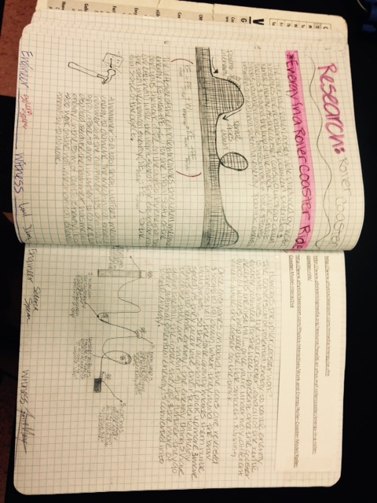

Slide 13
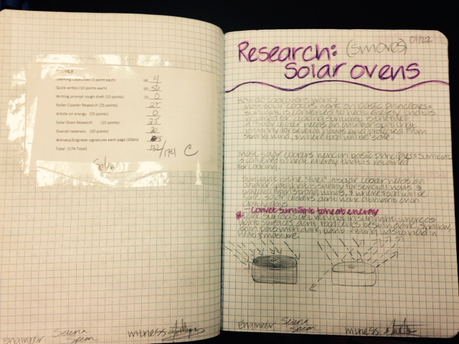

Slide 14
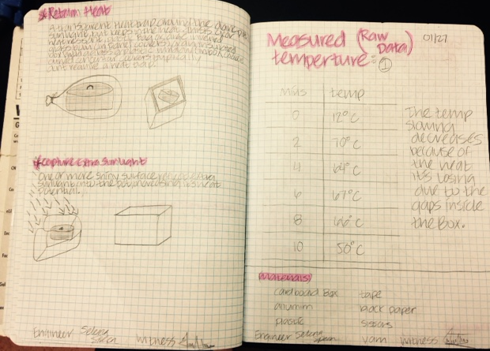

Slide 15
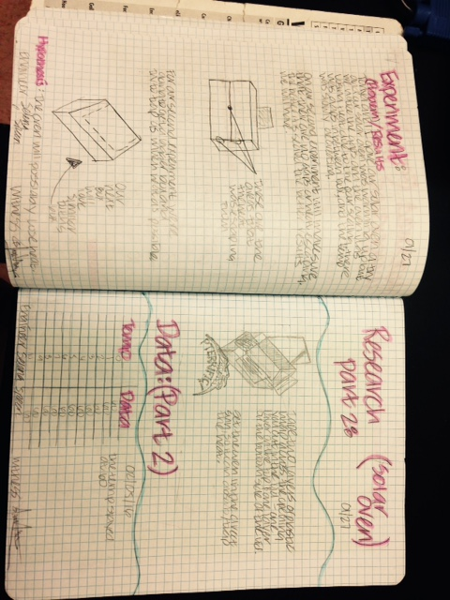

Slide 16
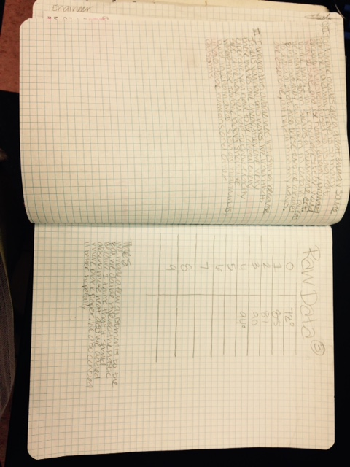

Slide 17
C.L.’s Notebook
Senior Student

Slide 18
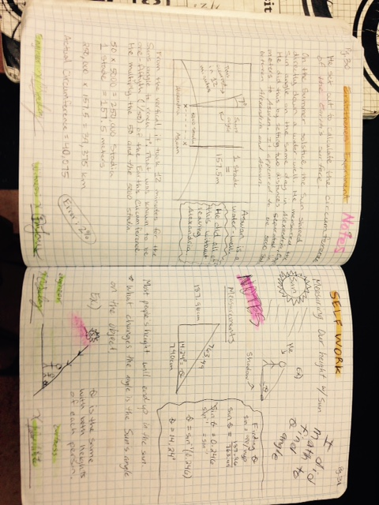

Slide 19
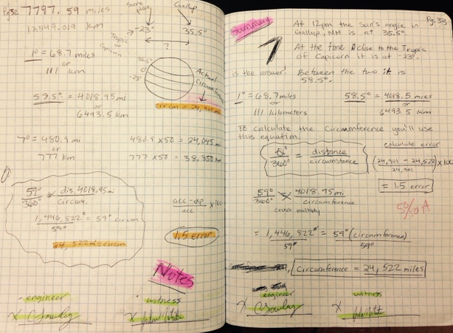

Slide 20
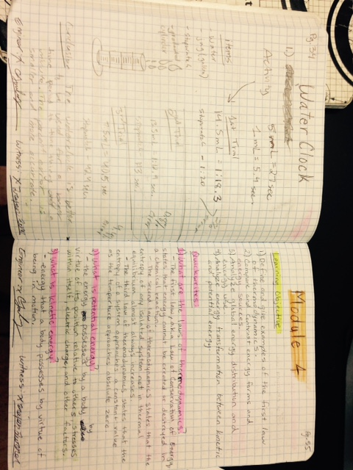

Slide 21
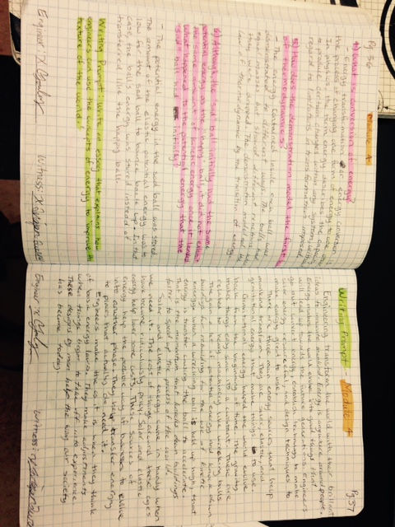

Slide 22
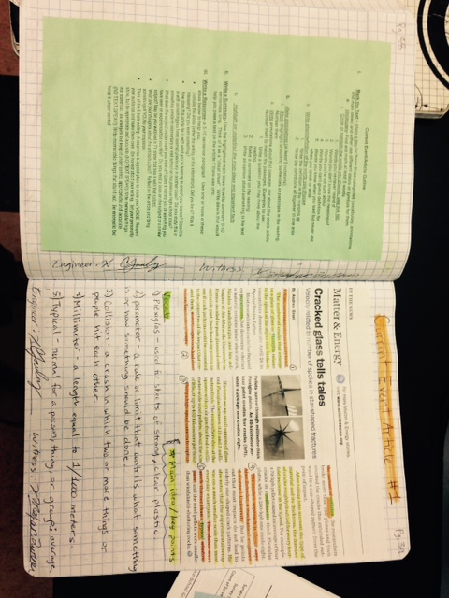

Slide 23
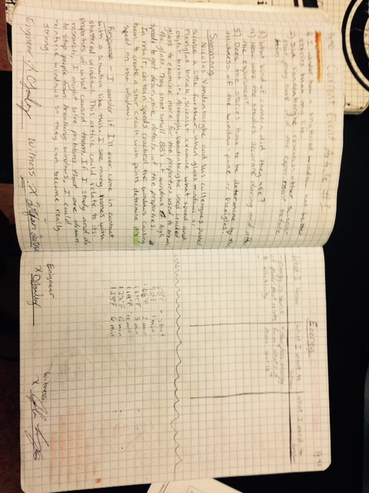

Slide 24
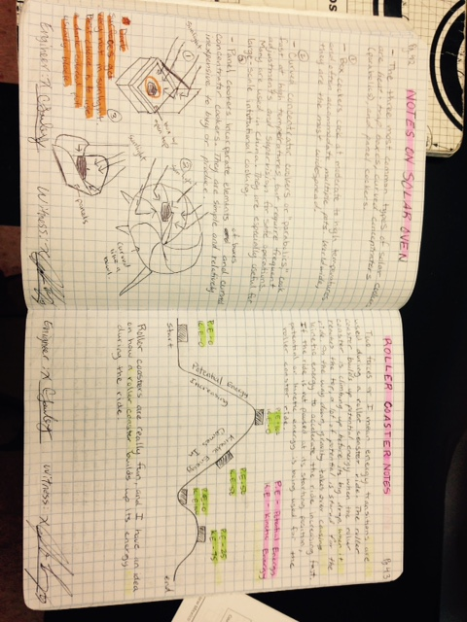

Slide 25
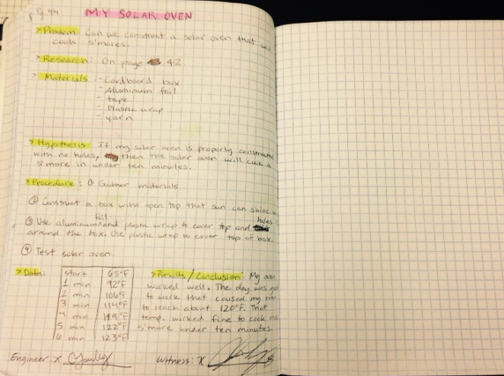

Slide 26
Z.L.’s Notebook
Freshman student

Slide 27
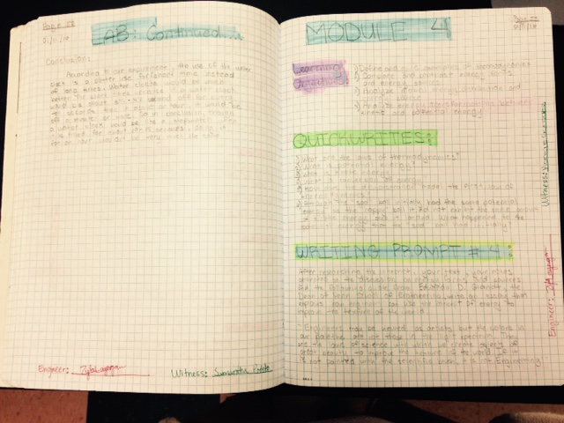

Slide 28
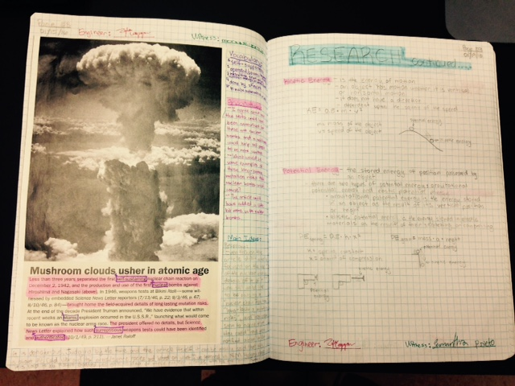

Slide 29
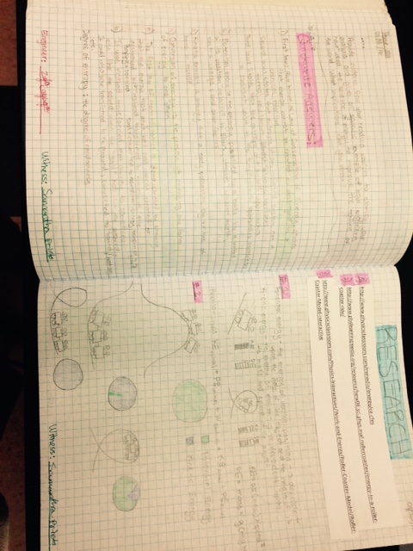

Slide 30
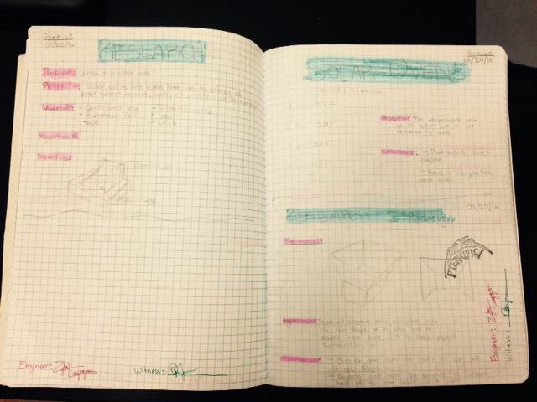

Slide 31
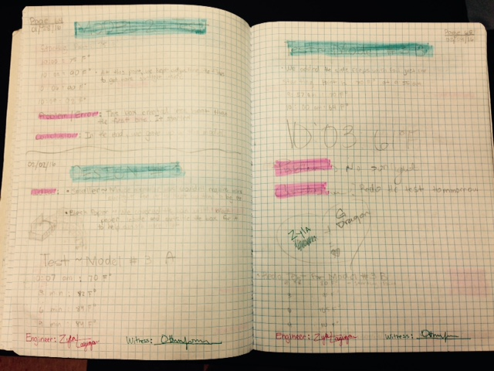

Slide 32
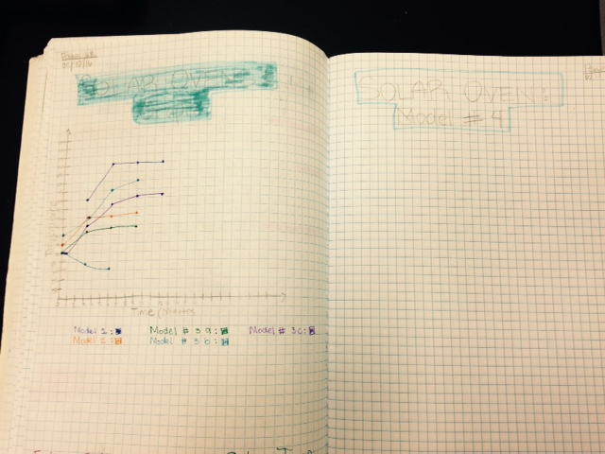

Slide 33
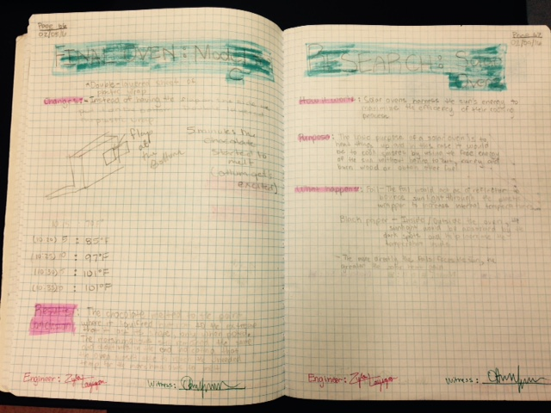

Slide 34
Elements to have in your Engineering Notebook
On every page:
Engineer’s signature
Witness’s signature
Page number
Date
Highlight titles, sections and important information
Every day:
Some sort of writing what you did in class that day-(Notes/ research/data tables/notations/pictures/drawings/inserts)
Show me paragraph- What did you learn today

Slide 35
Elements (continued)
Every Module:
Learning Objectives
Quick writes
Wring prompt for Essay
Rough draft
Typed Final Draft
Engineering Process
Notes
Research
Examples (pictures, drawings, descriptions)
Daily progress and data
Experiments/results/conclusions
Plan for culminating activity
Be neat and organized!

Slide 36
Notebook Rubric

