Slide 1
Earth, Moon and Sun Model
How to use the model

Slide 2
General Notes
Things to keep in mind while using the model

Slide 3
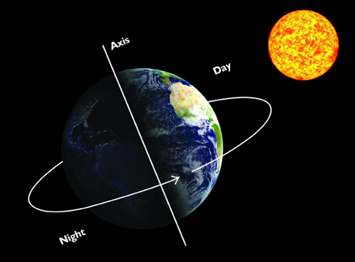
Earth/Moon/Sun Model (E/M/S model) NOTES
Day- the earth makes one complete rotation on its axis, 24 hours.
Day- When the earth is toward the sun, daylight.
Night- When the earth is away from the sun in its own shadow
Day and night are stationary positions, actually. The earth turns into the light or the dark.

Slide 4
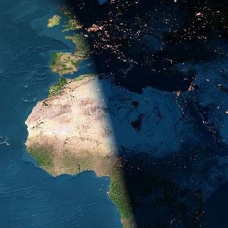
Spin the Earth several times; each complete spin is a day.
Watch how as the Earth turns, it turns into day and then into night. The lighted area doesn’t change, the part of the Earth IN the light changes.
Terminator

Slide 6
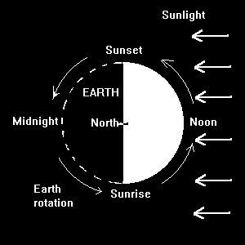
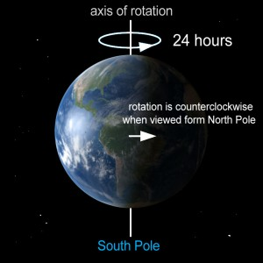
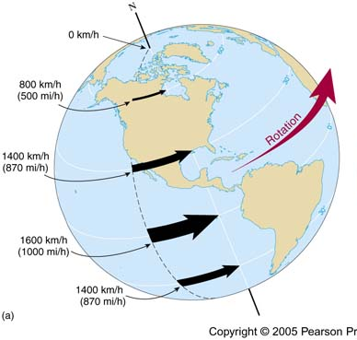

Slide 7
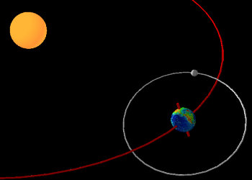
Month- the moon makes one complete revolution around the earth in orbit (approximately 28 days or 28 rotations of the earth)

Slide 8
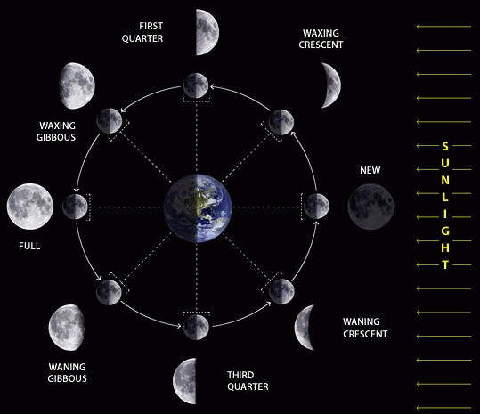
Since it takes nearly an entire month for the moon to go through its full cycle of phases, the change that happens over a period of a few hours is very small. A careful observer with a telescope could note the change, but to somebody looking at the moon with the unaided eye, the phase will appear exactly the same within a period of several hours.
ONE DAY
ONE DAY

Slide 9
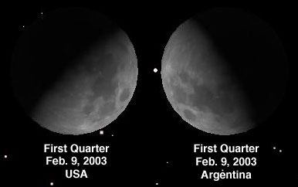
The phase of the moon is the SAME for the whole earth no matter if it appears in the sky of the observer or not (Remember, each phase lasts about 3 ½ days)
The earth spins about 28 times (28 days) during the time it takes the moon to go around the earth once (1 month). Try that on your model.
The phase of the moon would appear the same no matter where you are on the planet Earth. If an observer in Florida sees a full moon tonight, an observer in Wisconsin will also see a full moon tonight. However, if you traveled from one hemisphere to the other you might notice a difference. Here in the northern hemisphere, we say that when you see a phase that looks like a half-circle, and it's Light on the Left side, it's Last Quarter. The "L's" make a nice mnemonic for keeping First Quarter and Last Quarter straight. So, when it's light on the right it's First Quarter. However, look at the illustration. An observer in the southern hemisphere (Argentina) would see the moon upside-down compared to the way we are accustomed to seeing it (USA).

Slide 10
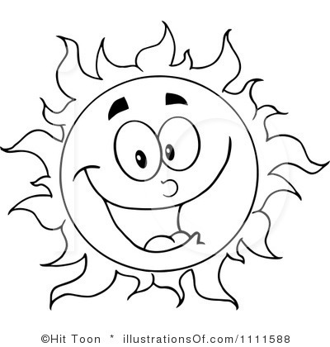
Time
1 am
12 am
Midnight
When using the model to tell the time at an area, look at the location of the observer and where it is on the time wheel.
The moon is NOT like a clock hand. It does not mark the time. Time is told by the location of the observer.
6 pm
12 pm
Noon
1 pm
Read time here
location
Gravity

Slide 11
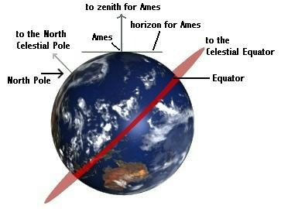
Gallup
Gallup
Gallup
The Zenith goes directly over the location where you are or the location you are talking about.

Slide 12
Moon Phases Rise, Set and Zenith Times

Slide 14
A. To tell the time a certain moon phase RISES:
Set the model for that phase.
(Remember the phase is the relationship between the positions of the earth, moon and sun and should NOT be changed during the calculations)
Set the horizon so the moon is at the EASTERN HORIZON
Set your location on earth to line up with the Zenith
Read the time at the Zenith
Read time here
Z
E
w
Location

Slide 15
Calculate Moon Rise Times
New Moon
Waxing Crescent
1st Quarter
Waxing Gibbous
Full Moon
Waning Gibbous
3rd Quarter
Waning Crescent

Slide 16
Calculate Moon Rise Times
Phase | Rise Time
New Moon | 6 am
Waxing Crescent | 9 am
1st Quarter | 12 pm (noon)
Waxing Gibbous | 3 pm
Full Moon | 6 pm
Waning Gibbous | 9 pm
3rd Quarter | 12 am (midnight)
Waning Crescent | 3 am

Slide 17
B. To tell the time a certain moon phase SETS:
Set the model for that phase.
(Remember the phase is the relationship between the positions of the earth, moon and sun and should NOT be changed during the calculations)
Set the horizon so the moon is at the WESTERN HORIZON
Set your location on earth to line up with the Zenith
Read the time at the Zenith
Read time here
Z
E
w
Location

Slide 18
Calculate Moon Set Times
New Moon
Waxing Crescent
1st Quarter
Waxing Gibbous
Full Moon
Waning Gibbous
3rd Quarter
Waning Crescent

Slide 19
Calculate Moon Set Times
Phase | Set Time
New Moon | 6 pm
Waxing Crescent | 9 pm
1st Quarter | 12 am (midnight)
Waxing Gibbous | 3 am
Full Moon | 6 am
Waning Gibbous | 9 am
3rd Quarter | 12 pm (noon)
Waning Crescent | 3 pm

Slide 20
C. To tell the time a certain moon phase is OVERHEAD:
Set the model for that phase.
(Remember the phase is the relationship between the positions of the earth, moon and sun and should NOT be changed during the calculations)
Set the horizon so the moon is at the ZENITH
Set your location on earth to line up with the Zenith
Read the time at the Zenith
Read time here
Z
E
w
Location

Slide 21
Calculate Moon Zenith Times
New Moon
Waxing Crescent
1st Quarter
Waxing Gibbous
Full Moon
Waning Gibbous
3rd Quarter
Waning Crescent

Slide 22
Calculate Moon Zenith Times
Phase | Zenith Time
New Moon | 12 pm (noon)
Waxing Crescent | 3 pm
1st Quarter | 6 pm
Waxing Gibbous | 9 pm
Full Moon | 12 am (midnight)
Waning Gibbous | 3 am
3rd Quarter | 6 am
Waning Crescent | 9 am

Slide 23
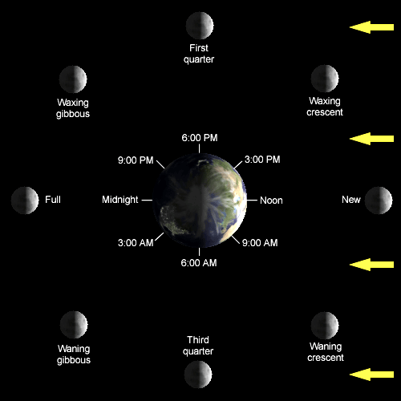

Slide 24
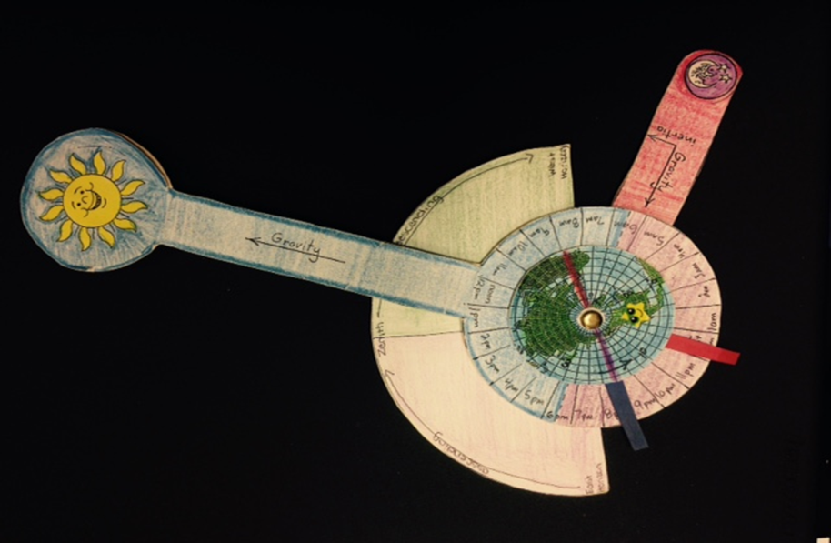
Finish the notes
Write at least 3 annotations
Share the annotations with your group
Write a Summary Paragraph explaining what you learned.
Write a Response Paragraph discussing what you think about what you learned.

Slide 25
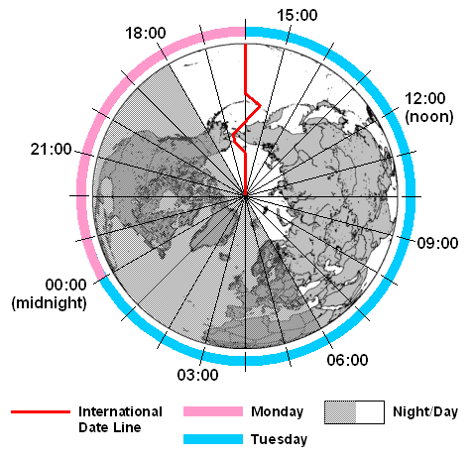
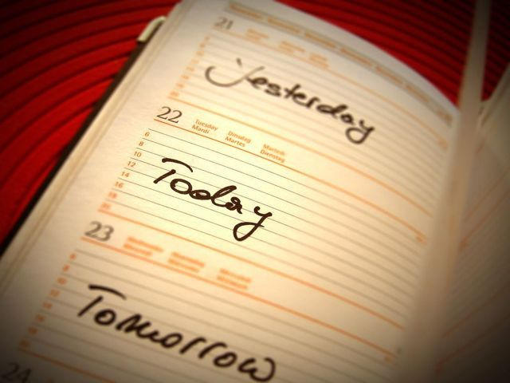
Today, Tomorrow and Yesterday
What does the International Dateline have to do with the days of the week?

Slide 26
3 days: today, tomorrow and yesterday
There are only 2 days on the earth at any one time; today (wherever you are is ‘today’) and either yesterday OR tomorrow. Two imaginary lines determine the change between the days:
Midnight- a line in space determined by the sun position
The International Dateline- a line on earth in the Pacific Ocean

Slide 27
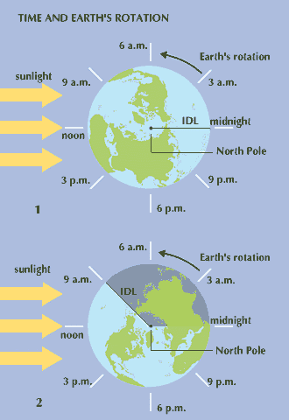
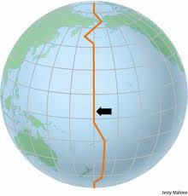
The International Dateline is an imaginary line 180 degrees lengthwise (or longitude). It separates the two days that exist on the earth at the same time
From 11 to 11:59, at the International Dateline, the entire world is on the same day
At midnight, a small chunk of the earth is starting a new day

Slide 28
Lets say the red area is Tuesday while the blue area is Monday. As you can see, majority of the world is on Monday, while the small slice of earth is already on the next day, Tuesday.
With each hour, the red area gets bigger

Slide 29
Now exactly half of the earth are on Tuesday, while the rest of the earth are on Monday.
If a plane were to fly around the world , it wouldn't keep subtracting days or going back in time, or adding days and going into the future, as most people believe; it would just keep switching between two days but since Tuesday keeps getting bigger and bigger, at one point the plane would be in the Monday area for maybe an hour and then fly into the Tuesday area for the rest of the plane trip, until it comes back into the Monday area, now even smaller than before.
That small blue area is Monday while the red area is Tuesday.

Slide 30
You know that every hour, more and more of the world are starting Tuesday and finishing Monday. From 11 to 11:59 the entire world will be red, meaning that the entire world is on Tuesday.
The small red area in the first picture had been on Tuesday the longest, so at Midnight, the small area will start Wednesday while the rest of the earth is slowly hour by hour completing Tuesday and starting Wednesday.

Slide 31
To use your model to tell which day it is:
Draw out the 2 lines, the section where you are is ‘today’ and the other section is yesterday or tomorrow.
If the other section is after midnight (fig. A) then it is tomorrow.
Traveling in a counterclockwise direction from the location that you’re talking about, if you come to midnight first, then the other day is tomorrow.
Earth rotates this way
Your Location
SUN
Tomorrow
SUN
IDL
Today
Today
IDL
Tomorrow
Midnight
Midnight
Fig. A

Slide 32
If the other section is before midnight (fig. B), then it is yesterday.
Traveling in a counterclockwise direction from the location that you’re talking about, if you come to international dateline first, then the other day is Yesterday.
Your Location
Earth rotates this way
SUN
SUN
IDL
Today
IDL
Yesterday
Today
Yesterday
Midnight
Midnight
Fig. B

Slide 33
Starting at the location where you are or are talking about
Go counter-clockwise (the way the Earth spins)
The location is ‘TODAY’
If you come to the IDL first the other day is YESTERDAY;
If you come to MIDNIGHT first, the other day is TOMORROW
The only time it is the same day for the whole earth is when the IDL and midnight align

Slide 34
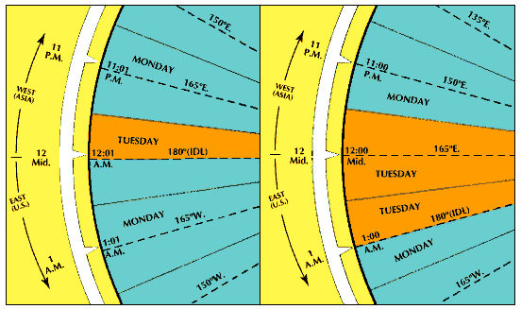

Slide 35
Use your model to calculate the days of the week and the time of day for each location in each scenario.
Scenario 1: 2 AM in Gallup on Wednesday
Scenario 2: 11 AM in Gallup on Friday
Scenario 3: 4 PM in Gallup on Sunday
Scenario 4: 6 AM in Japan on Thursday
Scenario 5: 6 AM in England on Monday
1-Gallup
2-Alaska
3-Japan
4-India
5-Saudi Arabia
6-England
7-Greenland
8-New York
9-Columbia
10- Hawaii

Slide 36
Scenario 1: 2 AM in Gallup on Wednesday
1-Gallup
2-Alaska
3-Japan
4-India
5-Saudi Arabia
6-England
7-Greenland
8-New York
9-Columbia
10- Hawaii
2 am Wed
11pm Tues
6 pm Wed
2 pm Wed
12 pm noon Wed
9 am Wed
6 am Wed
4 am Wed
4am Wed
11 pm Tue

Slide 37
Scenario 2: 11 AM in Gallup on Friday
1-Gallup
2-Alaska
3-Japan
4-India
5-Saudi Arabia
6-England
7-Greenland
8-New York
9-Columbia
10- Hawaii
11 am Fri
8 am Fri
3 am Sat
11 pm Fri
4 pm Fri
6 pm Fri
3 pm Fri
1 pm Fri
1 pm Fri
8 am Fri

Slide 38
Scenario 3: 4 PM in Gallup on Sunday
1-Gallup
2-Alaska
3-Japan
4-India
5-Saudi Arabia
6-England
7-Greenland
8-New York
9-Columbia
10- Hawaii
4 pm Sun
1 pm Sun
9 am Mon
5 am Mon
3 am Mon
11 pm Sun
8 pm Sun
6 pm Sun
6 pm sun
1 pm Sun

Slide 39
Scenario 4: 6 AM in Japan on Thursday
1-Gallup
2-Alaska
3-Japan
4-India
5-Saudi Arabia
6-England
7-Greenland
8-New York
9-Columbia
10- Hawaii
1 pm Wed
10 am Wed
6 am Thurs
2 am Thurs
12 am midnight Thurs
9 pm Wed
6pm Wed
3 pm Wed
3 pm Wed
10 am Wed

Slide 40
Scenario 5: 6 AM in England on Monday
1-Gallup
2-Alaska
3-Japan
4-India
5-Saudi Arabia
6-England
7-Greenland
8-New York
9-Columbia
10- Hawaii
11 pm Sun
8 pm Sun
3 pm Mon
11 am Mon
9 am Mon
6 am Mon
3 am Mon
1 am Mon
1 am Mon
8 pm Sun

