Slide 1
Electromagnetic spectrum part 2
The higher frequency types of electromagnetic energy are dangerous to humans
How are humans protected from the dangerous waves?

Slide 2
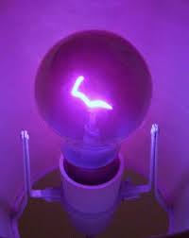
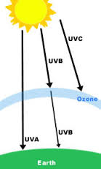
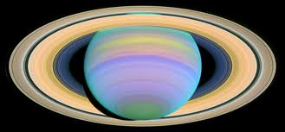
Ultraviolet (7.5 x 10¹⁴-3 x 10¹⁶ Hz)
UVA and UVB rays are from the sun and too much can cause direct DNA damage like sunburns and skin cancers, even blindness
UVB rays in the right amount can encourage Vitamin D production in the skin.
The Earth’s ozone layer filters out most of the harmful UV rays.
Human eyes can’t detect Ultraviolet Light but some insects can.

Slide 3
UV waves
UVA- longest waves
UVB- Medium length waves
UVC-shortest waves
Even though the UV waves are shorter than visible light, they still have a range from long to short within the UV section
The Ozone layer keeps out the shortest of the waves.
Ozone- O₃
Oxygen-O₂

Slide 4
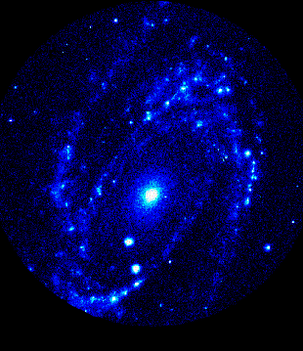
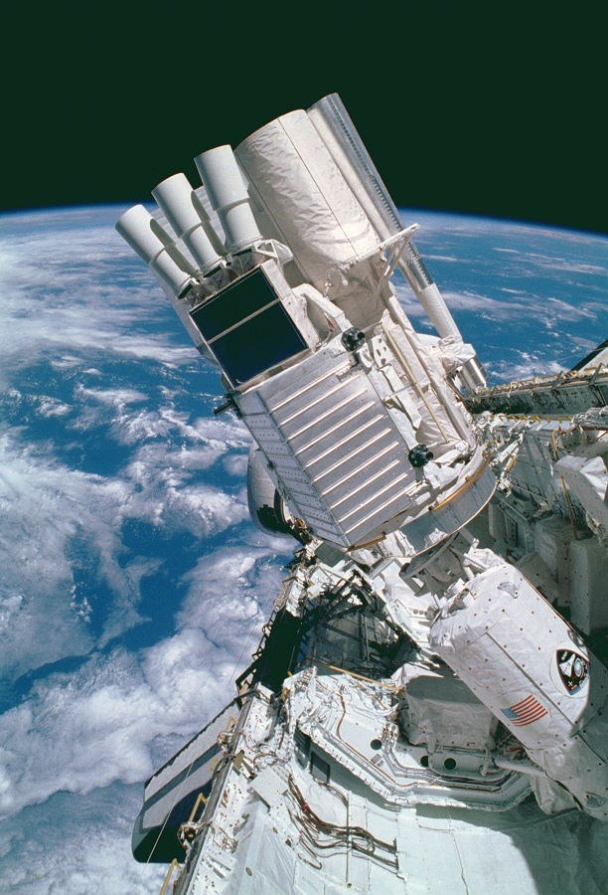
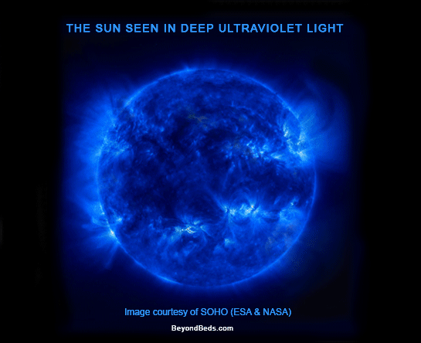
Some sources of UV rays would be stars and galaxies.
An ultraviolet telescope in the space shuttle.
Our sun is a star

Slide 5
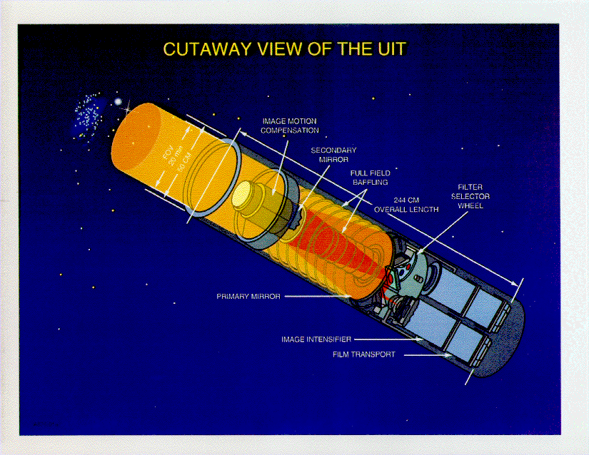

Slide 6
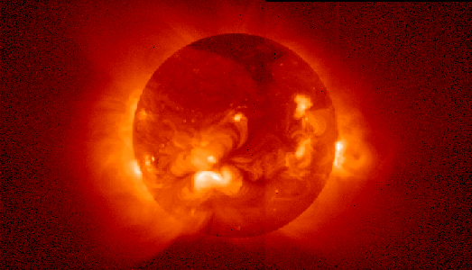
X-RAYS (3 x 10¹⁶ - 3 x 10¹⁹ Hz)
High frequency radiation. X-rays can penetrate most substances. Lead is one substance that stops the energy.
X-rays have helpful applications in medicine and other fields.
However, they are dangerous and can cause cellular damage at the DNA level.
Earth’s atmosphere absorbs most of the harmful x-rays from outer space
However, this makes it hard to view the x-ray sources from ground-based telescopes.
The most efficient x-ray telescopes are in orbit, outside earth’s atmosphere

Slide 7
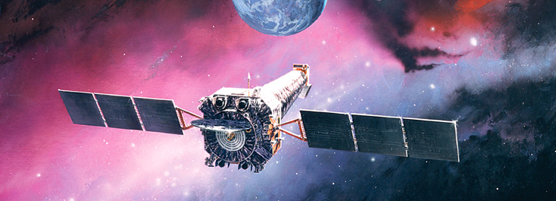
Chandra is an orbiting, x-ray observatory for observing x-ray sources from space

Slide 8
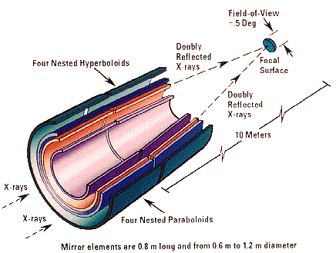
X-RAY TELESCOPE

Slide 9
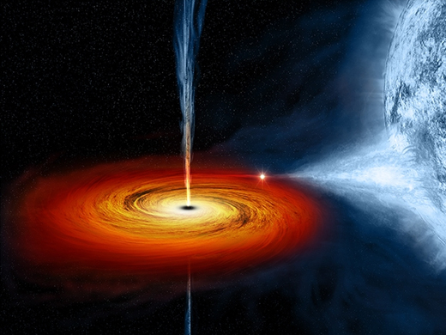
X-ray sources in outer space:
Galaxy clusters
Active galactic nuclei (AGN)
Supernova remnants
Stars
The Moon
Galaxies
Pulsars
X-ray binaries
(binary stars containing a white dwarf, neutron star or black hole).

Slide 10
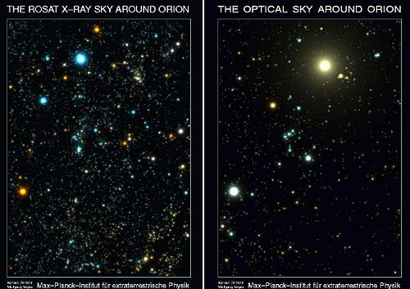
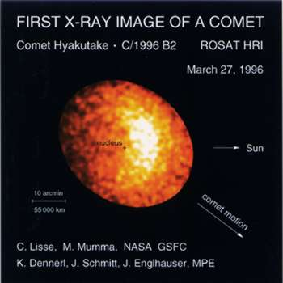
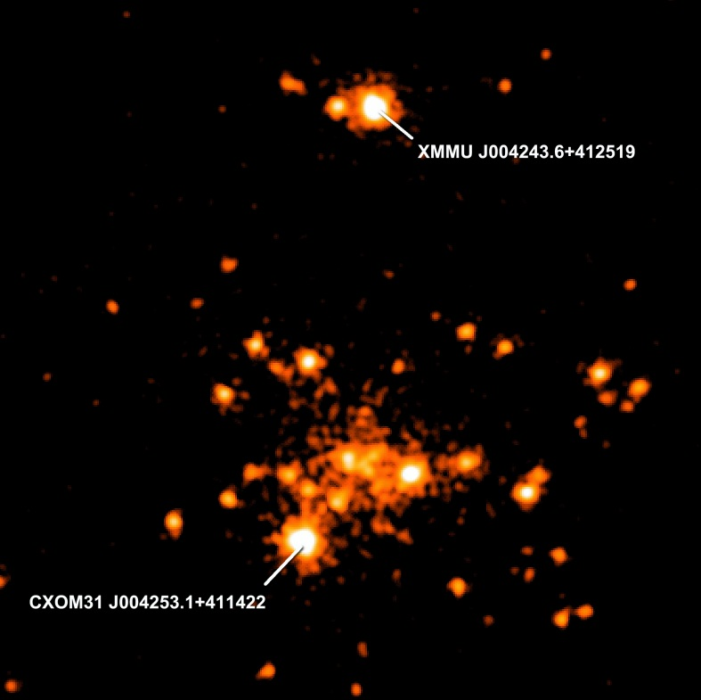
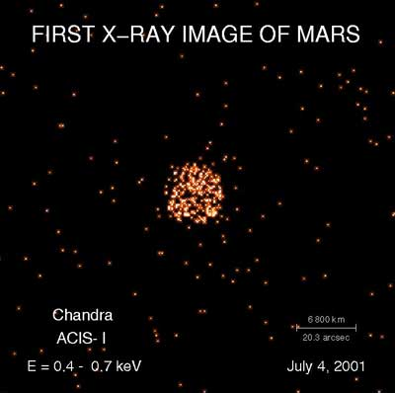

Slide 11
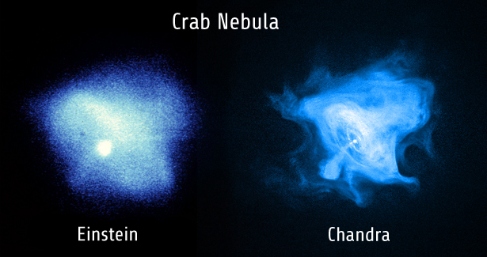
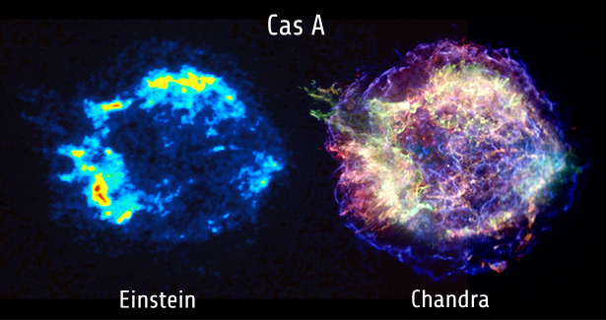
Chandra is a great advance in x-ray telescope technology.
Notice the difference in the Einstein Telescope and Chandra

Slide 12
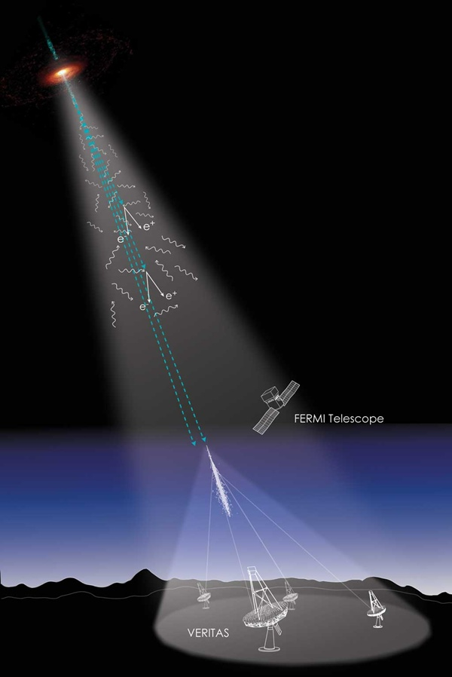
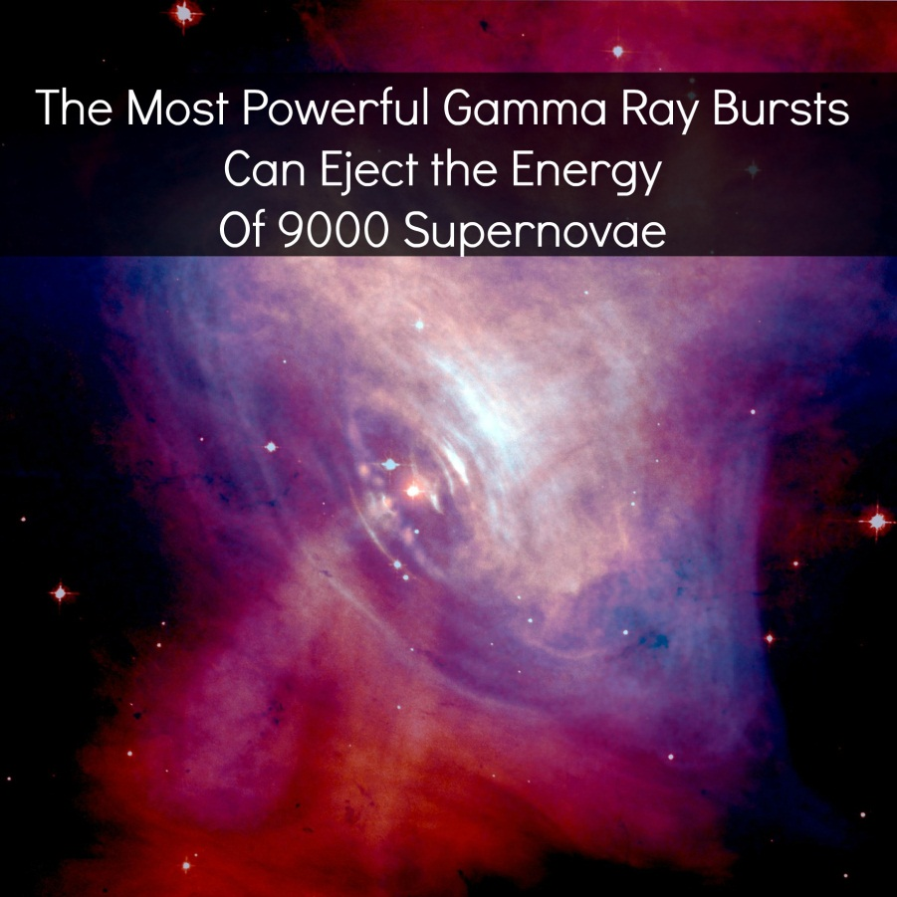
Gamma Rays (> 3 x 10¹⁹ Hz)
The highest frequency of all electromagnetic radiation.
It is extremely dangerous,
The earth’s atmosphere protects us from gamma rays, which cannot penetrate it.

Slide 13
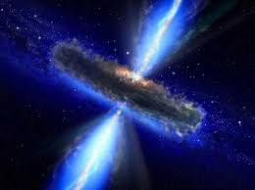
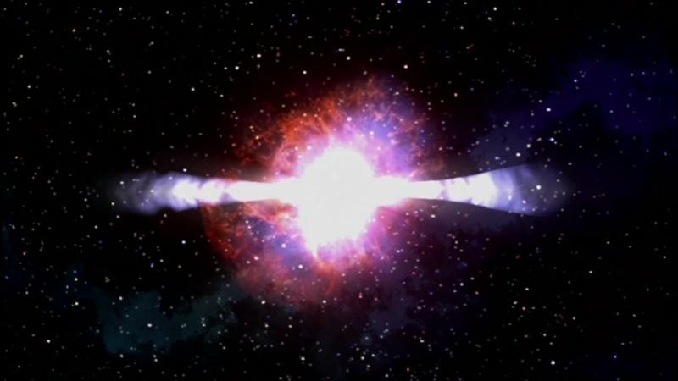
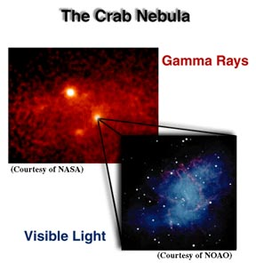
Gamma Rays are produced in:
Pulsars
Magnetars
Quasars
Active galaxies
Supermassive black hole
Gamma-ray bursts

Slide 14
