Slide 1
Electromagnetic Radiation
How is the electromagnetic spectrum organized?

Slide 2
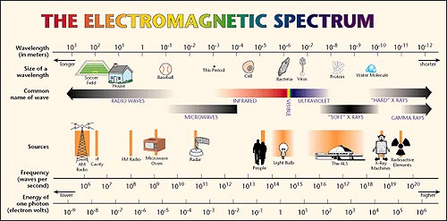
Electromagnetic radiation (e.m.r.)
The type of energy for all forms of e.m.r. is the same, the only difference between them is their wavelength and frequency.

Slide 3
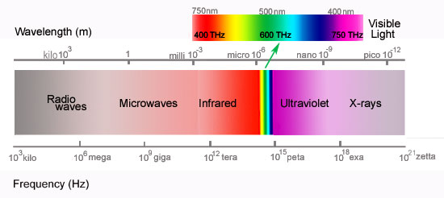
ORANGE
BLUE
YELLOW
RED
VIOLET
GREEN
Long wavelength
Short wavelength
Gamma
Rays
Low frequency
High frequency
Visible light is only a very small part of the whole electromagnetic spectrum.

Slide 4
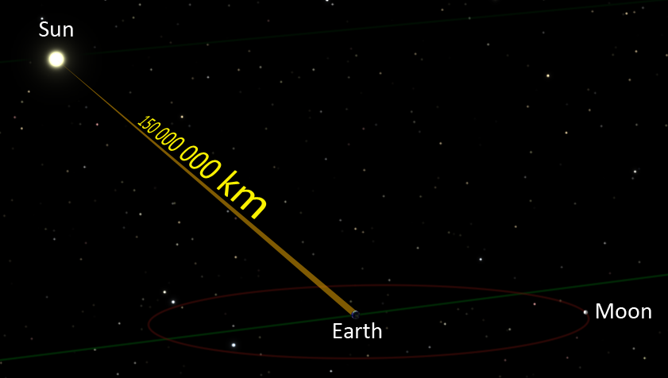
All electromagnetic radiation travels at the same speed, the speed of light, which is 300,000 km/s. This is equal to orbiting the earth 7 times in one second.
Light travels from the sun to the earth in 8 minutes
Light travels from the earth to the moon in 1.5 seconds
Light travels from the sun to Pluto in 6.5 hours.
8 minutes
1.5 seconds

Slide 5
The Electromagnetic spectrum is divided up into 6 divisions
Radio waves
Infrared waves
Visible light
Ultraviolet
X-rays
Gamma rays
Even though we have these divisions, and we treat them as if they are different, the only difference between these is the frequency. They are still the same type of energy: electromagnetic radiation.
The waves do behave differently because of their wavelengths.

Slide 6
The frequency of electromagnetic radiation is measured in Hertz.
Kilohertz is one thousand (1000) hertz
Mega hertz is one million (1,000,000) hertz
Giga hertz is 1000 MgHz or one billion (1,000,000,000) hertz
$$hertz \left(Hz\right)=\frac{1 vibration(cycle)}{1 second}$$
$$\left(AM\right)Kilohertz \left(kHz\right)=\frac{1000 vibrations (cycles)}{1 second}$$
$$(FM) Megahertz \left(MgHz\right)=\frac{1,000,000 vibrations (cycles)}{1 second}$$
$$Gigahertz \left(GHz\right)= \frac{1,000,000,000 vibrations (cycles)}{1 second}$$
AM amplitude modulation
FM frequency modulation

Slide 7
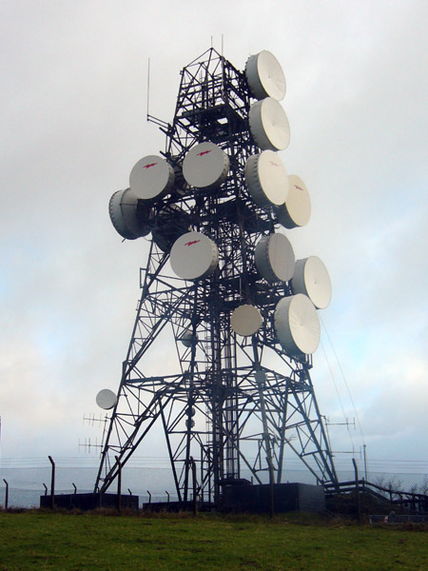
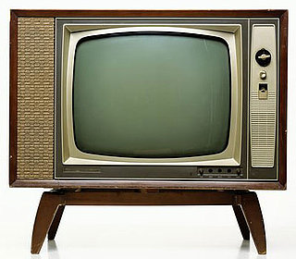
Radio waves (Up to 3 x 10¹¹ Hz)
Radio waves include:
AM and FM radio signals
TV signals
Microwaves
Background radiation from
Outer Space

Slide 8
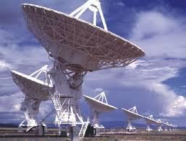
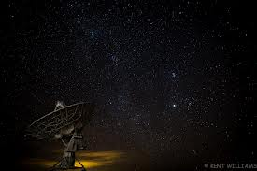
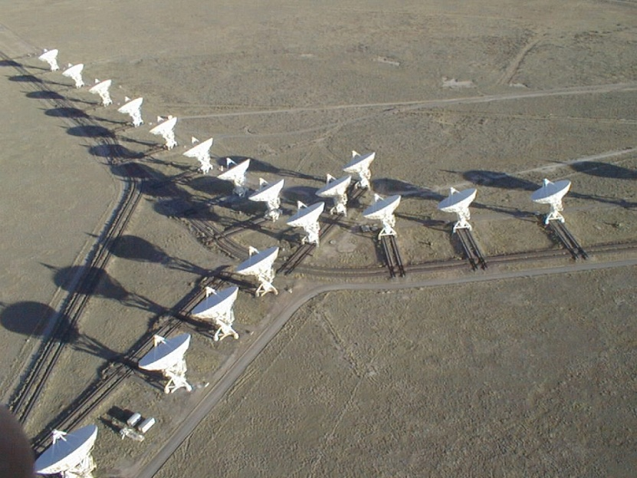
Very Large Array (VLA)
An array of radio telescopes in Soccoro, NM for receiving radio signals from outer space
The sources include:
The Sun
Supernova remnants
Pulsars
Star forming regions
Spiral galaxies
Radio galaxies
Quasars (quasi-stellar radio source)
Cosmic microwave background
Primordial black holes
RRATs (Rotating radio transients)
Extragalactic pulses

Slide 9
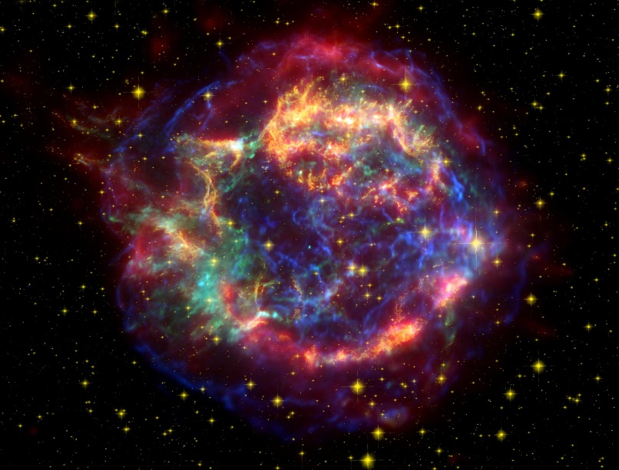
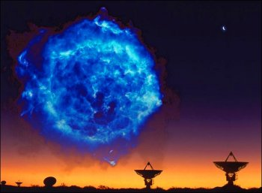
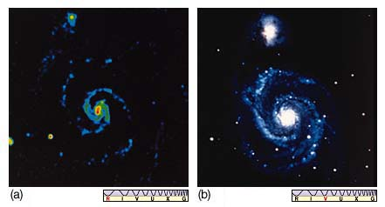
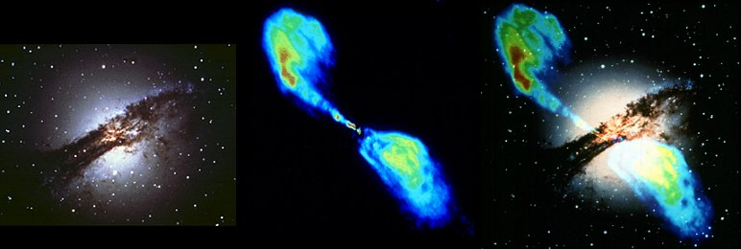

Slide 10
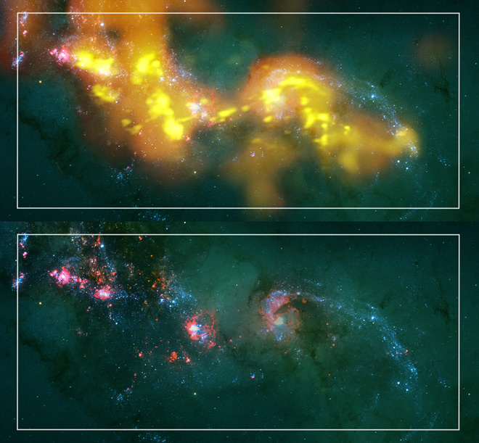

Slide 11
Comparing AM and FM signals

Slide 12
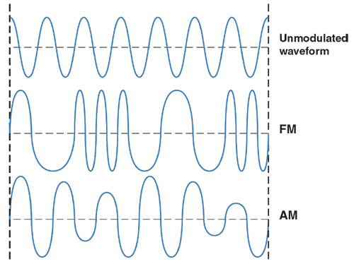

Slide 13
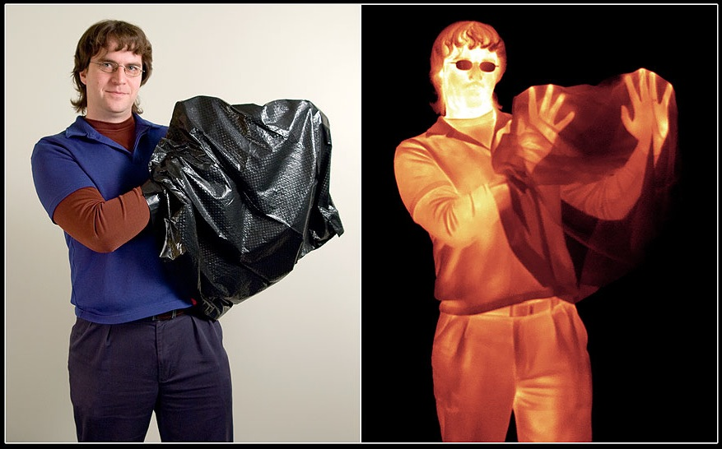
Infrared (3 x 10¹¹ - 4 x 10¹⁴ Hz)
Infrared is usually identified as heat.
All things give off heat, even ice, but some things give off more than others
We use Infrared telescopes to detect things not visible to the naked eye

Slide 14
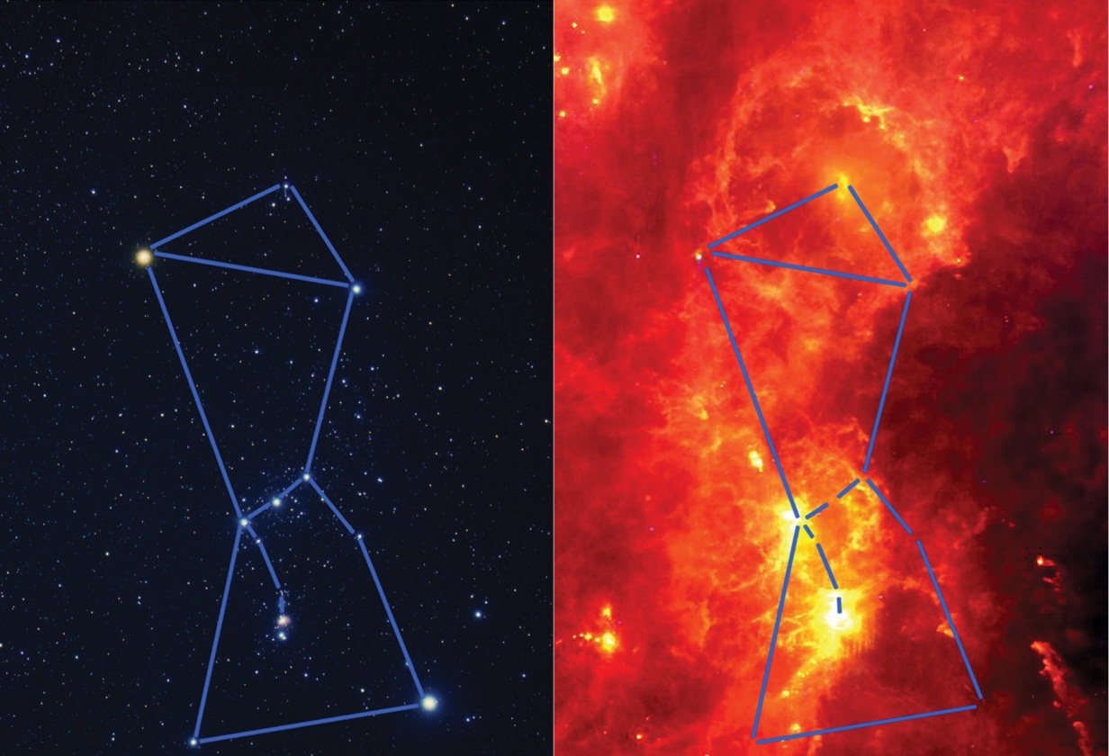
By detecting the thermal energy given off by a source, even though we can’t see it with our naked eyes, we can tell more about the different regions of space.
The technology takes the information received from infrared telescopes and makes them into visible images that are easier to interpret.

Slide 15
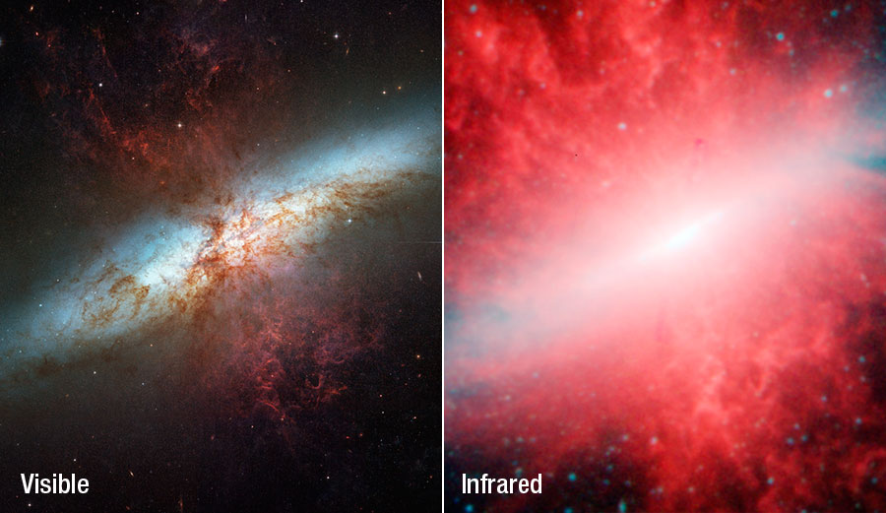
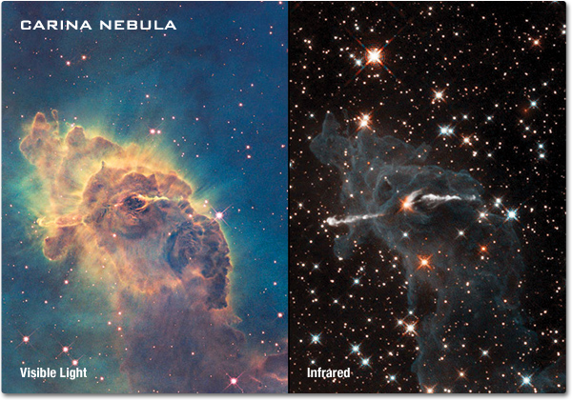
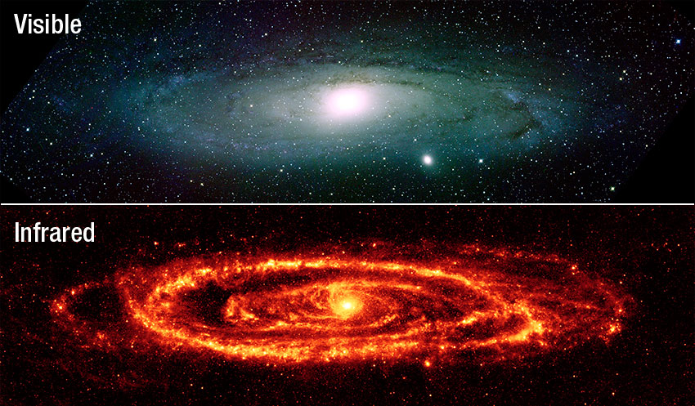
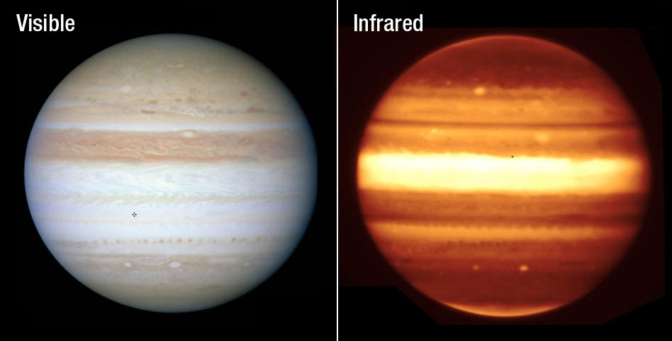

Slide 16
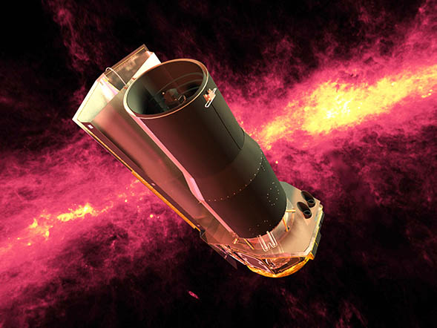
An infrared telescope in orbit around the earth.

Slide 17
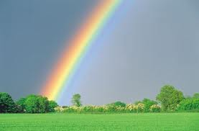
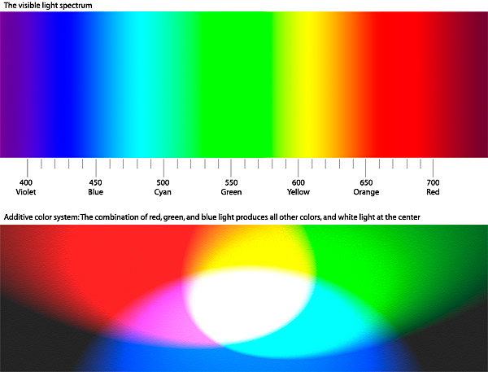
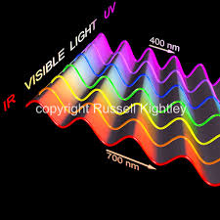
Visible Light (4 x 10¹⁴-7.5 x 10¹⁴ Hz)
Visible light includes the frequencies of the electromagnetic spectrum that human eyes can detect.
This is the smallest range of the electromagnetic spectrum.
This includes the colors of the rainbow.
4 x 10¹⁴ - 7.5 x 10¹⁴
4 x 10¹⁴ - 7.5 x 10¹⁴

Slide 18
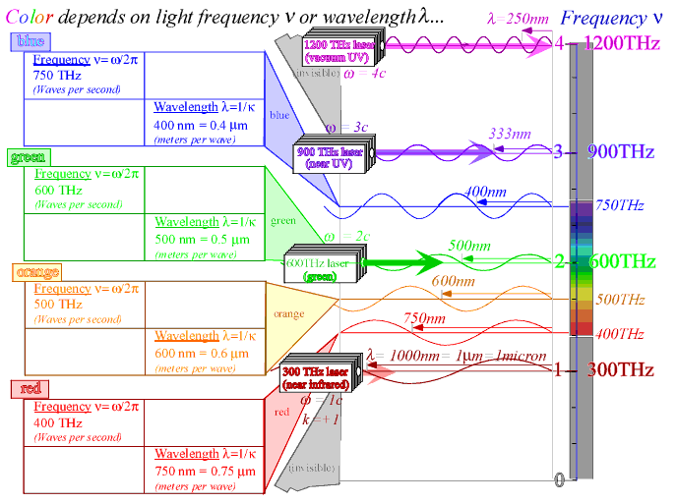

Slide 19
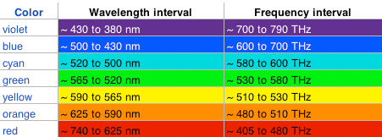
R
E
D
O
R
A
N
G
E
Y
E
L
L
O
W
G
R
E
E
N
B
L
U
E
i
n
d
i
g
o
V
I
O
L
E
T

Slide 20
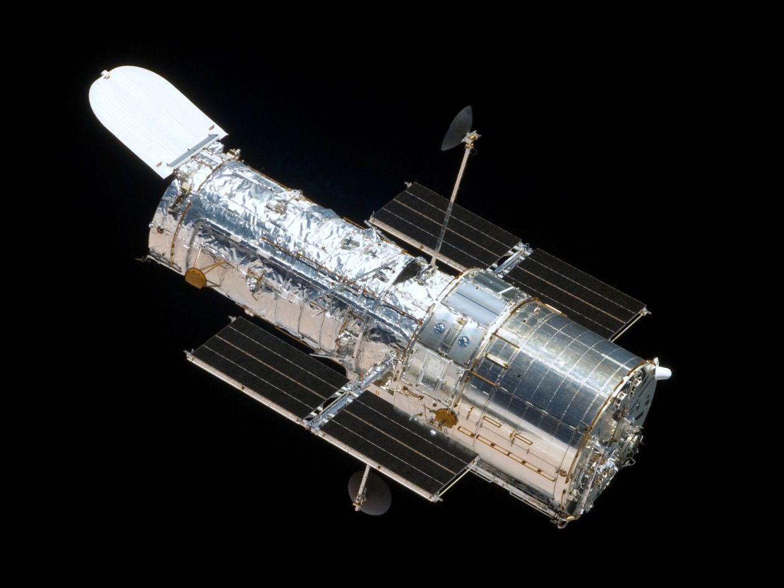
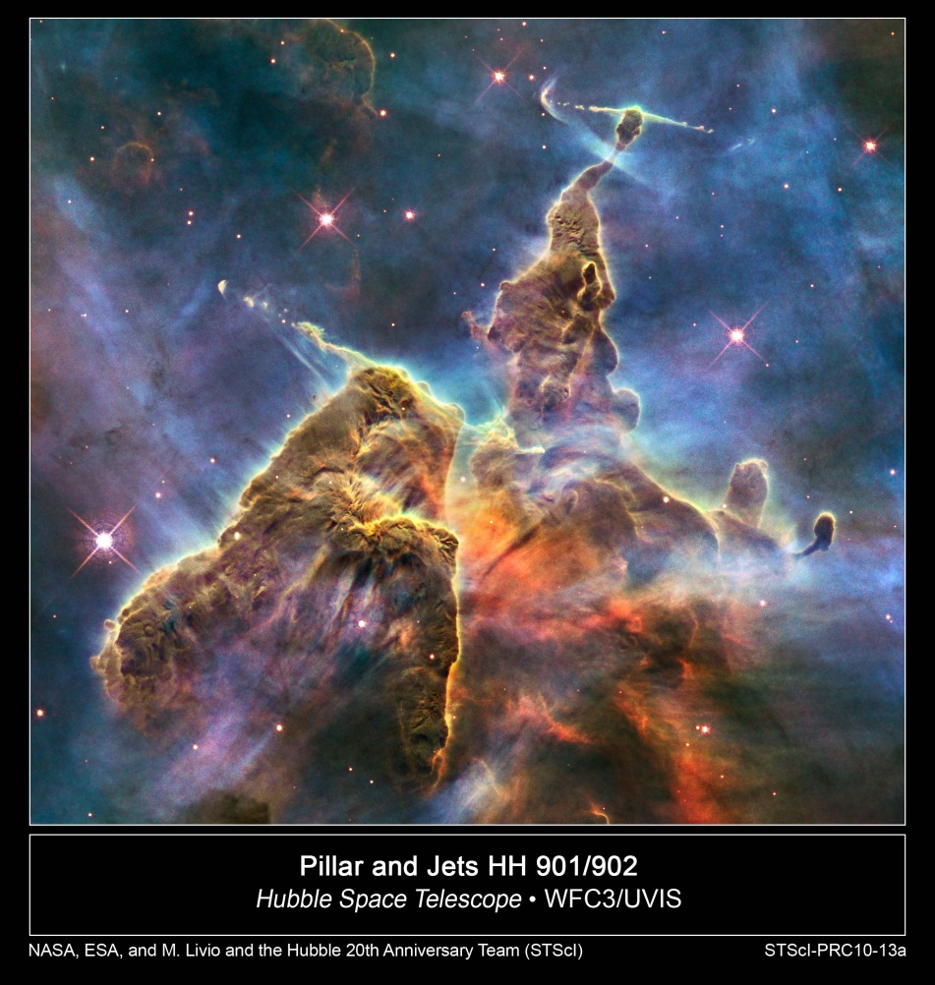
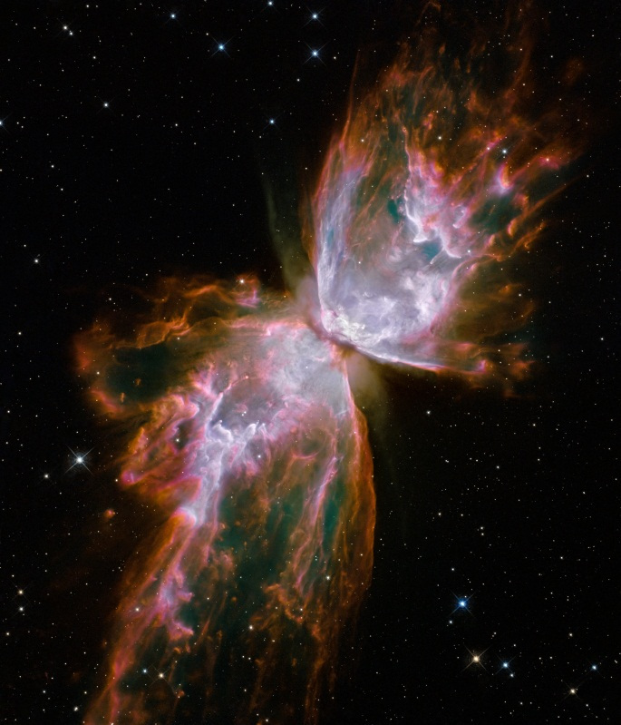
HUBBLE SPACE TELESCOPE

