Slide 1
Eclipses
What causes an eclipse?
How many different types of eclipses are there?

Slide 2
Definition
An eclipse is an astronomical event that occurs when an astronomical object is temporarily obscured, either by passing into the shadow of another body or by having another body pass between it and the viewer. An eclipse is a type of syzygy.
In astronomy, a syzygy /ˈsɪzɨdʒi/ (from the Ancient Greek suzugos (σύζυγος) meaning, "yoked together") is a straight-line configuration of three celestial bodies in a gravitational system.

Slide 3
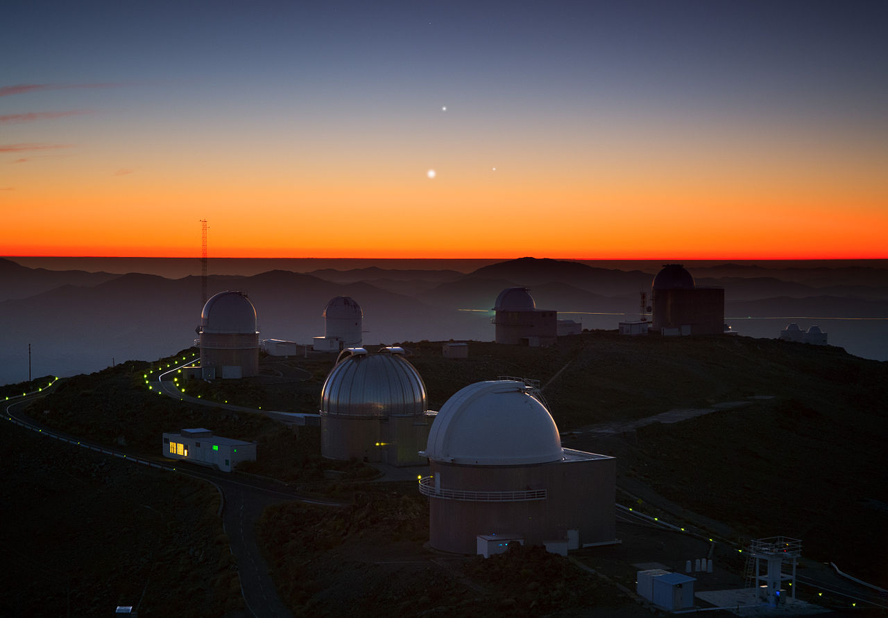
Above the round domes of La Silla Observatory, three astronomical objects in the Solar System — Jupiter (top), Venus (lower left), and Mercury (lower right). This is an astronomical syzygy. Even though the planets are not precisely lined up in an absolute straight line, they are in the same area of space, or quadrant, which classifies as a syzygy.

Slide 4
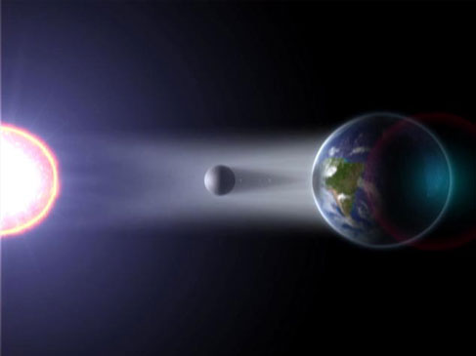
Artist’s conception of an eclipse
This is not to scale!

Slide 5
We only have eclipses during the full and new moon phases.
Those are the only times when the Earth , Moon and Sun are lined up and the shadows can fall on each other.
3rd Qu
Waning crescent
Waning gibbous
New
Full
Waxing crescent
Waxing gibbous
1st Qu
Shadow cones in space

Slide 6
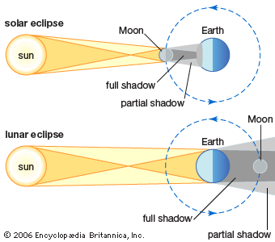

Slide 7
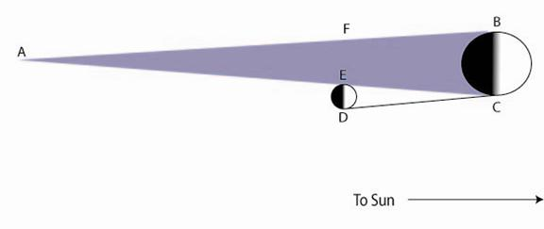
Why are shadows of planets and moons in the shape of a cone?
At this distance, we are closer to the object so it, and its shadow, appear bigger.
As we get farther away from the object, it appears smaller and consequently its shadow is smaller.

Slide 8
The moon’s orbit is tilted 5.2° to the ecliptic. This means that we can’t have an eclipse every month because the moon is either above or below the ecliptic during the correct phase. The syzygy only happens once or twice a year.

Slide 10
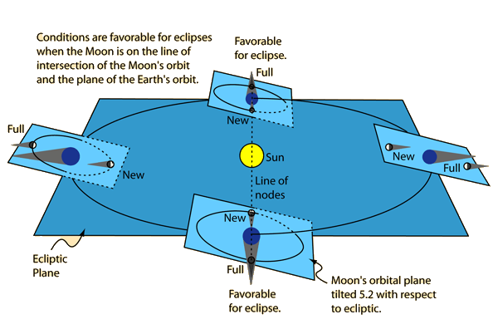
Notice: the tilt doesn’t change, the position in orbit changes as the Earth and moon go around the sun.

Slide 11
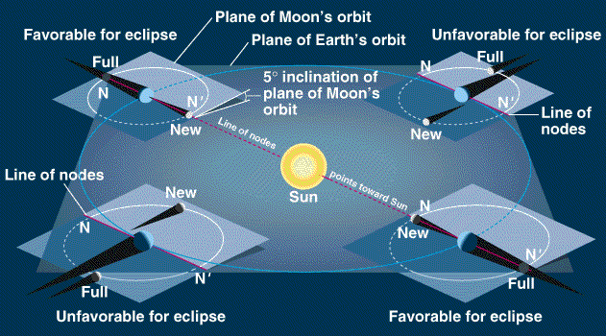

Slide 12
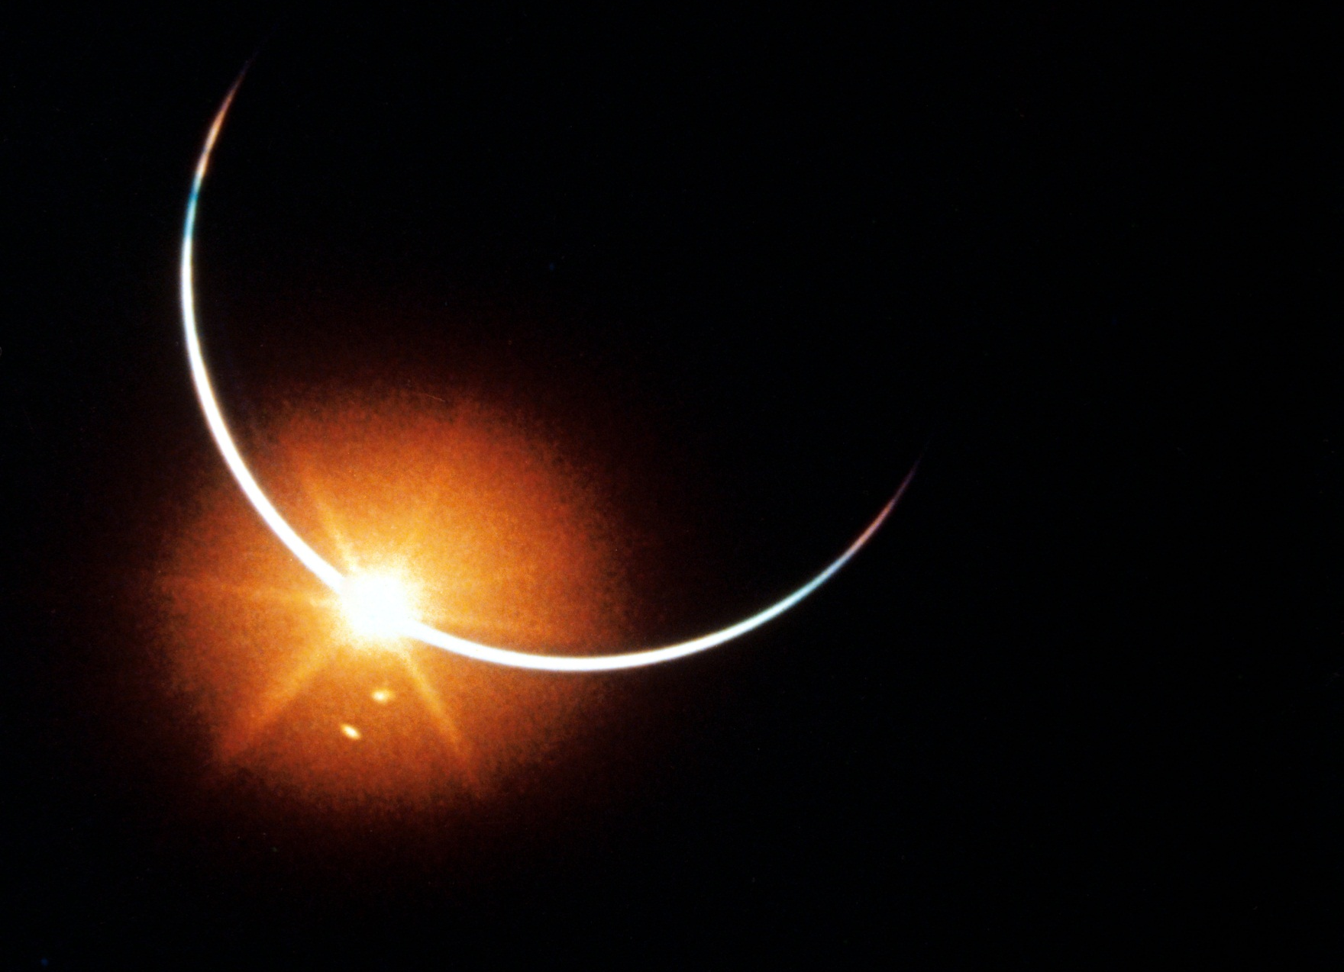
Solar Eclipse
Happens during a new moon. The shadow of the moon falls on the earth.

Slide 13
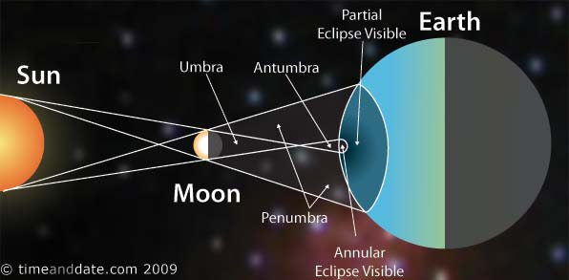
Solar Eclipse

Slide 14
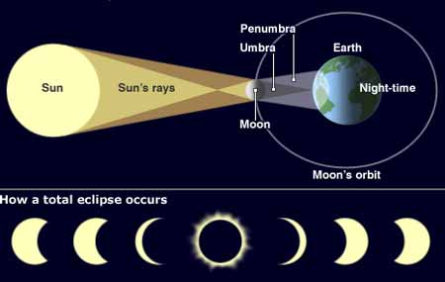
What does an eclipse look like?
Partial eclipses
Total Eclipse with the *corona visible
*Corona- Spanish for crown. The sun’s rays look like a crown

Slide 15
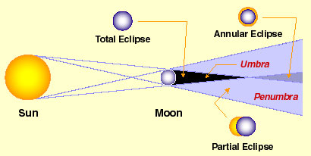
The difference between a total eclipse, a partial eclipse and an annular eclipse.
When the moon is farther away from us we get an annular eclipse because the moon appears smaller, so it doesn’t cover the whole sun.

Slide 16
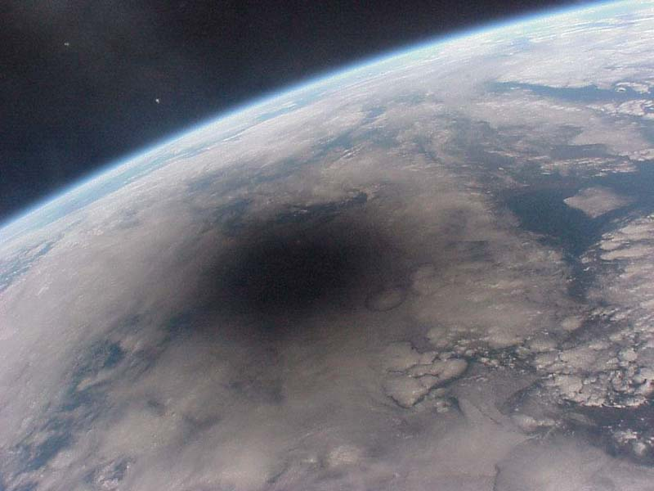
Area of totality
A picture of a Solar eclipse from space. This is the moon’s shadow on the earth

Slide 17
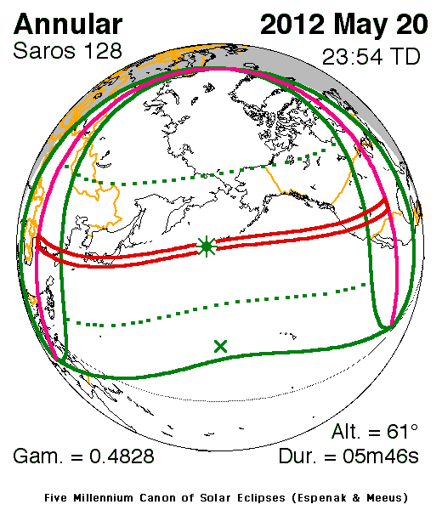
Area of partiality
Area of totality

Slide 18
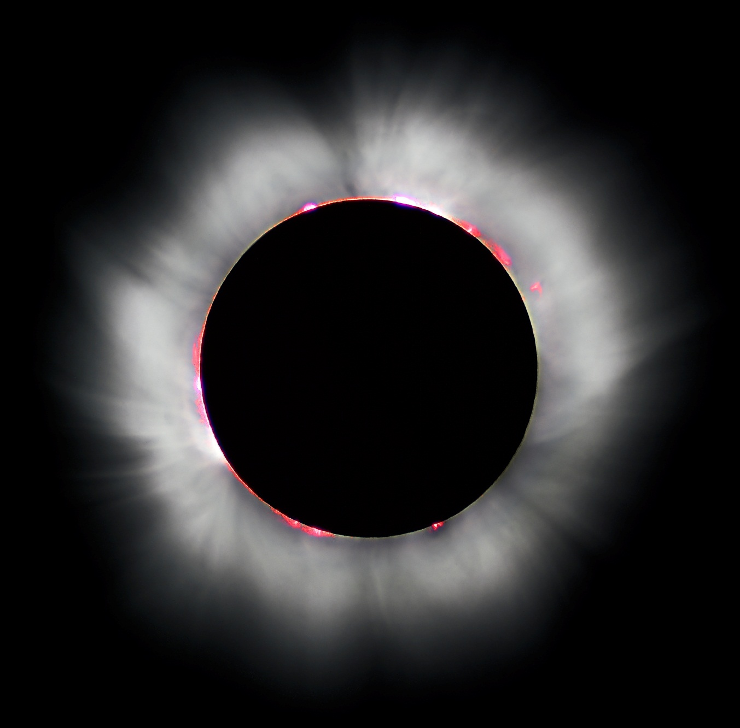
Total Solar Eclipse
Notice the flares and prominences in red. The corona is in white. The corona of the sun is not visible to the scientists unless we have a total solar eclipse.

Slide 19
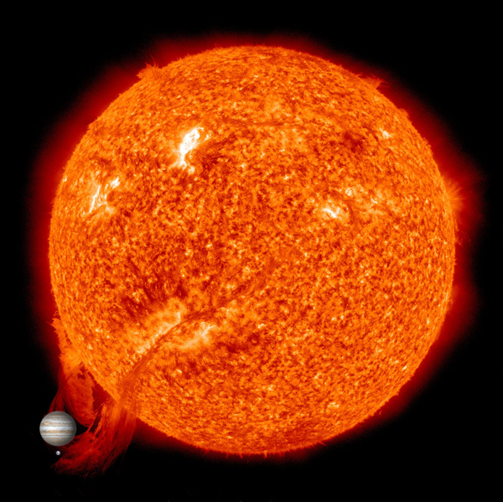
Solar Prominence
Sun Spots
Prominence
Jupiter
Earth
The planets are represented in a true scale size compared to the sun.

Slide 20
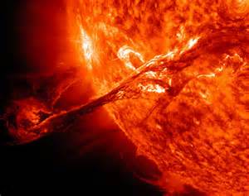
Solar Flares
These flares send electromagnetic energy into space that can reach Earth and even the outer planets. This energy causes auroras and disturbances in radio signals.

Slide 21
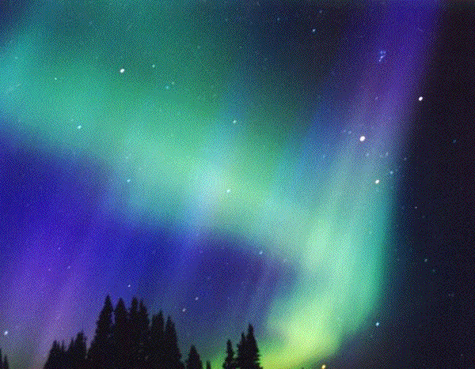
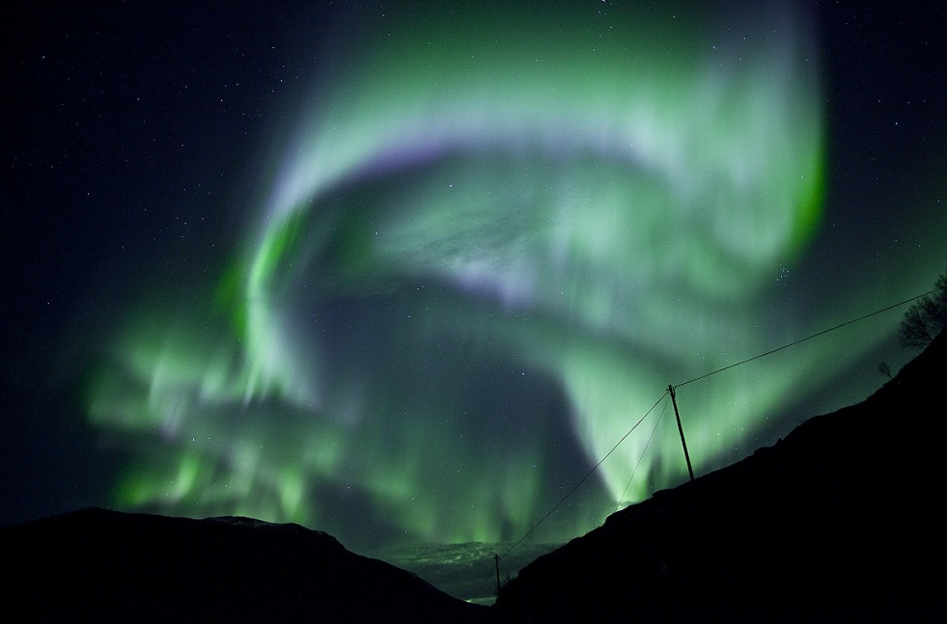
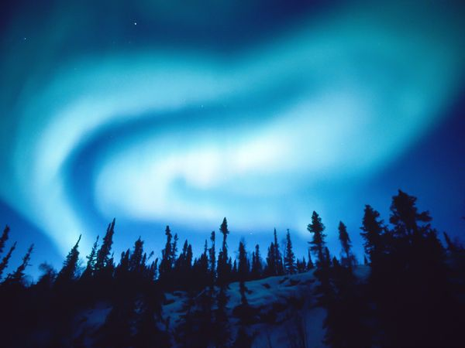
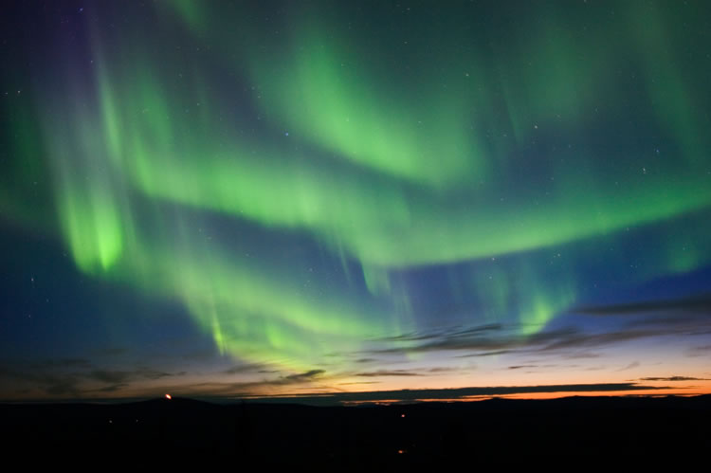
Aurora Borealis
When the sun’s energy interacts with the earth’s magnetic field at the poles, these beautiful lights appear in the sky.

Slide 22
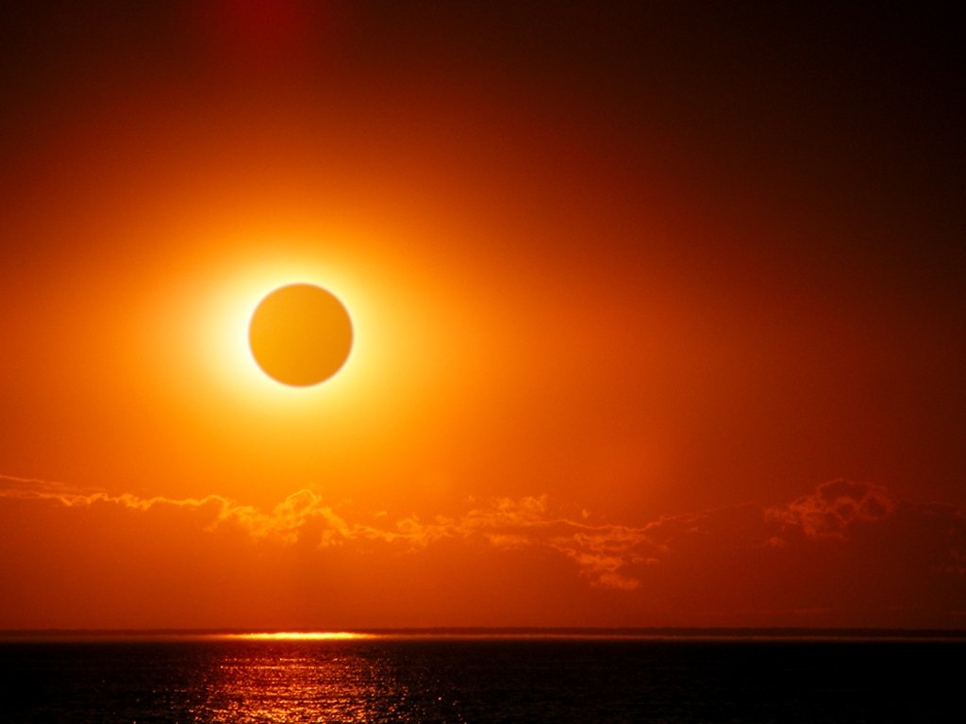
Annular solar eclipse
Notice that the corona is not visible in this picture. There is still a ring of the sun’s disk that is visible and very bright. Even with the majority of the sun obscured, the amount of sun that is visible can do permanent damage to your eyes.

Slide 23
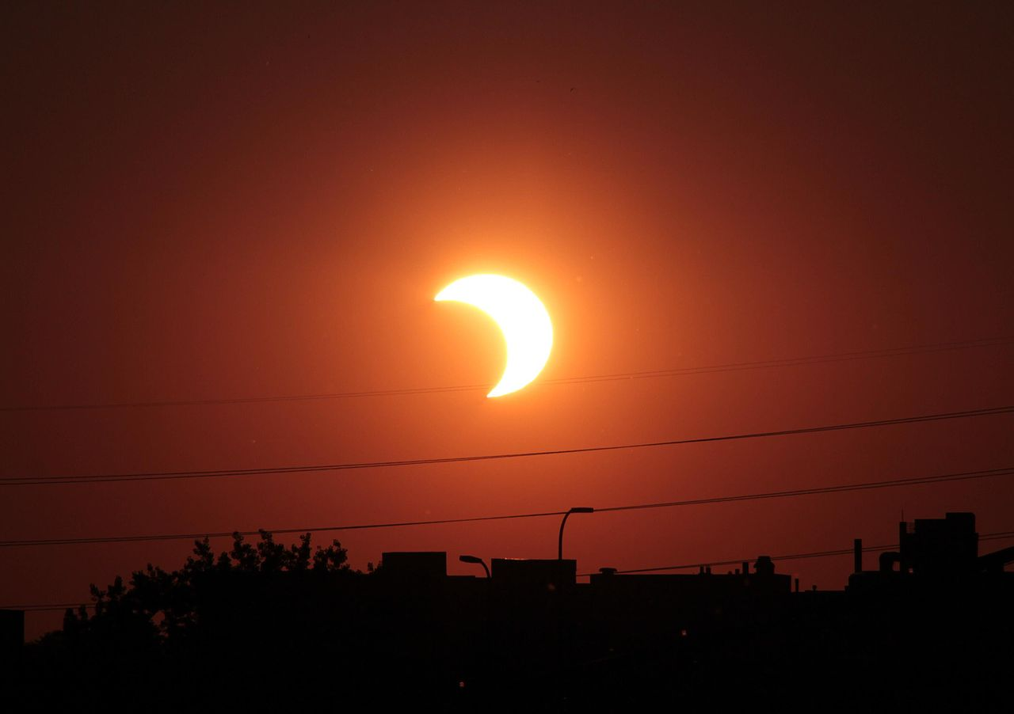
Partial Solar Eclipse

Slide 24
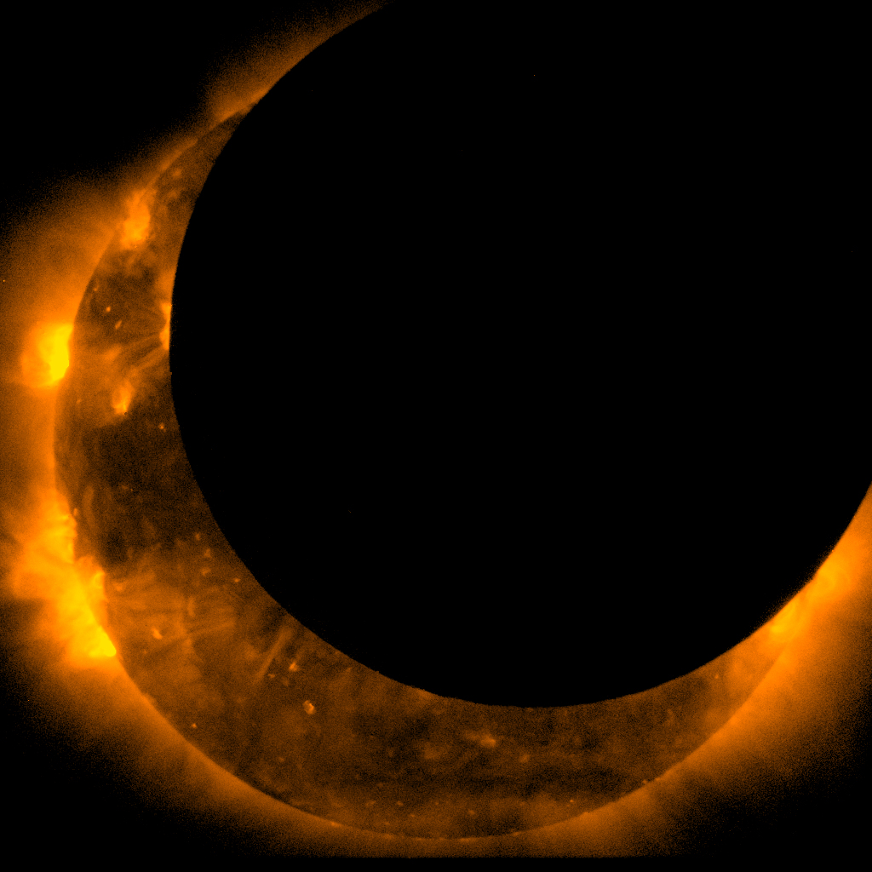
Partial Solar Eclipse
This was taken with special filters.

Slide 25
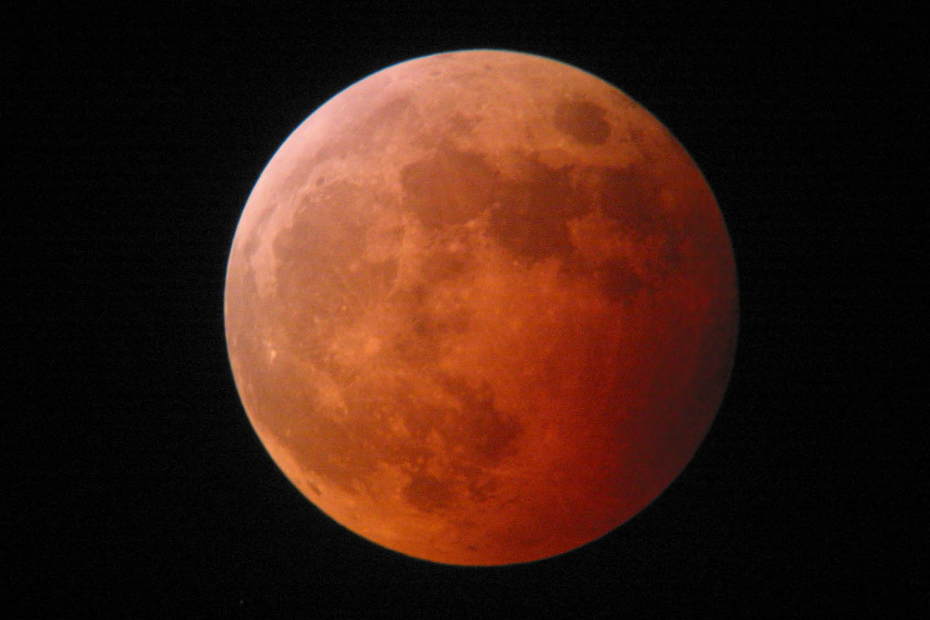
Lunar Eclipse
When the moon moves into the shadow of the earth during a full moon phase. Because of the reddish color of the moon, sometimes this eclipse is called a “Blood Moon”

Slide 26
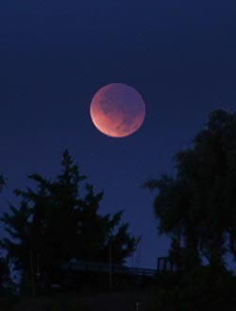
From Simi Valley, California, December 2011's totally eclipsed Moon hung just a few degrees above the western horizon. The southern half (lower left) of the disk, nearest the umbra's outer edge, is relatively bright.
Sky & Telescope / J. Kelly Beatty
From the Moon's perspective, the Sun remains completely hidden behind Earth for 59 minutes. From Earth's perspective, the lunar disk isn't completely blacked out but instead remains dimly lit by a deep orange or red glow. That's because Earth's atmosphere scatters and refracts (bends) sunlight that grazes the rim of our globe, and some of this light continues on toward the Moon. For an astronaut standing on the Moon during a total lunar eclipse, the situation would be obvious. The edge of the Earth would shine brilliant orange-red with the light of all the world's sunrises and sunsets happening at the time, and this light would be bright enough to cast a dim red glow on the lunar landscape at the astronaut's feet.

Slide 27
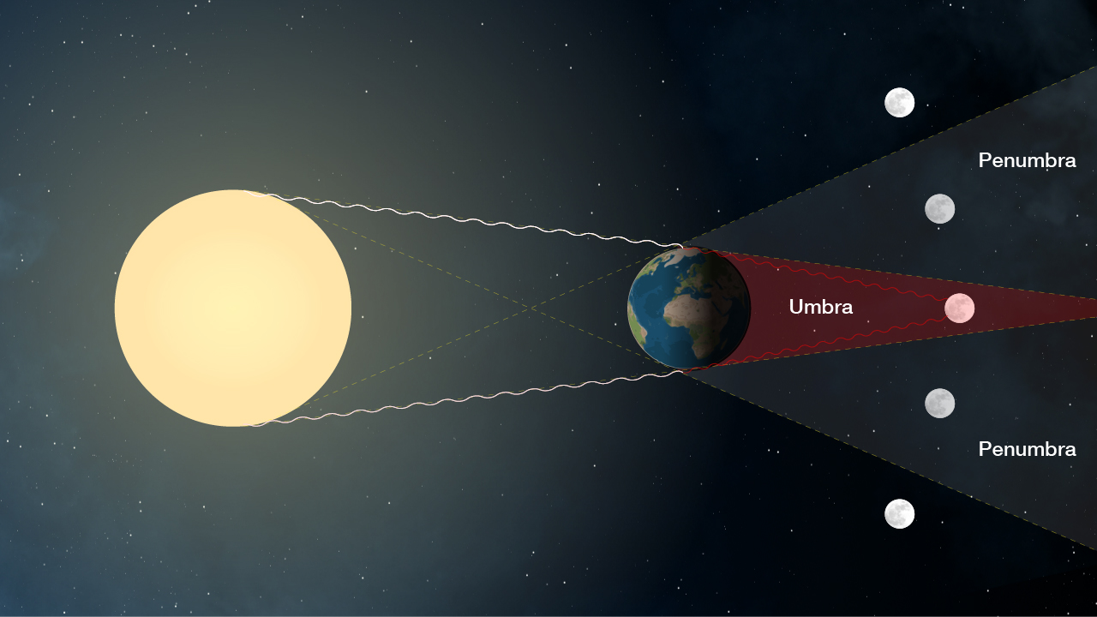

Slide 28
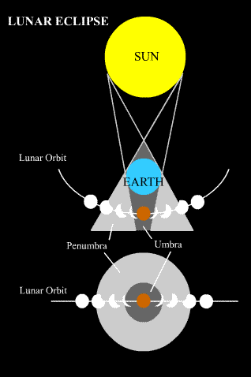
View from space
View from Earth

Slide 29
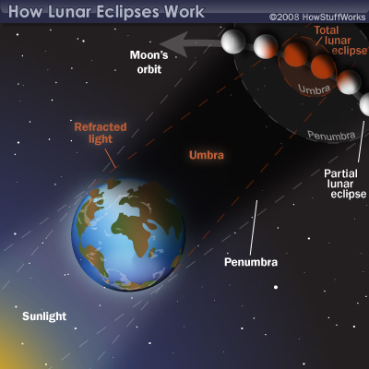

Slide 30
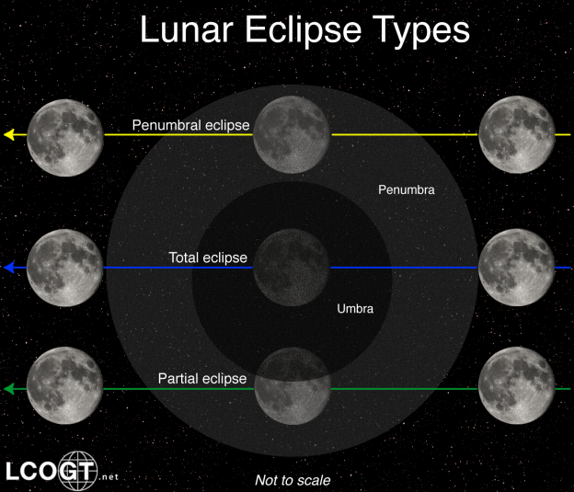
Different lunar eclipses

Slide 31
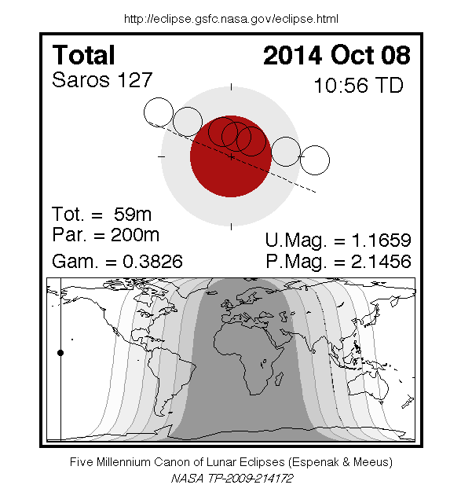

Slide 32
Total Solar Eclipse- all of the sun is covered by the moon
Partial Solar Eclipse-the whole sun is NOT covered up, portions are visible.
Total Lunar Eclipse-The whole moon is in the Earth’s shadow
Partial Lunar Eclipse-Only part of the moon is in the Earth’s shadow
Annular Solar Eclipse- The moon is too far away from the Earth so it appears smaller and doesn’t completely cover the sun. We see a bright ring of the sun. No corona is visible.
Annotations
Color coding
Write a summary
Write a response
You will a have an activity that you will need to use your notes! Be sure you have good notes
Finish your notes!

