Slide 1
Scale Model of the Solar System
Essential Questions
What is a scale model?
Why do most models of the solar system ignore either distance or size in them?
How do you convert measurements to scale?

Slide 2
Content and Language Objectives
Content Objectives:
Students will calculate, using math skills, scale diameters and radii of the planets and scale distance of the planets from the sun.
Students will use the scale diameters and radii of the planets to draw the planets to scale.
Students will use the scale distance from the sun to draw a representation of the solar system. Language
Language Objectives:
Students will answer the question verbally and in writing, “Why do we never see the planets’ size and distance to scale in a book or on a poster?”
Students will discuss with group members the proper techniques of constructing a model to scale.
Students will write notes and reflections on the skills they have learned in the lesson.

Slide 3
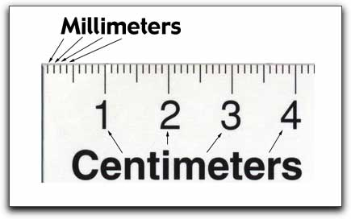

Slide 4
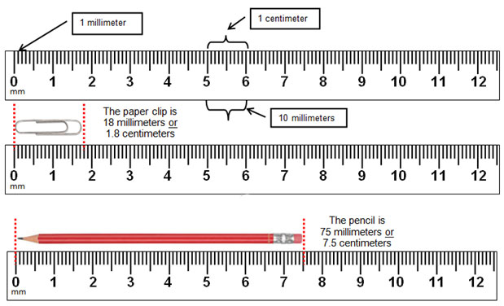

Slide 5
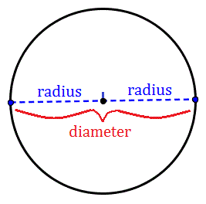
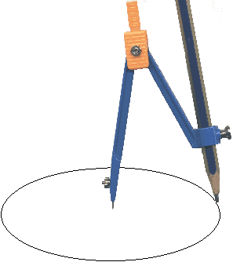

Slide 6
Draw a planet that is 2.5 mm in diameter.

Slide 7
Draw a planet that is 2.5 mm in diameter.

Slide 8
Your Planet must be 0.8 mm in diameter
B
A

Slide 9
Body | Diameter (km) | ÷ | Scale | Scale Diameter (cm) | ÷2 | Scale Radius (cm)
Sun | 1,391,900 |  | 10,000 | 139.2 cm | ÷2 | 69.6 cm
Mercury | 4,866
Venus | 12,106
Earth | 12,742
Moon | 3,478
Mars | 6,760
Ceres | 950
Jupiter | 142,984
Saturn | 116,438
Uranus | 46,940
Neptune | 45,432
Pluto | 2,274
Eris | 1,445

Slide 11
Body | Distance from the sun (millions of km) | ÷ | Scale | Scale Distance (cm)
Mercury | 57.95 |  | 50 | 1.2 cm
Venus | 108.11
Earth | 149.57
Moon (dist. from Earth) | 0.384
Mars | 227.84
Ceres | 414.0
Jupiter | 778.14
Saturn | 1427.0
Uranus | 2870.3
Neptune | 4499.9
Pluto | 5913.0
Eris | 10,200.0

Slide 13
Walk to Pluto: Scale Model of the Solar System
Copy and complete this table:
Body | Diameter (km) | ÷ Scale | Scale Diameter (mm/cm) | ÷2 | Scale Radius (mm/cm) | Distance (km) | ÷ Scale | Scale Distance (mm/m)
Sun | 1391900 | 5568 | 250/25 | ÷2 | 125/12.5 | N/A | 5568
Mercury | 4866 |  |  |  |  | 57,950,000 | 5568 | 10,407/10.4
Venus | 12106 |  |  |  |  | 108,110,000
Earth | 12742 |  |  |  |  | 149,570,000
Moon | 3478 |  |  |  |  | 384 ,000 from Earth!
Mars | 6760 |  |  |  |  | 227,840,000
Ceres | 950 |  |  |  |  | 414,000,000
Jupiter | 142984 |  |  |  |  | 778,140,000
Saturn | 116438 |  |  |  |  | 1427,000,000
Uranus | 46940 |  |  |  |  | 2,870,300,000
Neptune | 45432 |  |  |  |  | 4,499,900,000
Pluto | 2274 |  |  |  |  | 5,913,000,000
Eris | 1,445 |  |  |  |  | 10,200,000,000

Slide 14
Finish your notes:
Add annotations in the Cue Column
Color code your notes with at least 3 colors
Using the essential questions to help you, write a summary paragraph about what you have learned.
Essential Questions
What is a scale model?
Why do most models of the solar system ignore either distance or size in them?
How do you convert measurements to scale?
Write a response or reflection Paragraph

