Slide 1
Describing Motion
How are distance and displacement different?
How do we calculate an object’s speed?
What information does a distance/time graph provide?

Slide 2
Motion
Motion is movement; transition form one place to another
To describe motion we need:
A starting point
An ending point
Direction
Distance scale
Frame of reference
Reference Point
Frame of reference –whole piece
Points – parts
Coordinate system

Slide 4
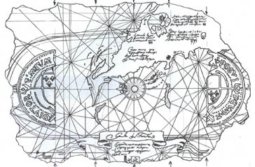

Slide 5
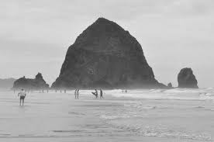

Slide 6
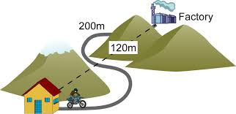
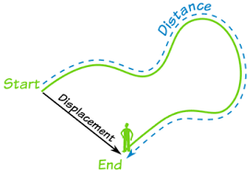
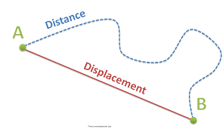
Displacement
Displacement is not the same as distance
Displacement-how far from the starting point
Distance-total length of movement

Slide 8
Adding displacements
Coordinate system
Positive direction
Negative direction
-
+

Slide 9
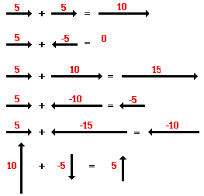

Slide 11
Speed
$Speed=\frac{Distance}{Time}$
$$s=\frac{d}{t}$$
$$Distance=$$
$$Time=$$

Slide 12
Questions p. 47
A passenger elevator travels from the first floor to the 60th floor, a distance 210m, in 35s what is the elevator’s speed?
A motorcycle is moving at a constant speed of 40 km/hr. how long does it take the motorcycle to travel a distance of 10 km?
How far does a car travel in 0.75 h if it is moving at a constant speed of 88 km/h?
Challenge: A long-distance runner is running at a constant speed of 5m/s . How long does it take the runner to travel 1 km?

Slide 13
Constant Speed and Changing Speed
Constant Speed never changes, it stays the same throughout the whole trip.
Changing speed, the speed changes throughout the trip.
Instantaneous Speed-
Example: what the speedometer says at that moment
Average Speed – total distance divided by total time
$$Average Speed=\frac{total distance}{total time}$$

Slide 14
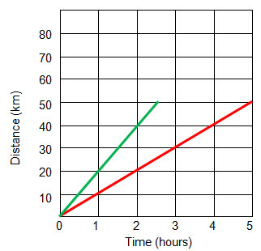
Graphing Motion
We can graph motion using a Distance vs Time graph
Distance is the dependent variable and time is the independent variable.
y-axis
Calculate Speed by finding the slope of the lines.
$$Slope=\frac{rise}{run}=\frac{y axis}{x axis}$$
x-axis

Slide 15
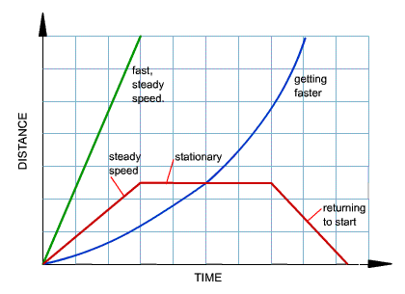
Speed on Distance vs. Time graphs
Average or constant speed is a straight line
Changing speed is curved or bent lines.

Slide 16
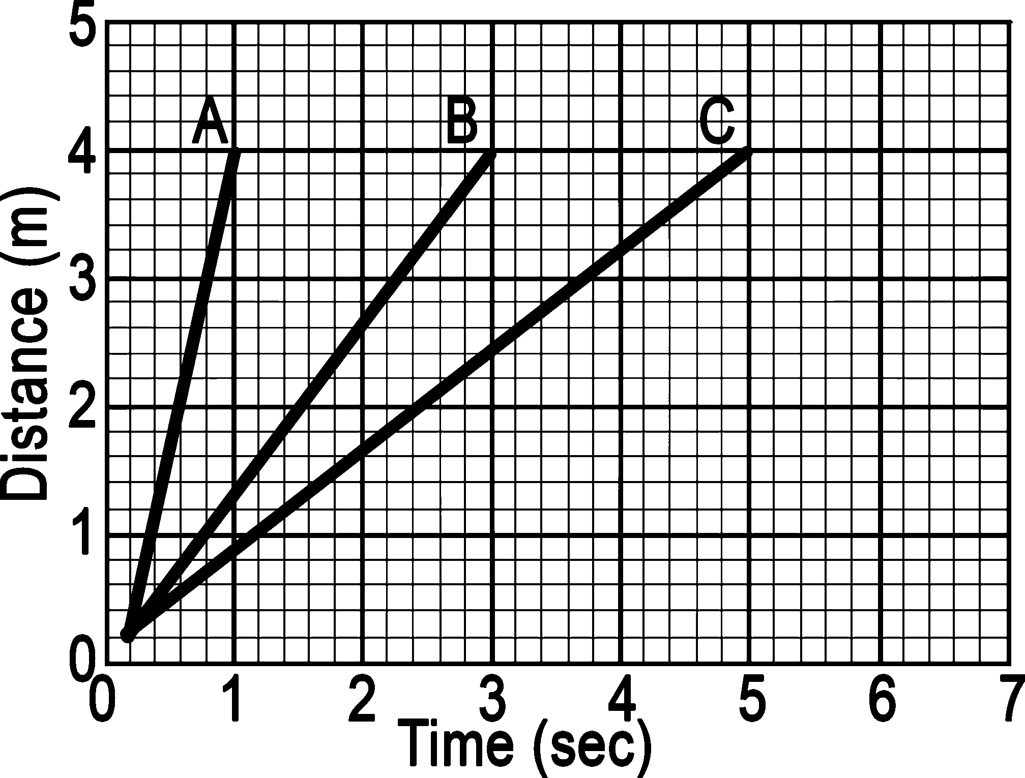
Steepness of lines

Slide 17
Describe the speed of each of these objects.
A
B
C

Slide 18
Section Summary
Motion occurs when an object changes its position relative to a reference point.
Displacement is the distance and direction of a change in position from the starting point.
Speed is the rate at which an object's position changes.
On a distance-time graph, time is the x-axis and distance is the y-axis.
The slope of a line plotted on a distance time graph is the speed.

Slide 19
Questions
5. Turn to your neighbor and describe the trip from your home to school using these words: position, distance, displacement, and speed.
6. Explain whether the size of an object’s displacement could be greater than the distance the object travels.
7. Describe the motion represented by a horizontal line on a distance vs time graph.
8. Describe the difference between average speed and constant speed.
9. During a trip, can a car’s instantaneous speed be grater than its average speed?

Slide 20
Applying Math Problems
10. Michiko walked a distance of 1.60 km in 30 min. Find her average speed
11. A car travels at a constant speed of 30 m/s for 0.80 h find the total distance traveled in km.
Additional Problems
A. Suzy drives for 3 hours to visit her Grandma in a different city. She has to go through road construction for a few miles and only goes 20 mph. She passes a truck at 85 mph. Halfway there she stops for gas and a snack for 15 minutes. Grandma’s house is 236 miles from Suzy’s house. What is her average speed?
B. Michael has to be at work at 9:00 am. He leaves his house at 8:30 am. If he drives 90 km per hour for the total distance of 54 km is he on time?

