Slide 1
Density Observed in Objects Foldable

Slide 2
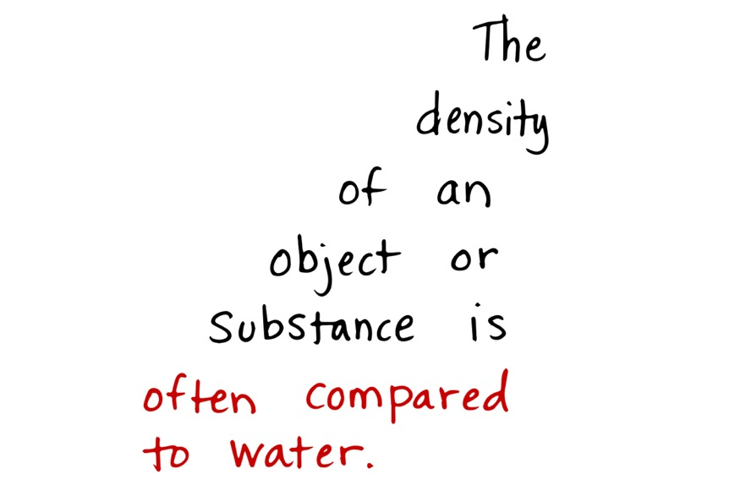

Slide 3
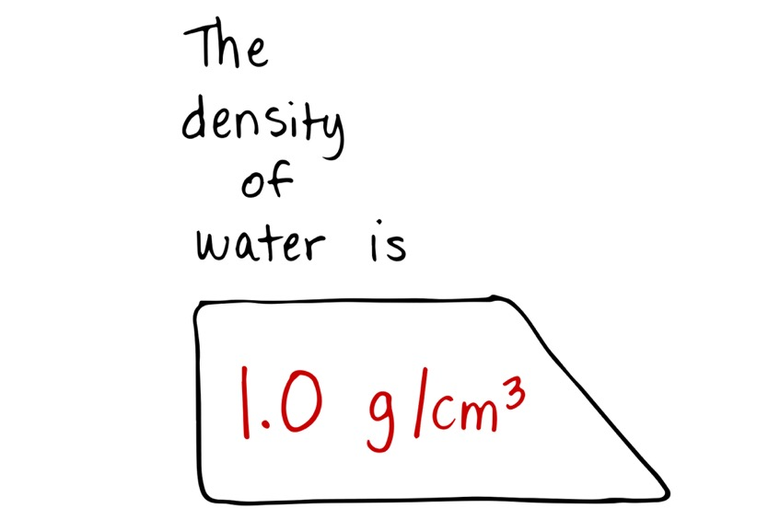
1.0 g/mL

Slide 4
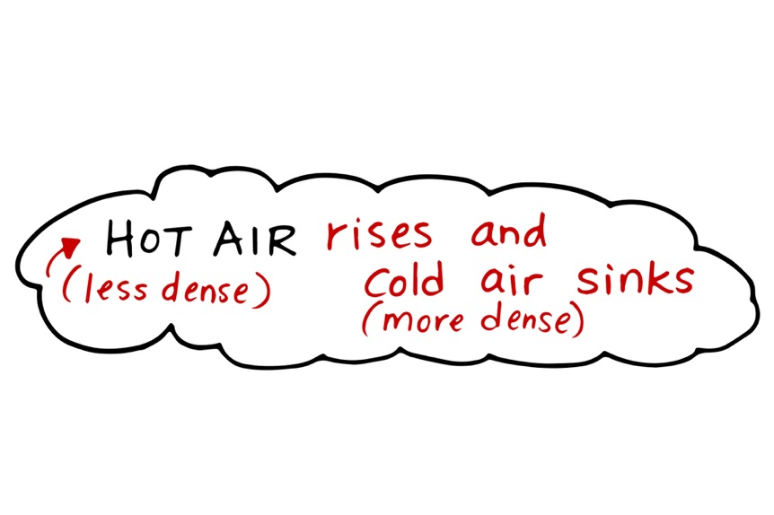

Slide 5
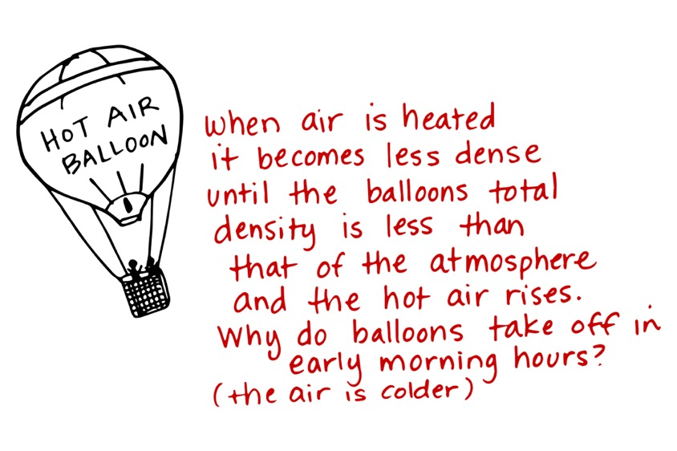
‘

Slide 6
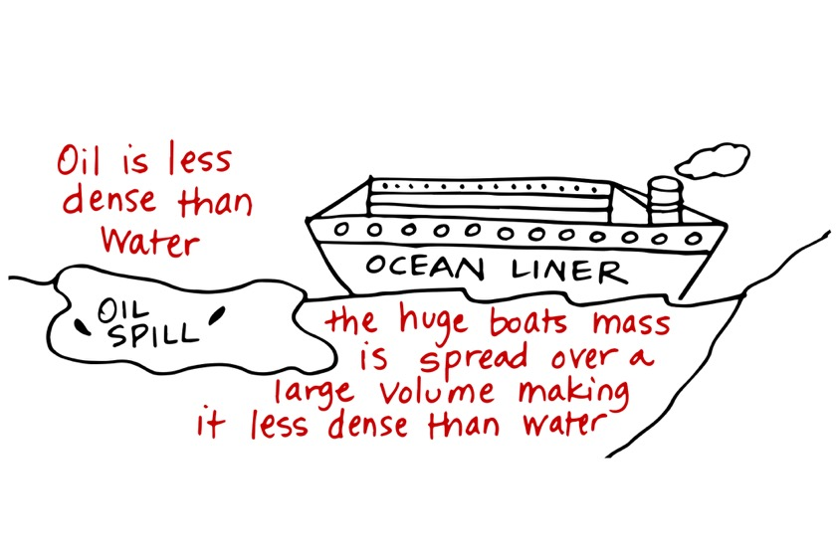
‘
A lot of empty space in a boat!

Slide 7
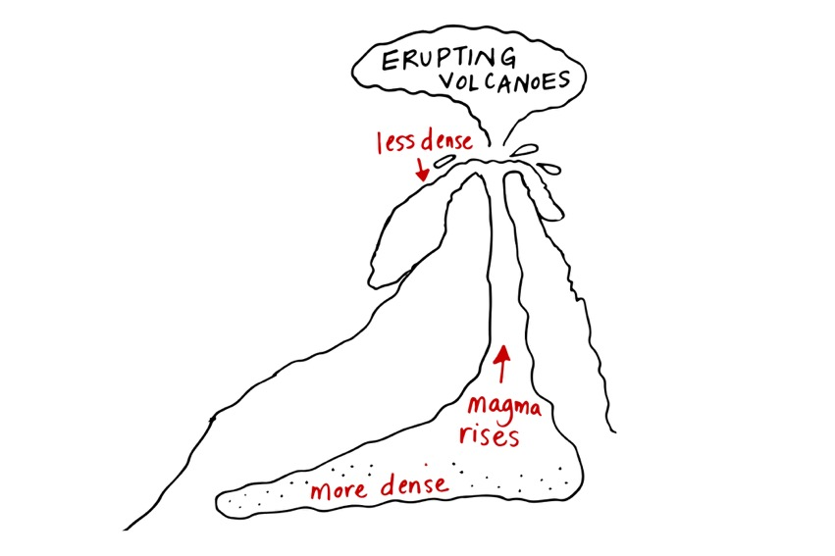
Magma in the earth heats and rises. When it cools it sinks. Magma is less dense than the surrounding rock.
Solid rock is most dense
Cool magma sinks
Hot
Heats up and rises again
Partly solid rock is more dense

