Slide 1
Density ________________________________________________ Foldable

Slide 2
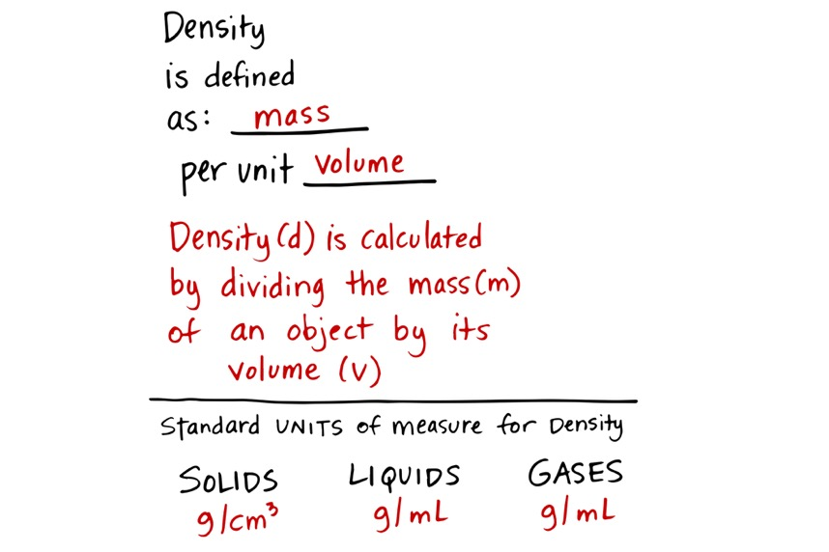
(mL =cm³)

Slide 3
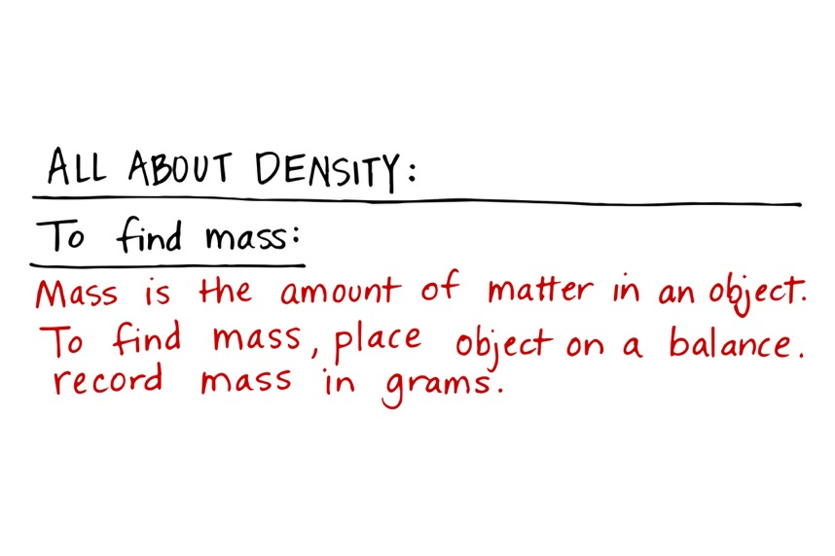
Mass = Volume x Density

Slide 4

Volume =length x width x height
cm³
Volume =Mass $÷$ Density
Volume = $\frac{\text{Mass} }{\text{Density} }$

Slide 5
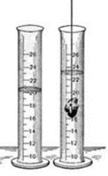
Ending
level
beginning
level
Volume in
mL
Ending
level
beginning
level

