Slide 1
Current Event Article Marking
A marking text method

Slide 2
Marking the text.
This method will help you to thoroughly understand an article or some current event that you read.
In this class, you will be given various articles to read and mark.
This method can also be used to mark a text book or other book you read.
If you cannot write on the article or book itself, adapt this method with post-it notes.

Slide 3
Getting started
Find the article
Cut it out
Prepare the article for marking
Read the article

Slide 4
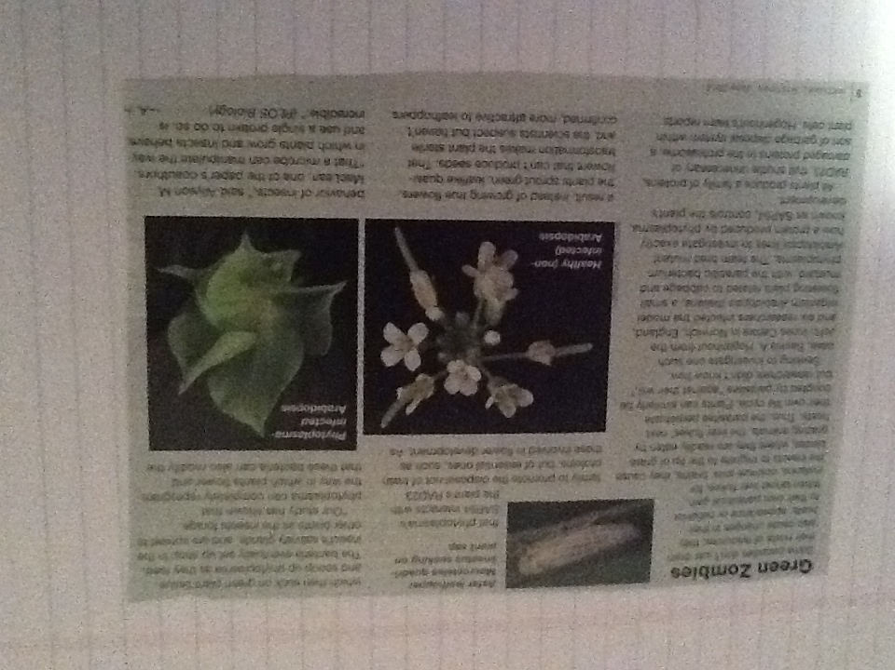
Choose your article
Sometimes you will choose the article or passage you want to read.
Sometimes the teacher will choose the article for you

Slide 5
Prepare the article
Sometimes you will have to cut the article out and glue it onto a page so you can mark it. Sometimes that is not necessary.
This article was cut out from a magazine and glued to a paper

Slide 6
Read the article
Read the article through once. You don’t have to do much else.
Just read it thinking about what the main idea is and making mental notes about vocabulary.
Did you understand all of it?
Also think about what is going through your head. What ideas, no matter how random, do you think about?

Slide 7
Choose the colors you will use for marking
You will need 3 colors, at least, for marking.
The colors can be highlighters, colored pens, crayons, colored pencils, etc.
Vocabulary
Annotations
Main Ideas and Summary
(optional) Reflection/Response
Make a key labeling the colors and the items they represent

Slide 8
Vocabulary
Mark the words for vocabulary
Write a definition

Slide 9
Vocabulary
Now that you have read the article once, go back through and mark vocabulary words.
You can highlight the words, or if you are using colored pens or other thinner utensil put circles or boxes around the words

Slide 10
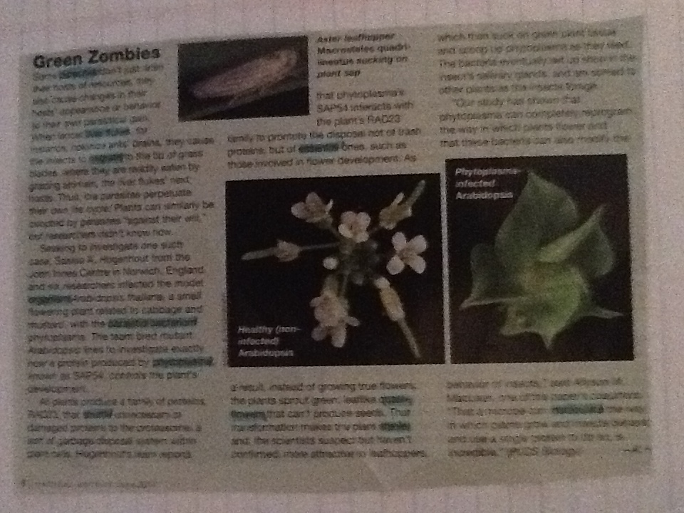
Vocabulary marking
I chose the color blue to highlight the words.
You must mark at least 5 words. You can always mark more!

Slide 11
Vocabulary (continued)
What words do you mark for vocabulary?
The obvious words to mark are words you don’t know, but what if you know all the words in the article?
Words you’ve never heard of
Words you don’t know the meaning of
Words you’re not sure about
Words you can’t give a definition for
Words you know when you read but never use when you speak or write
You should probably be able to find enough words now!

Slide 12
Vocabulary (continued)
Write short definition of the words you choose
Write the definition in the margins or
Write the definitions all together in one area
If you can’t write on the article, writing the definitions in one area of your paper is a good option.
I chose option one for my article as seen in the next slide

Slide 13
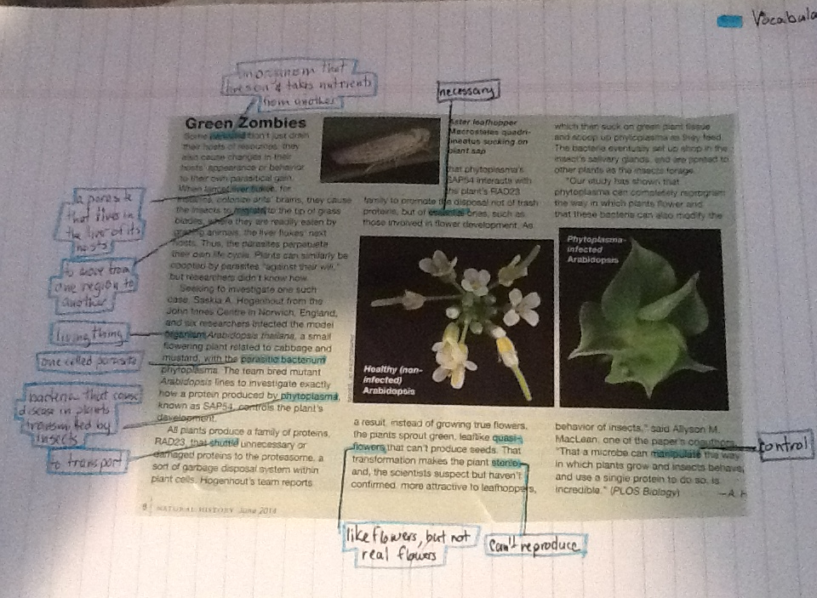
Vocabulary Definitions
Notice that I started to make my key in the corner. The words are highlighted and the definitions are outlined in that same color.

Slide 14
Re-Read the Article
Now that you know what the words mean, re-read the article.
Does the article make more sense?
Do you get a better idea of the meaning now?

Slide 15
Annotations
What random things go through your head as you read the article?
What connections can you make to your life?

Slide 16
Annotations
Make annotations in the margins (at least 5 notations)
These notations are about individual sentences or passages in the reading, not about the whole article.
Write a question you may have about the reading
Make a comment on the reading
Write an opinion about something in the text
Use the annotation/response starters from the Cornell Note-taking notes if needed.
As with the definitions, if you can’t write on the article itself, write the annotations in one area of your paper labeled as such.
You should write whatever pops into your head! These can be very profound thoughts!

Slide 17
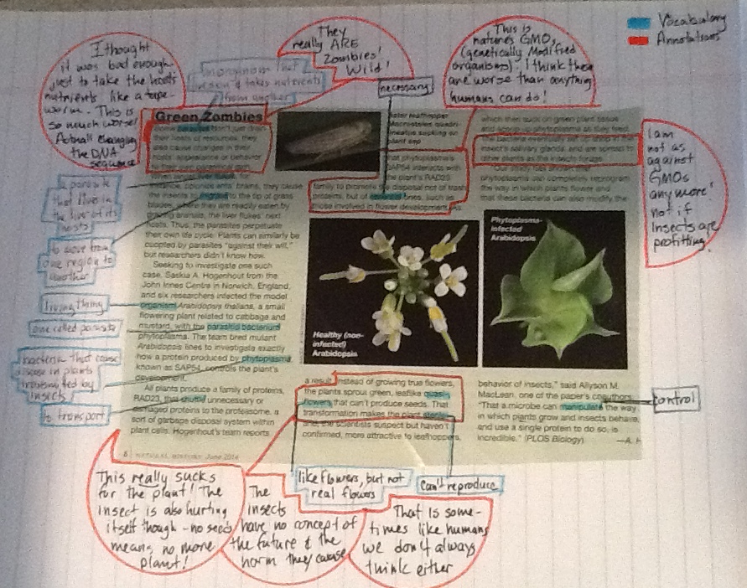
Annotations
I used a different color and shape to differentiate between the vocabulary and annotations.
I have also added the annotations to the key.

Slide 18
Main Ideas
What are the main ideas that the author wants you to understand?

Slide 19
Main Ideas
Using a different color, highlight or underline the main ideas of the article.
This is not just the one main idea of the article, the main ideas can also include the supporting ideas, too.
You will be using these ideas to write a summary later so get enough information.

Slide 20
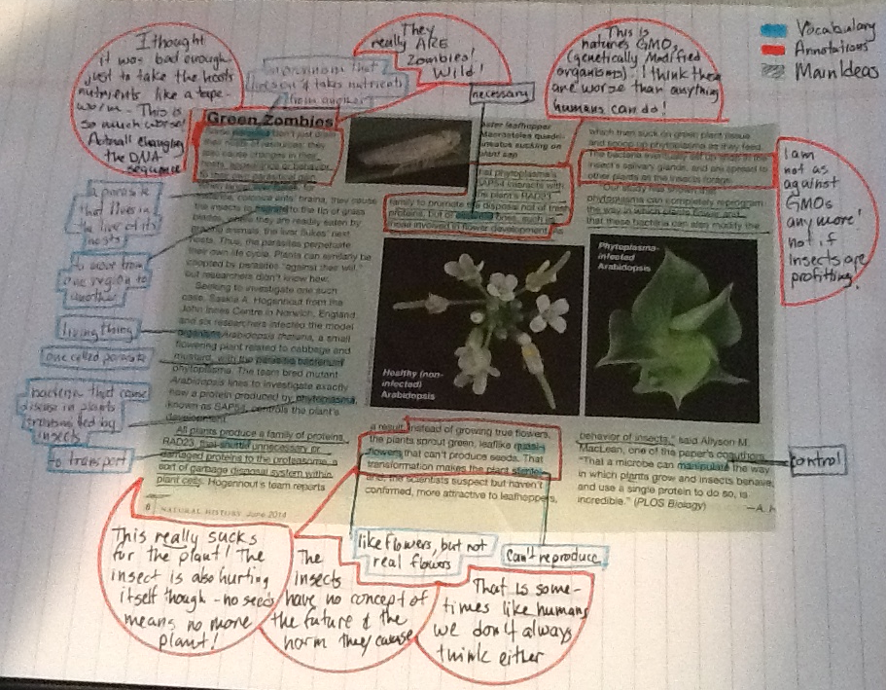
Main Ideas
I underlined the Main Ideas in green and marked it on the key.
If you can’t write on the article, write the main ideas in a separate area marked for such.

Slide 21
Summary and Reflection/Response Paragraphs
What was the article about and what did you think about it?

Slide 22
Summary Paragraph
Use the main ideas to write this paragraph
Don’t write, “The article is about . . .”
The summary paragraph should be a condensed version of the article without all the fluff.

Slide 23
Response Paragraph
Evaluate the article (either the writing or the information). Did you like it? Was it interesting? Did you learn something?
How does this article tie in with what you’re learning in one of your classes? Does it tie in with something you have learned previously in another class? Did you study this or something similar in elementary or mid school or in a previous high school class?
What does the subject matter make you think of? Does it remind you of something you have seen or experienced in your life? Did you read a book on the subject or a similar subject? Maybe you watched a TV show that ties in with that subject.
What are your thoughts about the article/subject? Reflect on the article and bring something of YOU to your response.
Respect your audience and make them care. Be honest about your writing. Let your personality shine, but be appropriate and accurate (NO TEXT SPEAK!) Write memorable things that stand out. Be energetic but keep it under control.

Slide 24
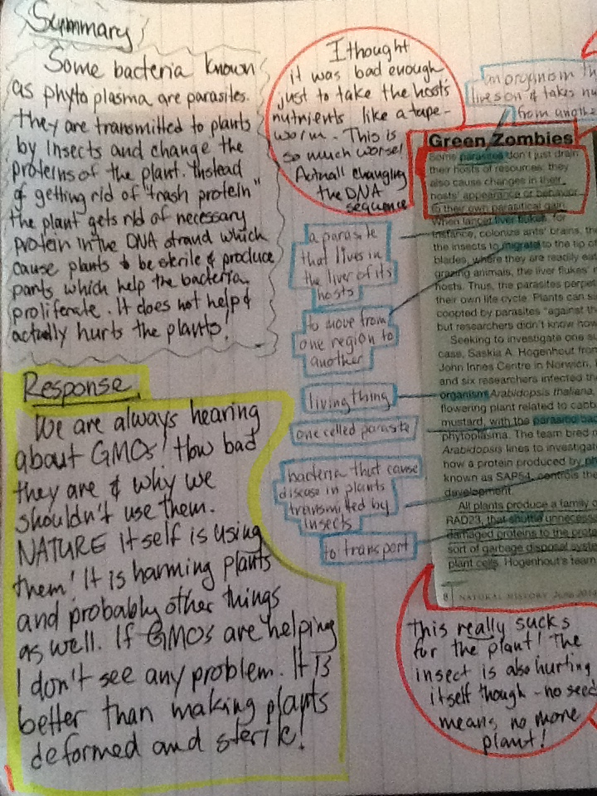
Summary and Response Paragraphs

Slide 25
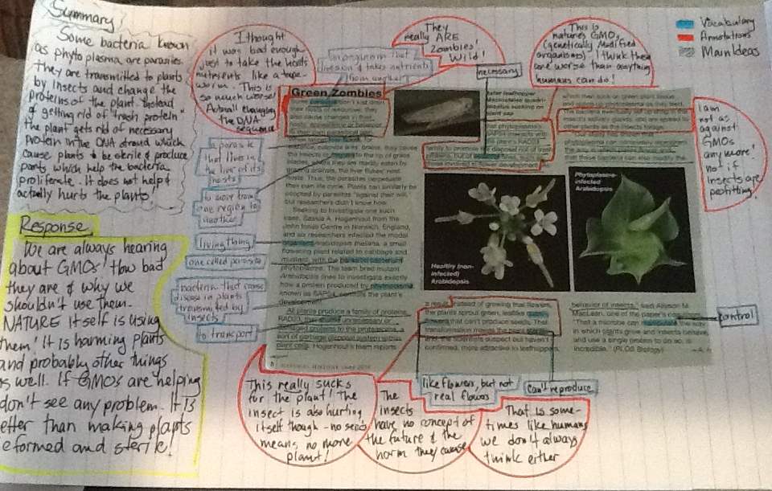
The Complete Article

Slide 26
Application
Reading the article just once or before understanding all the words and meanings can leave you with false ideas or an incomplete understanding of what the author is trying to say.
Now looking at the article after you have marked it you can understand so much more.
This method can be adapted to reading difficult text books, or other assigned reading from your teachers.
Most good readers already do a form of this method. They may not write everything down but they are doing the same techniques in some form.

Slide 27
Quick Outline of what we learned and how this is graded:
Find 5 vocabulary words, at least; write the definitions for each
Mark 5 passages and write 5 annotations about them, at least!
Highlight main ideas, enough for a summary
Write a Summary paragraph at least 5 sentences long
Write a Response paragraph at least 5 sentences long
Be sure your heading and a key for colors is on the page.
5 points
5 points
5 points
5 points
5 points
25 total points possible

Slide 28
Examples
Here are some students’ work

Slide 29
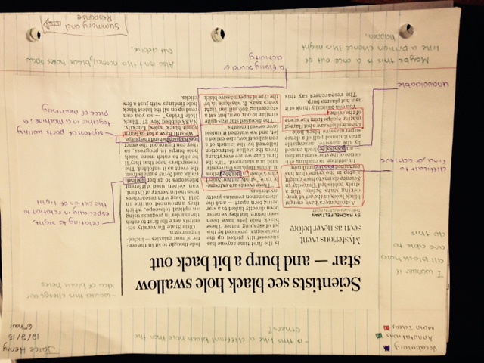

Slide 30
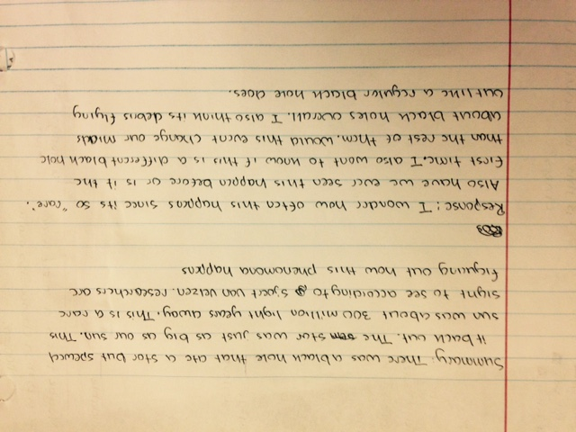

Slide 31
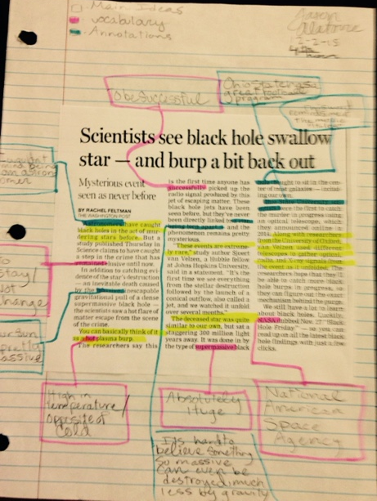

Slide 32
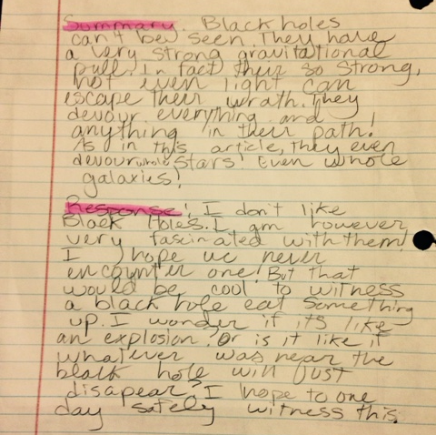

Slide 33
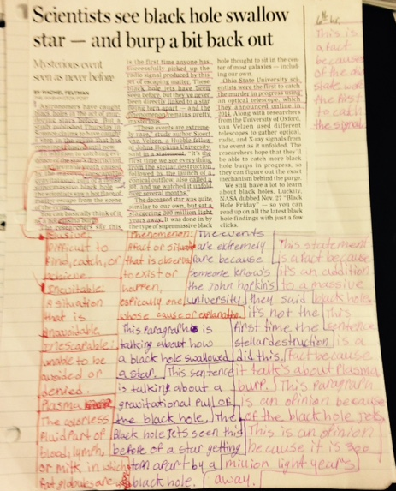

Slide 34
