Slide 1
Color
How do we see color?
What is color?
How are colors different from one another?
What are additive and subtractive colors?
How are LED lights different from incandescent or fluorescent lights?
How do filters work?

Slide 2
Vocabulary
Opaque
Transparent
Translucent
Reflect
Refract
Transmit
Emit
Absorb
Incandescent
Fluorescent

Slide 3
We see color in 3 ways
Reflected - light shines on an object and some color bounces off
Transmitted - Light shines through an object like a filter, and some color passes through
Emitted – light is produced by a source like a star or a lightbulb or and LED emitter
Reflect-bounce off
Transmit- go through
Emit - produce

Slide 4
Color (visible light) is the only part of the Electromagnetic spectrum that we can see.
Our eyes can detect these wavelengths:
700 nanometers red (7 x 10⁻⁹ meters)
400 nanometers violet (4 x 10⁻⁹ meters)
Some people can detect higher or lower wavelengths but most cannot.
The frequency of visible light is:
4 x 10¹⁴-7.5 x 10¹⁴ Hz
Remember ROY G BiV
70 nm 45 nm 75 nm 20 nm 30 nm 130 nm

Slide 5
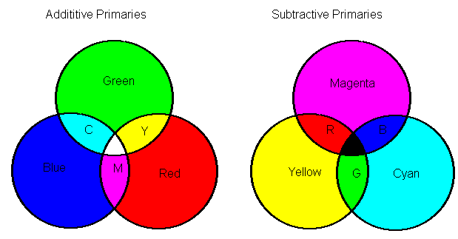
Color wheels
Light
filters
Additive-adding wavelengths, more light
Subtractive- taking wavelengths, less light

Slide 6
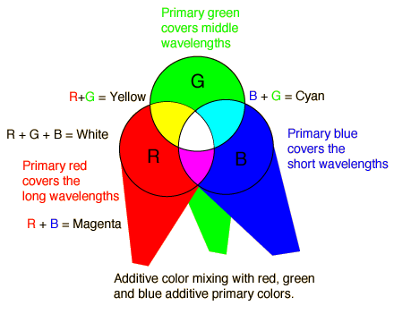
Additive colors-
3 different light beams shining on the same spot

Slide 7
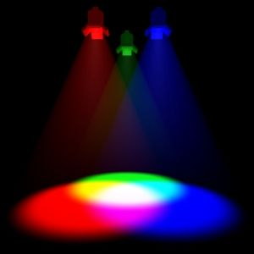

Slide 8
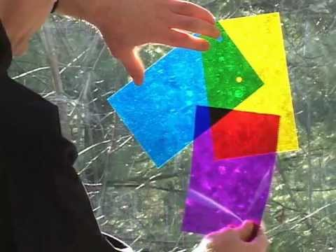
https://www.youtube.com/watch?v=5inTryUaQyg
https://www.youtube.com/watch?v=Hbxy1W9O_Wk#t=228.182493

Slide 9
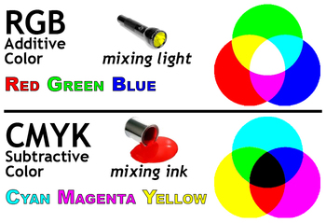

Slide 10
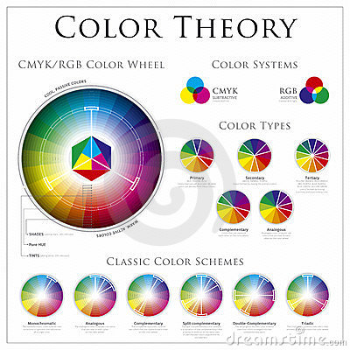

Slide 11
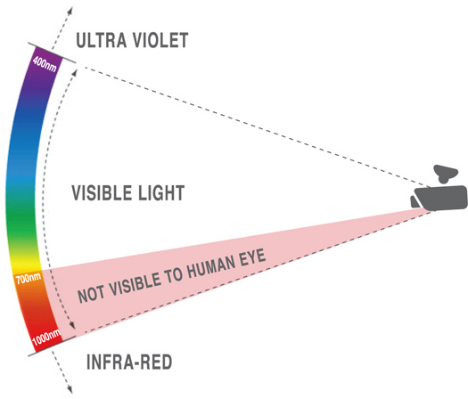
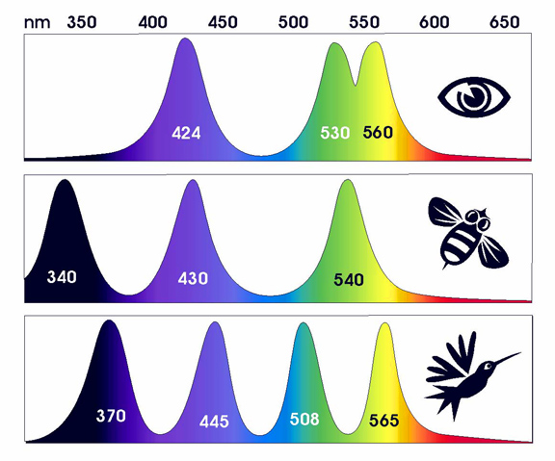
Some animals and insects can see higher or lower wavelengths

Slide 12
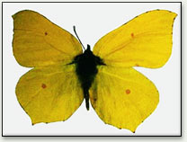
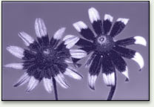
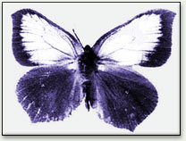
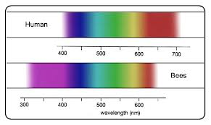
What bees see
visible
ultraviolet

Slide 13
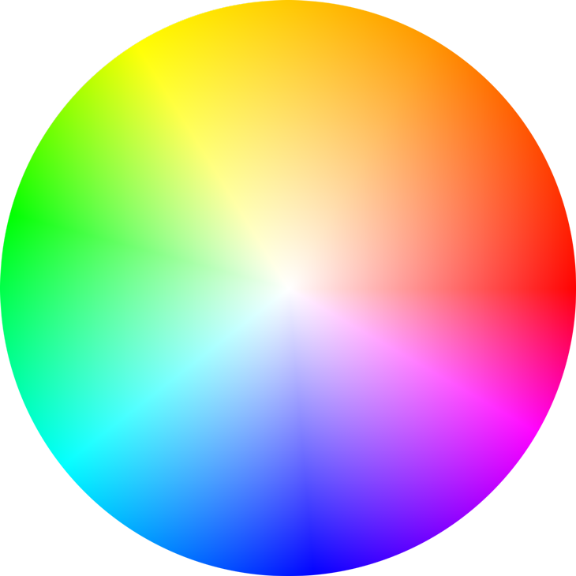
White and Black are not colors.
White is when all colors of light are reflected.
Black is when all colors of light are absorbed.
We can only see color that has been reflected or transmitted to our eyes.

Slide 14
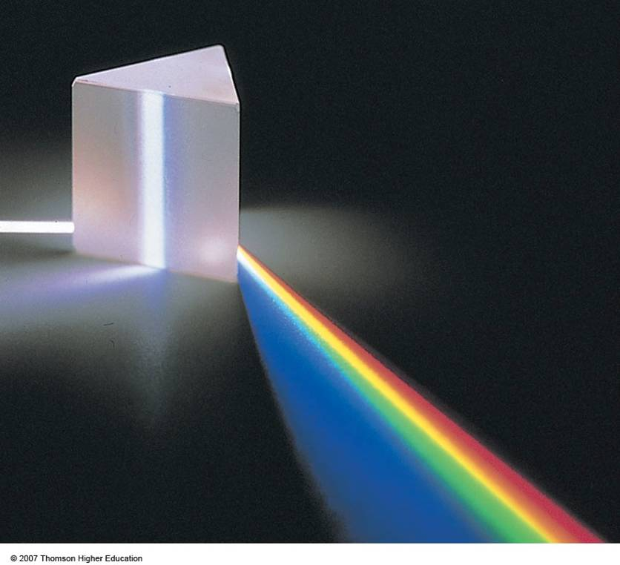
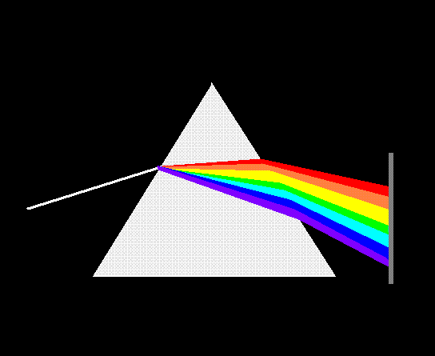
Prisms
You can separate white light into the different colors by shining it through a prism.
The different colors bend a different amount because of their wavelengths so the light is organized into different colors.
Red has the longest wavelength so it bends the least.
Violet has the shortest wavelength so it bends the most.

Slide 15
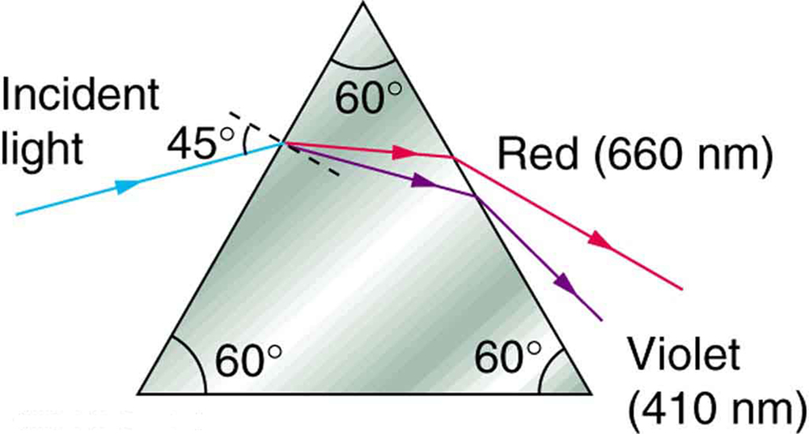

Slide 16
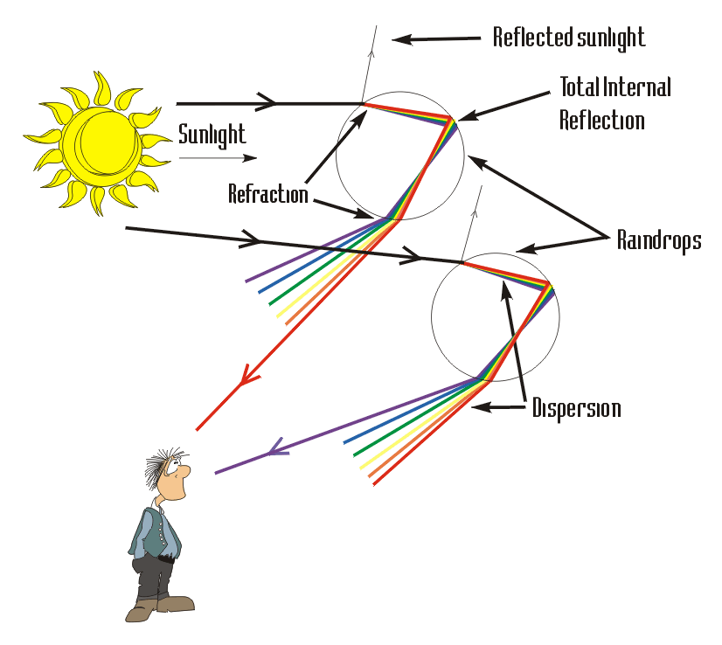
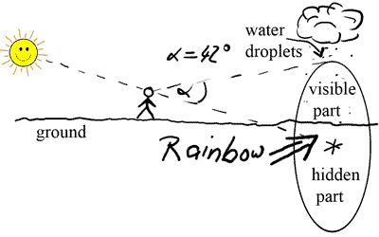
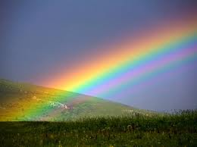
How we see rainbows
The raindrops act like prisms

Slide 17
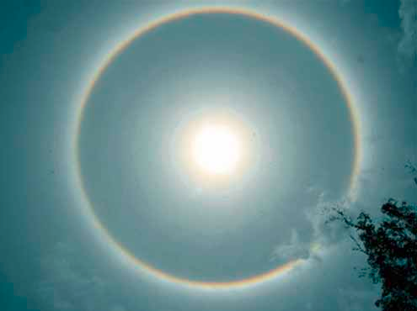
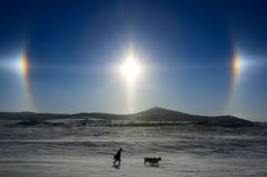

Slide 18
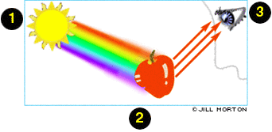
How do we see color?
White light¹ hits the object but only the color we see is reflected³, the rest is absorbed².

Slide 19
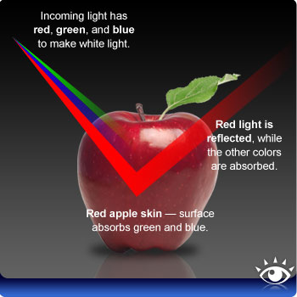
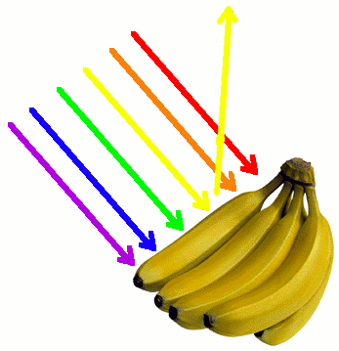
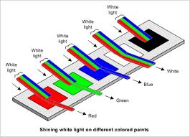
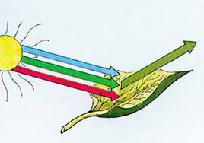

Slide 20
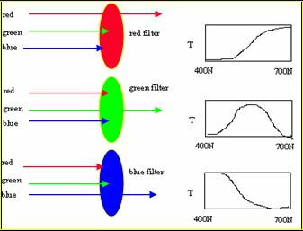
Filters
A filter only lets certain wavelengths through, the others it absorbs.
Therefore less light gets through, it is not as bright.
Notice, the light doesn’t ‘turn red’ in the first example, all colors but red are absorbed and ONLY red is transmitted.
Filters do not change the color of light they only let certain colors through.

Slide 21
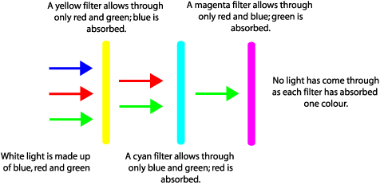
What happens with multiple filters?

Slide 22
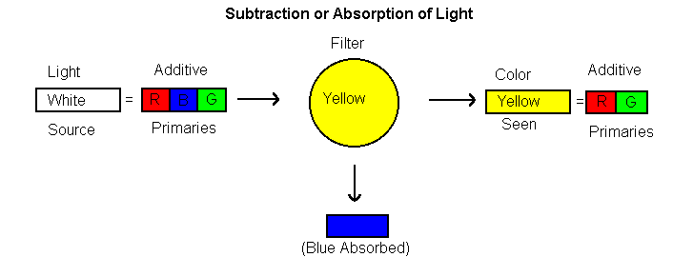
How do filters work

Slide 23
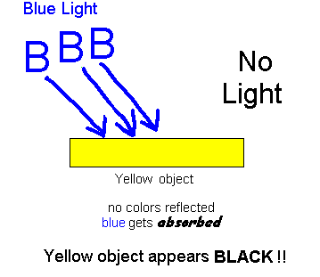
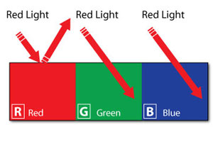
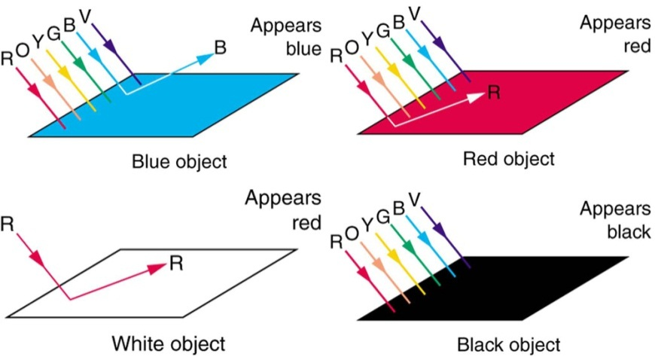
Color and filters
If only one color is shone on an object that can’t reflect that color we see black!

Slide 24
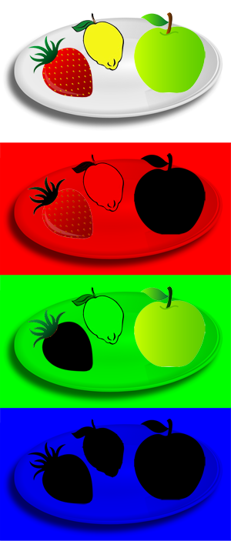
Objects in white light
Same objects in red light (the yellow reflects some red, the red reflects red, but the green absorbs all red so appears black).
Same objects in green light (the yellow reflects some green, the red absorbs green so appears black, but the green reflects green).
Same objects in blue light (the yellow, red, and green absorb blue so all appear black).

Slide 25
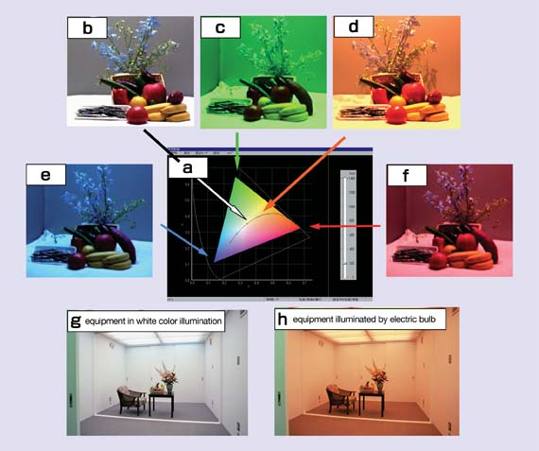

Slide 26
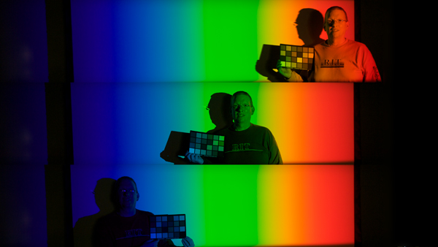
The man’s shirt is orange

Slide 27
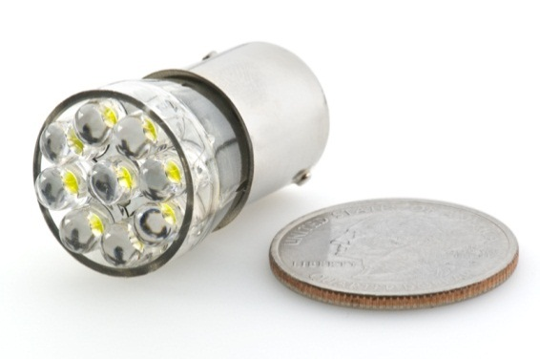
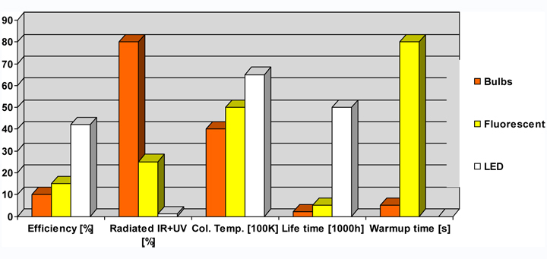
LED lights
LED stands for “light emitting diode”
This device only emits certain wavelengths so you only get one color (unless it is white then it is all colors)
Instead of producing all colors in a white light and then filtering out the colors not wanted, in LED ONLY the color wanted is produced
This saves on energy because there is no wasted light
Less infrared energy (heat) is produced and wasted.
di·ode
ˈa semiconductor device with two terminals, typically allowing the flow of current in one direction only.

Slide 28
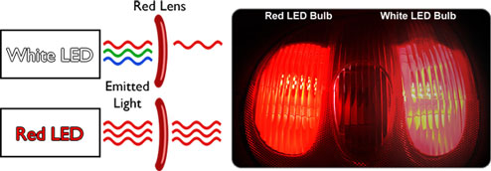
Compare one emitted frequency to more than one

Slide 29
Review
How do we see color?
What is color?
How are colors different from one another?
What are additive and subtractive colors?
How are LED lights different from incandescent or fluorescent lights?
How do filters work?

Slide 30
Finish the notes
Color Code
Add annotations
Write a summary
Write a response

