Slide 1
4.3 ELECTRON CONFIGURATION
Essential Questions:
What is the Aufbau Principle?
What is Pauli’s Exclusion Principle?
What is Hund’s Rule?
What is an electron configuration?
How do we write an electron configuration?

Slide 2
HOTEL CHEMISTRY
Welcome to the electron hotel ……what a lovely place!
Imagine you are the owner of a hotel.
Rooms are filled up in a certain order.
You want to fill the rooms on the lower floors first.
Each room can only hold a certain number of people.
Each room can only hold 2 people!
Some rooms fill faster than others.
Each person in a hotel can be found using their floor, room, and bed number.
THIS IS JUST LIKE THE ELECTRONS AND THEIR ORBITALS!

Slide 3
Electron hotel

Slide 7
I. Writing Electron Configurations
A. Rules
1. Aufbau Principle
2. Pauli Exclusion Principle
3. Hund’s Rule

Slide 9
No two electrons in the same atom can have the same set of four quantum numbers.

Slide 11
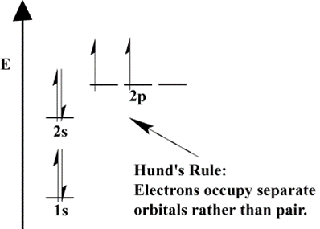
3. Hund's Rule - Orbitals of equal energy are each occupied by one electron before any orbital is occupied by a second electron, and all electrons in singly occupied orbitals must have the same spin.
_↑_ ___ ___ _↑_ _↑_ ___ _↑_ _↑_ _↑_ _↑↓ _↑_ ↑_
2p 2p 2p 2p

Slide 13
B. Orbital Notation
1. Unoccupied orbitals are represented by a line, _____. Lines are labeled with the principal quantum number and the sublevel letter.
2. Arrows are used to represent electrons. Arrows pointing up and down indicate opposite spins.

Slide 15
C. Configuration Notation
1. The number of electrons in a sublevel is indicated by adding a superscript to the sublevel designation.
Hydrogen = 1s¹
Helium = 1s²
Lithium = 1s²2s¹

Slide 17
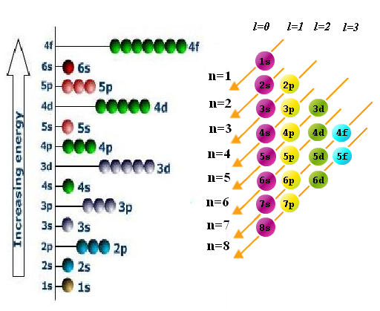

Slide 18
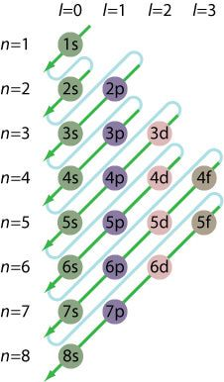
Filling the orbitals

Slide 21
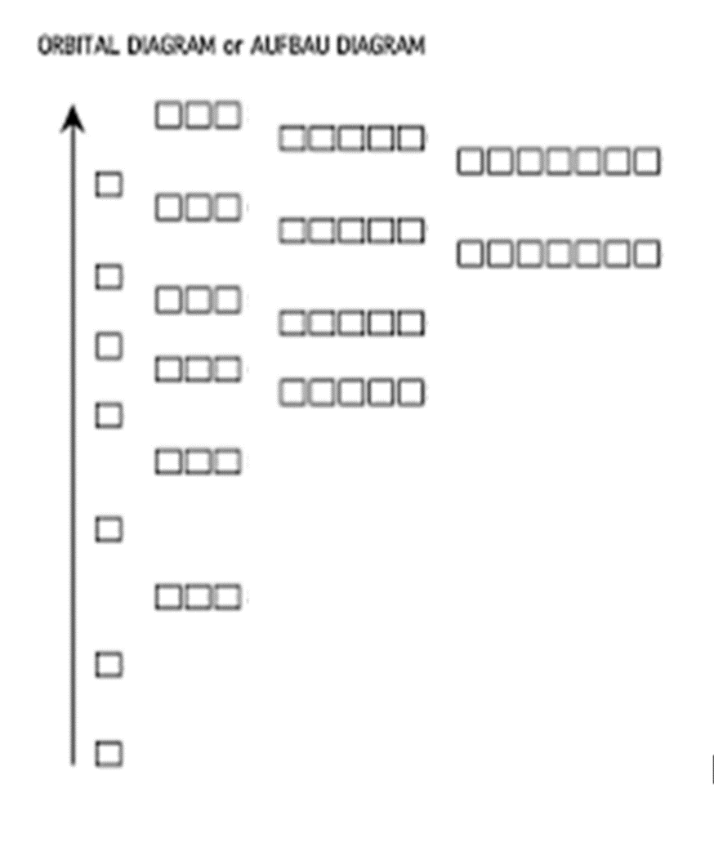
Energy increases
S p d f

Slide 22
Symbol | #e- | Electron Configuration | Orbital Diagram
 |  |  | 1s | 2s | 2p
 |  |  | _______ | _______ | ________ ________ ________
 |  |  | _______ | _______ | ________ ________ ________
 |  |  | _______ | _______ | ________ ________ ________
 |  |  | _______ | _______ | ________ ________ ________
 |  |  | _______ | _______ | ________ ________ ________
 |  |  | _______ | _______ | ________ ________ ________
 |  |  | _______ | _______ | ________ ________ ________
 |  |  | _______ | _______ | ________ ________ ________
 |  |  | _______ | _______ | ________ ________ ________
 |  |  | _______ | _______ | ________ ________ ________

Slide 24
D. Exceptional Electron Configurations
1. Irregularity of Chromium
a. Expected: 1s²2s²2p⁶3s²3p⁶4s²3d⁴
b. Actual: 1s²2s²2p⁶3s²3p⁶4s¹3d⁵
2. Irregularity of Copper
a. Expected: 1s²2s²2p⁶3s²3p⁶4s²3d⁹
b. Actual: 1s²2s²2p⁶3s²3p⁶4s¹3d¹⁰
3. Numerous transition and rare-earth elements transfer electrons from smaller sublevels in order to half-fill, or fill, larger sublevels.

