Slide 1
Chapter 4:Arrangement of Electrons in atoms

Slide 2
4.2 The Quantum Model of the Atom
Essentials Questions:
1. What was Louis de Broglie’s role in the development of the quantum model of the atom?
2. Compare and contrast the bohr model and the quantum model.
3. How did the Heisenberg uncertainty principle and the Schrödinger wave equation lead to the idea of atomic orbitals?
4. What are the 4 quantum numbers and what is their significance?
5. What is the relationship between the sublevels, atom’s main energy levels, number of orbitals per sublevel and number of orbitals per main energy level?

Slide 3
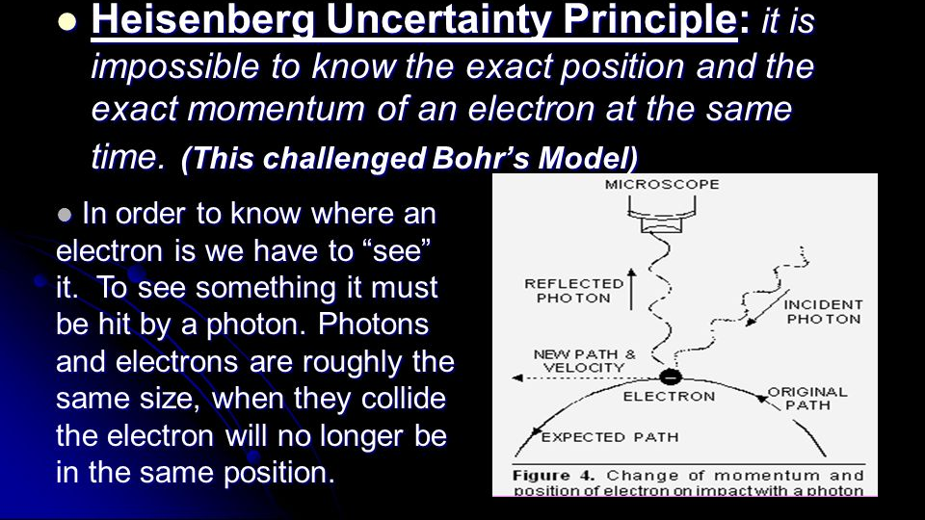
I. Probability and the Electron
The Heisenberg uncertainty principle states that the position and direction of motion of the electron cannot be simultaneously determined.
“WE CAN’T SEE WHERE AN ELECTRON IS, ONLY WHERE IT WAS.”

Slide 4
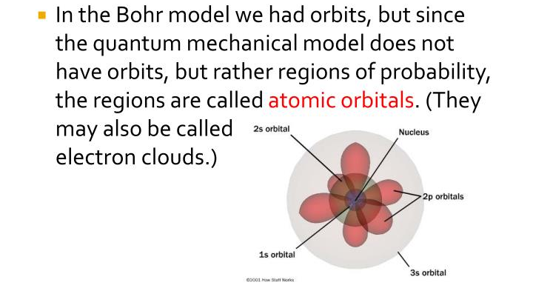
II. Regions of probability
Regions of probability in which electrons may be found in an atom are determined by mathematical equations that are described by quantum theory. These regions are called orbitals.
Regions of Probability
Atomic Orbitals
Electron Clouds

Slide 5
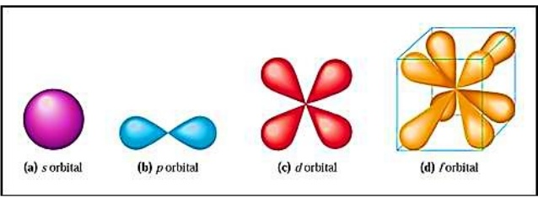
III. Atomic Orbital
Atomic Orbital - A 3-dimensional region in space where there is a high probability of finding an electron.
ORBITALS ARE 3-D
s orbital
p orbital
d orbital
f orbital

Slide 6
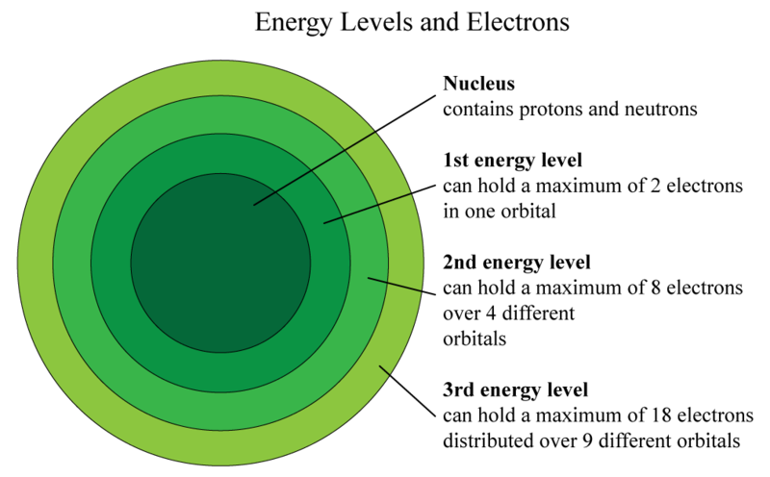
IV. Energy Levels of electrons (n)
A. Indicate the distance of the energy level from the nucleus
B. Values of n are positive integers
  1. n=1 is closest to the nucleus, and lowest in energy.
C. The number of orbitals possible per energy level (or "shell") is equal to n² .
n=1
n=2
n=3

Slide 7
V. Energy Sublevels (The quantum model, continued)
A. Indicate the shape of the orbital
B. Number of orbital shapes allowed in an energy level = n
Shapes in the first four shells are designated s, p, d, f
VI. Energy Sublevels (The quantum model, continued)
A. A single orbital can contain only two electrons, which must have opposite spins.
B. Two possible values for spin, +1/2, -1/2
https://www.youtube.com/watch?v=ewtgUFSMsnY

Slide 8
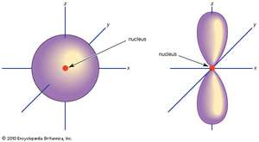
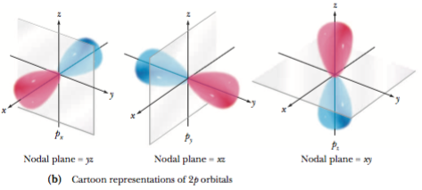
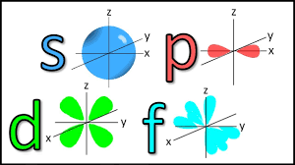
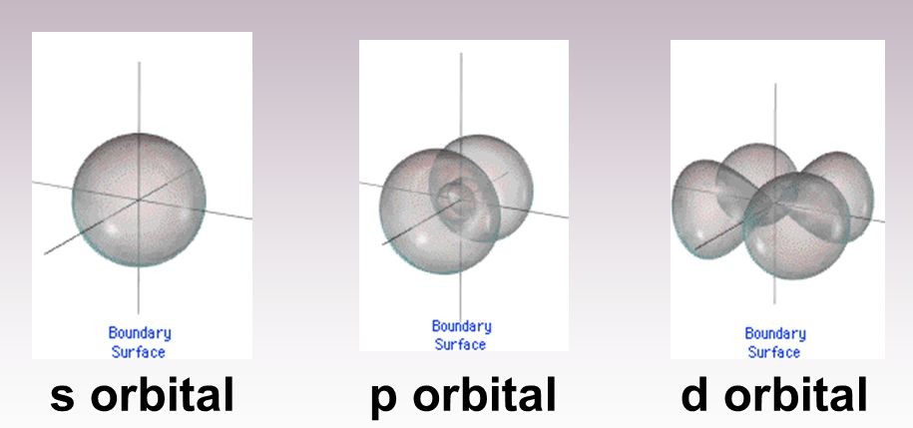

Slide 9
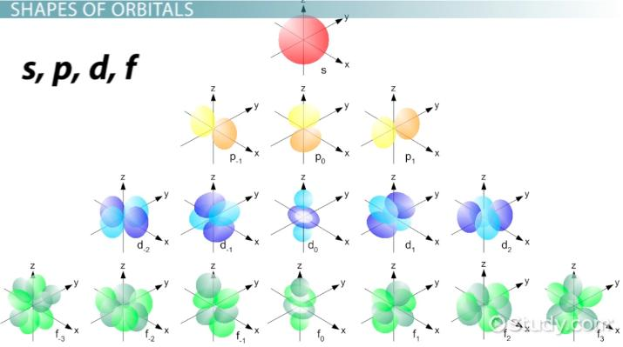

Slide 10
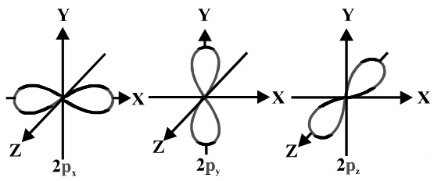
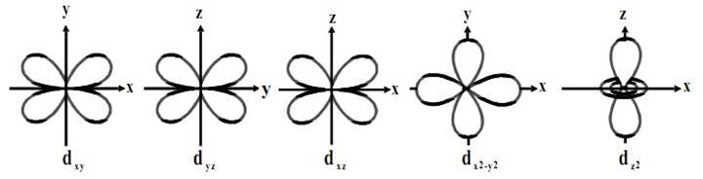

Slide 12

Finish your notes!
Reread the notes
Color Code
Add annotations
Write a summary
Write a response

