Slide 1
Chapter 5 The Periodic Law
5.1 History of the Periodic Table
I. Mendeleev and Chemical Periodicity
A. Mendeleev noticed a repeating pattern, or periodicity, in properties of elements if he arranged them by their atomic masses. B. He was even able to predict as yet undiscovered elements based on where they ought to be in the periodic table that he developed.

Slide 2
II. Moseley and the Periodic Law
A. Moseley organized the periodic table according to atomic number, which showed a more consistent pattern of properties.
B. The physical and chemical properties of the elements are periodic functions of their atomic numbers, which is the periodic law.

Slide 3
III. The Modern Periodic Table
A. The periodic table is an arrangement of the elements in order of their atomic numbers so that elements with similar properties fall in the same column, or group.
1. The noble gases are unreactive elements in the last group of the periodic table.
2. Lanthanides are the elements with atomic numbers from 58 to 71.
3. Actinides are the elements with atomic numbers from 90 to 103.

Slide 4
5.2 Electron configuration and the periodic table
Lesson objectives
Students will identify trends in the periodic table by coloring a model of the periodic table and taking notes.
Students will define and illustrate vocabulary words about the periodic table.

Slide 5
5.2 Electron configuration and the periodic table
I. Periods and blocks of the periodic table
A. Periods -Horizontal rows on the periodic table
1. Period number corresponds to the highest principal quantum number of the elements in the period.
B. Sublevel Blocks - Periodic table can be broken into blocks corresponding to s, p, d, f sublevels.
Periods=
n levels (1-7)
Groups =
sub levels (s,p,d,f)

Slide 6
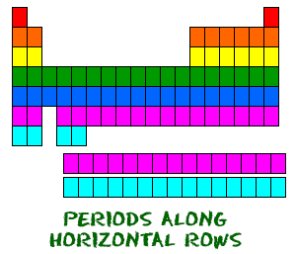
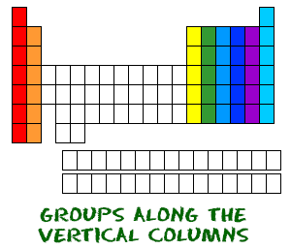
Periods and Groups

Slide 7
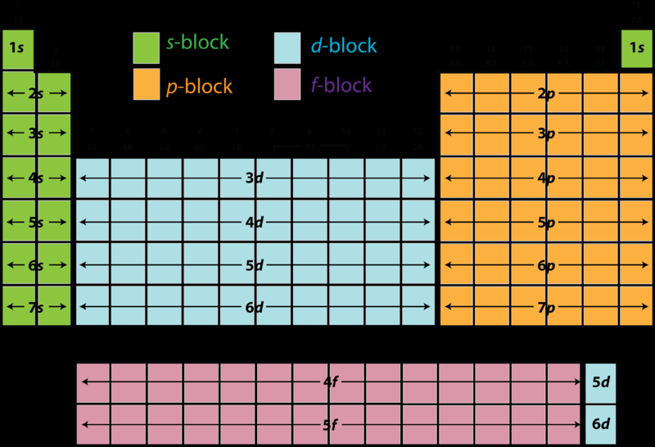

Slide 9
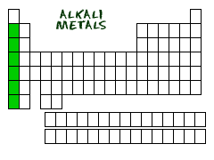
II. Blocks and Groups
A. s-Block, Groups 1 and 2
1. Group 1 - The alkali metals
a. One s electron in outer shell
b. Soft, silvery metals of low density and low melting points
c. Highly reactive, never found pure in nature

Slide 10
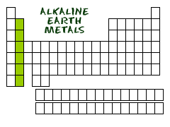
(s-block continued)
2. Group 2 - The alkaline earth metals
a. Two s electrons in outer shell
b. Denser, harder, stronger, less reactive than Group 1
c. Too reactive to be found pure in nature

Slide 11
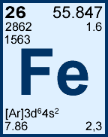
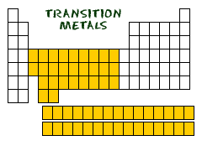
B. d-Block, Groups 3 - 12
1. Metals with typical metallic properties
2. Referred to as "transition" metals
3. Group number = sum of outermost s and d electrons
[Ar]3d⁶4s²
6+2=8
Iron is Group 8

Slide 12
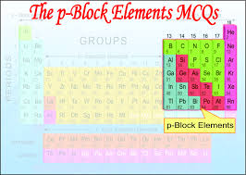
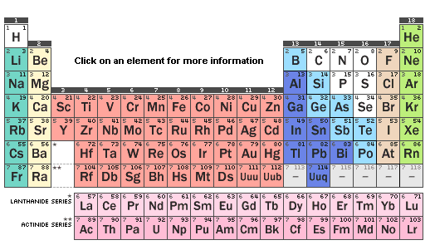
C. p-Block elements, Groups 13 - 18
1. Properties vary greatly
a. Metals
(1) softer and less dense than d-block metals
(2) harder and denser than s- block metals

Slide 13
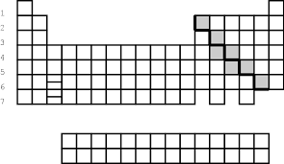
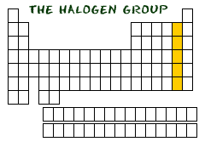
b. Metalloids
(1) Brittle solids with some metallic and some nonmetallic properties
(2) Semiconductors
c. Nonmetals
(1) Halogens (Group 17) are most reactive of the nonmetals.

Slide 14
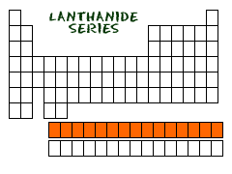
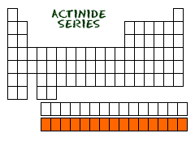
D. f-Block, Lanthanides and Actinides
1. Lanthanides are shiny metals similar in reactivity to the Group 2 metals.
2. Actinides
a. All are radioactive.
b. Plutonium (94) through Lawrencium (103) are man-made.

Slide 15
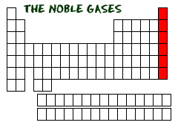
E. Noble Gases-Group 18
1. All in gaseous form
2. Do NOT react with anything

Slide 16
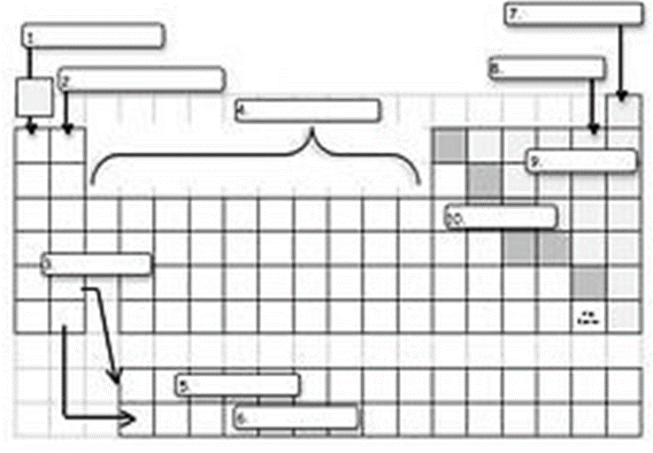

Slide 17
