Slide 1
22.4 Nuclear Fusion and Fission
Essential Questions:
What is the difference between Nuclear Fission, Nuclear Fusion and Chain Reaction?
How can nuclear fission be used to generate power?
What are some benefits of a fusion reaction compared to a fission reaction?
What are the difficulties of fusion reactions currently?

Slide 2
Fission and Fusion of Atomic Nuclei
I. Nuclear Fission
A. Nuclear Fission - A very heavy nucleus splits into more stable nuclei of intermediate mass

Slide 3
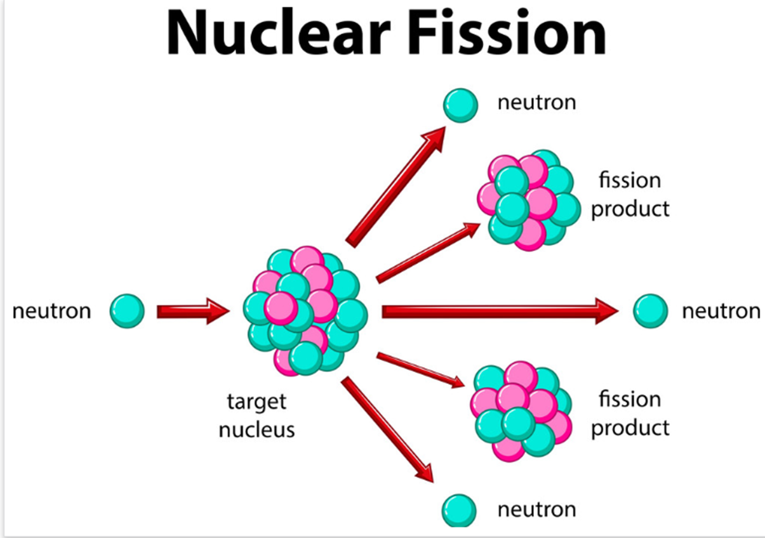

Slide 4
B. Nuclear Chain Reaction - A reaction in which
the material that starts the reaction is also one
of the products and can start another reaction

Slide 6
Video of nuclear fission https://www.youtube.com/watch?v=Ezbyg2iNdQs

Slide 7
C. Critical Mass - The minimum amount of nuclide that provides the number of neutrons needed to sustain a chain reaction.

Slide 8
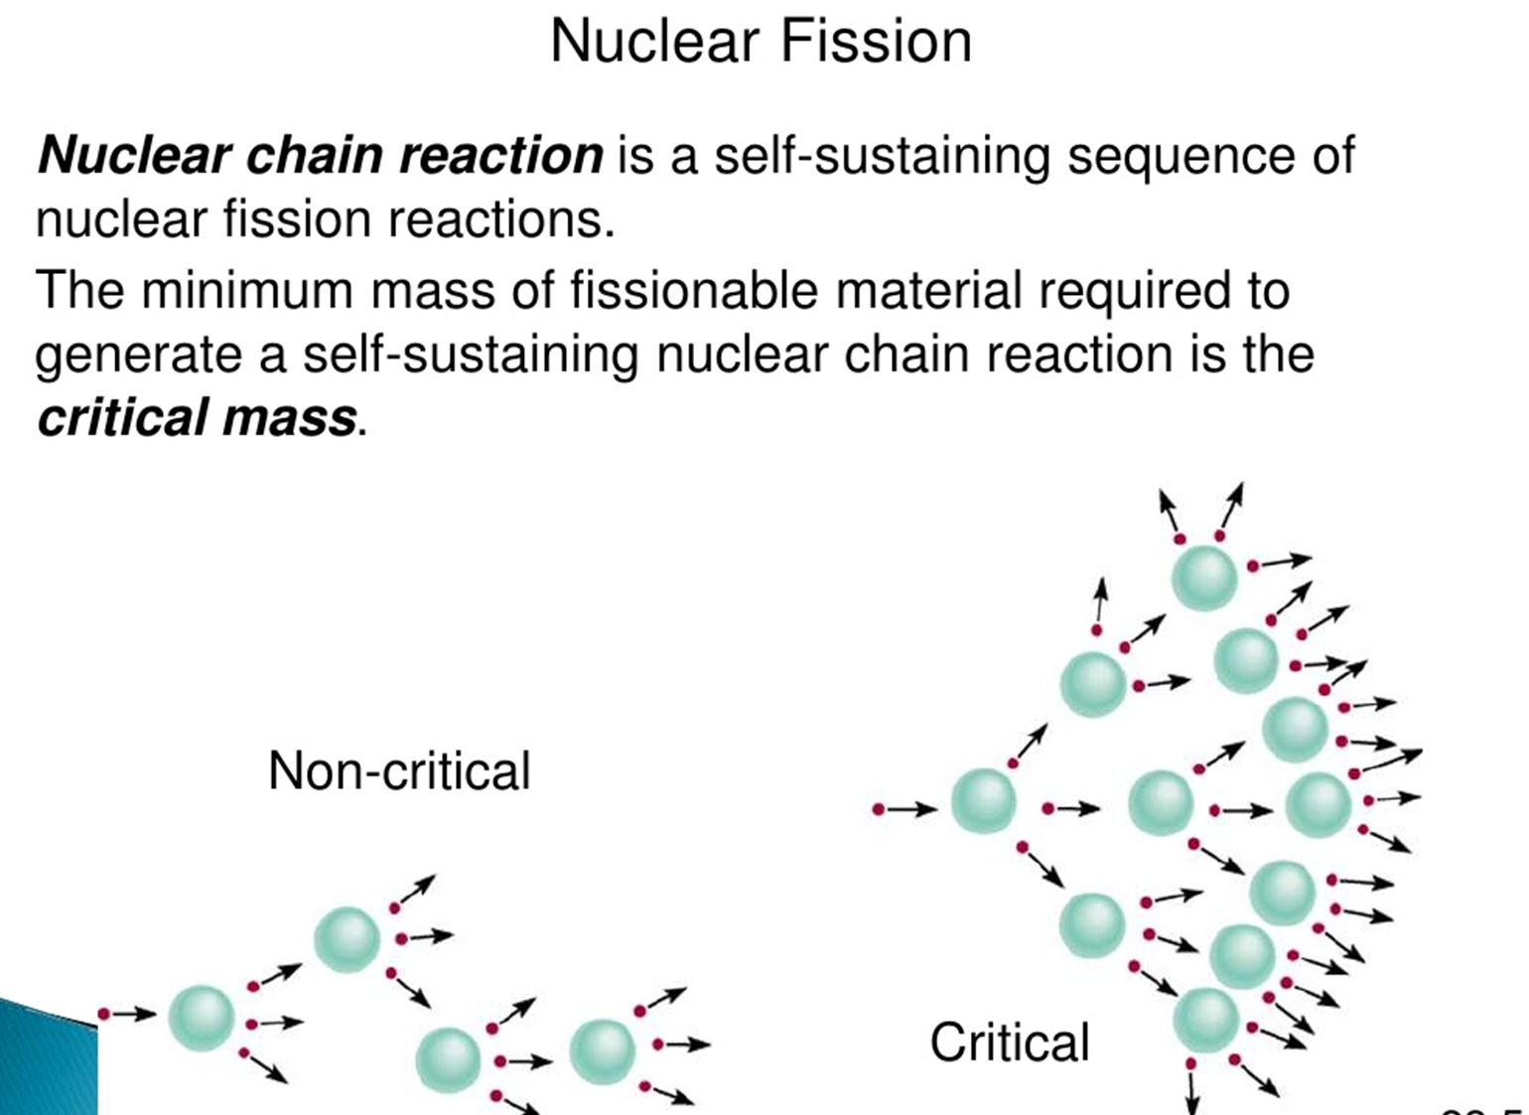
Domino Effect
*Without critical mass, there is no nuclear chain reaction

Slide 9
II. Nuclear Fusion - Light-mass nuclei combine to form a heavier, more stable nucleus

Slide 10
Problems with fusion as an energy source
No known material can withstand the temperatures of a fusion reaction which are greater than 100,000,000 K.
This is a picture of an H-Bomb or Hydrogen Bomb. This is produced by fission
The A-Bomb or Atom Bomb was dropped on Hiroshima and Nagasaki. That bomb is produced by fusion.
New Mexico’s los Alamos and Sandia National Labs were where the first nuclear devices were developed and tested. These devices helped bring about the end of WWII. The labs are still used by the defense industry to keep the United States safe and the by-products improve our technology and lives.

Slide 11
Fusion Video
https://www.popularmechanics.com/science/energy/a23829/fusion-explainer-kurzgesagt/

Slide 12
Stars get their energy from nuclear fusion
H→ He →N → C → O → Mg →Si →Fe →Ni → etc
Our star (the sun) and earth (and the rest of the planets) are made from the remnants of a supernova that exploded billions of years ago. The only way the heavier elements can be made is in a supernova of a giant star. The elements that made us are from an exploded star!
We are star dust!

Slide 13
Finish this sections of Notes:
Color code the notes
Add annotations to the cue column
Write a Summary Paragraph
(answer the essential questions here!)
Write a Response Paragraph.

