Slide 1
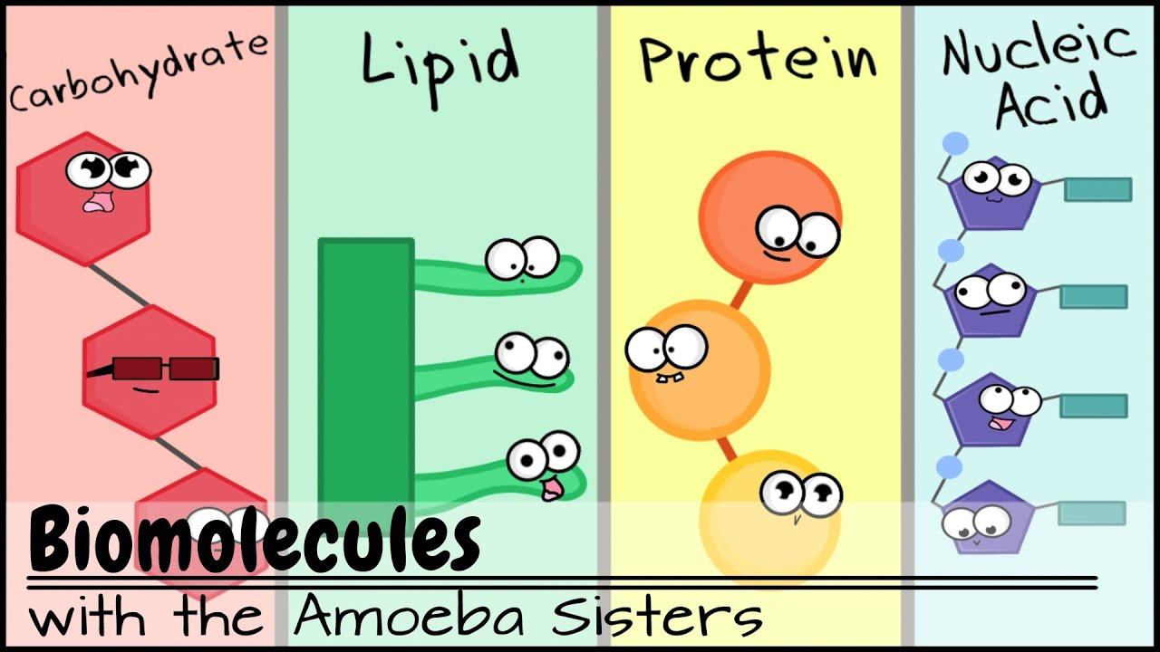
Carbon Compound Foldable

Slide 2
Making your Carbon Compound Foldable
Step 1
Fold paper in ½ lengthwise
(along the long edge)

Slide 3
Making your Carbon Compound Foldable
Step 2
Unfold paper, then fold in ½ along other axis short wise
(along the short edge)

Slide 4
Making your Carbon Compound Foldable
Step 3
Unfold paper, then…
Fold the outer edges to the center crease

Slide 5
Making your Carbon Compound Foldable
Step 4
Cut ONLY along the RED dotted line.
DO NOT cut all the way to center of page

Slide 6
Making your Carbon Compound Foldable
Step 5
On the outside, label your 4 flaps with the names of the 4 carbon compounds:
Carbohydrates
Proteins
Lipids
Nucleic Acids
Carbohydrates
Proteins
Nucleic
Acids
Lipids

Slide 7
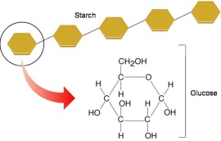
Making your Carbon Compound Foldable
Step 6
On the inside, first draw an example of a monomer and a polymer for each compound
Polymer
Proteins
Monomer
Nucleic
Acids
Lipids

Slide 8
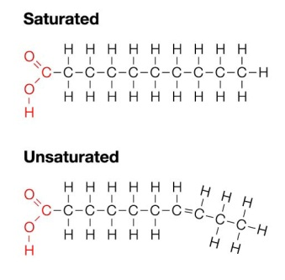
Making your Carbon Compound Foldable
Step 7
On the inside, next describe the compound:
Description
Elements
Purpose
Examples:
Monomers
Polymers
Other
Polysaccharide
Elements: C, H, O
Purpose: Fast energy, structural
Examples: Monomer – glucose Polymer – starch, cellulose, chitin, glycogen
Proteins
Monosaccharide
Nucleic
Acids

Slide 9
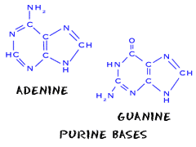
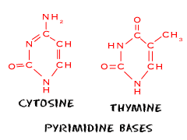

Slide 11
Completing your Foldable
Use the Organic Chemistry and Biomolecule notes to complete your foldable.

Slide 12
Color your finished product.
Glue your foldable into the notebook on the page indicated.

