Slide 1
Astronomy and Physical Science Composition Books
Set up; organization; grading

Slide 2
Name on Front
Write your name on your composition book using markers
You can write it on a piece of paper and attach it using packing tape,
You can decorate the paper, just be sure we can read your name easily.
Write:
If lost please return to Mrs Seslar, B201

Slide 3
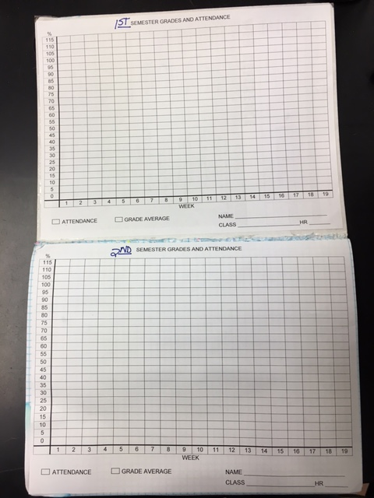
Grade Graphs
Cut out and Glue the 2 graphs to the inside front cover and the first page.

Slide 4
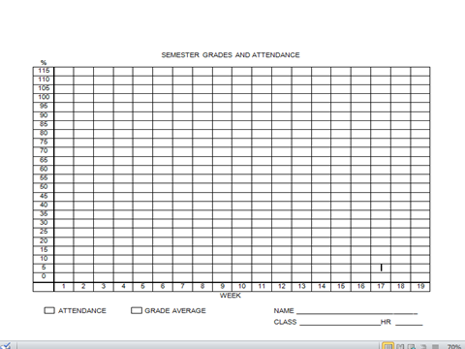

Slide 5
Grade Graphs
Fill in the blanks
Name
Hour
Class name
Write 1st Semester on one and 2nd Semester on the other
Draw a line for passing (60%)
Draw a line for your goal grade (you choose)
The graph will be a line graph; choose 2 colors:
Attendance
Grades

Slide 6
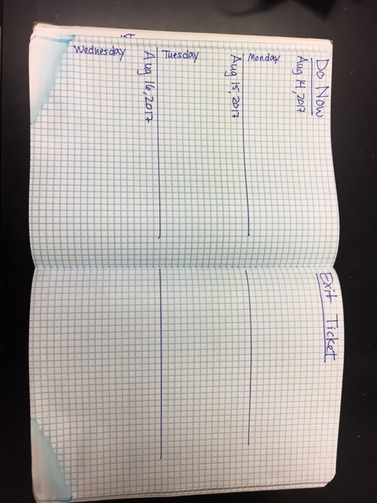

Slide 7
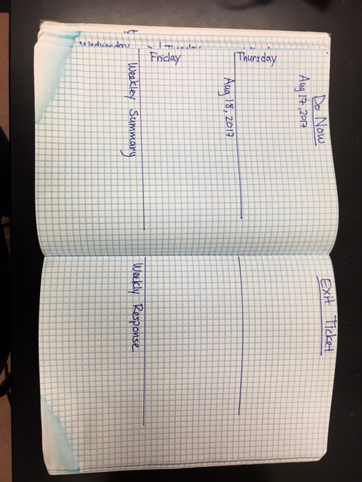

Slide 8
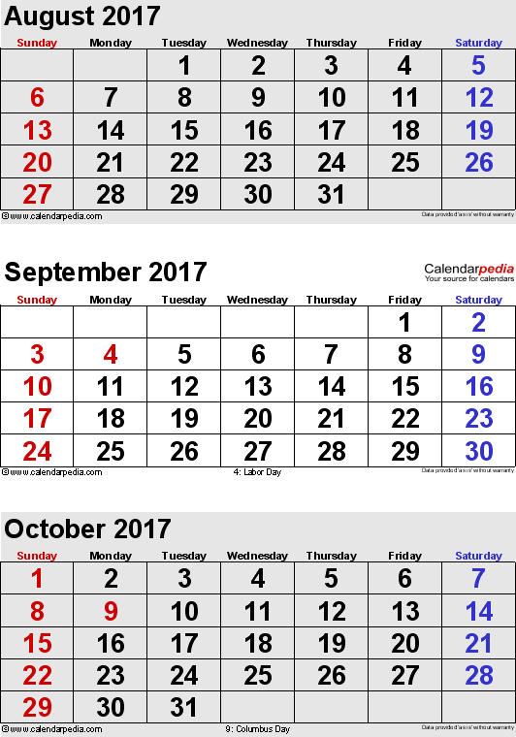

Slide 9
Do Now Activities
Every day you will have a ‘Do Now’ Activity- something to WRITE
You may have to answer a review question
You may have to describe and write questions about a picture of topics we will be covering that day.
You may have an activity to do.
I may choose something else as we go on in the year.

Slide 10
Exit Tickets
At the end of class during the last few minutes you will write an exit ticket
The exit ticket will be something short to write about the day.
Sometimes you will answer questions
Sometimes you will write about what you learned
However, there will be something to do every day!

Slide 11
Weekly Summary and Response
Each week you will write a summary of what you learned. It cam be general or detailed.
You will also write a response.
These should be 3-5 sentences each.

Slide 12
Grading
You will be graded on the completeness of your books.
We will discuss correct answers
If you miss a day, the activity, questions, or picture will be posted on the website. It is YOUR responsibility to catch up.

