Slide 1
Angular Measure
Measuring with angles

Slide 2
Angular Measure
Angular measure is used to find apparent distance between objects in the sky. (This is NOT used to measure distance from earth!)
Angular measure is also used to measure the apparent size of objects in the sky. It is used to measure, planets, stars, moons, asteroids, nebulae, galaxies and constellations.
Remember, angular measure is apparent size and distance. It is only what it seems from the viewpoint of the observer. It is not real size or distance!
Plural of
nebula

Slide 3
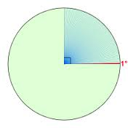
Arc Degrees Degrees in a circle, sphere, or angle
We measure angles with arc degrees
There are 360 degrees in a circle or sphere.
There are 180 degrees in a ½ circle or sphere
Remember, we see only ½ of the sky at a time so we can see 180º of the celestial sphere.
1 degree

Slide 4
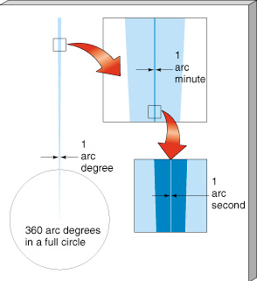
ARC DEGREES
Arc Degrees are divided up into smaller units like meters are divided up into centimeters and millimeters.
Arc Degrees º
Arc minutes’
Arc seconds”

Slide 5
There are 60’ (arc minutes) in an arc degree
There are 60” (arc seconds) in an arc minute
There are 3600” (arc seconds) in an arc degree
1º = 60’
1’ = 60”
1º = 3600”

Slide 6
When we look at the sky, we imagine it to be like a protractor. The observer stands at the zero point.

Slide 7
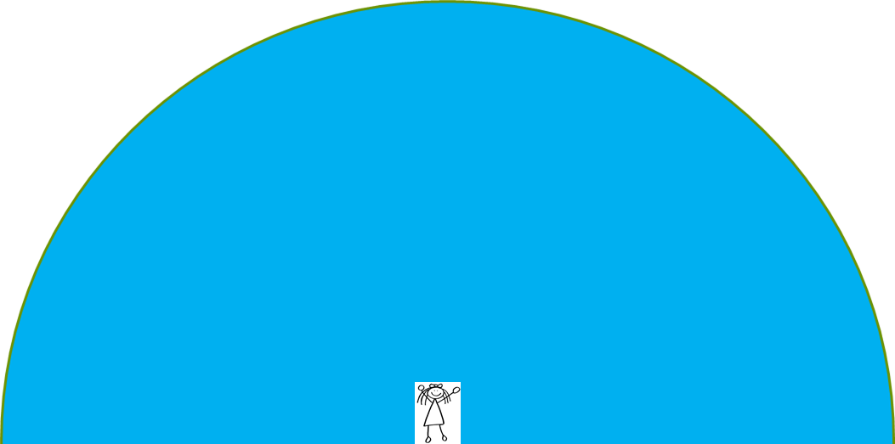
The horizon is 0º (zero degrees) The zenith is 90º (ninety degrees) º
90º
0º
0º

Slide 8
Angular measure can show:
How high something is above the horizon
52º
37º

Slide 9
Angular measure can show:
How far apart objects that appear on the
celestial sphere apparently are from
each other.
17º

Slide 10
Angular measure can show:
The apparent diameter of a celestial object.
7.5º

Slide 11
Subtend
sub·tend
səbˈtend/
verb: 1. (of a line, arc, or figure) to form an angle at a particular point when straight lines from an object’s extremities are joined at that point.

Slide 12
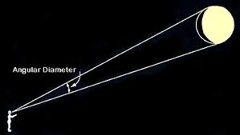
Angular measure of the moon
How many degrees in diameter is the moon?
How many degrees does the moon
subtend?
Write your guess down.

Slide 13
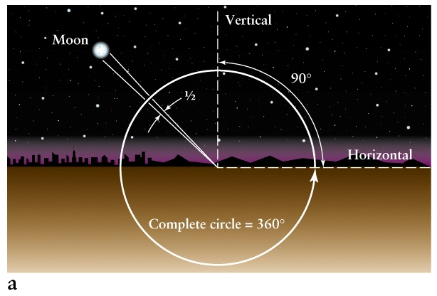

Slide 14
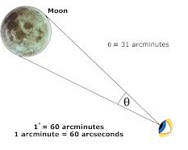
Angular measure of the moon
0.5º or ½º how many
arc minutes (‘) is that?
θ is the Greek letter
‘theta’. It means
“unknown angle”

Slide 15
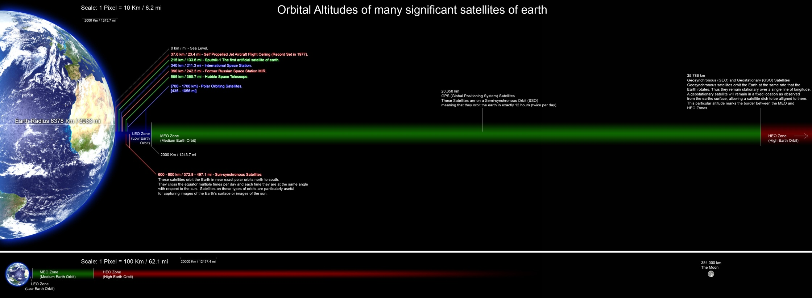
Orbital Altitudes of Some Earth Satellites
The scale distance between the Earth and Moon
"Orbitalaltitudes" by Rrakanishu - Own work. Licensed under GFDL via Wikimedia Commons - http://commons.wikimedia.org/wiki/File:Orbitalaltitudes.jpg#mediaviewer/File:Orbitalaltitudes.jpg

Slide 17
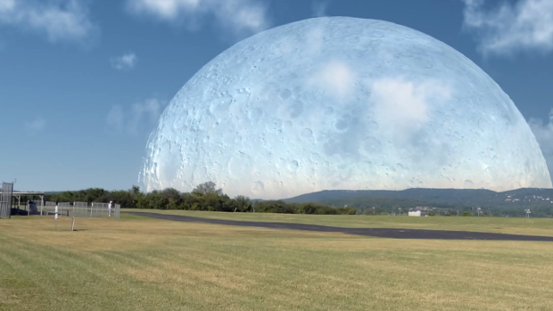
This is What the Sky Would Look Like if the Moon Was at the Same Distance as the ISS.

Slide 18
What would happen if the Moon was replaced by other planets in the Solar System?
Yes, in actuality probably a devastating gravitational tug resulting in the deaths of billions, or worse, as the oceans suddenly rise up and flood the Earth, our air is tugged from the atmosphere and we fly towards our new neighbour, screaming and burning as we go.
But what would it look like just before that happened?
Kind of cool.

Slide 19
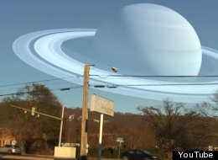
What would Saturn look like if it was the same distance from Earth as the moon.

Slide 20
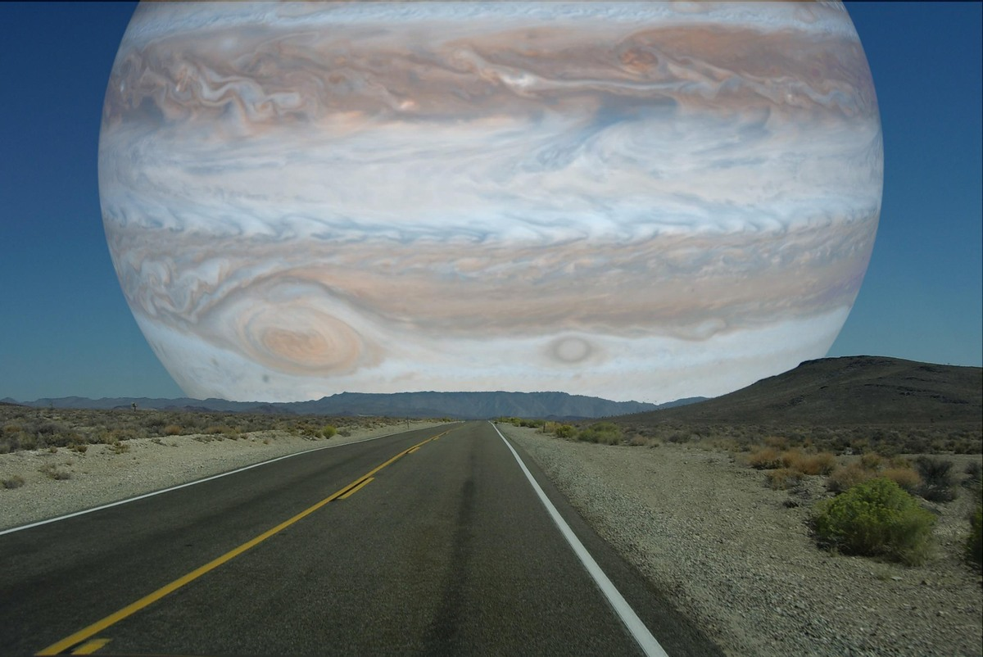
What Jupiter would look like if it were the moon's distance away from Earth.

Slide 21
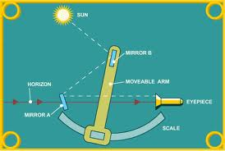
Instruments used to measure angles of celestial objects
Sextant

Slide 22
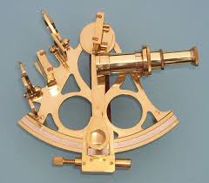
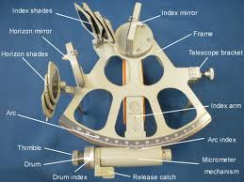

Slide 23
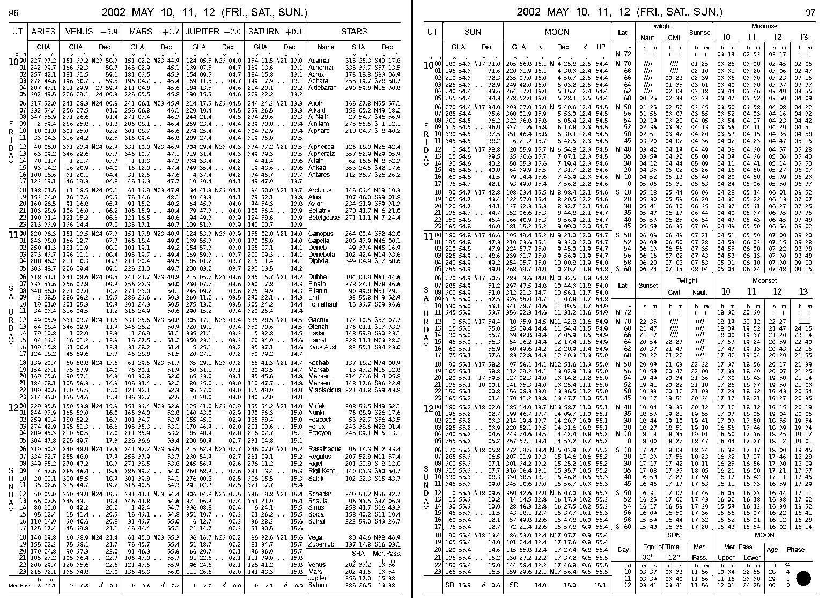
Nautical Almanac

Slide 24
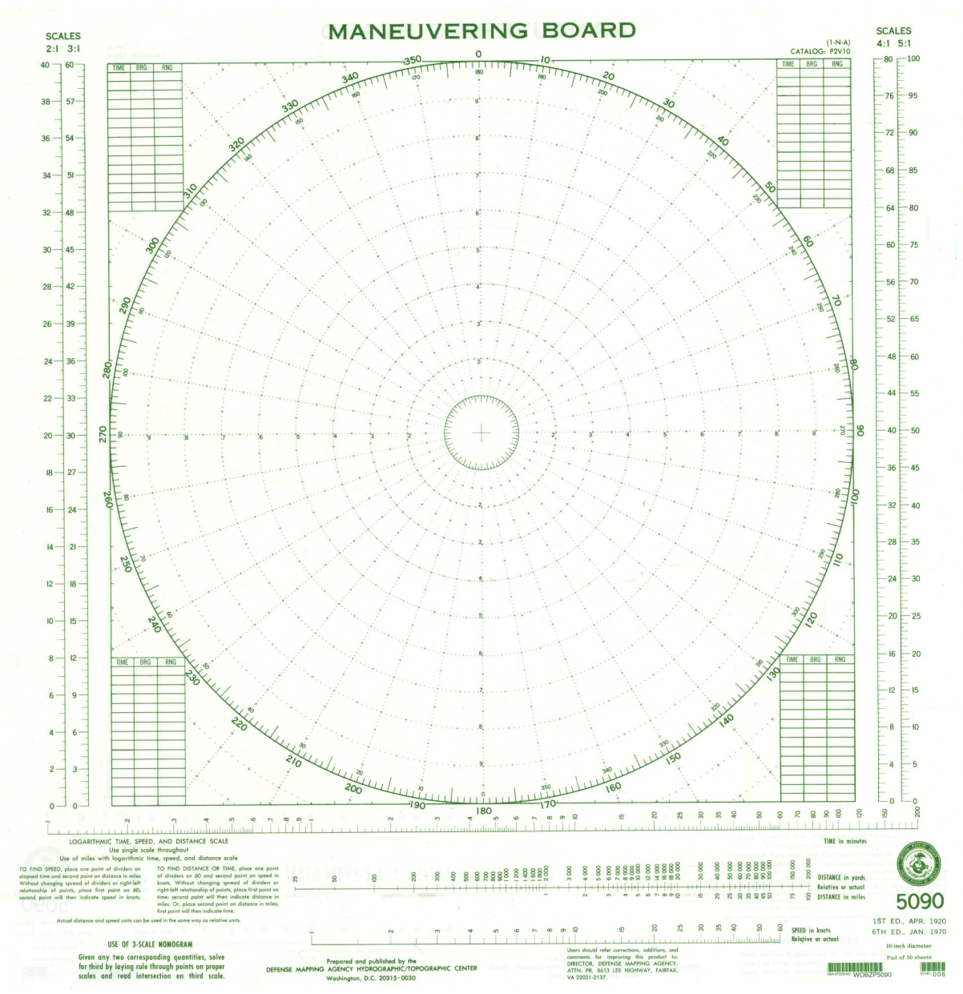
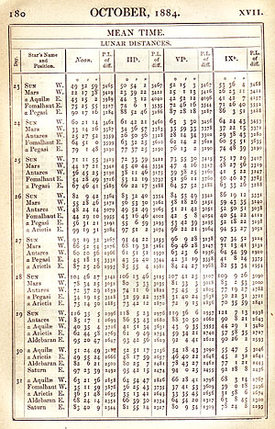

Slide 25
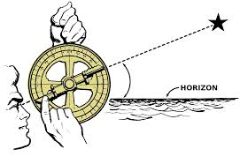
Instruments used to measure angles of celestial objects
Astrolabe

Slide 26
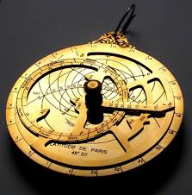
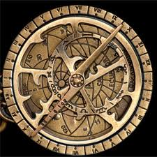
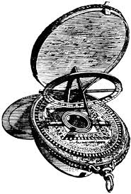
astrolabe

Slide 27
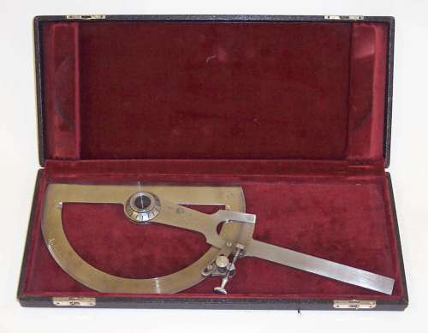
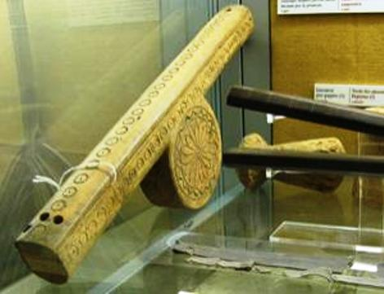
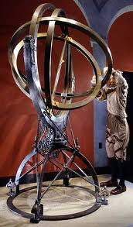
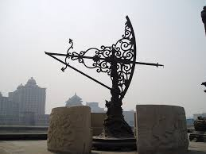
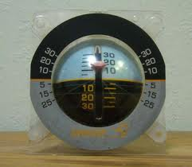
Instruments used to measure angles

Slide 28
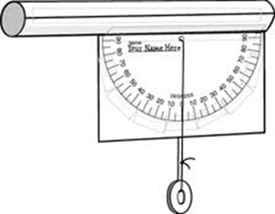
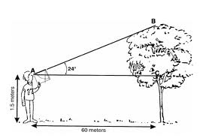
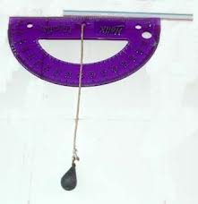
Inclinometer

Slide 29
Finish Your Notes
Annotations
Color-coding
Summary
Response

Slide 30
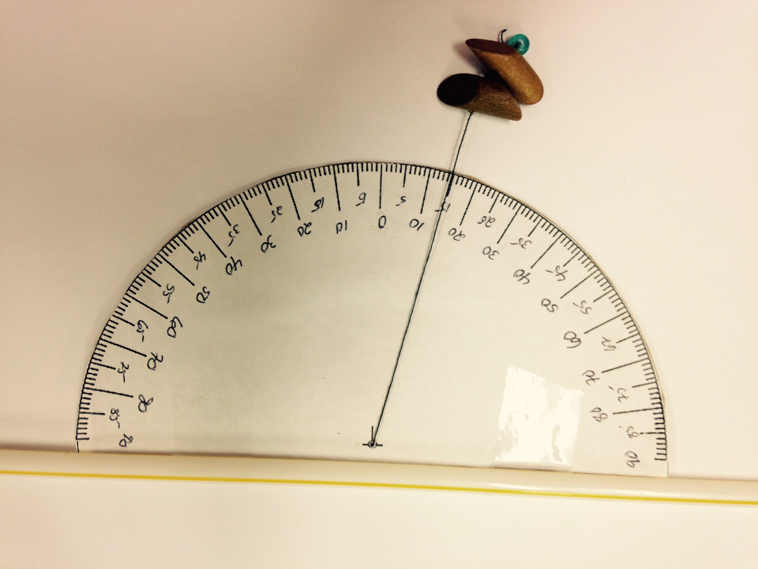
DO NOT wrap the string around the straw or the top of the cardboard
The string must swing freely from this pivot point
Use a push pin to make a hole at the pivot point
Number your astrolabe like this: Remember it is not a protractor
Your beads must not hang down any lower than 1 or 2 centimeters below the astrolabe

Slide 31
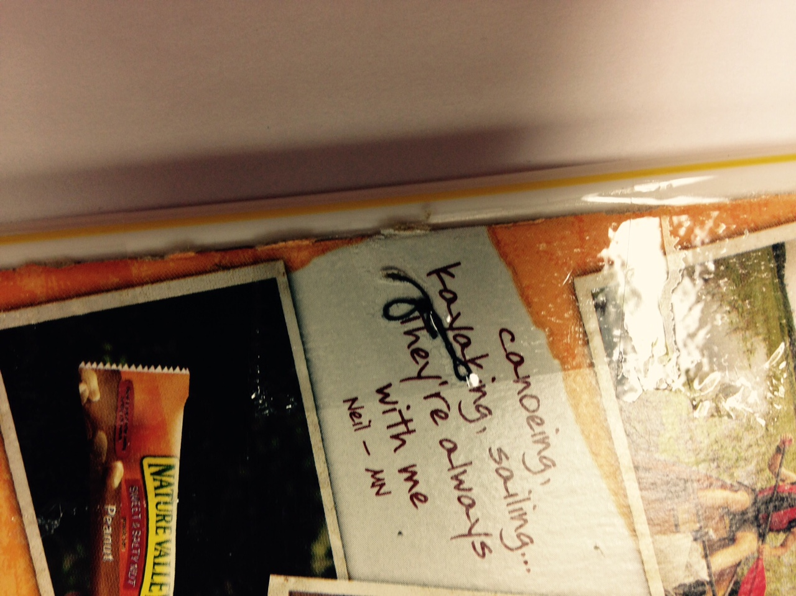
Thread the string through the hole at the pivot point
Tie a large knot in the string and tape it down

Slide 32
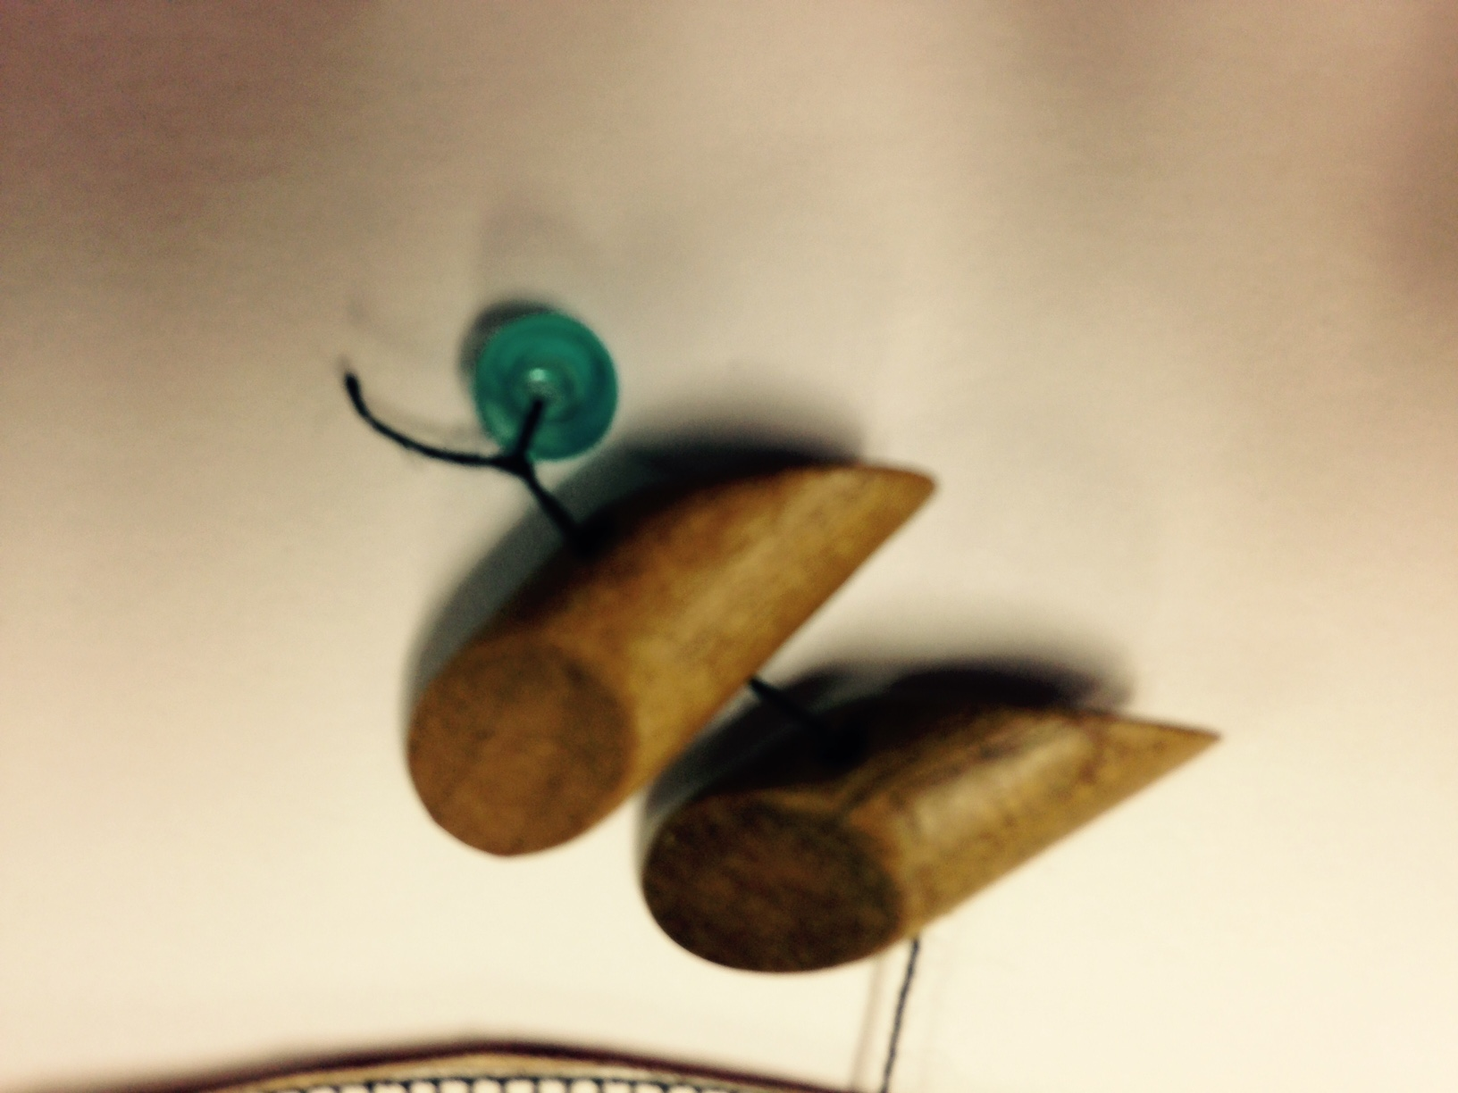
Write your name somewhere on the astrolabe.
When attaching your beads, put a small bead at the end, loop the string through and around the small bead, and tie it off. This prevents the other beads from sliding off a knot.

Slide 33
